Slide 1
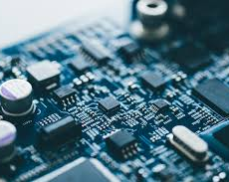
EECT 101 – intro to electronics
Fall 2019
By: Seth Wills

Slide 2
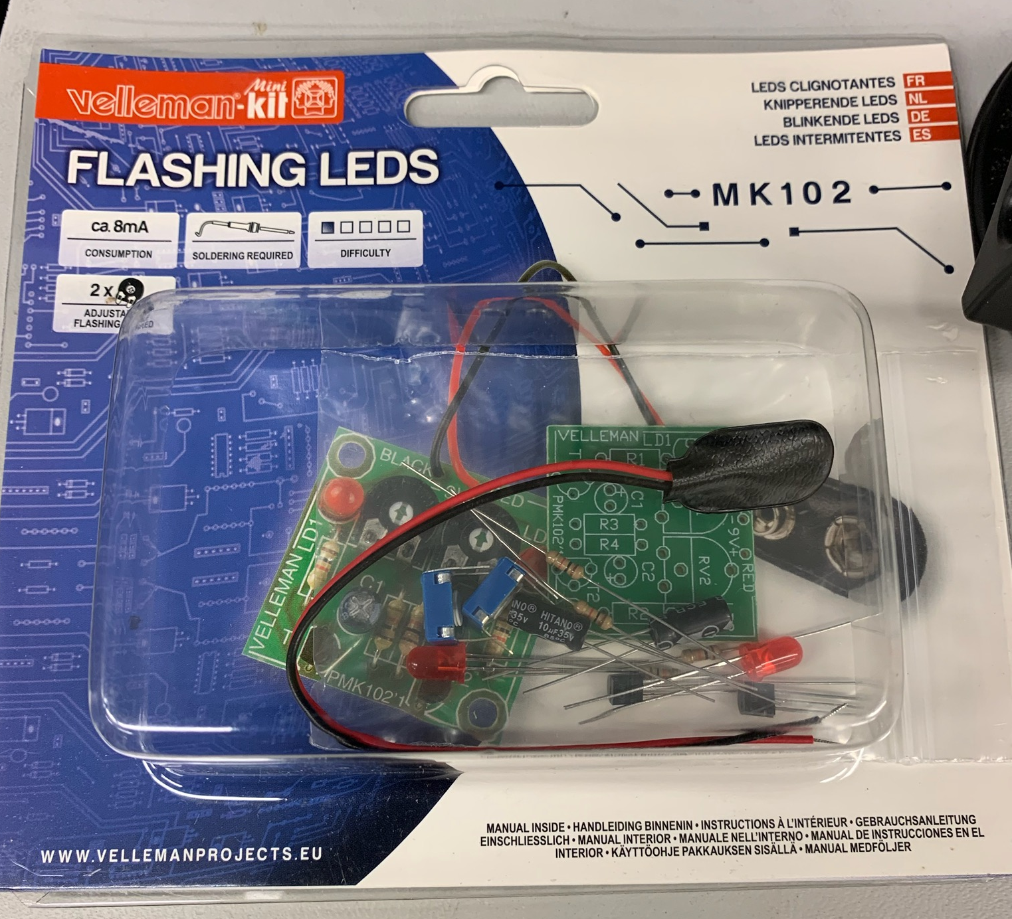
Lab 1 – Building the led Blinker kit
The purpose of this lab is to build the led blinker kit
Equipment needed:
Led blinker kit
Weller wes51 soldering iron
60/40 solder
Soldering stand
Solder remover pump
Soldering sponge
Dc Variable Power Supply

Slide 3
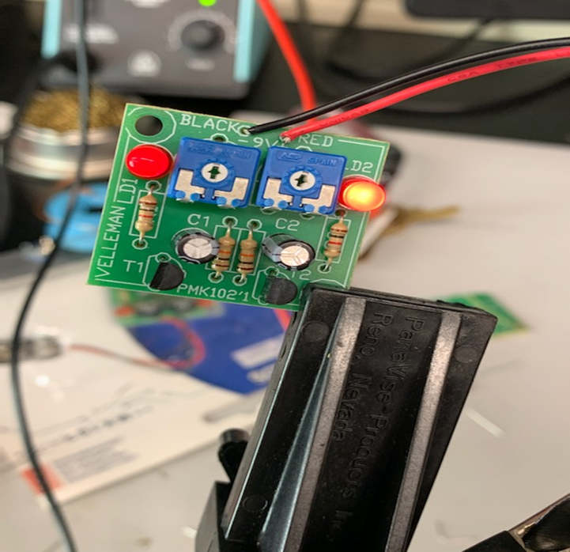
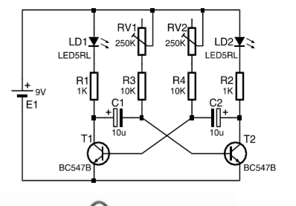
Lab 1- Part 2
Schematic and functioning circuit

Slide 4
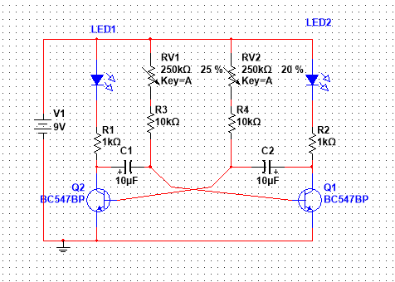
Lab 1- Part 2
Here is the multi-sim for the flashing lights
Multisim flashing lights

Slide 5
Lab 1 - observations
Found circuit with a rapidly blinking LED and a non functioning side. Found a capacitor and LED was installed incorrectly. Repaired faulty install.

Slide 6
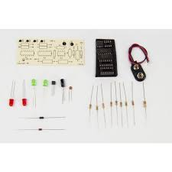
Lab 2 –the Solder Practice kit SPB-2
The purpose of this lab is to build the solder practice kit
Equipment needed:
SPB-2
Weller wes51 soldering iron
60/40 solder
Soldering stand
Solder remover pump
Soldering sponge
Dc Variable Power Supply

Slide 7
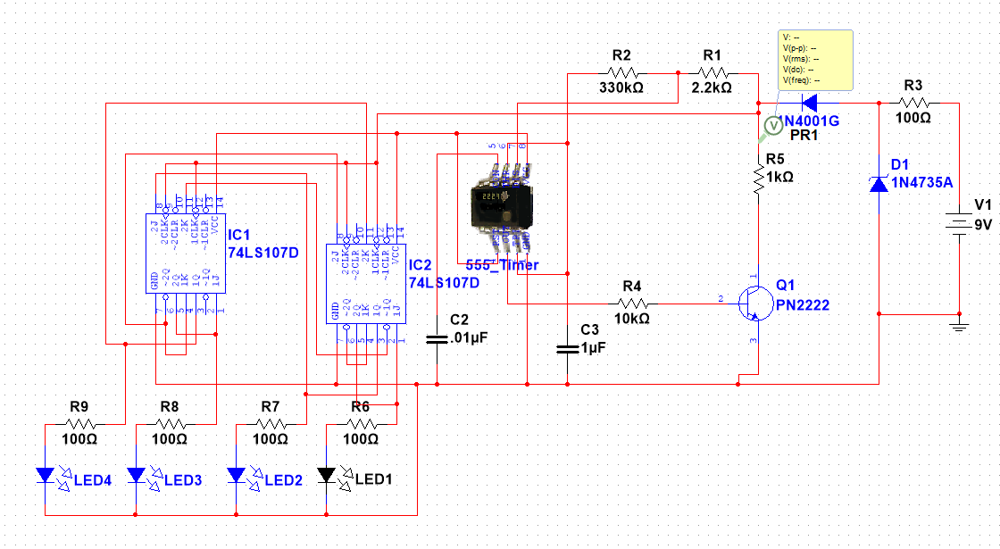
Lab 2 – part 2
Solder practice kit had no available schematics available had to design own.
SPB multi-sim

Slide 8
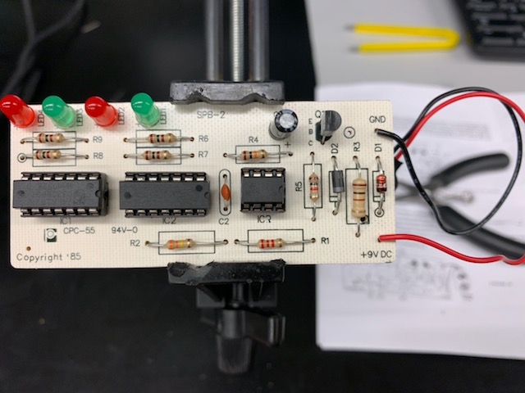
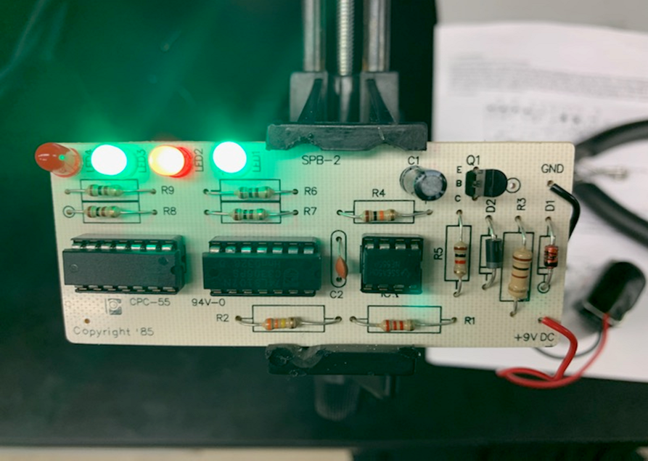
Lab 2 – part 3
Fully functioning practice kit

Slide 9
Lab 2 – Observations
Found several kits with components not properly placed. The multi-sim is not functional. Apparently a manufacturing flaw in the design. Couldn’t replicate the problems old boards had different behaviors.

Slide 10
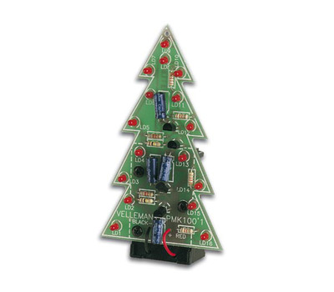
Lab 3 – Troubleshooting the Christmas tree
The purpose of this lab is to troubleshoot Christmas tree kit
Equipment needed:
Christmas tree kit
Weller wes51 soldering iron
60/40 solder
Soldering stand
Solder remover pump
Soldering sponge
Dc Variable Power Supply

Slide 11
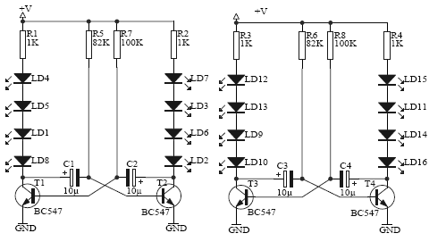
Lab 3 – Part 2
Tree schematic

Slide 12
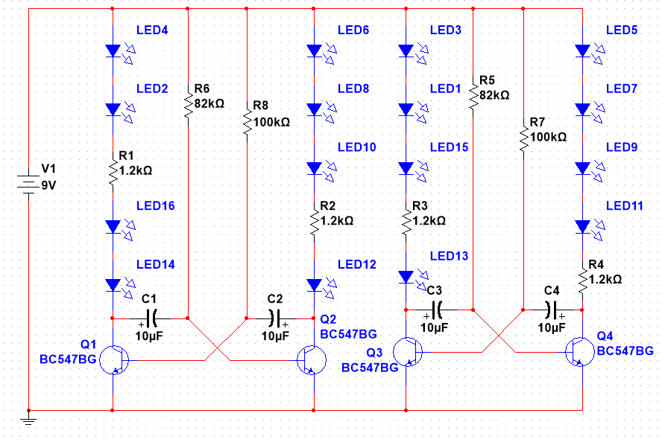
Lab 3 – Part 3
Multi-sim schematic of the tree
Multi-sim Christmas tree

Slide 13
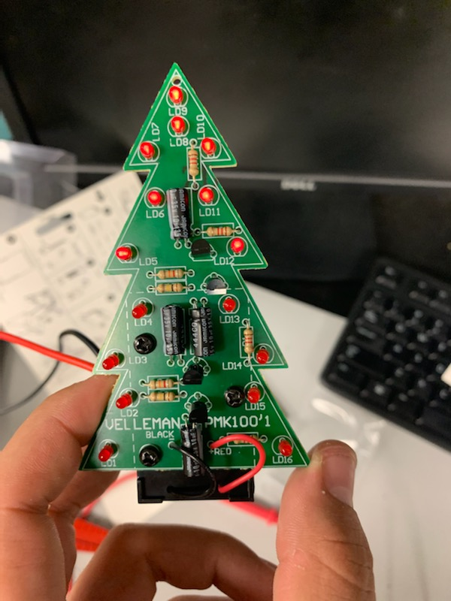
Lab 3 – Part 4
This is the fully function Christmas tree kit with alternating LED’s

Slide 14
Lab 3 – observations
When designing the Multi-sim the LEDs needed to be dropped to a lower ma value design to function in the schematic. Found identical problems with leads falling off and backwards LEDs in the systems

Slide 15
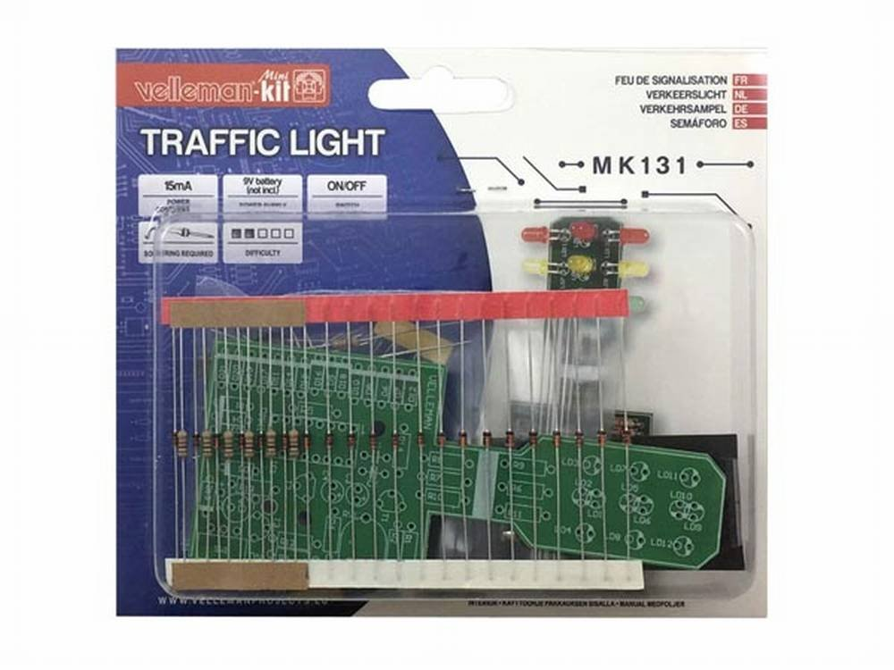
Lab 4 – Building the stop light kit
The purpose of this lab is to build the stop light kit
Equipment needed:
stop light kit
Weller wes51 soldering iron
60/40 solder
Soldering stand
Solder remover pump
Soldering sponge
Dc Variable Power Supply

Slide 16
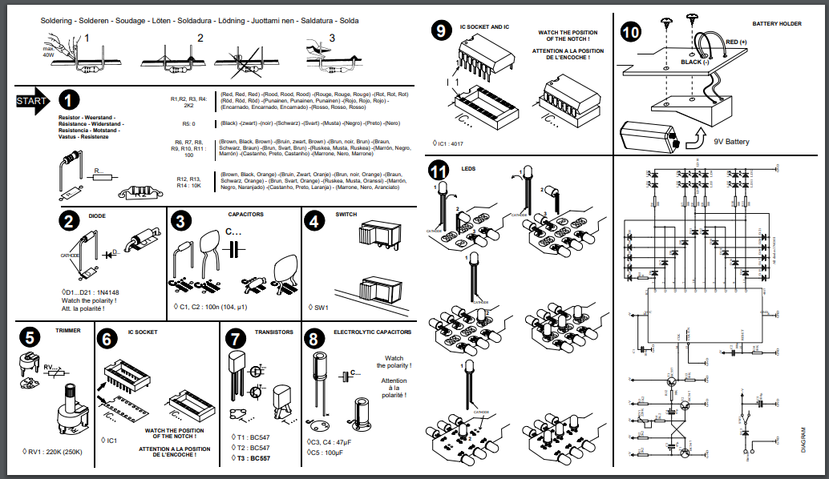
Lab 4 – Part 2
Instructions of the stop light

Slide 17
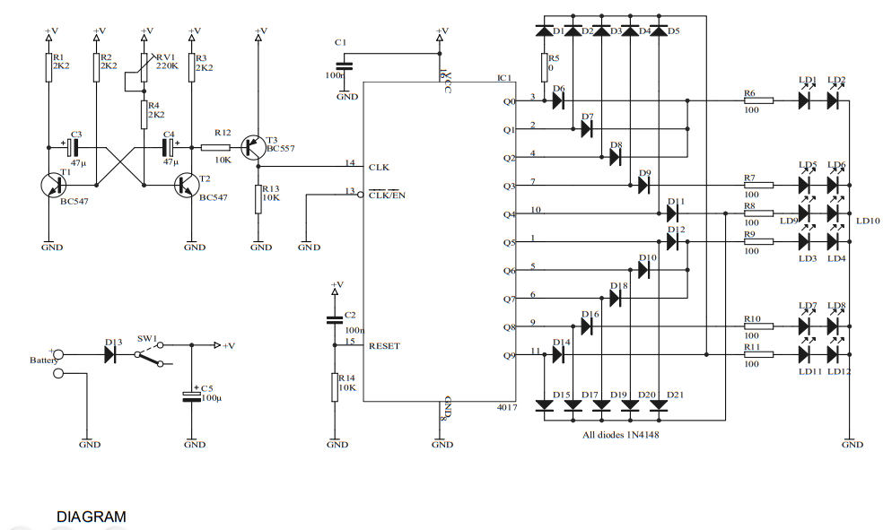
Lab 4 – Part 4
Begun the Multi-sim was unable to complete after a week of research found a compatible IC 4017BP was not able to edit the part.
Stop light Multi-sim
Schematic of the stoplight

Slide 18
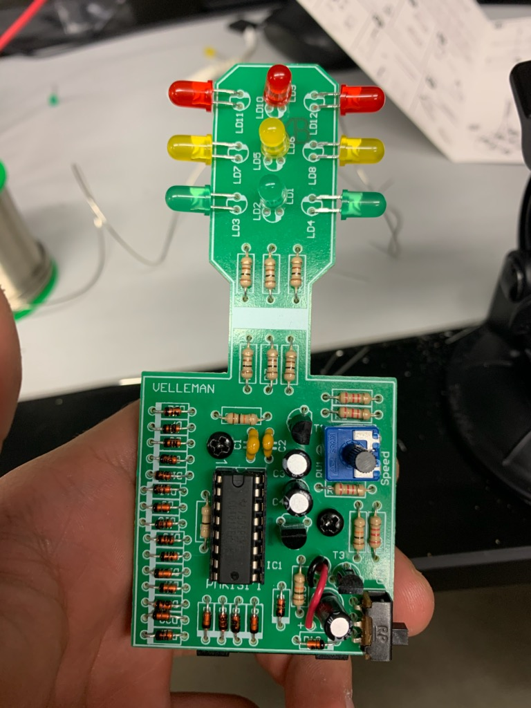
Lab 4 – Part 5
This is the completed stop light circuit

Slide 19
Lab 4 – Observations
Problems discovered found a discrepancy in the directions for the backside of the circuit. The orientation of the diodes made no sense. Assisted in repairing a broken trace.

Slide 20
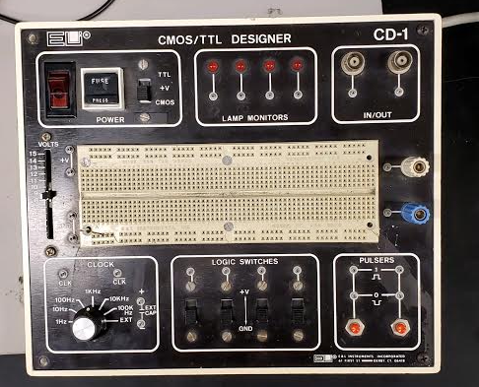
Lab 5 – Refurbish old elvis
The purpose of this lab is to troubleshoot an old ELVIS.
Equipment needed:
Weller wes51 soldering iron
60/40 solder
Soldering stand
Solder remover pump
Soldering sponge
Digital multi-meter
LCR meter
oscilloscope

Slide 21
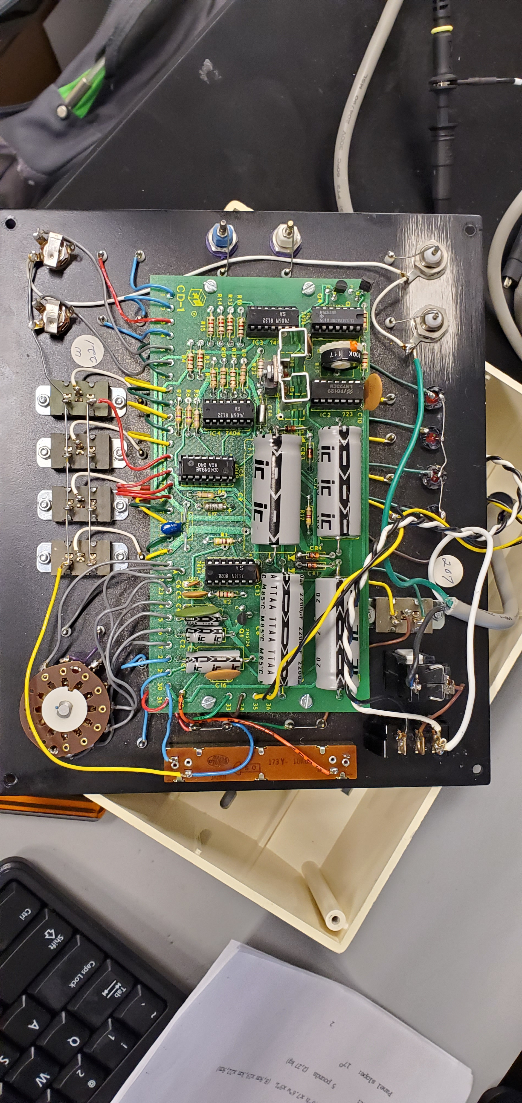
Lab 5 – 7 part 1 Review of the CmOS/TTL designer cd-1
CD-1 test excel
CD-1 Manual
Begun troubleshooting the Elvis 1 here are the testing parameters and manual

Slide 22
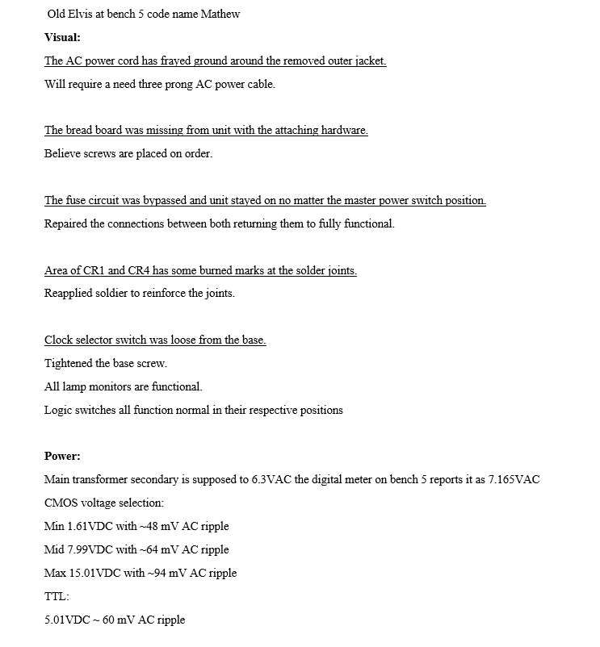
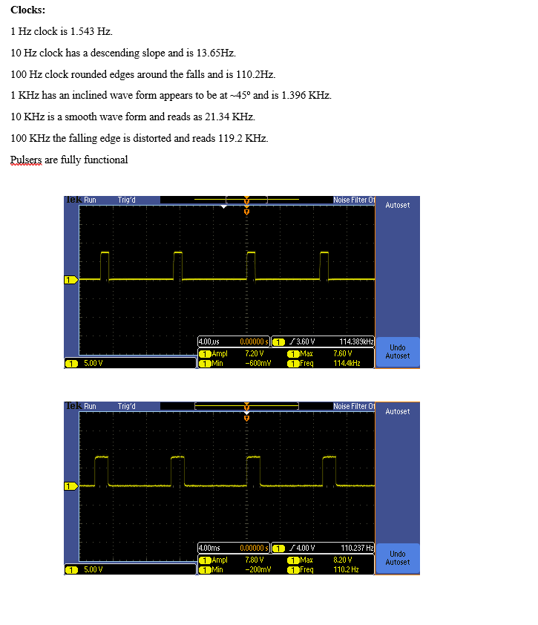
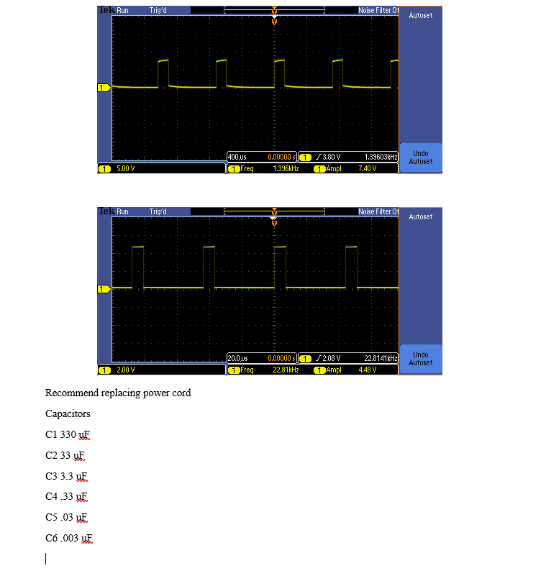
Lab 5 – 7 part 2
Word Doc
Here is the summary of the report and link

Slide 23
Lab 5 – 7 observation
The unit at bench 5 had minimal problems with it. A prior fix to the unit had by-passed the fuse. Learn and interesting system design. The design had incorporated a flip flop design to generate a base clock which was due to time domain of RC time constant of capacitor’s

Slide 24
Lab 9+ Fix what ever the instructor gives us
Equipment needed:
Weller wes51 soldering iron
60/40 solder
Soldering stand
Solder remover pump
Soldering sponge
Digital multi-meter
LCR meter
oscilloscope

Slide 25
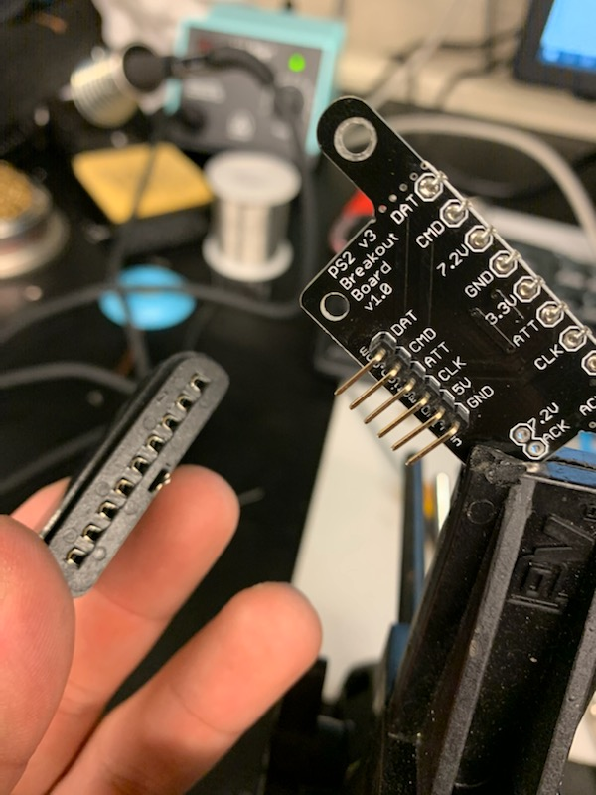
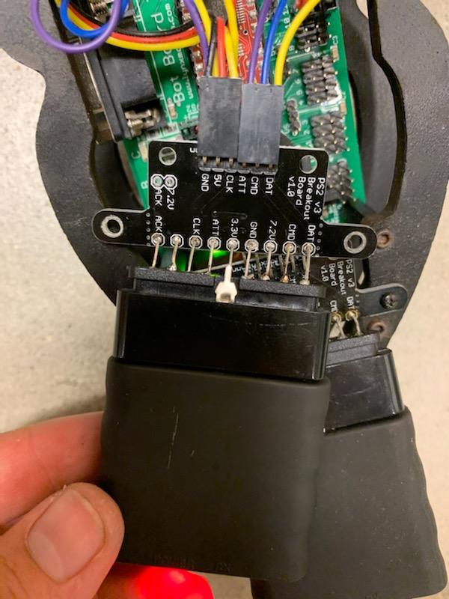
Lab 9 part 1
Receiver before and after fix

Slide 26
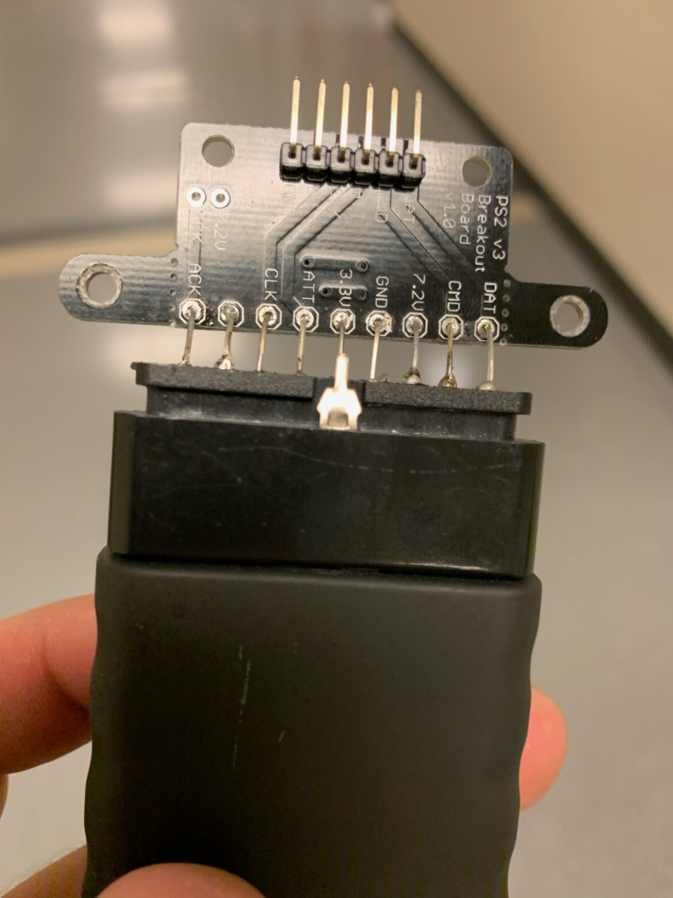
Lab 5 – Part 7
This is our completed fix receiver

Slide 27
Lab 9 - Observations
Challenge to fix the receiver was keeping the connections from getting to hot and causing permeant damage to the connector side.

Slide 28
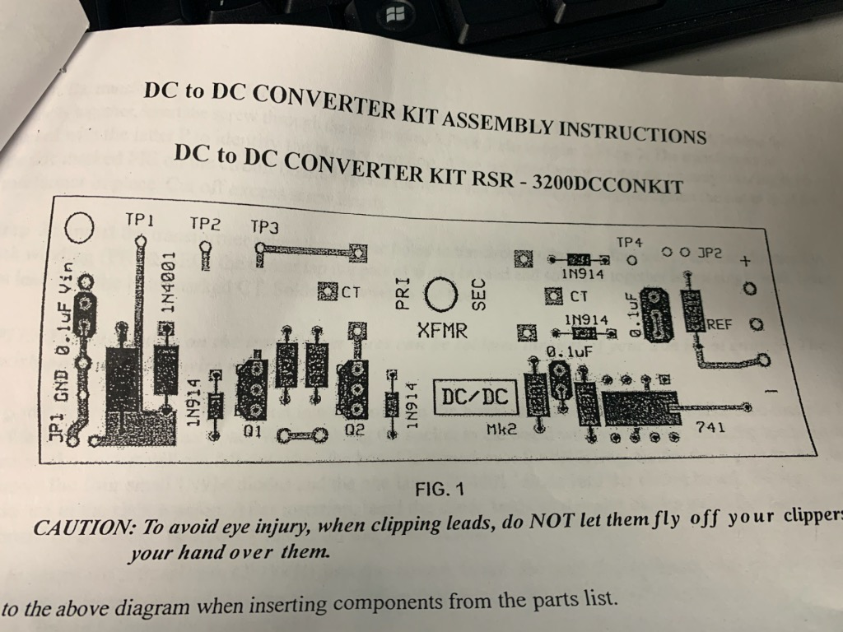
Lab 10 – DC to DC Converter
The purpose of this lab is troubleshoot a DC to DC Converter
Equipment needed:
DC to DC Converter
Weller wes51 soldering iron
60/40 solder
Soldering stand
Soldering sponge
Digital Multi meter

Slide 29
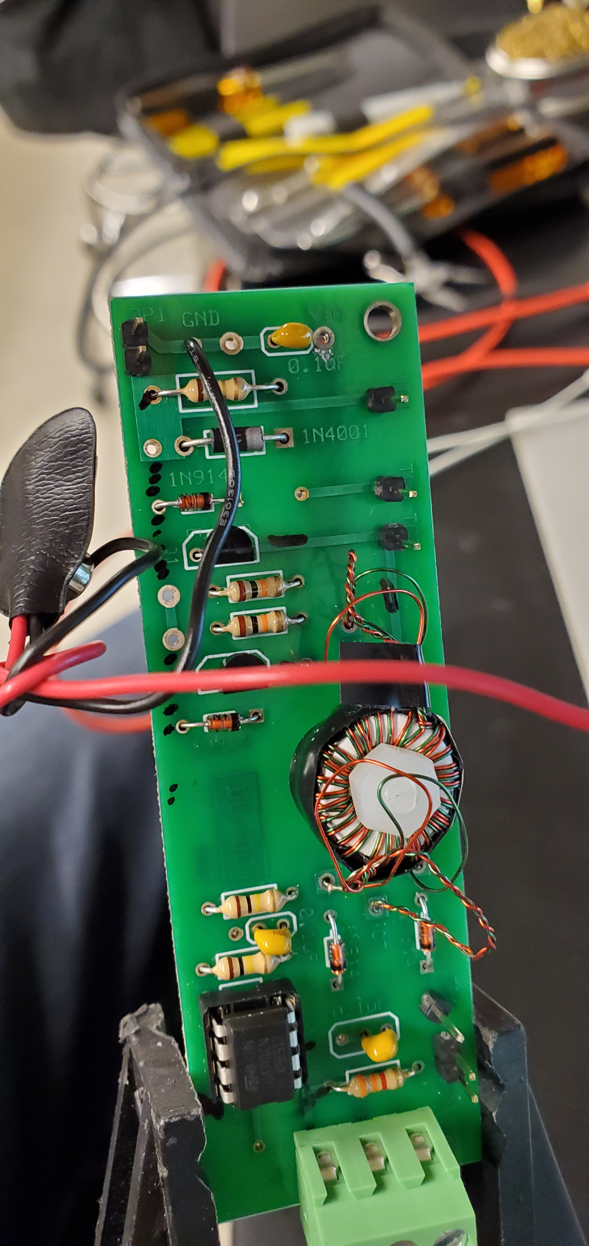
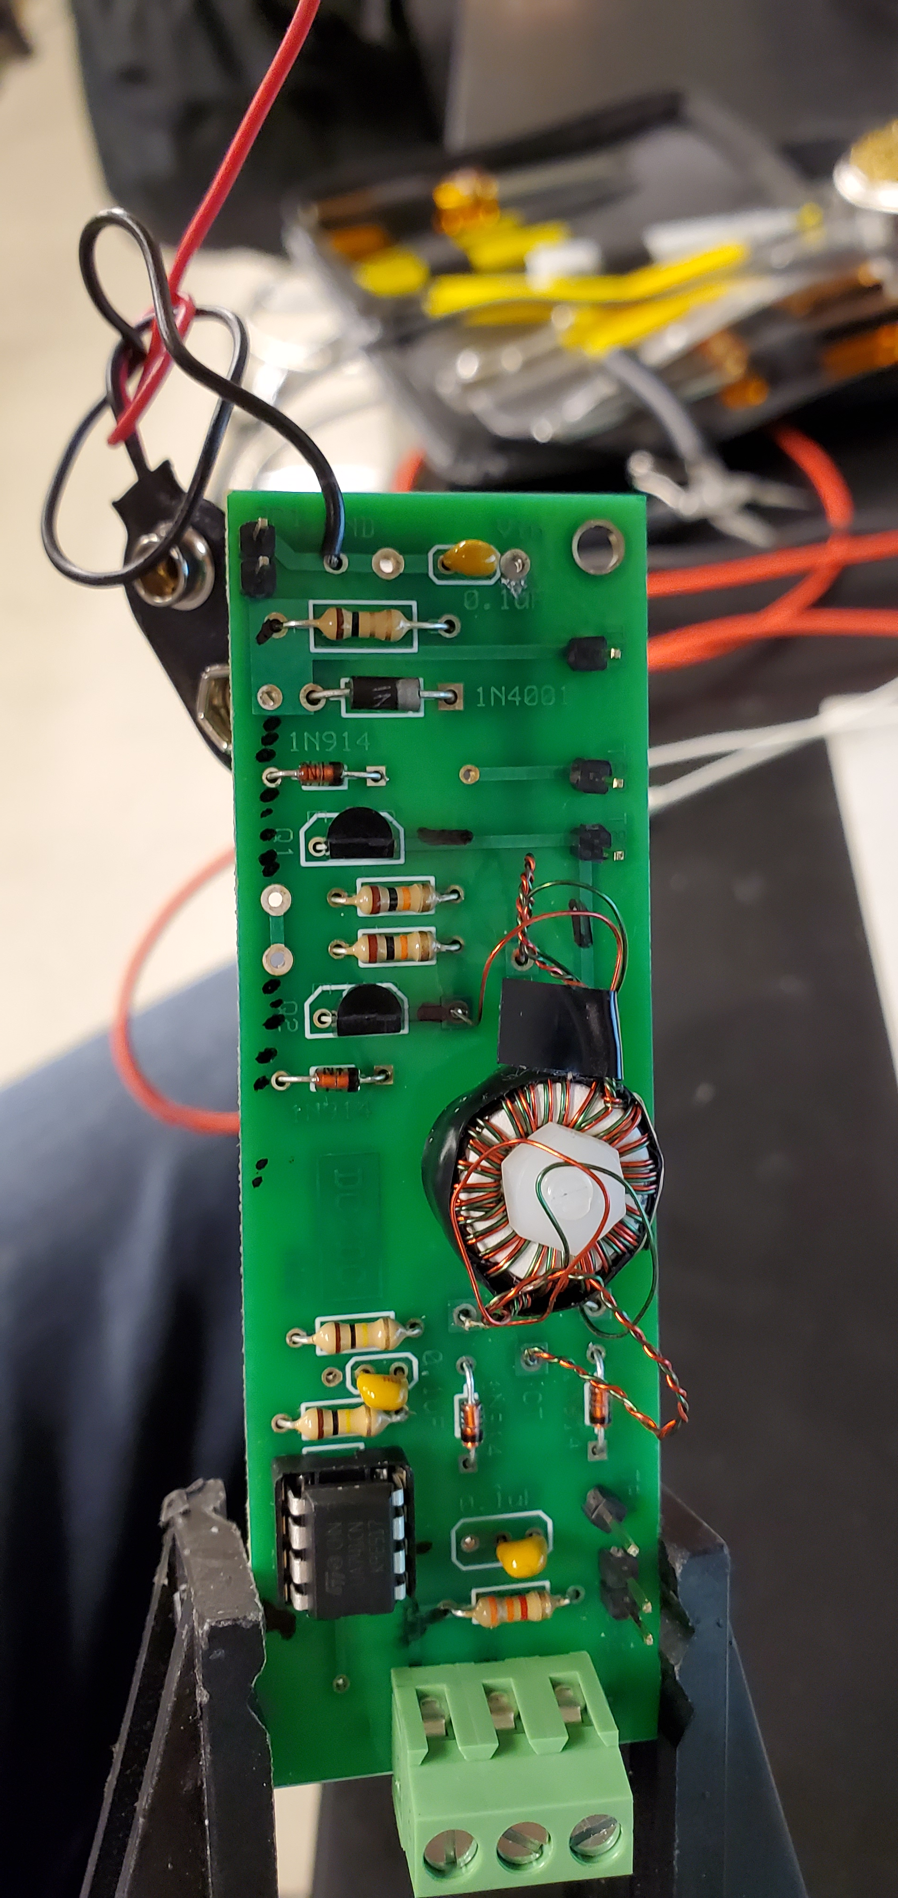
Lab 10– pArt 1
Broken DC to DC convertor

Slide 30
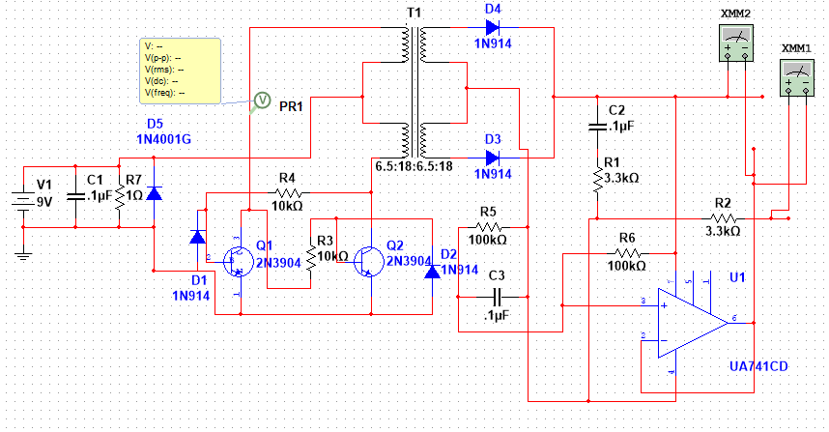
Lab 10 – pArt 4
Schematic of the dc to dc converter
Multi-Sim DC to DC

Slide 31
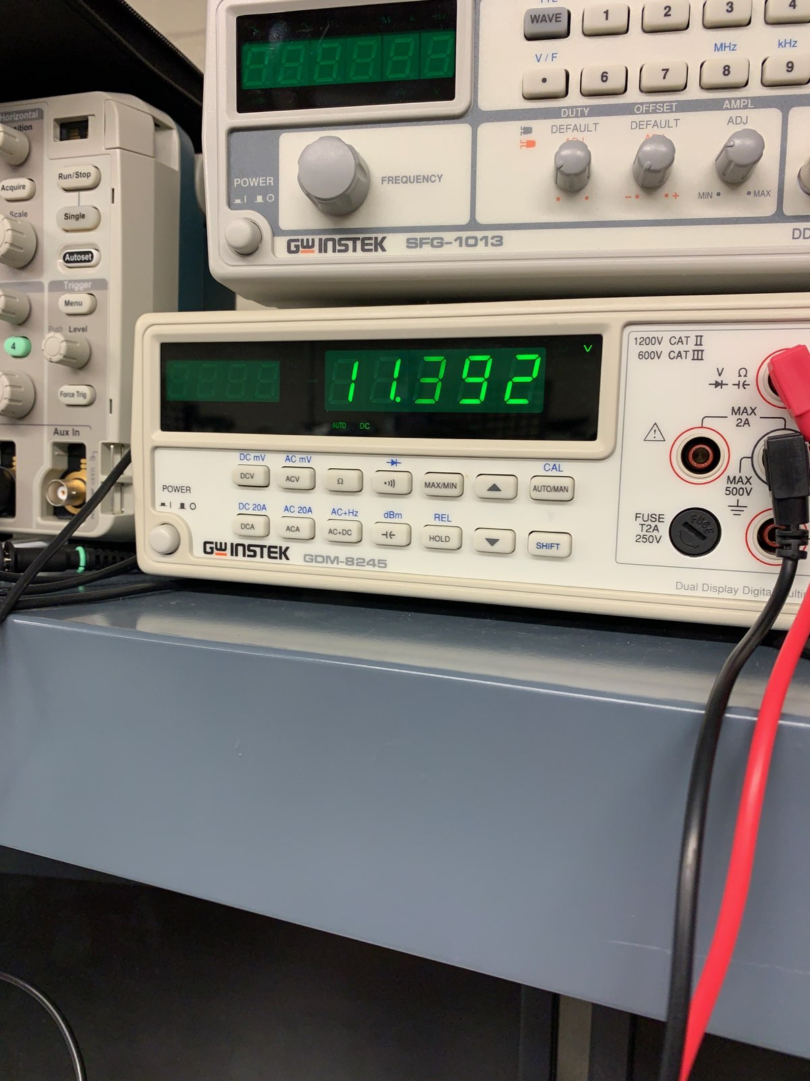
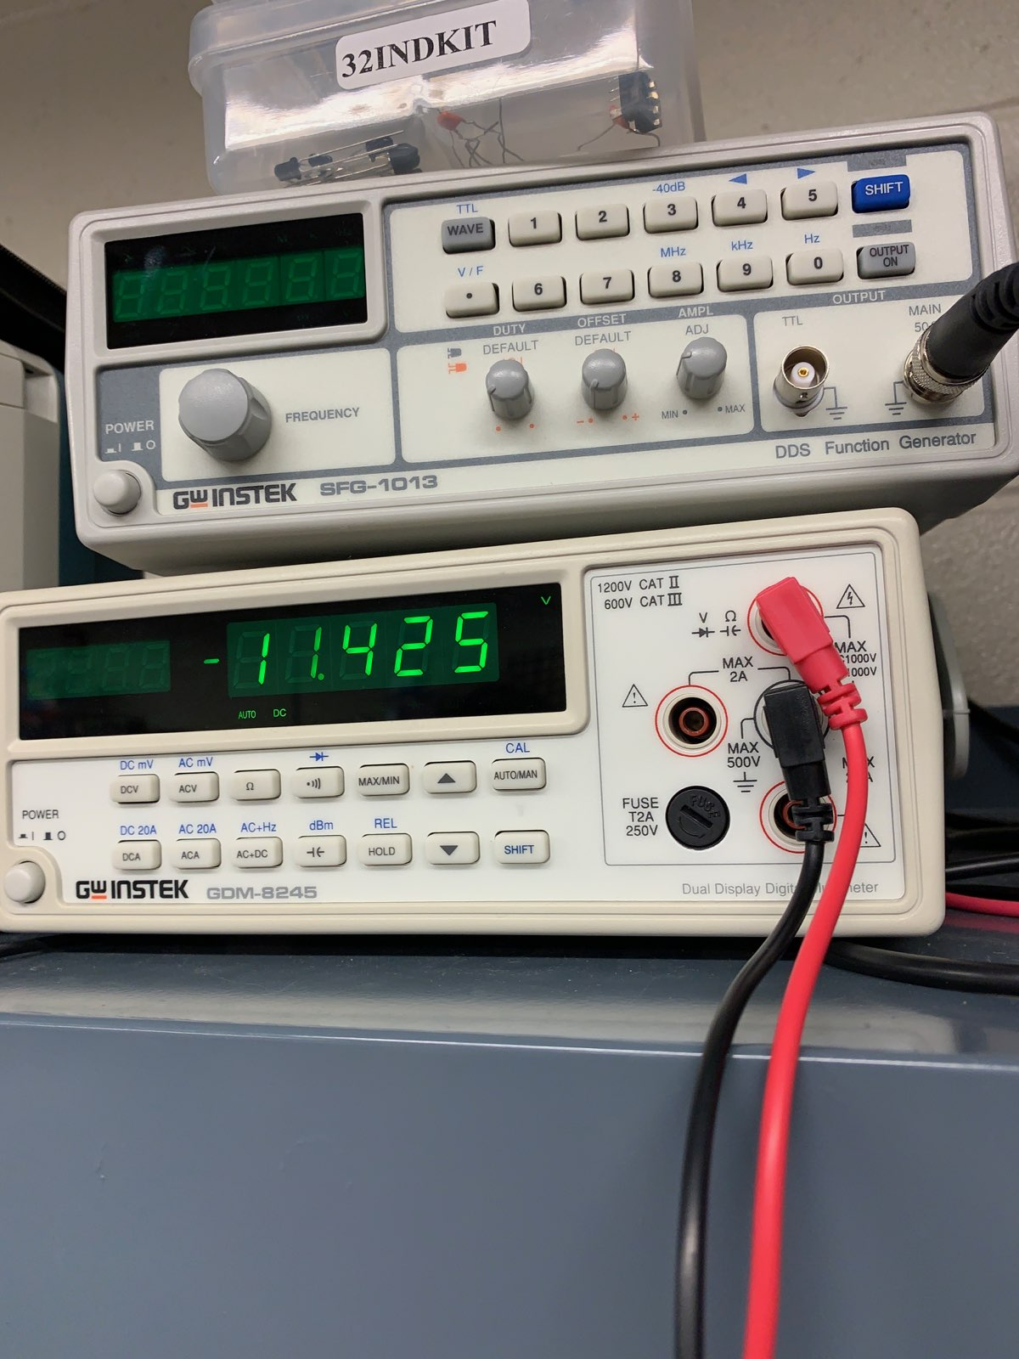
Lab 8 – pArt 5

Slide 32
Lab 10 – Observations
Found broken power wire and a capacitor in the wrong place.

Slide 33
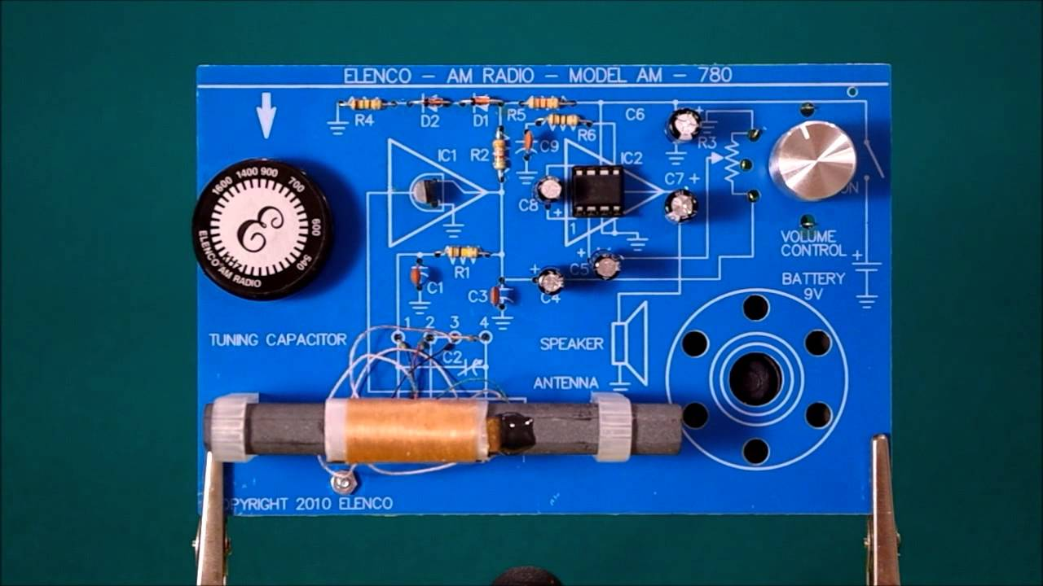
Lab 11 – Am radio kit
The purpose of this lab is to trouble shoot an AM Radio kit
Equipment needed:
AM Radio Kit
Weller wes51 soldering iron
60/40 solder
Soldering stand
Soldering sponge

Slide 34
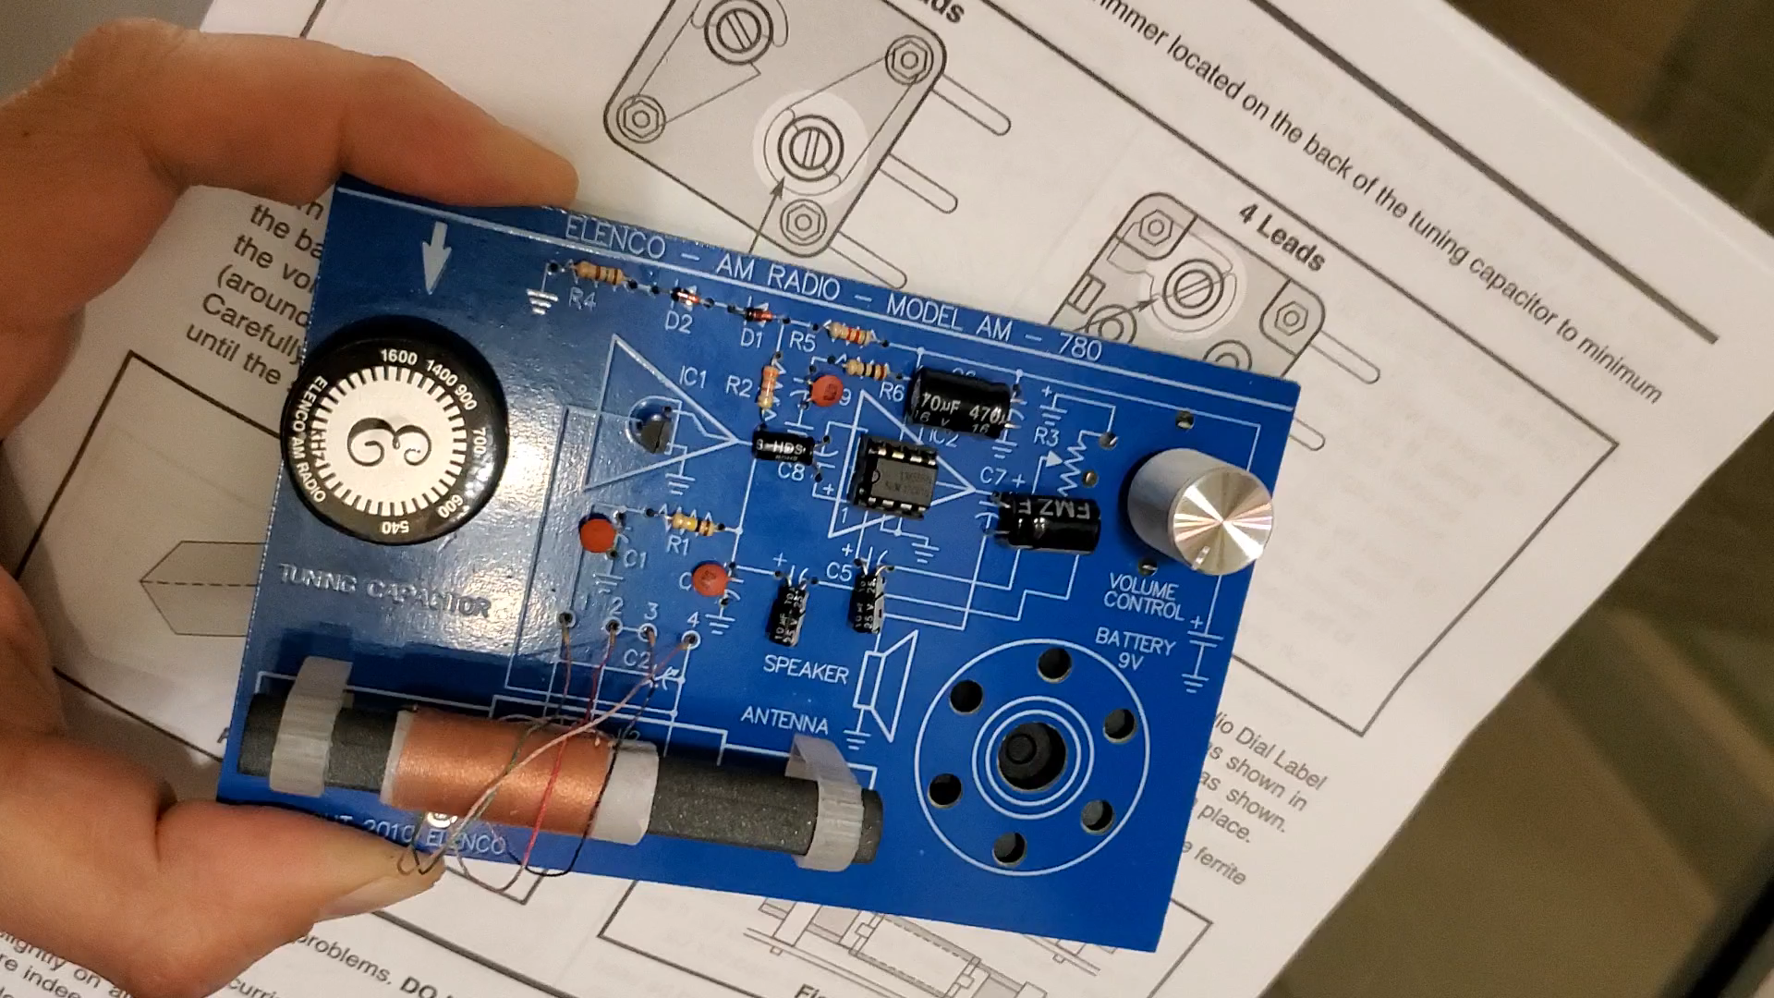
Lab 11 part 1 – AM radio
Found better directions online than what came with the unit.
Manual for AM radio model 780
Video of Elenco AM RADIO model 780

Slide 35
Lab 11 observations
Troubleshot a broken AM Radio. The radio was out of tune adjusted capacitor was way out of adjustment.

