Slide 1
Simulating Motors with PSpice

Slide 2
PSpice lacks the ability to directly represent mechanical properties, so in order to represent a motor in multisim, circuits that emulate the mathematical relationships between the mechanical properties and the electrical properties of a motor will be used.

Slide 3
Electrical Circuit
The base electrical circuit will consist of a voltage source, inductor, resistor, and a current controlled voltage source.
The voltage source will be used as power supply
The current controlled voltage source will be used to represent the back_emf (a ccvs must be used because its value is dependent on the current that will be obtained from the mechanical circuit equivalent)
The resistor will be used to represent the resistor of the coils in the armature
The inductor represents the induction of the coils

Slide 4
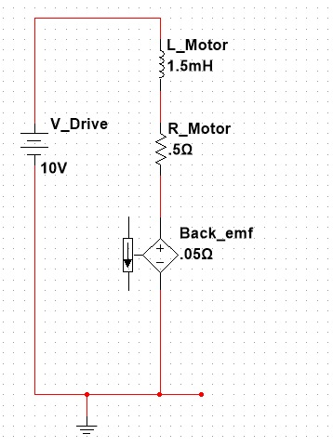
Electrical Circuit

Slide 5
Mechanical Circuit Equivalent
The mechanical circuit will contain the following multisim components to represent mechanical properties
Mechanical Property | Electrical Circuit Equivalent
Torque | Current Controlled Voltage Source
Friction | Resistor
Moment of Inertia | Inductor
Angular Velocity | Current

Slide 6
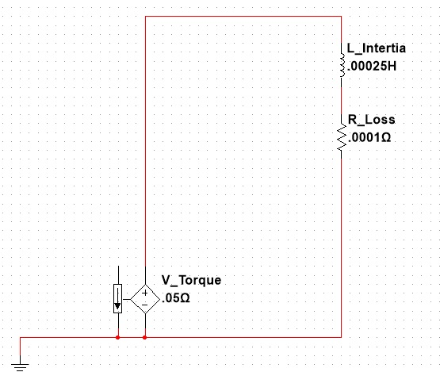
Mechanical Circuit Equivalent

Slide 7
Relationships
The speed at which the motor shaft rotates is represented by the current in the mechanical circuit. This allows to use the ccvs from our electrical circuit and connect it to the mechanical circuit to properly represent the back_emf as it too is dependent on the speed of rotation of the motor shaft (current of mechanical circuit)
The torque the motor will apply is dependent on a special value called the “torque constant” and the current flowing through the electrical circuit. This is represented using a ccvs connected to the electrical circuit.

Slide 8
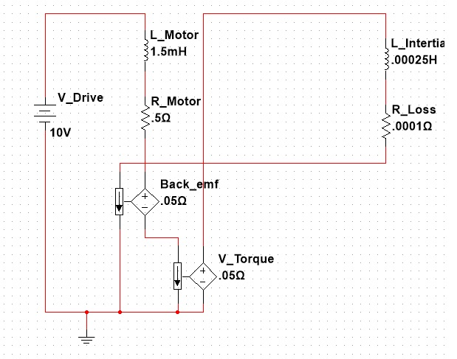
Full Circuit

