Slide 1
Lab Notebook
Lucas Bazile

Slide 2
Lab 0
Objectives
Simulate And, Or and equivalent circuits
Verify truth tables
Choose and build one of the circuits

Slide 3
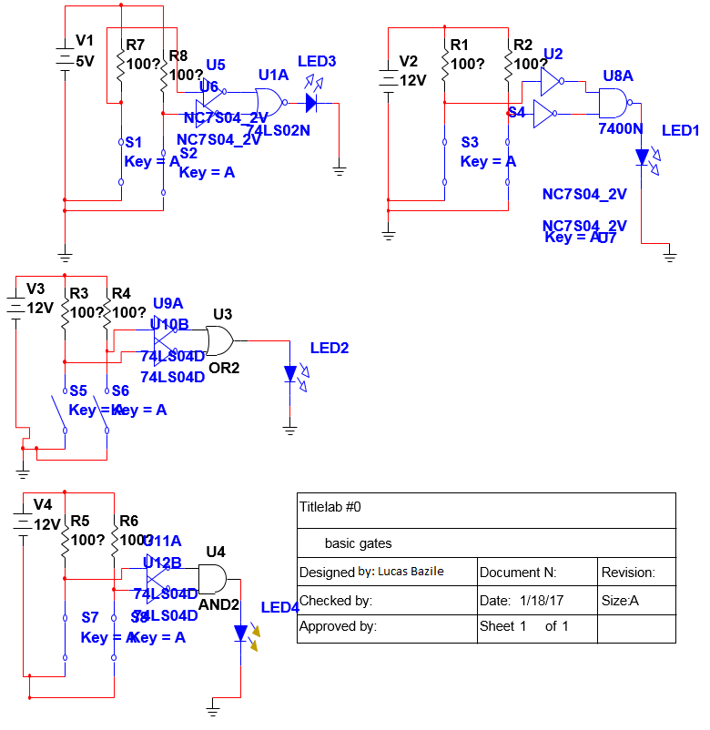
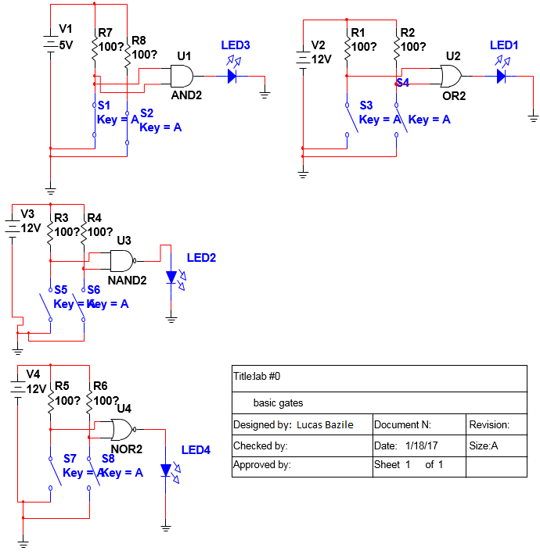
Multisim

Slide 4
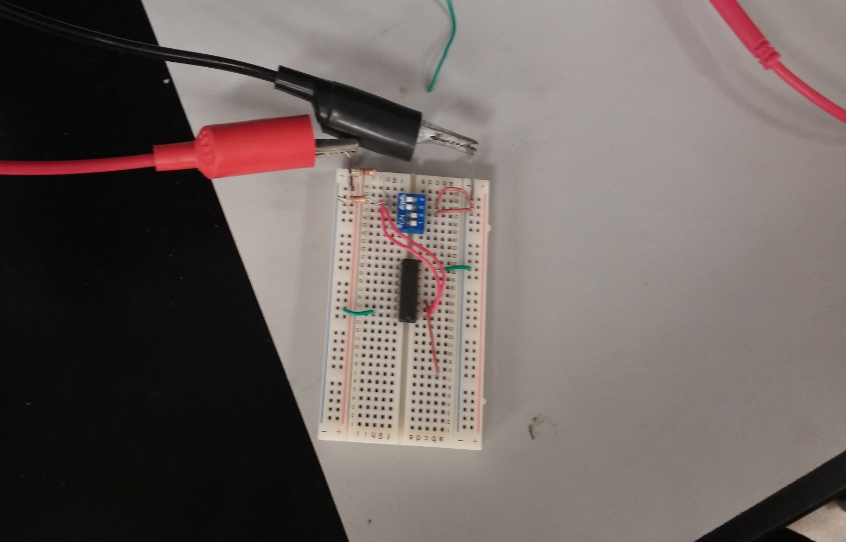
AND Gate Build

Slide 5
Components
Component Quantity
          Quad Switch 1
          74LS08N 1
          1k Resistor 2

Slide 6
Notes
I remembered all the gates and their functions but experienced brief setbacks when simulating and building the function. The setbacks were due to having little experience with simulating and building circuits in addition to not using the skills for a few weeks.

Slide 7
Lab A
                Objectives
Build Circuit 4-2 on page 139 in multisim
Verify Outputs
Simplify Circuit With Karnaugh Map
Use Logic Converter to Derive Simplified Boolean Expression

Slide 8
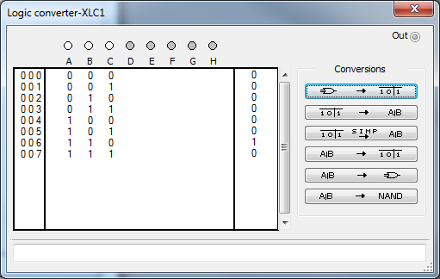
Multisim

Slide 9
Truth Table and Karnaugh Map
 | Truth Table
A | B | C | Z
0 | 0 | 0 | 0
0 | 0 | 1 | 0
0 | 1 | 0 | 0
0 | 1 | 1 | 0
1 | 0 | 0 | 0
1 | 0 | 1 | 0
1 | 1 | 0 | 1
1 | 1 | 1 | 0
 | K-Map
 | C' | C
A'B' | 0 | 0
A'B' | 0 | 0 | =ABC'
AB | 1 | 0
AB' | 0 | 0

Slide 10
Items Used
Component Quantity
          74LS08N 1
          74LS02N 1
          74LS11D 2
          74LS04D 2
          DIPSW1 6
          5v DC Source 2

Slide 11
Notes
Initially had a lot of problems getting the circuit to behave as intended. Finally got it to work by starting from scratch and making sure gates were getting inputs from between resistor and switch.
Karnaugh seemed easy enough after reviewing the process. It was a small map since there were only 3 inputs
Logic converter kept giving an error when I tried to apply it to the circuit. After a few attempts I got it working though not entirely sure what I did to make it work.

Slide 12
Lab B
Test 6 Fundamental Gates
Test with Logic Analyzer

Slide 13
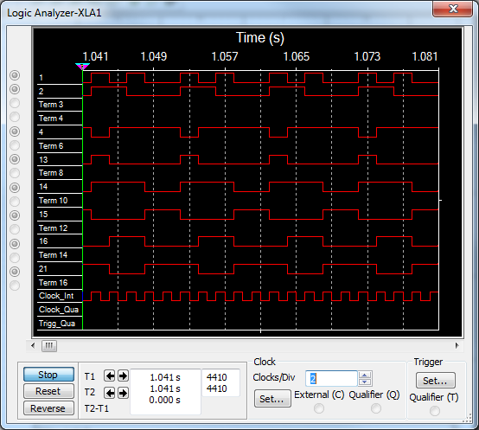
Multisim

Slide 14
Items Used
Component Quantity
          74LS08N 1
          74LS00 1
          74LS32N 1
          74LS02N 1
          74LS86N 2
          74LS04N 1
          Digital Clock 2

Slide 15
Notes
I hadn’t used the digital clock sources before but they seem straightforward
Also hadn’t used the logic analyzer before. I still do not know how to operate it very well but with Andy’s help I was able to get a decent readout
I used an XOR gate with an inverter because none of the XNOR gates in multisim were listed on ivytechengineering.com

Slide 16
Lab C
Simulate theorems 1-8 in multisim
Prove Theorems 13-17 with multisim

Slide 17
Simulations of 1-8

Slide 18
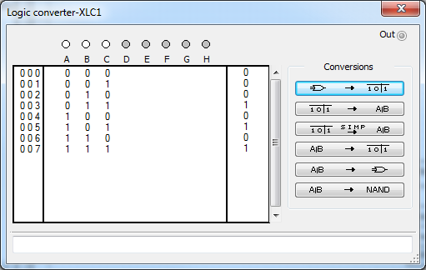
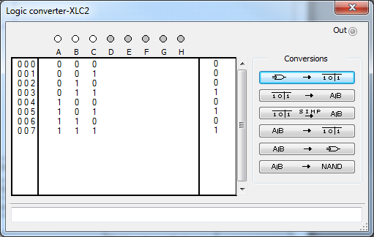
Multisim 13a

Slide 19
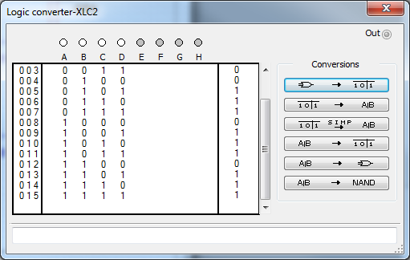
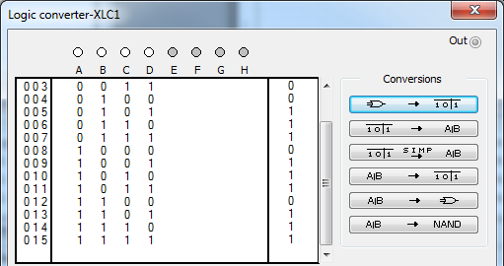
Multisim 13b

Slide 20
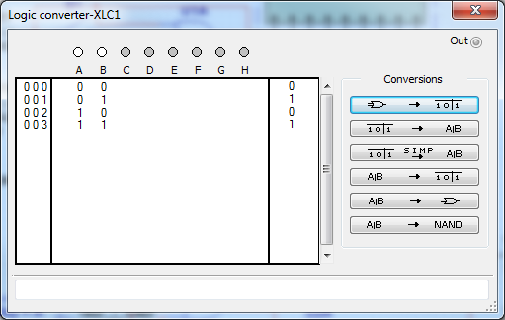
Multisim 14

Slide 21
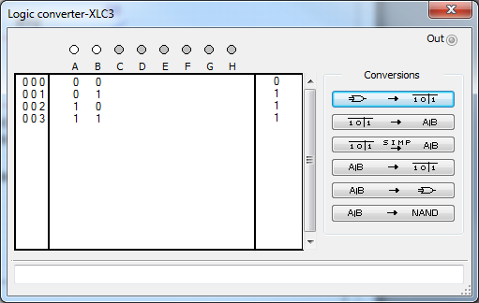
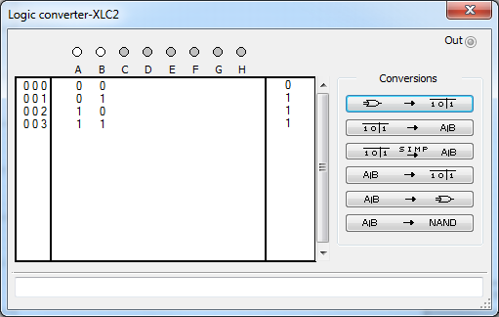
Multisim 15a

Slide 22
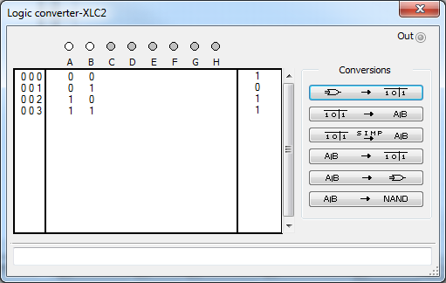
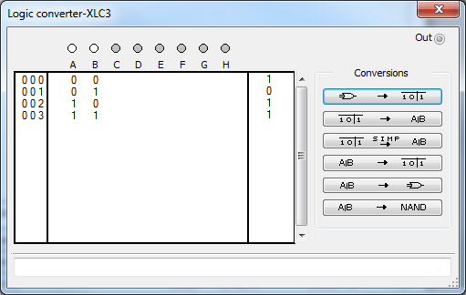
Multisim 15b

Slide 23
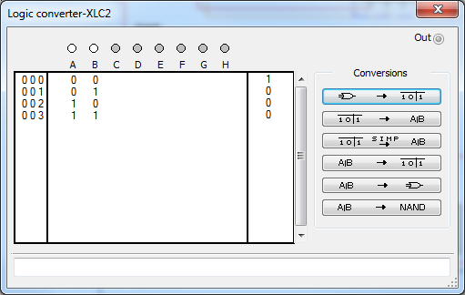
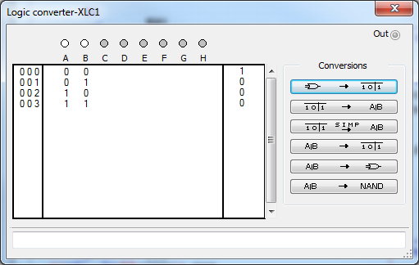
Multisim 16

Slide 24

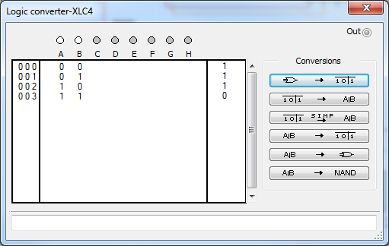
Multisim 17

Slide 25
Items Used
Components Quantity
          7408 24
          7432 14
          7404 9
          DIPSW1 40
          1k Resistor 42
          5V DC Source 15
          7402 1
          7400 1

Slide 26
Observations
The logic converter occasional gave me problems. I had a lot of circuits the would cause an error and could not be analyzed however, when testing the circuits manually with switches and volt meters, I would observe the desired behavior. By repeatedly recreating the circuits and changing location of components, I was eventually able to get accurate readouts for each circuit.

Slide 27
Lab D
Simulate 1-3 clock using flip flops
Build circuit and test results

Slide 28
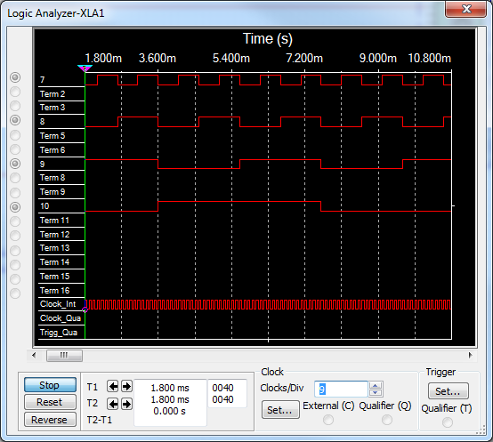
Multisim

Slide 29
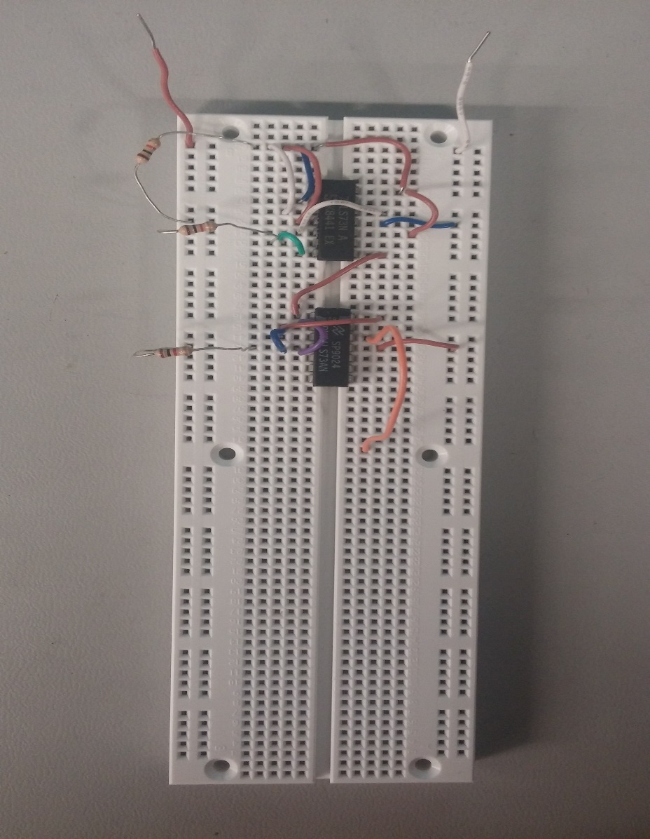
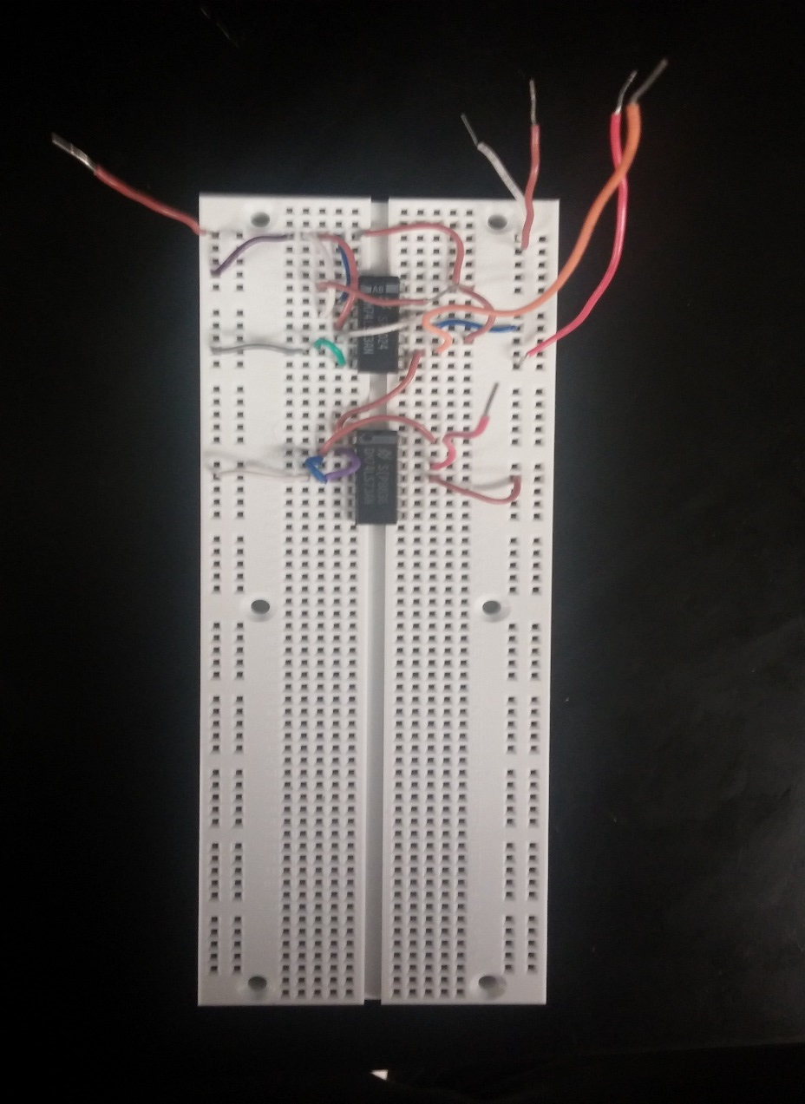
Build

Slide 30
Items Used
Component Quantity
          74LS73 2
          1k Resistor 3

Slide 31
Notes
This was my first time being introduced to the concept of halving clock speed by running a clock through a series of flip flops but it makes sense
My first build would not achieve a 5v active state. This is because I put resistors in series with the gates (which I have always done). I found out this is not how one should create this circuit because by doing so I’m lowering the voltage from the 5v source that reaches to component, which needs the full 5v to operate correctly.
Proper and efficient set up of logic analyzer parameters remains elusive

Slide 32
Lab 0-D Notes
The components 74LS08N and 7408N in multisim are represented as the same exact component as far as I can tell but the ivytechengineering.com webpage only has the LS version of the component. For other components like jk flip flop however the webpage has 7470 and multisim doesn’t. I sometimes am not sure what components to use in simulation but I suppose I will learn as I continue to simulate and build.
Also still don’t know how to properly use logic analyzer or converter. Also have no experience with oscilloscope and other devices I get the feeling we should have learned about.

Slide 33
Lab 1
Objective
Characterize D Flip Flop

Slide 34
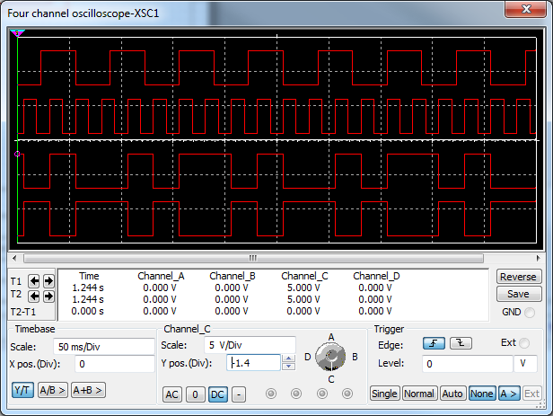
D Flip Flop

Slide 35
Logic Diagram

Slide 36
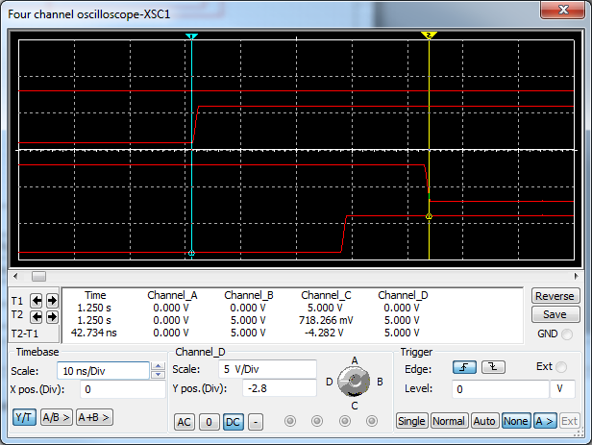
Properties
The Clocked D Flip Flop will take an input and transfer it to the output only when the clock goes positive.
Normally Implemented by inverting one of the inputs on a clocked JK flip flop and then connecting the J and K inputs to the same signal.
There is approximately 28ns of propagation delay from the time the clock goes positive and the output Q’ changes states, and 43ns of delay from when the clock goes positive and the output Q changes states.
D | Clock | Q
0 | Positive edge | 0
1 | Positive Edge | 1

Slide 37
Notes
I tested multiple times and Q’ always changes states before Q which is interesting.
Multisim records propagation delay of a changing from one state to another as about one nanosecond from peak to peak.
I characterized a clocked d flip flop but could not find a version in multisim without preset and clear, which is why I omitted mentioning them.

Slide 38
Lab 2
Characterize JK – Flip Flop

Slide 39
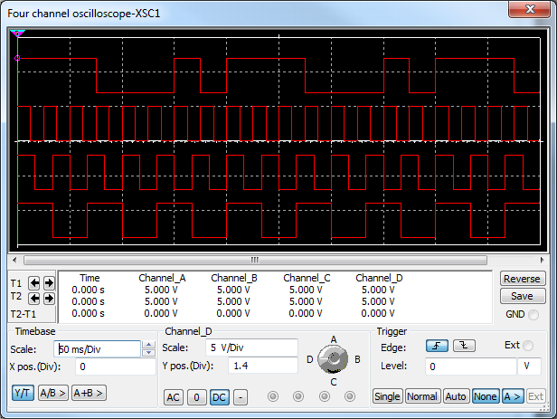
JK Flip Flop

Slide 40
Logic Diagram

Slide 41
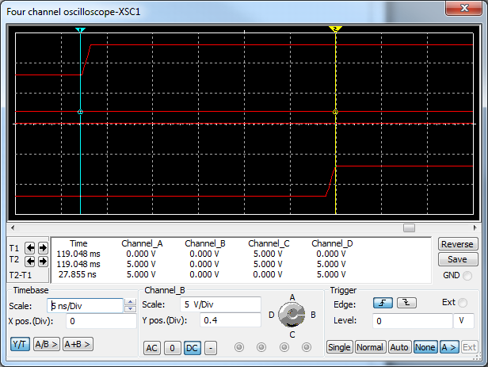
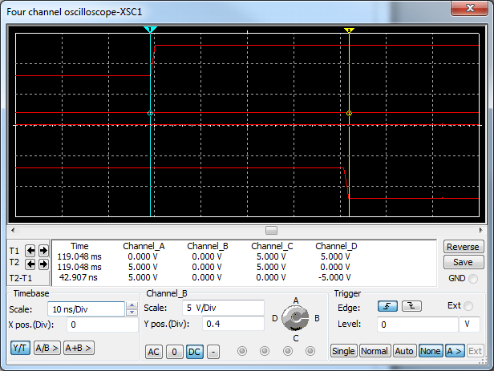
Properties
A positive edged JK flip flop will change its outputs when the clock goes positive depending on inputs J and K.
There is approximately 28ns propogation delay from when the clock goes positive and Q’ changes states, and 43ns from when the clock goes positive and Q changes states.
J | K | Clock | Output
0 | 0 | P Edge | No Change
1 | 0 | P Edge | 1
0 | 1 | P Edge | 0
1 | 1 | P Edge | Toggle

Slide 42
Notes
Again, the propagation delay is shorter from the clock trigger to Q’ than to Q. This makes sense since clocked d flip flops are derived from this flip flop and exhibit that characteristic.

Slide 43
Lab 3
Characterize SR Flip Flop

Slide 44
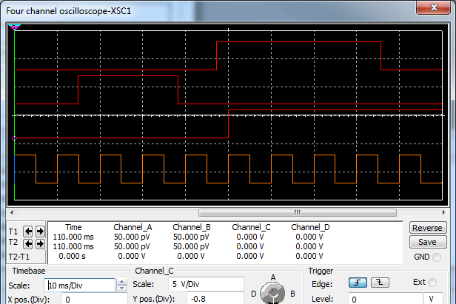
Logic Diagram/Behavior

Slide 45
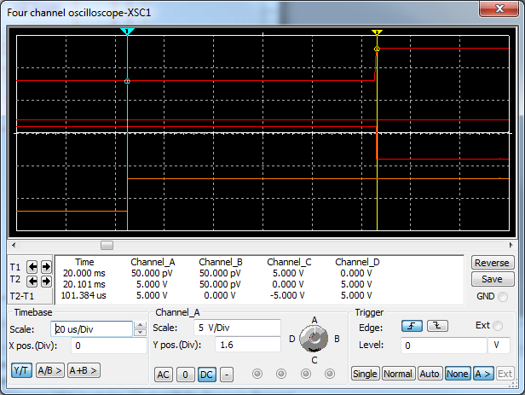
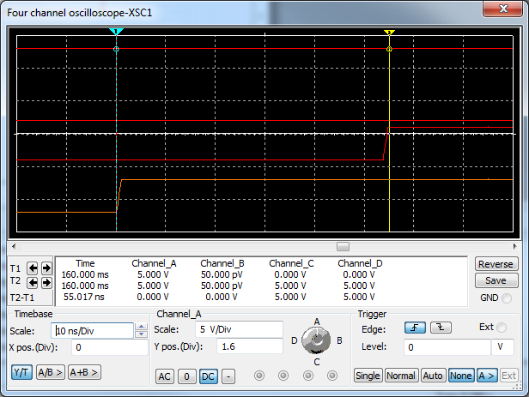
Properties
The Clocked Triggered SR flip flop will change states when the clock goes positive depending on inputs S and R as shown by the table. When both inputs are high, the output becomes ambiguous, which is undesirable.
The propagation delay from the positive edge of the clock to a change in Q is around 10ns and the delay from clock to Q’ is around 20us.
S | R | Clock | Output
0 | 0 | P Edge | No change
1 | 0 | P Edge | 1
0 | 1 | P Edge | 0
1 | 1 | P Edge | Ambiguous

Slide 46
Notes
I couldn’t find an SR flip flop in multisim so I just showed its logic with the gates.
I couldn’t use clocks on the inputs S and R because when both went high it would cease the oscilloscope readings and crash the multisim circuit, so I put switches in to manipulate the inputs manually and show the different states of the circuit while avoiding the ambiguous state.

Slide 47
Lab 4
Characterize NAND Gate Latch

Slide 48
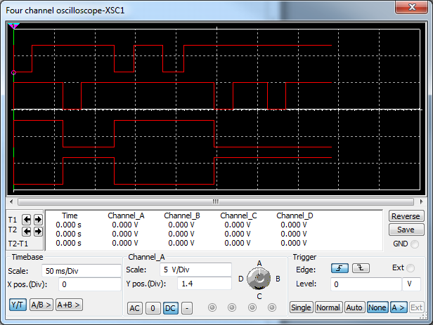
Logic Diagram

Slide 49
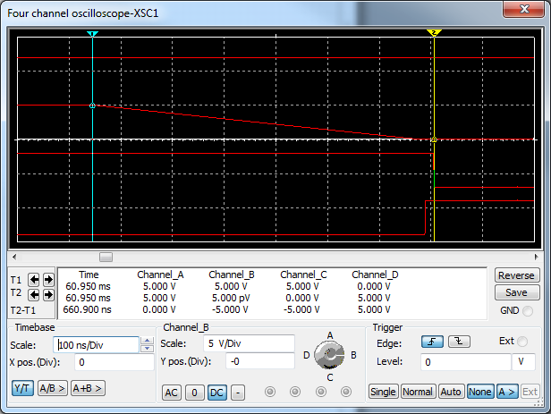
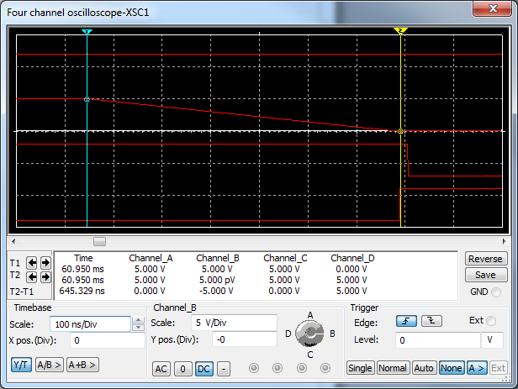
Properties
The normal position for the gates inputs are high.
When set is pulsed low, the output will go high, this is called setting the latch.
When the reset is pulsed low, the input will go low, this is called resetting the latch.
When both set and reset are low at the same time, the circuit does not know how to behave because the logic cannot agree, you will get an invalid or ambiguous state.
Propagation delay from pulsing an input to a change in Q’ is around 645ns.
Propagation delay from pulsing an input to Q changing is around 661ns.
Set | Reset | Output
1 | 1 | No Change
0 | 1 | Q=1
1 | 0 | Q=0
0 | 0 | Invalid

Slide 50
Notes
I had to use manual switches again because when both inputs would go low the circuit would crash.
The length of time it took the logic level to go from high to low when opening and closing the circuit was much higher than the time it took for a gate reading the input to change its state as seen by the long initial transition in the oscilloscope readings and the relatively fast change in states of Q and Q’.

Slide 51
Lab 5
Objectives
Build 2’s compliment circuit in multisim

Slide 52
Circuit

Slide 53
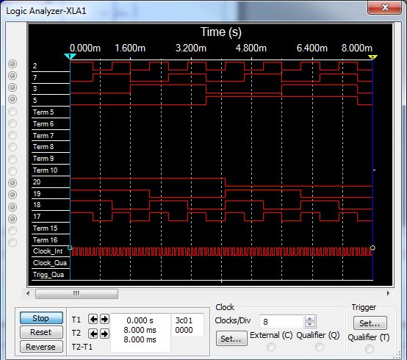
Circuit with clocked inputs

Slide 54
Parts
              Component Quantity
              5v power supply 4
              DIP Switch 4
              1k Resistor 4
              74ls04 1
              74ls283 1
              Green Led Bar 1
              Blue Led 1
              Digital Constant 4

Slide 55
Notes
I made the circuit with a 4 bit clock input in order to capture all input values and their outputs over a short amount of time.

Slide 56
Lab 6
Objectives
Build 4 bit adder in multisim

Slide 57
Simlation

Slide 58
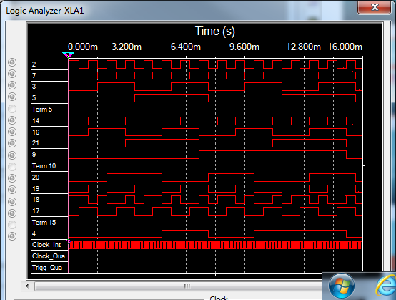
Circuit with 4 bit clock inputs

Slide 59
Parts
          Component Quantity
          5v DC power supply 8
          1k Resistor 8
          74ls283 1
          Red LED 1
          Green LED Bar 1
          DIP Switch 8

Slide 60
Notes
I again used clocked inputs to record all values over a time period to easier display the results.

Slide 61
Lab 7
Simulate and build figure 6-14 using DIP switches to manipulate inputs

Slide 62
Simulated operations

Slide 63
Simulated Operations

Slide 64
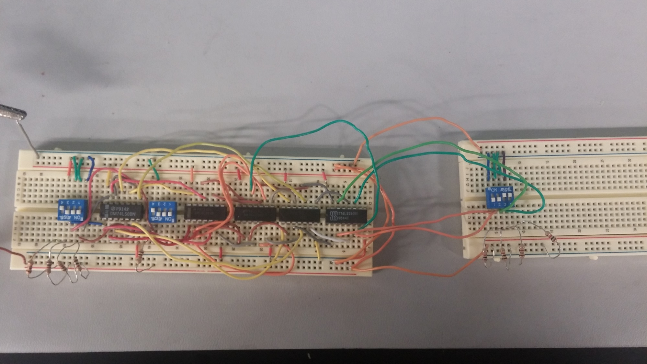
Build

Slide 65
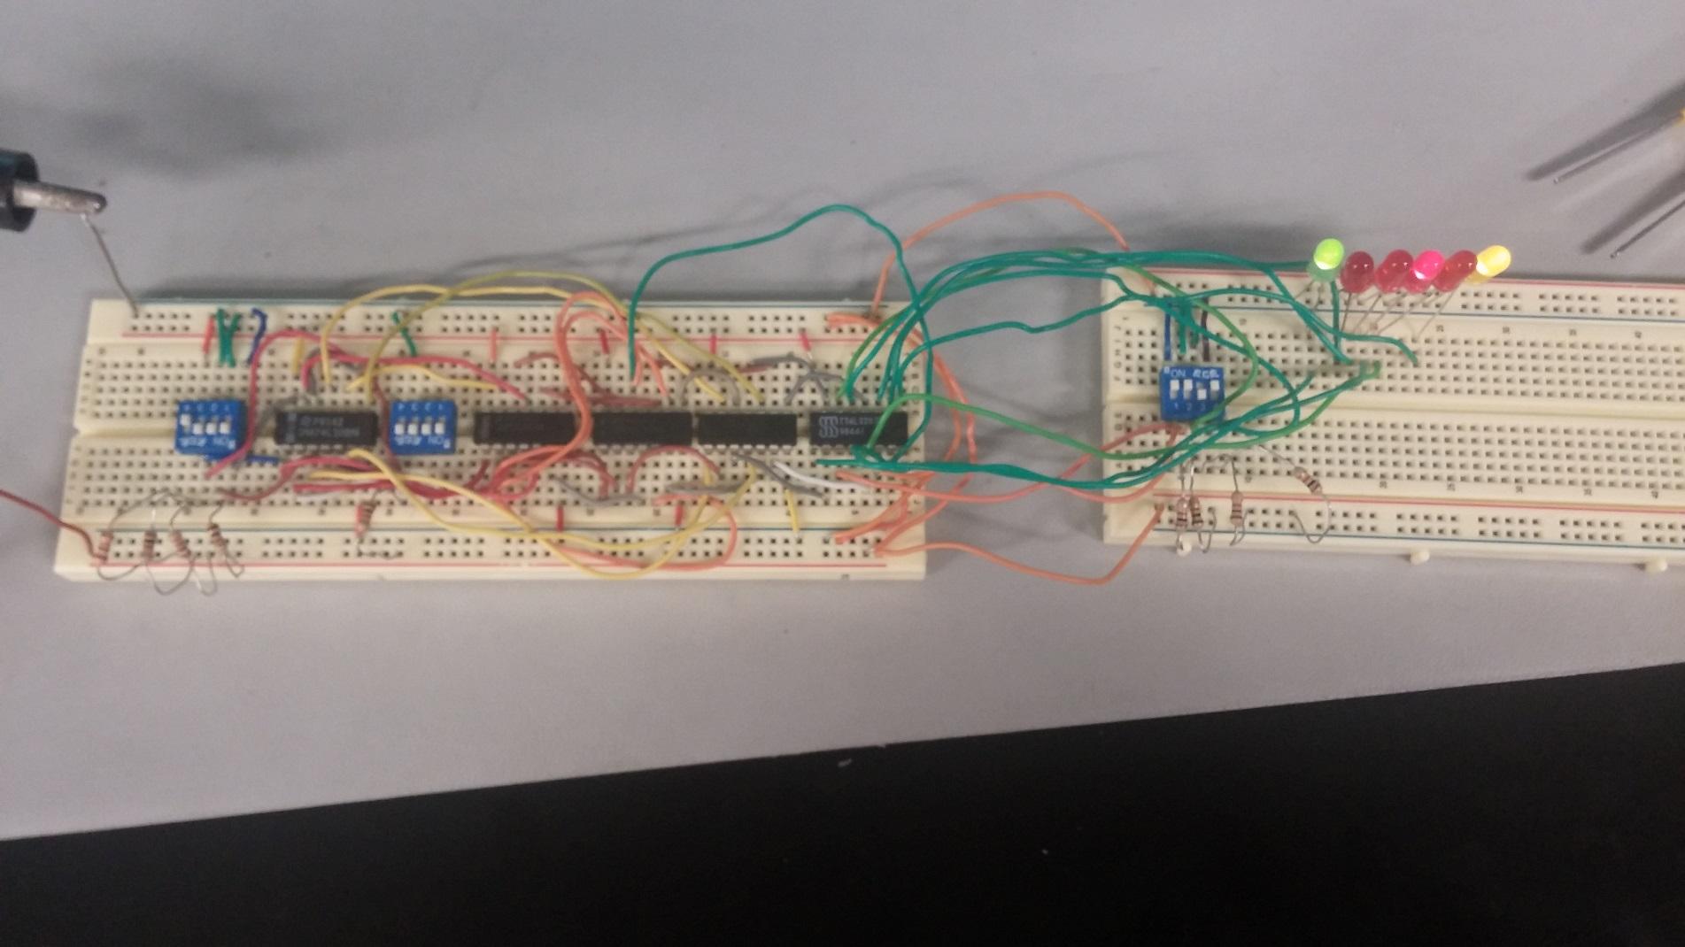
Build
LSD
Subtrahend
(0010)
Carry Out
Carry In
Sub/Add Operation
(In Sub Position)
Minuend
(0100)

Slide 66
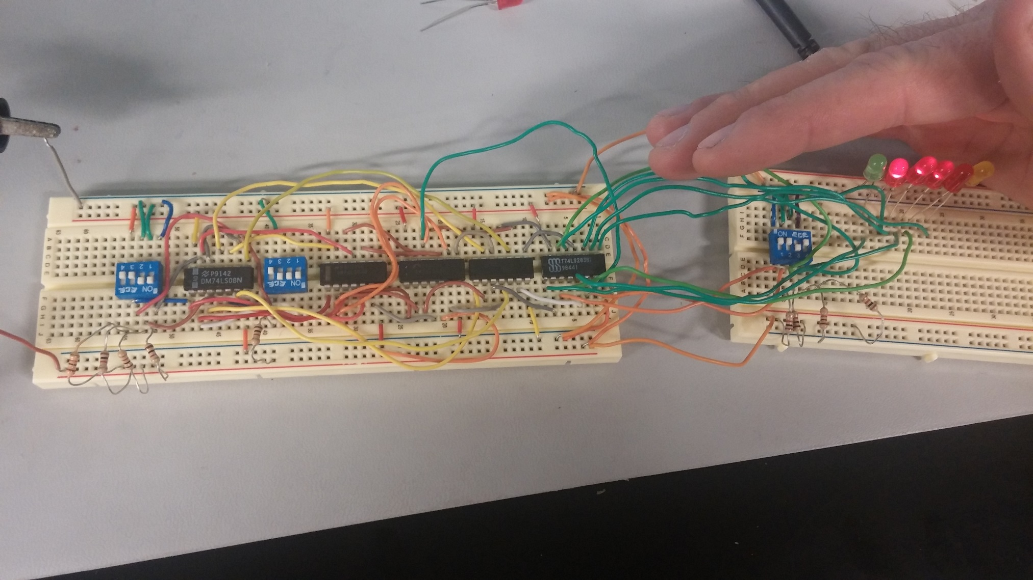
Build
(1010)
LSD
In Add Position
(0100)

Slide 67
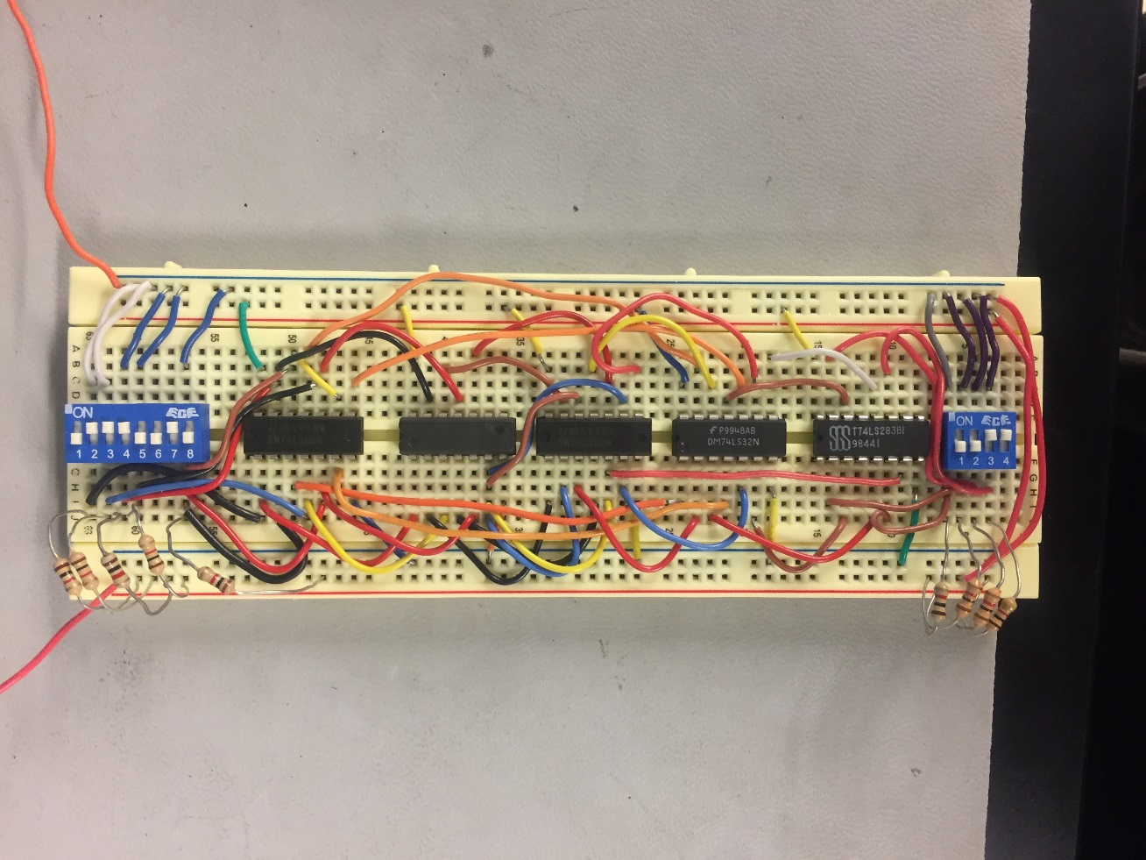
Build 2

Slide 68
Notes
I had a lot trouble ensuring my switches were working properly in multisim, once I put a resistor in each branch rather than one resistor for all branches the circuit worked as intended.
Circuit only had one minor problem after building which was one of IC’s was not grounded.
The wiring to the switches was incorrect with respect to correctly representing the significance of the digits
In the top switch, the significance of the digits represented from left to right was 2,4,1,3
In the bottom switch, the significance of the digits represented from left to right was 2,1,3,4
After introducing LED’s to show the outputs of the 74ls283, the logic highs dropped from around 4.5v to 2.1v
I rebuilt this circuit much neater at a later date. I included its picture because it is the circuit I used going forward.

Slide 69
Parts
          Component Quantity
          74ls08 2
          74ls32 1
          74ls04 1
          1k Resistor 9
          5v DC power supply 1
          4 Terminal DIP Switch 3
          Red LED 4
          Green LED 1
          Yellow LED 1
          74ls283 1

Slide 70
Lab 8
Simulate and Build 7 segment display circuit

Slide 71
Simulation

Slide 72
Notes on simulation
I had some difficulty creating the component in multisim. It turns out I was continuously missing one of the very obviously stated steps. That’s embarrassing.

Slide 73
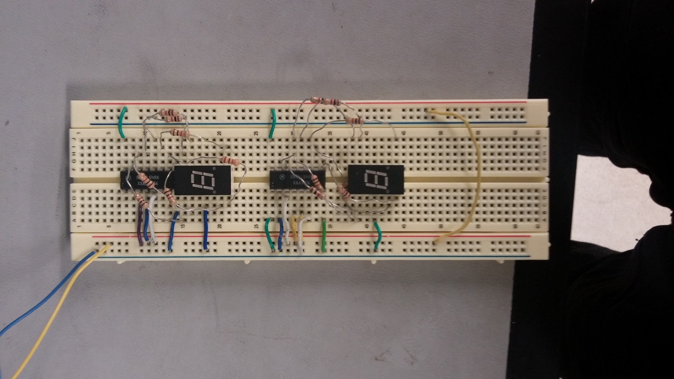
Build

Slide 74
Parts
            Component Quantity
            08MAN74 2
            1k Resistor 14
            74LS48N 2

Slide 75
Notes
I had some difficulty trying to keep the circuit clean looking.
Keeping the resistors from coming into contact in such close proximity is a hassle.

Slide 76
Lab 9
Build 4 bit binary to 5 bit BCD converter circuit

Slide 77
Simulation

Slide 78
Simulation Notes
This is the logic for the custom part we made with multisim in lab 8
My partner and I collaborated on this simulation so I put his name on the title block

Slide 79
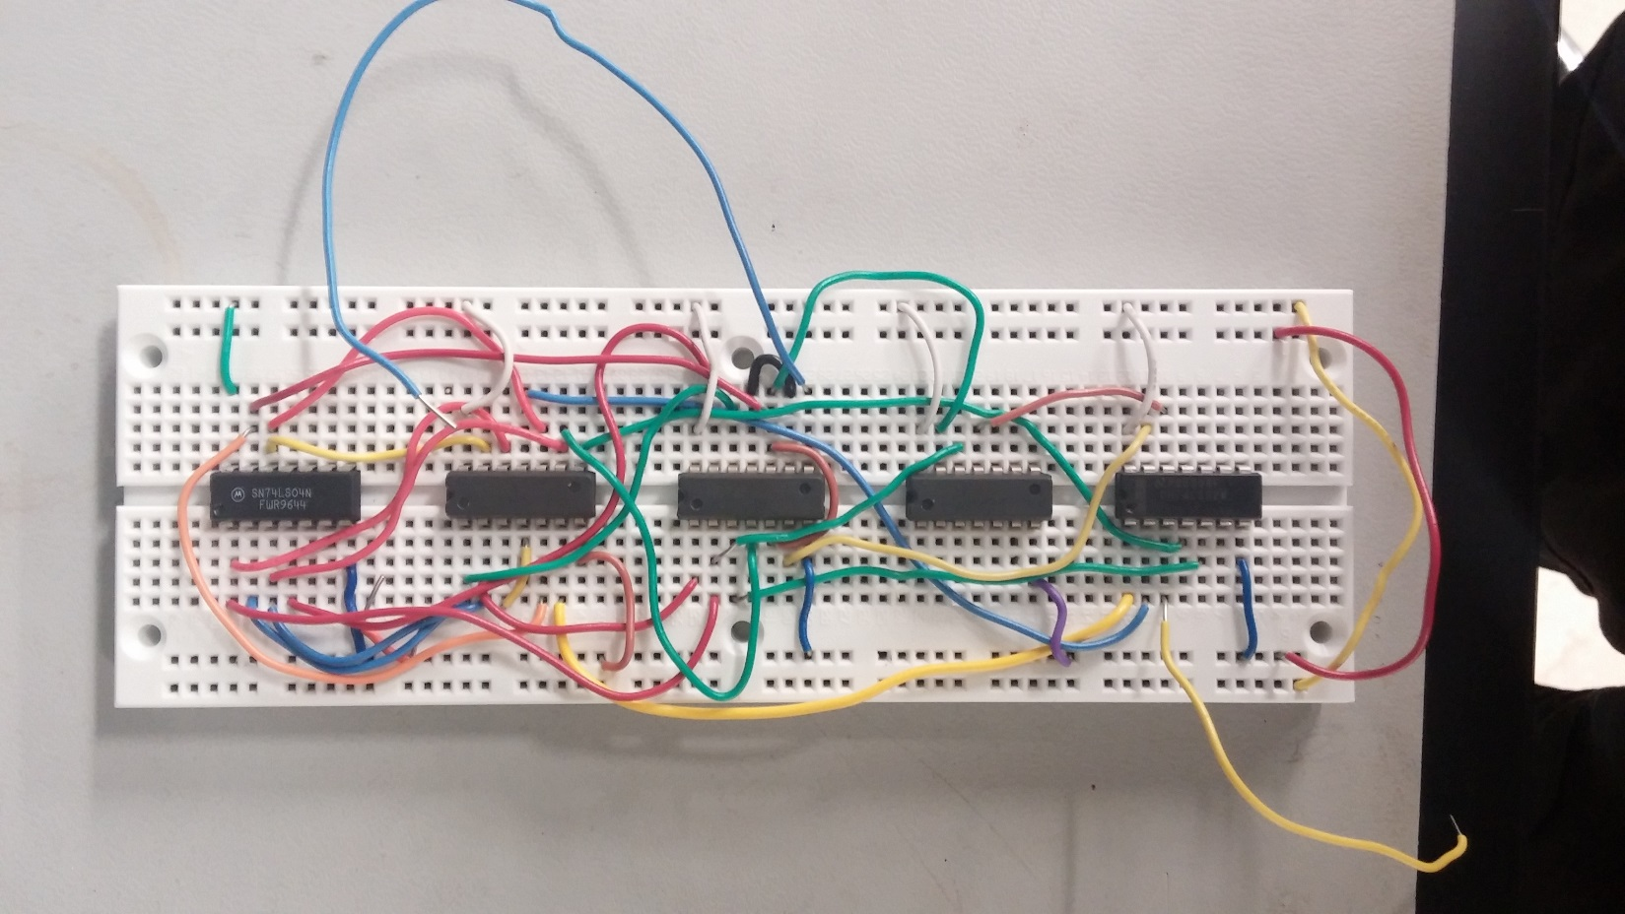
Build

Slide 80
Parts
              Component Quantity
              74LS04 1
              74LS08 3
              74LS32 1

Slide 81
Build Notes
Though the circuit was straightforward to build (especially with sumlation to guide me) I still had to make to attempts at making the circuit. Silly mistakes take a long time to identify and should therefore be avoided.
The loose wires on the board are the wires that will connect it to the other parts of the Mini-Lou

Slide 82
Lab 10
Complete the Mini-Lou

Slide 83
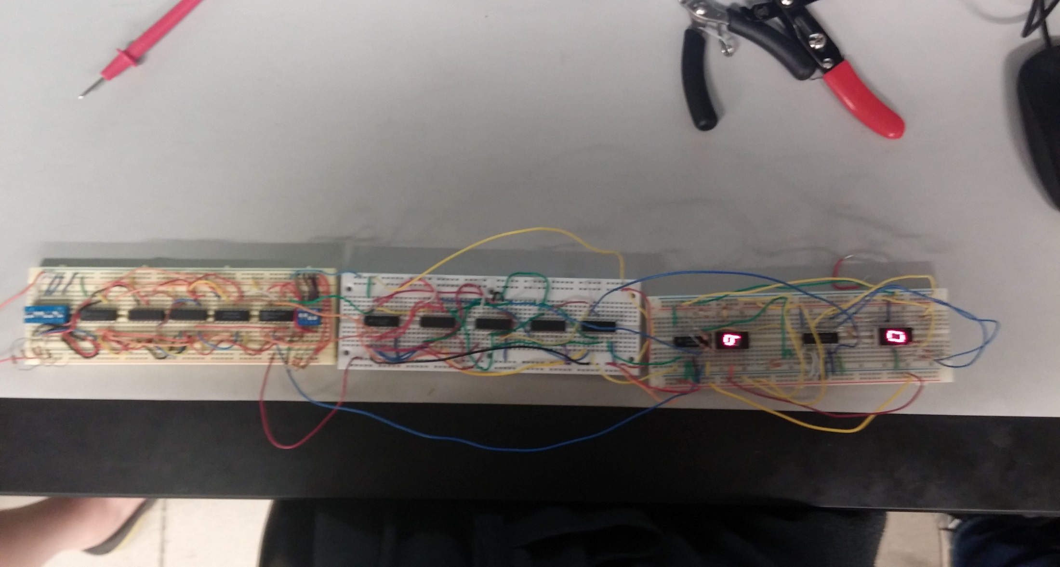
Build

Slide 84
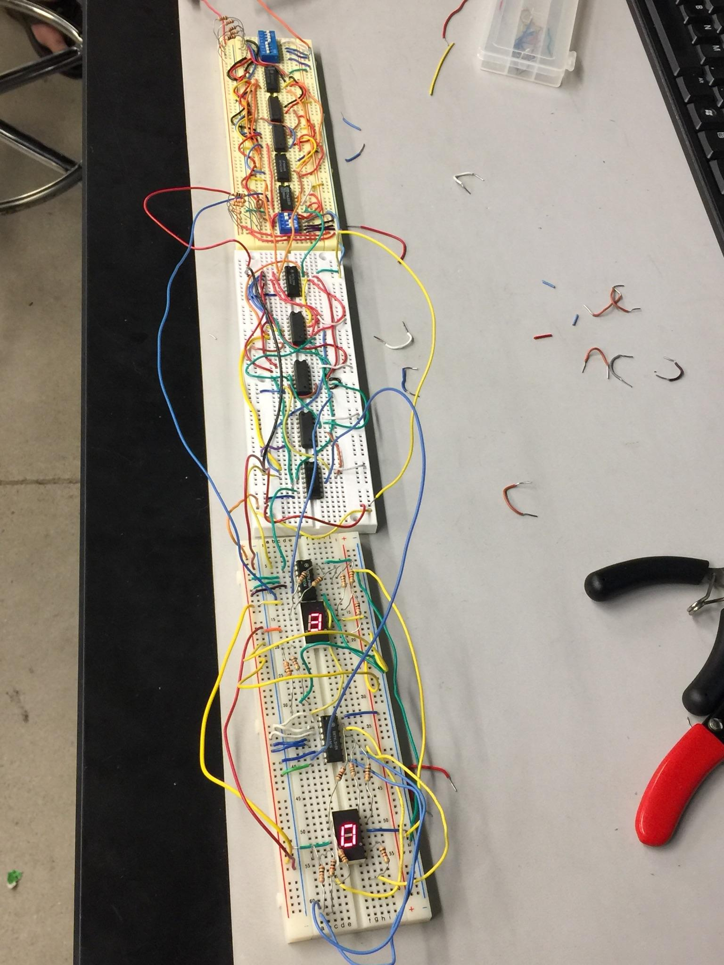
Build

Slide 85
Parts
            Component Quantity
            08MAN74 2
            1k Resistor 23
            74LS48N 2
          74ls08 5
          74ls32 2
          74ls04 2
          5v DC power supply 1
          4 Terminal DIP Switch 1
          8 Terminal DIP Switch 1
          74ls283 1

Slide 86
Notes
ITS ALLIIIIIIVVVEEEEE!!! Or at least works as intended
Possibly the most practical calculator to date.
Project took about 5 weeks to complete.
Students from other classes had pilfered pieces from our 4bit binary to 5bit BCD board so we had to remake it which was frustrating.
Circuit worked just fine first time all parts were connected together properly.

Slide 87
Lab 11
Use Arduino in place of “74xyzJA” board in Mini-Lou project.

Slide 88
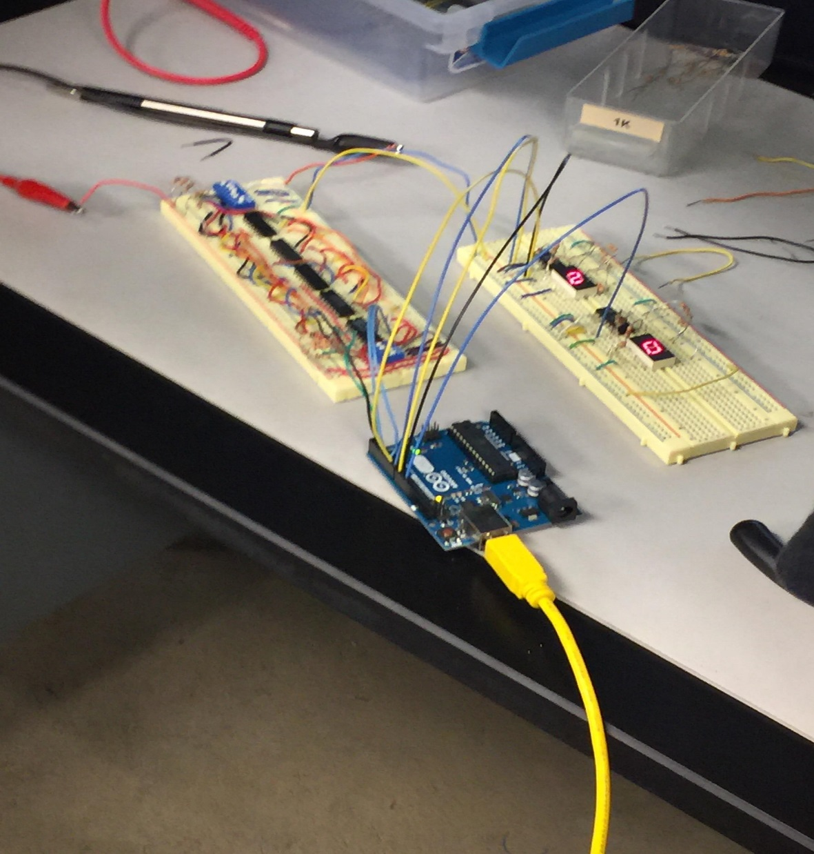
Build

Slide 89
Notes
In the end I used a series of “if” statements rather than Boolean functions to achieve the desired effect.
Took a decent amount of research to figure out how to program the Arduino but it seems like its going to be fun to mess around with it.
We used an Arduino uno in our circuit.

Slide 90
Overall CLASS NOTES
I tend to use 1k resistors at all times, I should get used to using different values.
I still need to work on making my multisim circuits a direct schematic that will be easy to follow when building.
My circuits tend to get too messy, need to work on being neater.
I improved immensely at troubleshooting both mine, and other people’s circuits, which is great.
I also got way quicker at rebuilding circuits I’ve built before
I look forward to working with arduino, basic stamps, and raspberry pi

