Slide 1
EECT 112 Lab Notebook
By: Justin Wells

Slide 2
Table of Contents
Lab 1 – AND, OR Logic (slide 3)
Lab 2 – AND, OR, INVERT (slide 10)
Lab 3 – NAND Alternative (slide 18)
Lab 4 – Car Alarm (slide 26)
Lab 5 – NAND SR Latch (slide 33)
Lab 6 – Binary Counter to 7 – Segment Display (slide 41)
Lab 7a – Blinking LED (slide 48)
Lab 7b – Process Control (slide 53)
Lab 8 – Software Counter (slide 58)

Slide 3
Lab 1 - AND, OR Logic

Slide 4
Lab 1 – AND, OR Logic
Objective of the Lab
To understand the differences between an AND and OR gate, and their different outputs.
Equipment and Materials Used
2x 10k Ohm Resistors
1x 74LS32 OR chip
1x 75LS08 AND chip
Power Supply: RSR HY1802D S/N: 022510026
Digital Multimeter: GwINSTEK GDM-8245
S/N: CL860264
Research
Class lecture
EECT 101

Slide 5
Lab 1 – AND, OR Logic
Lab Procedure
This lab was a simple lab on how to understand how AND and OR gates work. We created a simulation in multisim using one AND and one OR gate with two SPST switches to determine their inputs. We recorded their outputs and compared them to the truth table we made in class. From there we went to the lab and remade the circuit on an Elvis board to check how the circuits work in real life.

Slide 6
Lab 1 - AND, OR Logic
And
A | B | X
0 | 0 | 0
0 | 1 | 0
1 | 0 | 0
1 | 1 | 1
Or
A | B | Y
0 | 0 | 0
0 | 1 | 1
1 | 0 | 1
1 | 1 | 1
Multisim for Lab one. Both switches are in the 1 position, producing a 1 on both outputs.

Slide 7
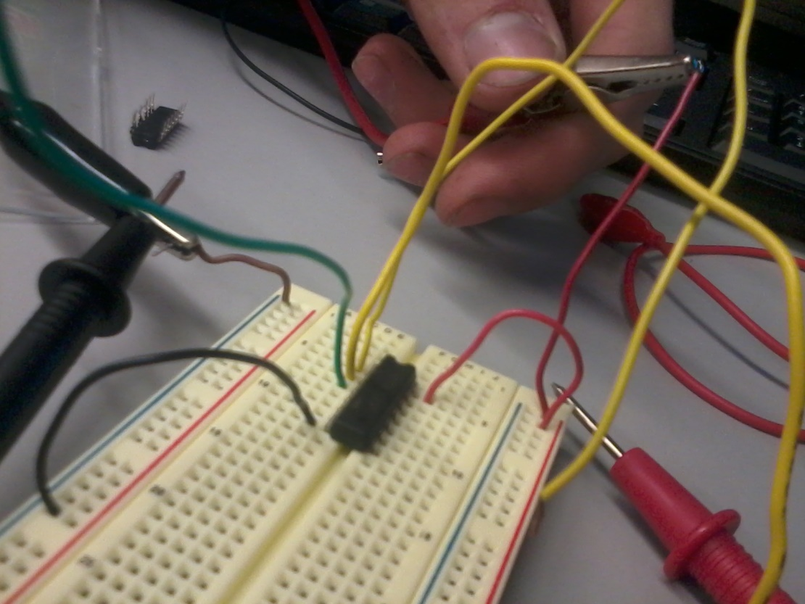
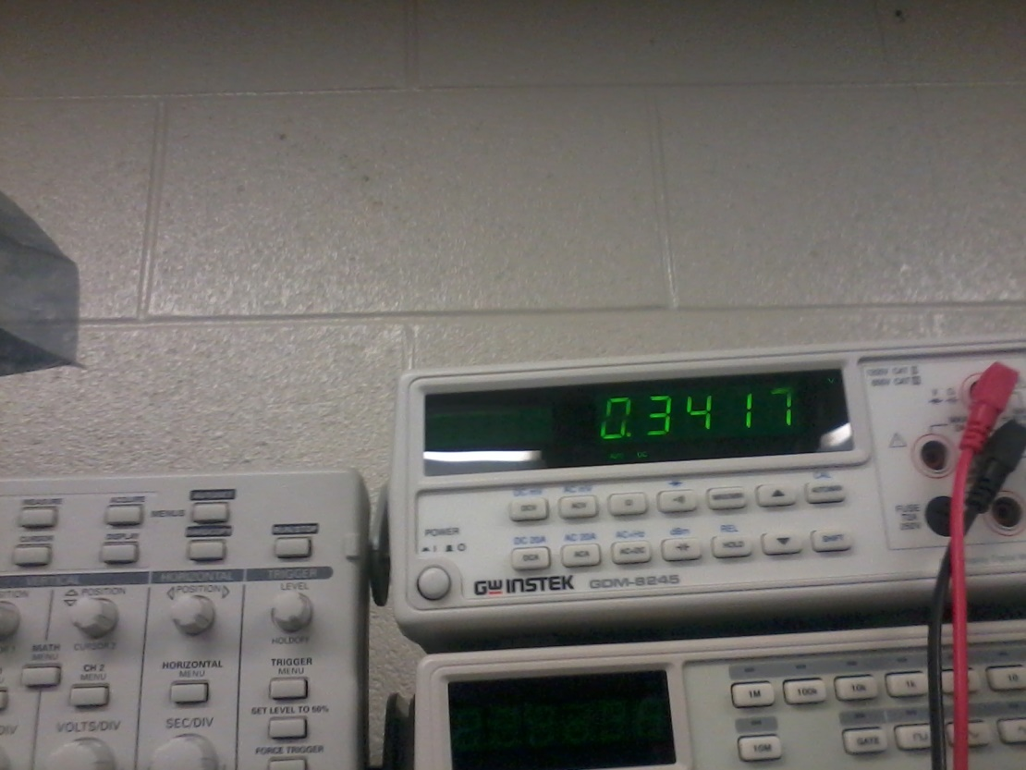
Lab 1 - AND, OR Logic

Slide 8
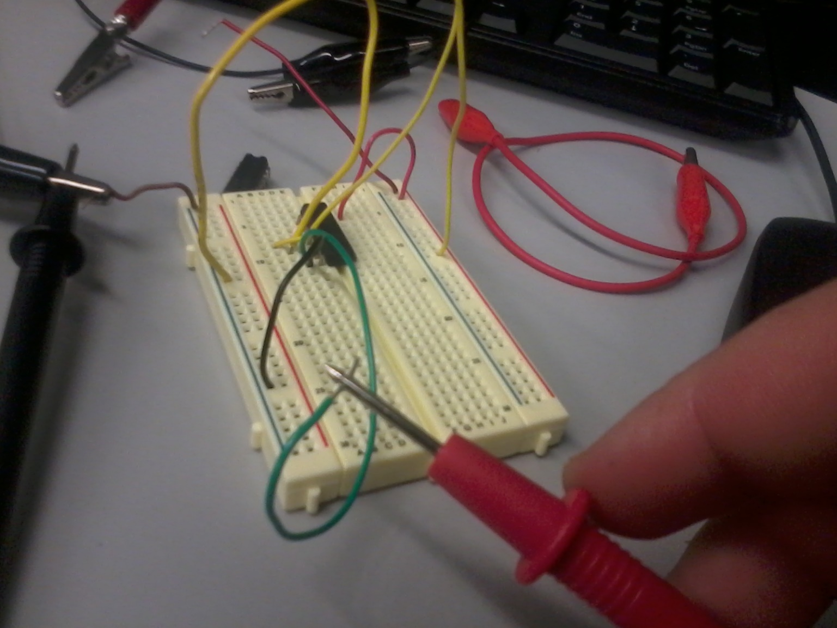
Lab 1 - AND, OR Logic

Slide 9
Lab 1 – AND, OR Logic
Conclusion
During our testing our AND chip produced correct results with the lows being around .13v and the high producing about 4.5v. The OR chip produced low voltages during all stages of testing, usually around .03v with both highs producing a .31v.

Slide 10
Lab 2 – AND, OR, INVERT

Slide 11
Lab 2 – AND, OR, INVERT
Objective of the Lab
To build a circuit that will invert the input voltage from a high to a low and vice versa.
Equipment and Materials Used
Breadboard
2x 10k Resistors
1x 74LS32 OR Chip
1x 74LS04 INVERT Chip
1x 74LS08 AND Chip
Power Supply: RSR HY1802D S/N: 022510026
Digital Multimeter: GwINSTEK GDM-8245
S/N: CL860264
Research
In class lecture

Slide 12
Lab 2 – AND, OR, INVERT
Lab Procedure
This lab was a continuation of the lab we produced last week. What we added this lab was one INVERT chip after each AND and OR chip in the circuit produced last week, both in multisim and in the lab. From there we recorded the measurements and then made a small circuit using two INVERT gates.

Slide 13
Lab 2 – AND, OR, INVERT
74LS32
Gate 1 | Gate 2 | Output
0 | 0 | 0.159v
0 | 1 | 4.47v
1 | 0 | 4.47v
1 | 1 | 4.47v
74LS04
Gate 1 | Gate 2 | Output
0 | 0 | 4.41v
0 | 1 | .126v
1 | 0 | .126v
1 | 1 | .126v
Double Inverted
Gate 1 | Gate 2 | Output
0 | 0 | 0.125v
0 | 1 | 4.43v
1 | 0 | 4.43v
1 | 1 | 4.43v

Slide 14
Lab 2 – AND, OR, INVERT
Multisim of Lab 2. Switch one is in the 1 position and switch two is in the 0 position. On the final outputs this produces a 1 0 1.

Slide 15
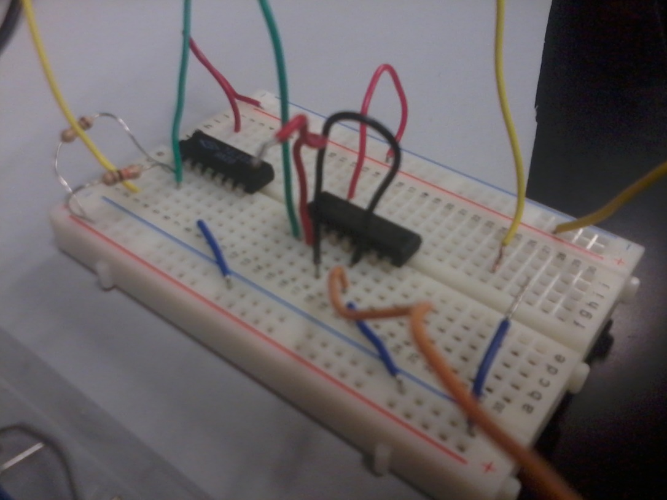
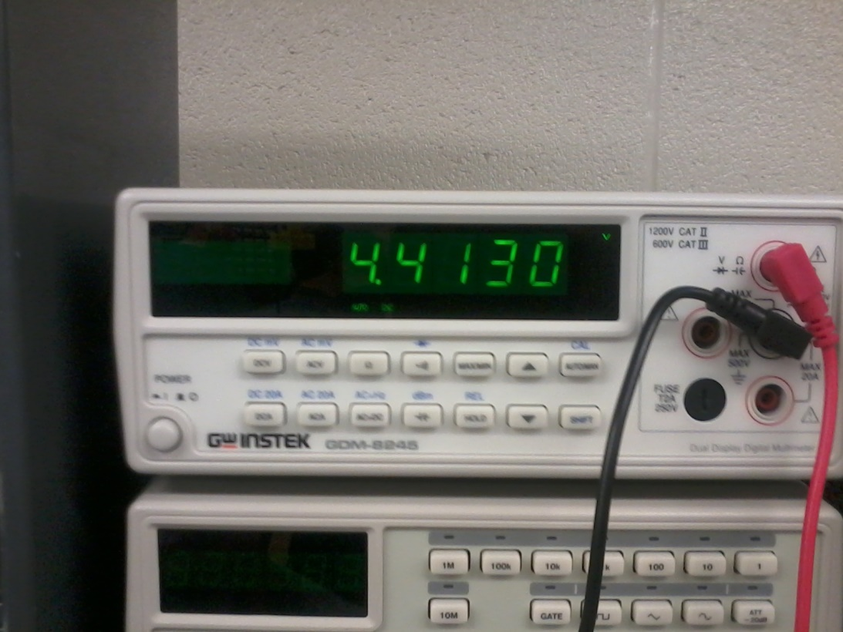
Lab 2 – AND, OR, INVERT

Slide 16
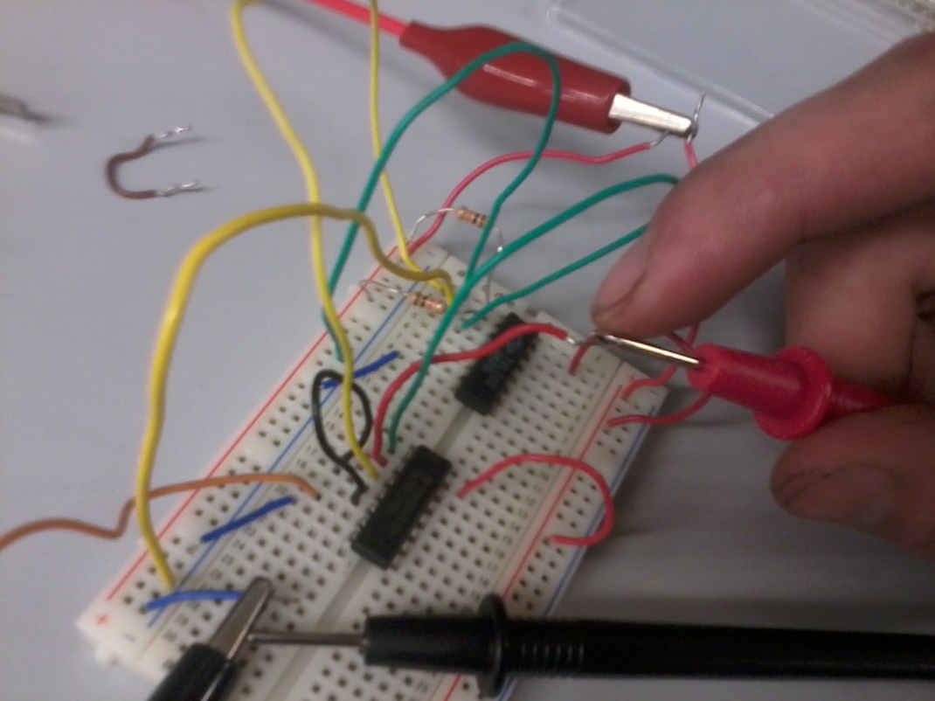
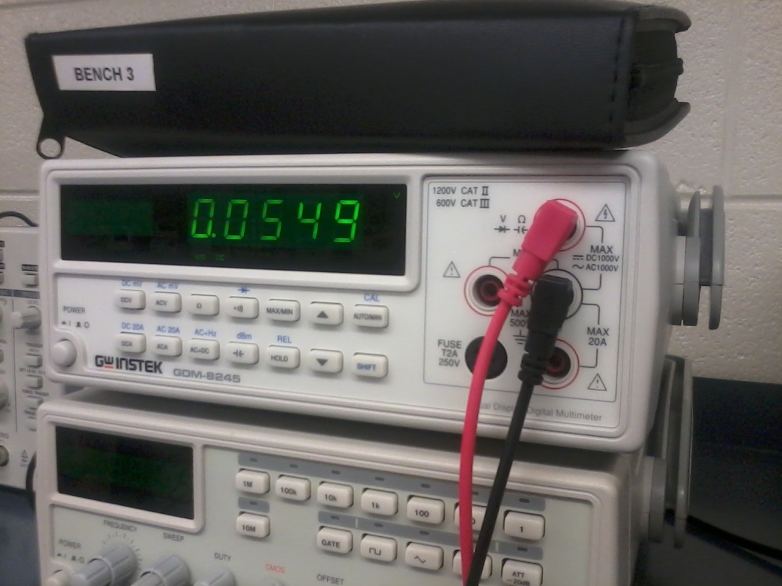
Lab 2 – AND, OR, INVERT

Slide 17
Lab 2 – AND, OR, INVERT
Conclusion
We ran into no problems this lab, though learning how the chips worked was very interesting. From just this lab alone I felt I could start to understand how we could start using TTL chips to make more advanced hardware, such as how sensors work and what we could do with them later on.

Slide 18
Lab 3 – NAND Alternative

Slide 19
Lab 3 – NAND Alternative
Objective of the Lab
To create a circuit that will give the same outputs as a 3 chip circuit only using 1 NAND chip
Equipment and Materials Used
Elvis breadboard
1x 4 gate DIP switch
4x 10k Resistors
1x 72LS00 NAND chip
1x 74LS08 AND chip
1x 74LS32 OR chip
1x 74LS04 INVERT chip
Research
In class lecture

Slide 20
Lab 3 – NAND Alternative
Lab Procedure
Beginning this lab we created a multisim using one INVERT chip, one AND, chip and one OR chip to make a circuit that produces a voltage based on four input signals. We recorded the results of what the four inputs gave us and then recreated the circuit using NAND gates. Recreating this circuit only took us one NAND chip, and only three of the gates on the chip. Recording the same results, we recreated the lab on the Elvis board and used the LED on the board to check the results.

Slide 21
Lab 3 – NAND Alternative
Multisim for lab 3. The bottom right simulation is a simplification for the other simulation on the page.

Slide 22
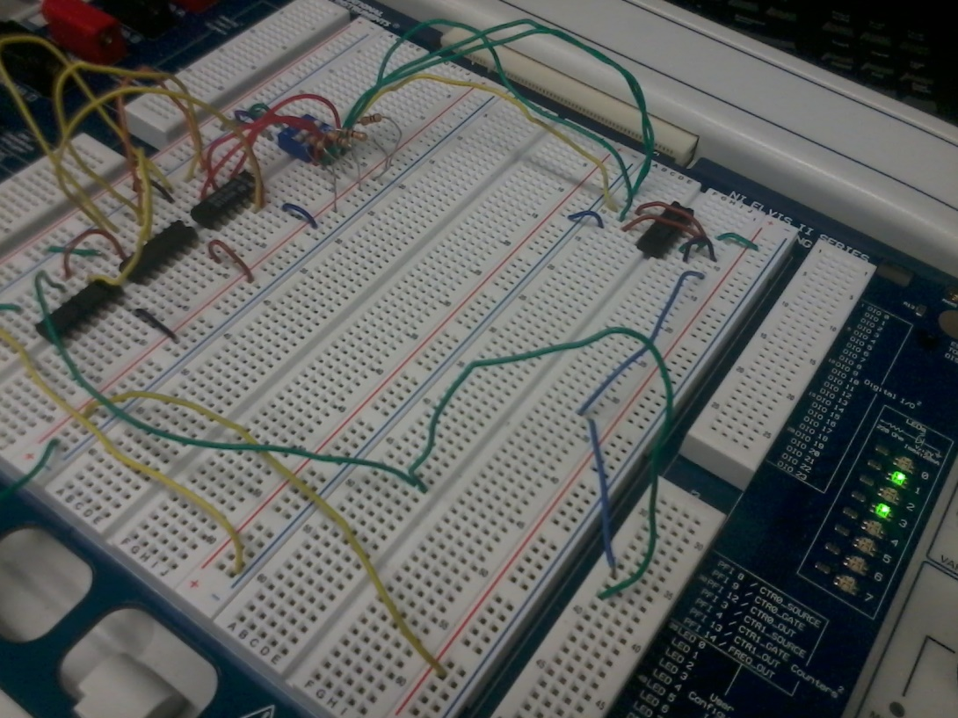
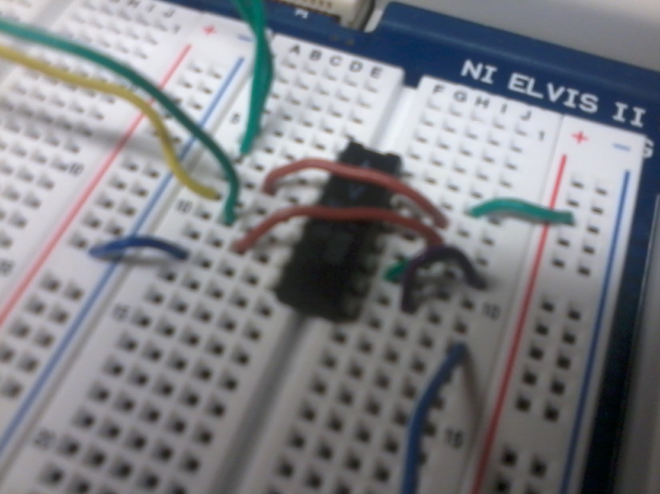
Lab 3 – NAND Alternative

Slide 23
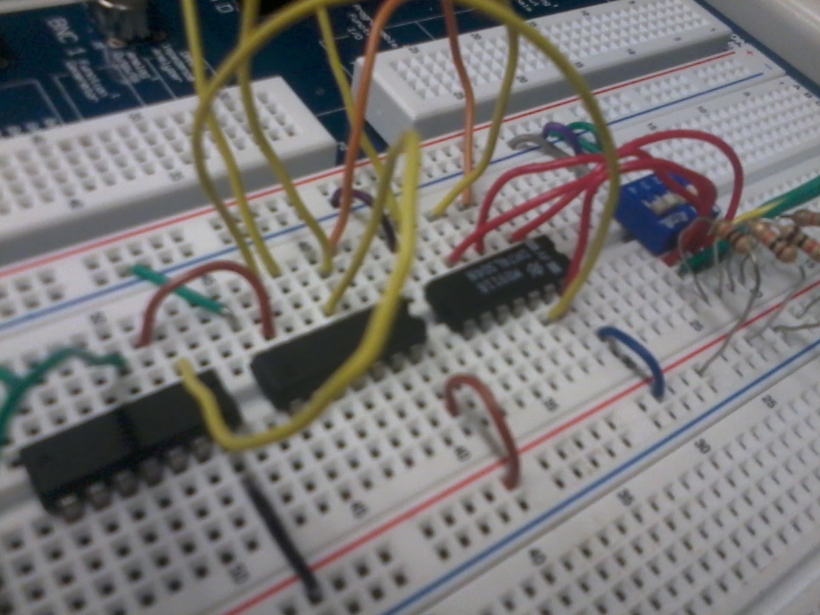
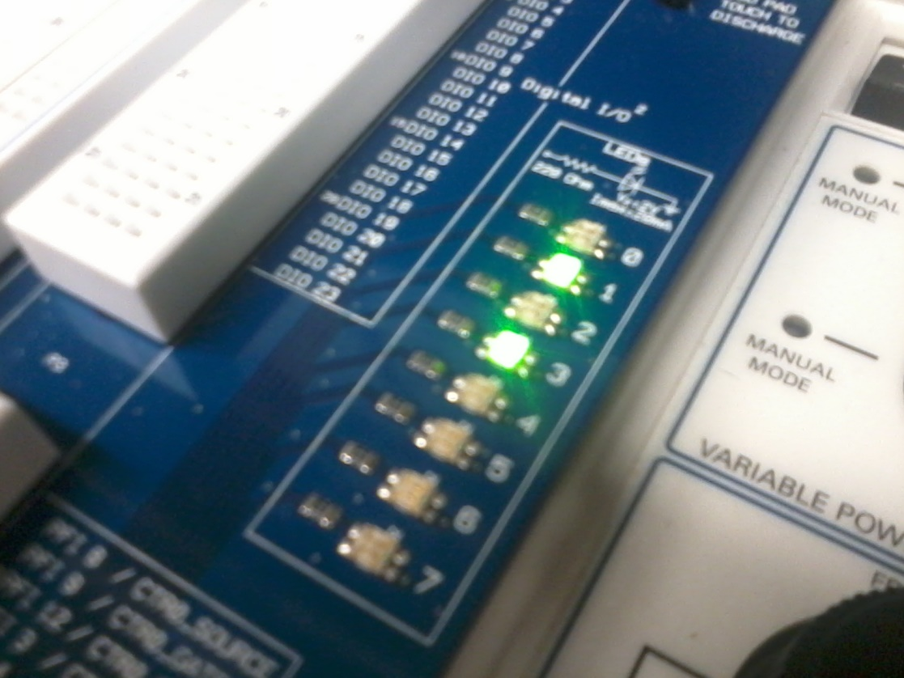
Lab 3 – NAND Alternative

Slide 24
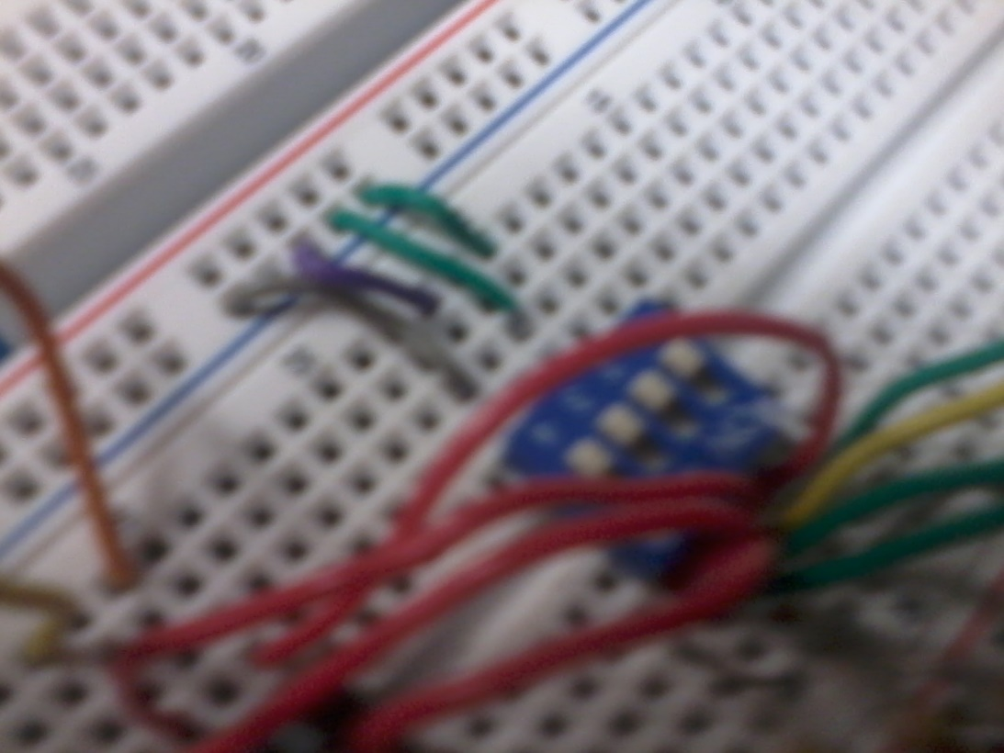
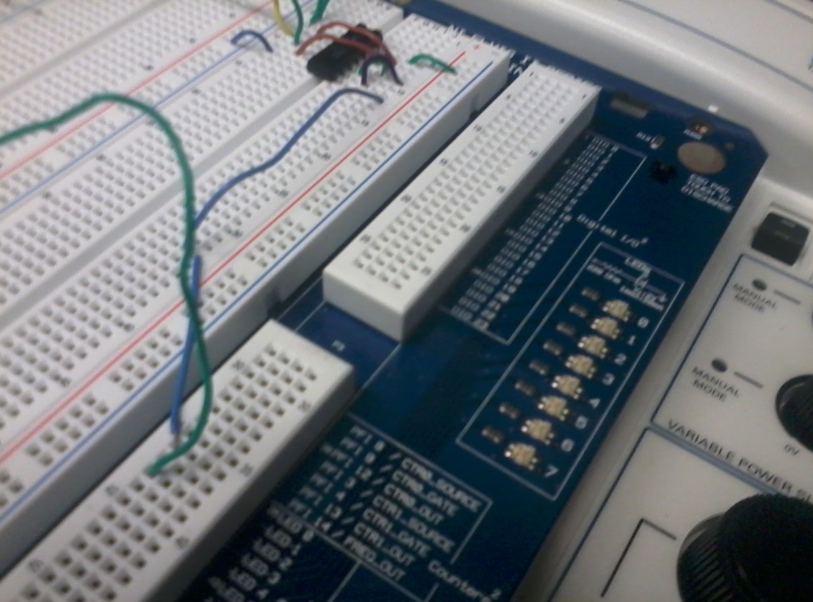
Lab 3 – NAND Alternative

Slide 25
Lab 3 – NAND Alternative
Conclusion
This lab also went smoothly and showed us a ton of interesting concepts. The best concept in my mind is how much more efficient one can make a circuit just using NAND chips as opposed to using many different chips. It seemed after this lab that an INVERT chip could be rendered useless a lot of the time in favor of either NAND or NOR chips, though I can still see some specific uses for them.

Slide 26
Lab 4 – Car Alarm

Slide 27
Lab 4 – Car Alarm
Objective of the Lab
To design a system that will give off a warning light when specific conditions are met.
Equipment and Materials Used
Elvis breadboard
1x 4 gate DIP switch
3x 10k Resistors
1x 74LS08 AND chip
1x 74LS32 OR chip
1x 74LS04 INVERT chip
Research
Entire class thus far

Slide 28
Lab 4 – Car Alarm
Lab Procedure
This lab was the hardest so far, rightfully so as the midterm. We had to make a circuit with no outline given to us on how to produce an alarm in a car when specific conditions were met. First we produced a truth table of what needs to happen for the conditions to be met for the alarm to activate. From there, using AND, OR, and INVERT chips we produced the multisim and tested the results to our truth table. Afterward we created the simulation on an Elvis breadboard and recorded the results in the lab.

Slide 29
Lab 4 – Car Alarm
Multisim of our midterm, the car alarm. All switches are currently in the 1 position, indicating there should not be an alarm activating.

Slide 30
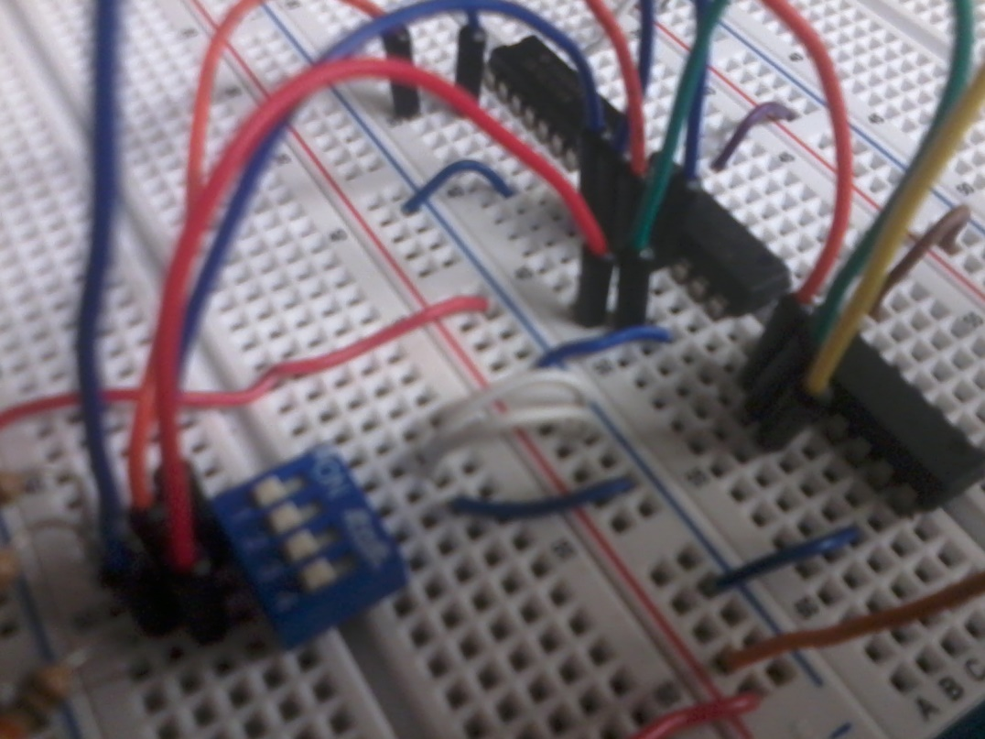
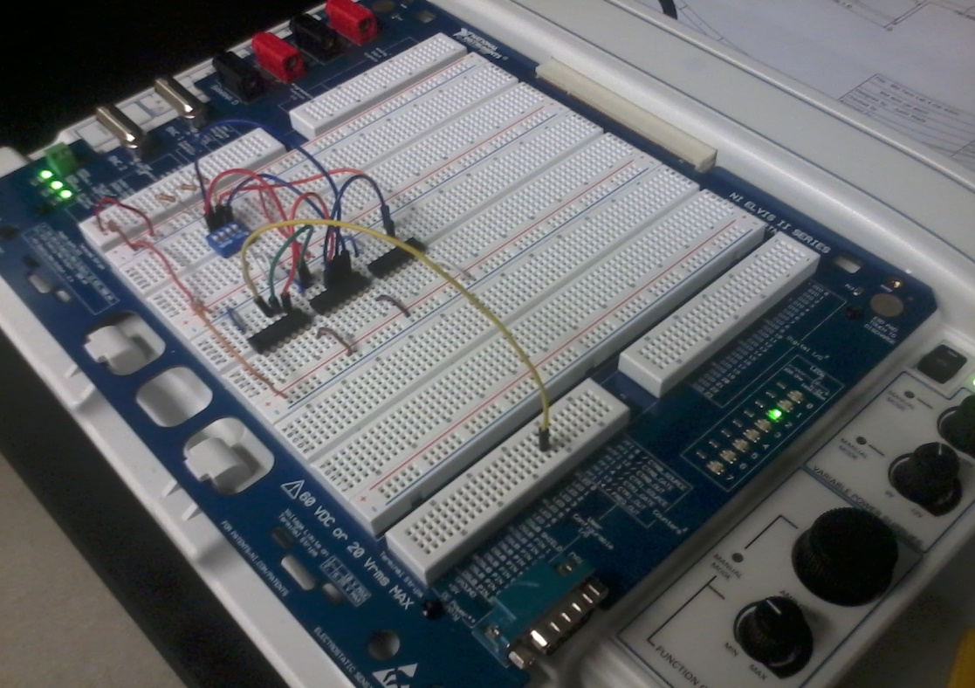
Lab 4 – Car Alarm

Slide 31
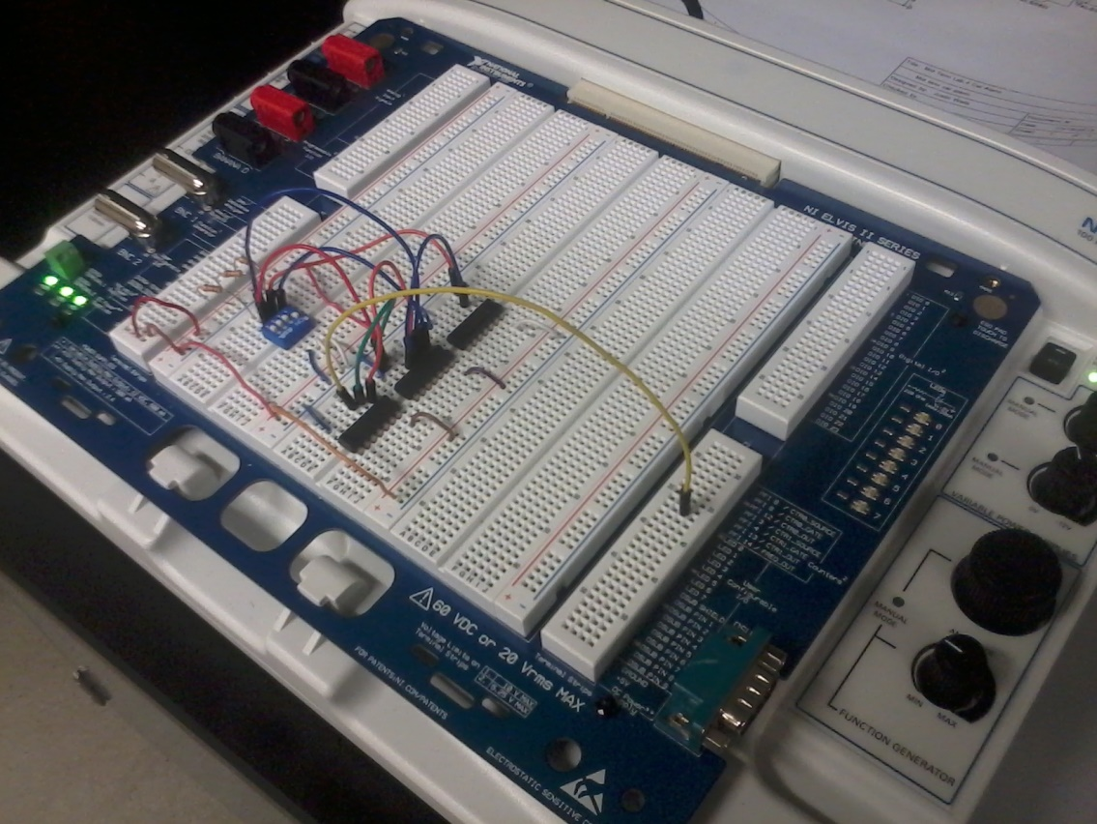
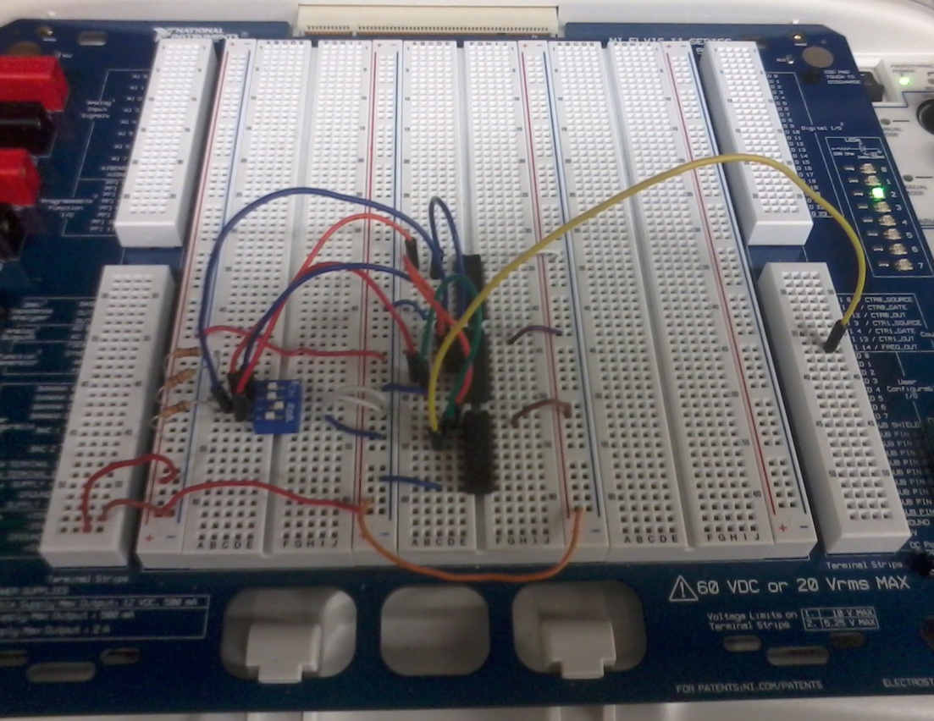
Lab 4 – Car Alarm

Slide 32
Lab 4 – Car Alarm
Conclusion
This was a challenging lab as right from the beginning as I mixed up one of the symbols of the truth table. This took about ten minutes to diagnose what was wrong and recreate the table. After that mistake was found the lab was fairly simple. The chips produced the expected results with no problems. The only real problem after I diagnosed what was wrong in the truth table was trying to complete the extra credit. Recreating the circuit with only NAND gates seemed impossible, added to that only with one chip. I came very close but had to conclude my work before I could finish it. I had the simulation working, but would use two NAND chips instead of one.

Slide 33
Lab 5 – NAND SR Latch

Slide 34
Lab 5 – NAND SR Latch
Objective of the Lab
To understand how an SR latch works to create memory.
Equipment and Materials Used
Elvis breadboard
1x 4 gate DIP switch
2x 10k Resistors
1x 74LS08 NAND chip
Research
In class lecture

Slide 35
Lab 5 – NAND SR Latch
Lab Procedure
This lab itself was not very challenging. We wired the multisim to create a NAND SR Latch. This is where two NAND gates are hooked up and their outputs run to one of each other’s inputs. From there we wired an oscilloscope to the circuit to test the output voltages as each switch is turned either to a 1 or 0. After the multisim we moved to the lab and recreated the circuit on an Elvis board, using an LED on the board to act as the oscilloscope. We switched the circuit around ten different times and recorded their results.

Slide 36
Lab 5 – NAND SR Latch
Trial | Q | QB
1 | 0 | 1
2 | 1 | 0
3 | 0 | 1
4 | 1 | 1
5 | 1 | 0
6 | 0 | 1
7 | 0 | 1
8 | 1 | 1
9 | 1 | 0
10 | 0 | 1

Slide 37
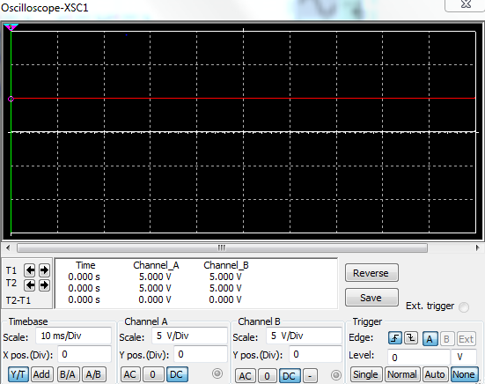
Lab 5 – NAND SR Latch
Multisim of lab 5. Both switches are in the 0 position, producing a 1 on the oscilloscope.

Slide 38
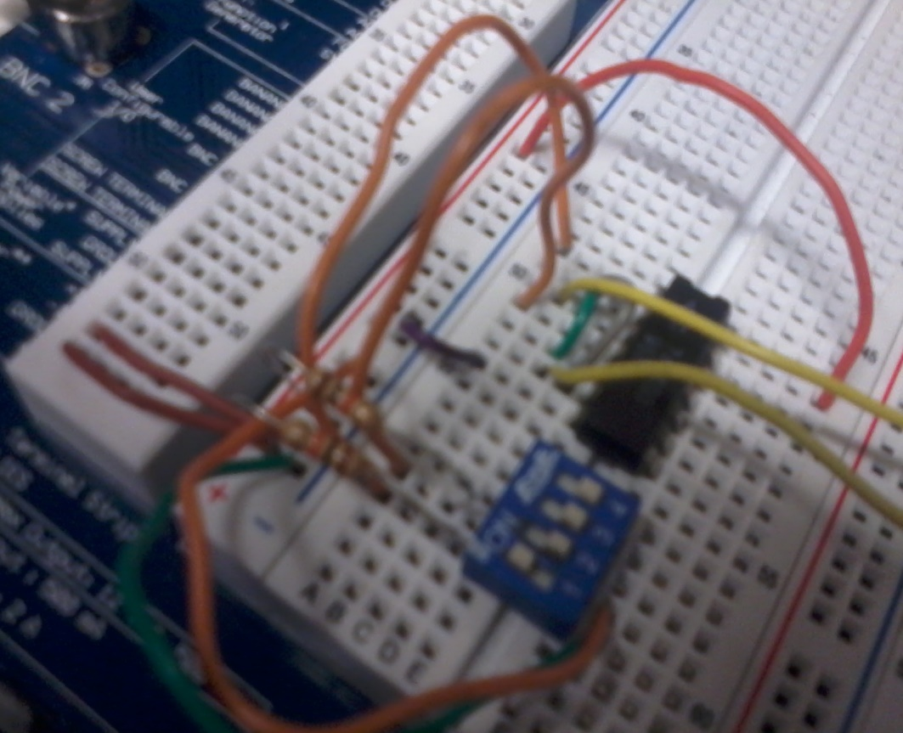
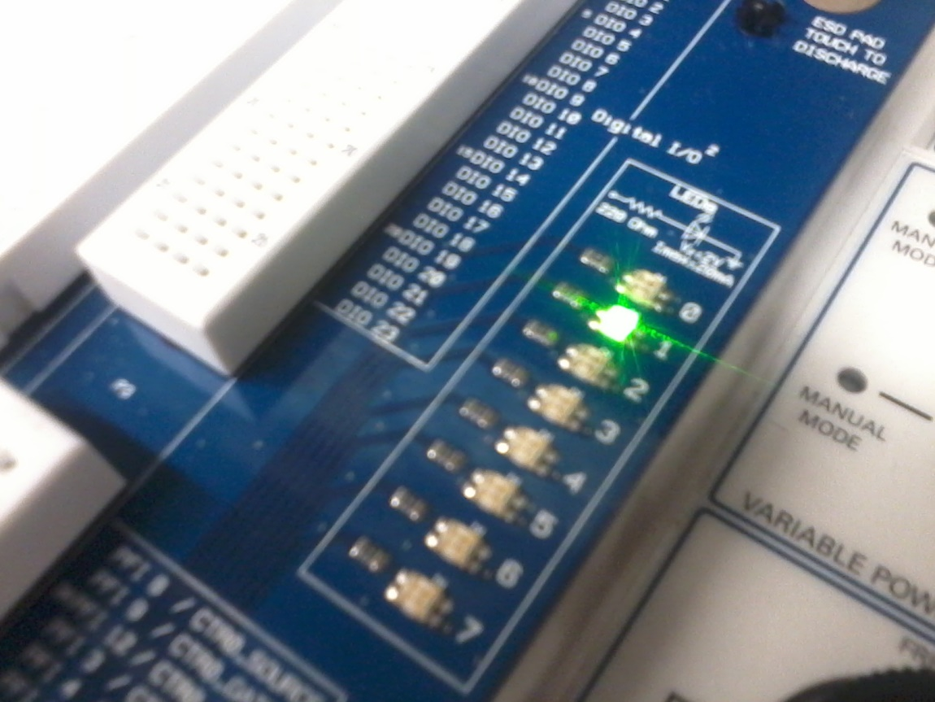
Lab 5 – NAND SR Latch

Slide 39
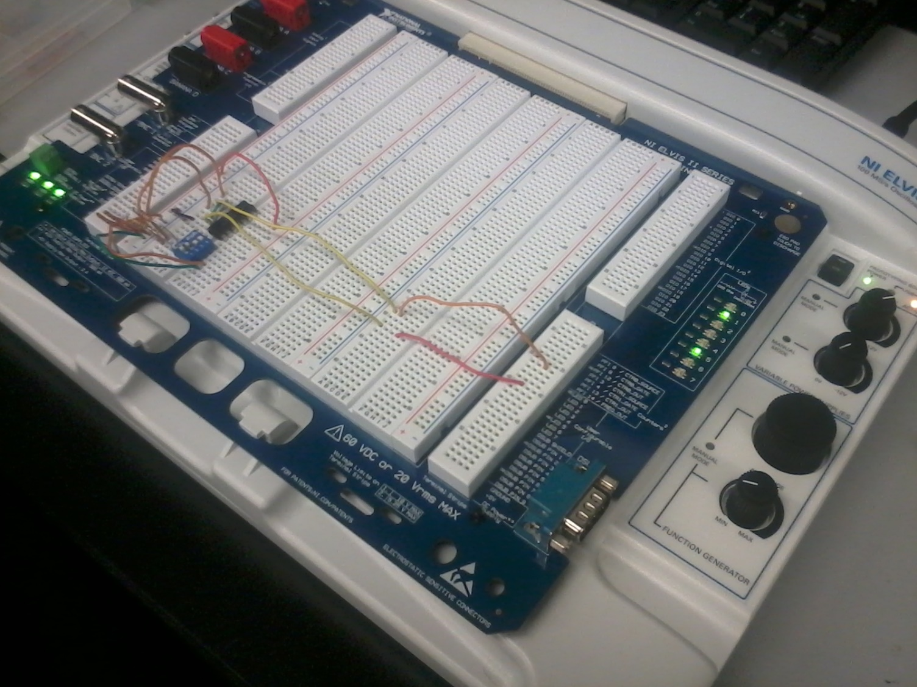
Lab 5 – NAND SR Latch

Slide 40
Lab 5 – NAND SR Latch
Conclusion
This lab was quick and simple to make but showed us how memory works. I learned that essentially how memory works is it uses an SR latch that switches into a position and stays that way based on what the input is. If the input changes a certain way it will not change the output and will save the previous input.

Slide 41
Lab 6 – Binary to 7-Segment Counter with 555 Timer

Slide 42
Lab 6 – Binary to 7-Segment Counter with 555 Timer
Objective of the Lab
To build and understand how to light a seven segment display using a 555 timer to create BCD results.
Equipment and Materials Used
Elvis breadboard
1x 4 gate DIP switch
2x 10k Resistors
Research
In class lecture

Slide 43
Lab 6 – Binary to 7-Segment Counter with 555 Timer
Lab Procedure
This lab took quite a bit of work. We had to learn how to hook up all the chips and the display before starting this lab. Once we learned how to hook up the chips and display we created our multisim and messed with the capacitor on the 555 timer to give a faster countdown, so we didn’t have to wait as long to check when it worked. After we checked how everything worked we moved into the lab and recreated the circuit on the Elvis board.

Slide 44
Lab 6 – Binary to 7-Segment Counter with 555 Timer
Multisim for lab 6, showing an input powering a 555 timer, which clocks a BCD counter, which sends the code to a BCD to seven segment display converter, which finally powers up the seven segment display.

Slide 45
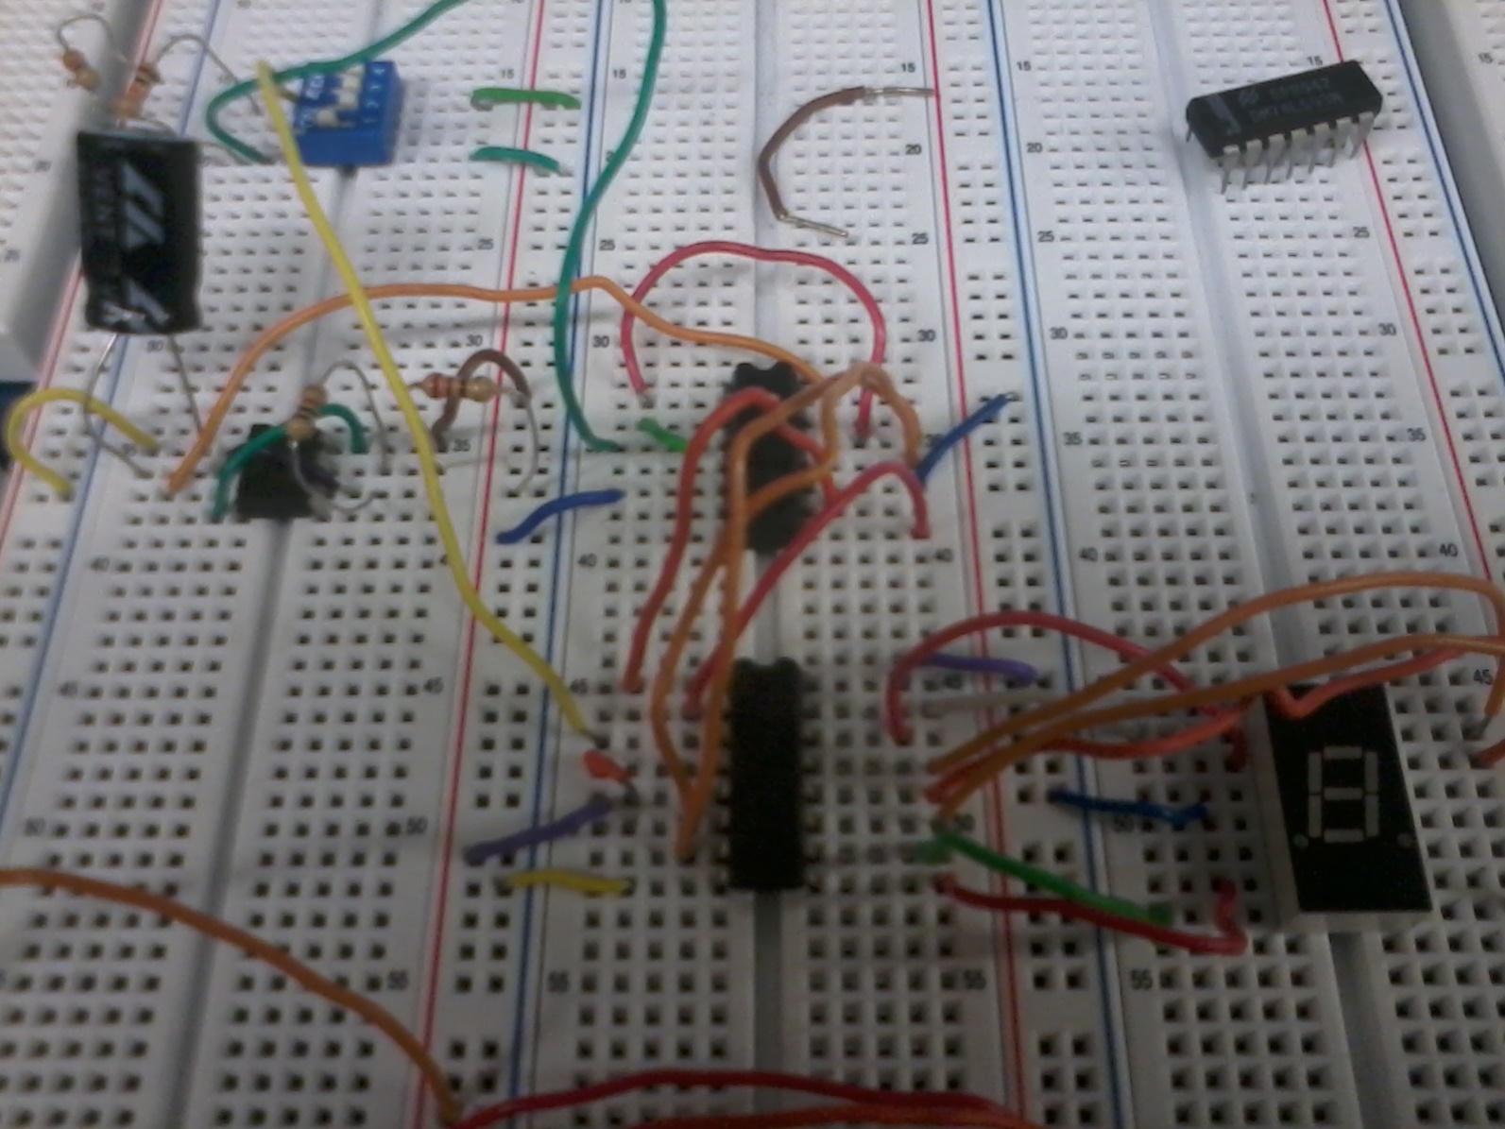
Lab 6 – Binary to 7-Segment Counter with 555 Timer

Slide 46
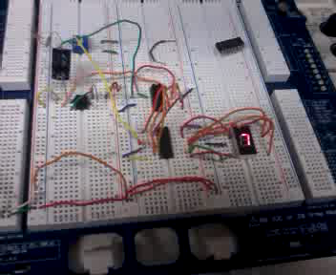
Lab 6 – Binary to 7-Segment Counter with 555 Timer

Slide 47
Lab 6 – Binary to 7-Segment Counter with 555 Timer
Conclusion
This lab was extremely annoying because we started with a bad chip. Our 74LS93 chip turned out to be bad and was sending incorrect signals to the BCD to Seven segment display counter. This took us about an hour to diagnose before we switched out the chip and everything worked perfectly afterward.

Slide 48
Lab 7a – Blinking LED

Slide 49
Lab 7a – Blinking LED
Objective of the Lab
Using the BASIC STAMP board we had to make an LED blink 5 times when a button is pressed.
Equipment and Materials Used
BASIC STAMP board
1x Push button
LED
10k Resistor
Research
BASIC STAMP manual
Industrial Control Student Workbook

Slide 50
Lab 7a – Blinking LED
Lab Procedure
This lab started out with us in the lab as opposed to using multisim. For this lab we had to build a simple circuit consisting of a push button leading into an input on the BASIC STAMP and an output on another connector of the stamp leading to an LED. From the book we wrote the given code and uploaded it into the BASIC STAMP.

Slide 51
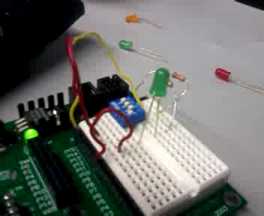
Lab 7a – Blinking LED

Slide 52
Lab 7a – Blinking LED
Conclusion
This lab easily prepared us for the BASIC STAMP final project and acutally aided us later in fixing our project when we could not get it working. It introduced coding to us as well as Programmable Logic Devices, which I had only heard of before in the form of an Arduino. I learned a ton from this lab even if it was just BASIC programming.

Slide 53
Lab 7b – Process Control

Slide 54
Lab 7b – Process Control
Objective of the Lab
To build, on the BASIC STAMP board a circuit that would monitor a variable resistor and light an LED when the “temperature” of the circuit reached below 100 degrees and above 120 degrees.
Equipment and Materials Used
BASIC STAMP breadboard
1x 10k Ohm Resistor
1x Capacitor
1x 4 input DIP switch
1x Green LED
1x 1k Ohm Potentiometer
Research
Industrial Control Student Workbook

Slide 55
Lab 7b – Process Control
Lab Procedure
This lab was very similar to the last lab in procedure, we copied the code from the Workbook and tried to decipher what it meant before actually testing it out on the board. Once copied down we uploaded the code to the board and started changing the resistance on the potentiometer to indicate the temperature changes for the LED to light up.

Slide 56
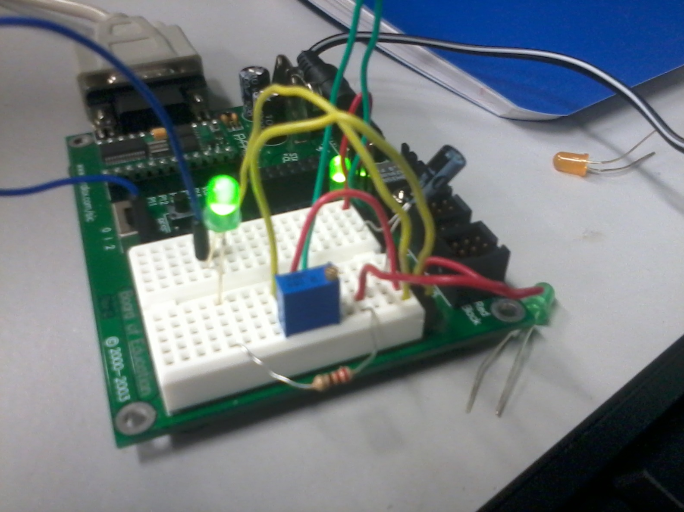
Lab 7b – Process Control

Slide 57
Lab 7b – Process Control
Conclusion
This lab only had one minor problem for us. Our potentiometer was set too high to begin with and that was setting our LED off at very different resistances than was set by the lab. This we fixed by just guessing and setting the potentiometer as low as it would go and raising it from there until it worked correctly.

Slide 58
Lab 8 – Software Counter

Slide 59
Lab 8 – Software Counter
Objective of the Lab
From scratch, code four LEDs to light up in binary sequence from one to 15.
Equipment and Materials Used
BASIC STAMP breadboard
4x LED
10k Ohm resistor
Research
Industrial Control Student Workbook

Slide 60
Lab 8 – Software Counter
Lab Procedure
We began this lab by observing and trying to diagnose how to write the code for the LEDs using the previous two labs. We wrote the code for the lab using a more brute force method, telling the LEDs specifically when to light up. This took us about an hour or so to figure it out and wire the whole thing up.

Slide 61
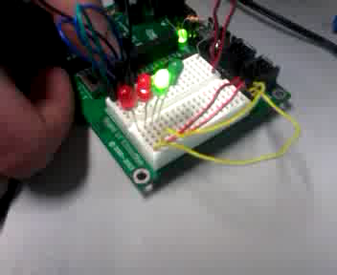
Lab 8 – Software Counter

Slide 62
Lab 8 – Software Counter
Conclusion
This lab proved a major challenge because we had to figure out the code ourselves with only very minor previous exposure to coding. Once we figured out the more brute force method of coding the lights, which was writing exactly how each light would act in it’s specific time, the lab proved to be easy. I knew there had to be an easier method to code this, which was confirmed after further research.

