Slide 1
EECT 101-50C Lab Notebook
Introduction to Electronics and Projects
Spring 2015
Justin Wells
05/06/2015

Slide 2
Table of Contents
Lab 1 –Measuring Resistors
Lab 2 – Measuring Resistors in Series and Parallel
Lab 3 – Simulating Resistors in Multisim
Lab 4 – Using the Oscilloscope and Function Generator
Lab 5 – Inductors and Capacitors
Lab 6 – First Soldering Experience
Lab 7 – Identifying Parts and Soldering Kit
Lab 8 – 555 Timer Chip
Lab 9 – Filters
Lab 10 – Converting a Square Wave to a Sine Wave
Lab 11 – Testing 74xx Series Chips
Lab 12 – Lissajous Pattern and Sega Genesis Repair
Lab 13 – AC to DC Power Supply
Lab 14 – Electrostatic Discharge
Lab 15 – Testing Soldering Kit
Lab 16 – Soldering

Slide 3
Lab 1- Measuring Resistors

Slide 4
Lab 1 – Resistors
Objective
  To learn how to use the color bands and a multimeter to gauge the resistance of resistors
Equipment and Material
Multimeter(GwINSTEK GDM-8245 CL860333)
Three resistors(330 Ohm, 3.9k Ohm, 1k Ohm)
Research and Information
    Lab equipment and resistor tutorials at www.ivytechengineering.com and Youtube.
    Ohm’s Law

Slide 5
Lab 1 – Resistors
Details, Procedures, etc.
Watch tutorial videos on lab equipment, Ohm’s law, and resistors.
Measure the resistance of resistors using the color bands on the resistors.
Turn on and use a multimeter to measure the actual resistance of the resistors.
Determined whether the resistors were within tolerance given by the resistor bands.

Slide 6
Lab 1 – Resistors
Summary and Conclusions
Two of the three resistors measured in class were in tolerance of what was given by the bands on the resistor itself. The one that was not in tolerance was off by just over 100 Ohms.

Slide 7
Lab 2 – Measuring Resistors in Series and Parallel

Slide 8
Lab 2 – Measuring Resistors in Series and Parallel
Objective
    To understand how resistors work in Series and Parallel
Equipment and Materials
  Multimeter(GwINSTEK GDM-8245 CL860333)
  five resistors(2.2k Ohm, 330 Ohm, 4.7k Ohm, 820 Ohm, 1k Ohm)
  Solderless Breadboard(166911A)
Research and Information
  Tutorials at www.ivytechengineering.com and YouTube
  First, learn the resistor color code: http://www.youtube.com/watch?v=kvQBhXo_tF0
  Tutorials at http://www.ivytechengineering.com/ee_stuff/ee101_vids_resistors.html
  Ohm’s Law: https://www.youtube.com/watch?v=d34-VKc2cyY

Slide 9
Lab 2 – Measuring Resistors in Series and Parallel
Details, Procedures, etc.
Watched tutorials on how to measure the resistance of resistors in series and parallel, and how to use a breadboard.
Gathered a set of resistors and calculated their resistance, then measured.
Calculated the resistance of the resistors in series and parallel.
Hooked resistors up to a breadboard in four different configurations.
Measured the actual resistance of the resistors in above mentioned configurations.

Slide 10
Lab 2 – Measuring Resistors in Series and Parallel
Summary and Conclusions
The resistors were within tolerance of what was indicated on the bands. Originally we messed up the calculations for the resistors in parallel and the answers came out wrong. Later concluded we forgot to take the reciprocal of the answer we came up with. Once that was figured out our answers were much closer to the actual measured results.

Slide 11
Lab 3 – Simulating Resistors in Series and Parallel in Multisim

Slide 12
Lab 3 – Simulating Resistors in Series and Parallel in Multisim
Objective
  To understand how to use Multisim to simulate a circuit
Equipment and Materials
  Computer
Research and Information
  Tutorials at www.ivytechengineering.com and YouTube

Slide 13
Lab 3 – Simulating Resistors in Series and Parallel in Multisim
Watched tutorials on how to use Multisim.
Using the measurements and configurations from lab 2, recreated the configurations of the resistors in series and parallel.
Measured the resistors in and ideal, simulated environment and compared the resistances to the measurements from lab 2.

Slide 14
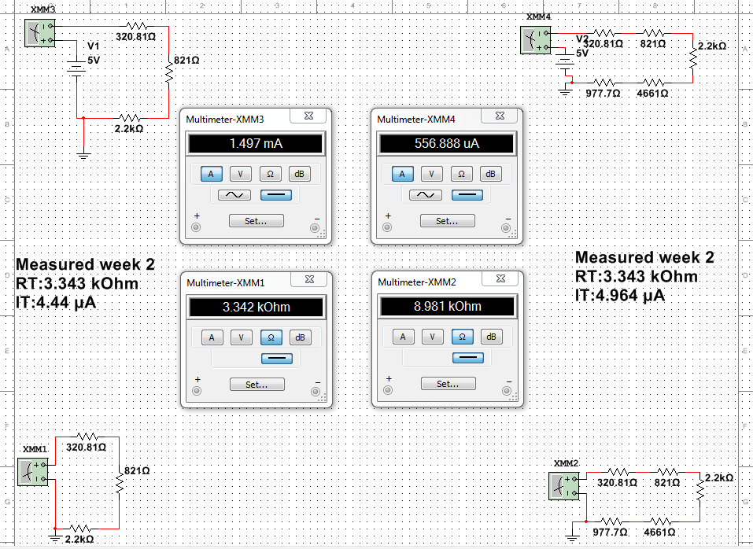
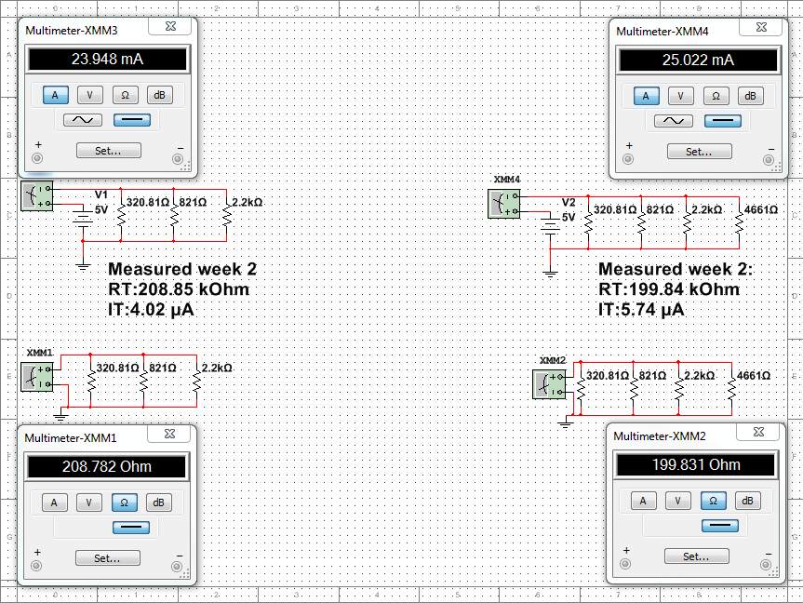
Lab 3 – Simulating Resistors in Series and Parallel in Multisim

Slide 15
Lab 3 – Simulating Resistors in Series and Parallel in Multisim
Summaries, Conclusions, etc.
All measurements in the simulator were very close to what was measured during the lab week two. Every answer was close, however none of the calculated or measured answers matched what actually was measured during week two.

Slide 16
Lab 4 – Using the Oscilloscope and Function Generator

Slide 17
Lab 4 – Using the Oscilloscope and Function Generator
Objective
  To understand how to use an Oscilloscope and Function Generator
Equipment and Materials
  Oscilloscope(Tektronix A-149372)
  Function generator(Gw INSTEK C706266)
  Multimeter(Gw INSTEK CL860260)
Research and Information
  Tutorials at www.ivytechengineering.com and YouTube

Slide 18
Lab 4 – Using the Oscilloscope and Function Generator
Details, Procedures, etc.
Watched tutorials on how to use an Oscilloscope and reviewed the Function Generator
Hooked up the Function Generator to the Oscilloscope.
Powered up both machines and configured the Function Generator to produce a 100 Hz sine wave t 1V.
Use the Oscilloscope to verify what is produced by the Function Generator.
Record the pulse width, amplitude, and period shown on the Oscilloscope.

Slide 19
Lab 4 – Using the Oscilloscope and Function Generator
Details, Procedures, etc. (contd.)
Repeat previous steps, changing the Function Generator to put out a 1KHz square wave at 5V with a 50% duty cycle.
Oscilloscope displayed an angled wave. Discovered we were measuring the wave in AC, not DC.
Repeat recording of the new wave.
Change the square wave to produce an 80/20 duty cycle
Record the changes in the wave from the duty cycle change.

Slide 20
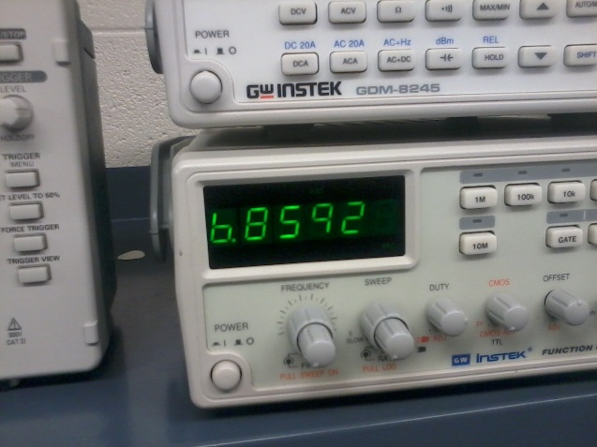
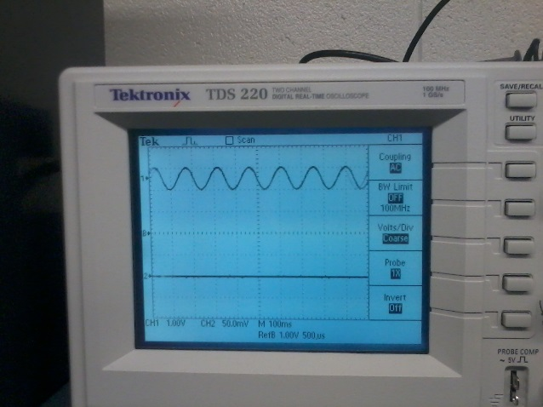
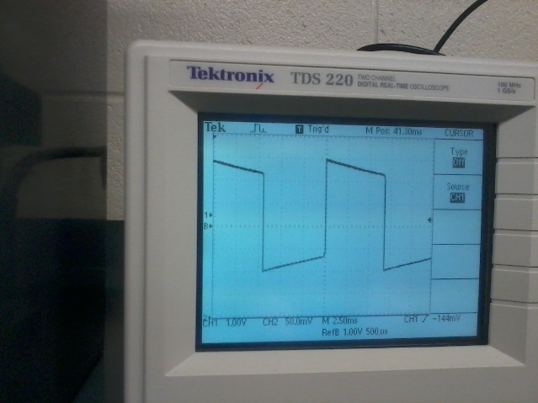
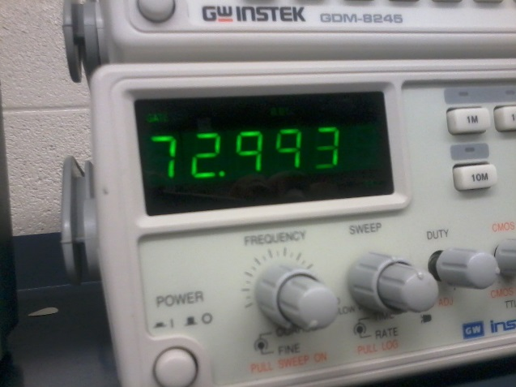
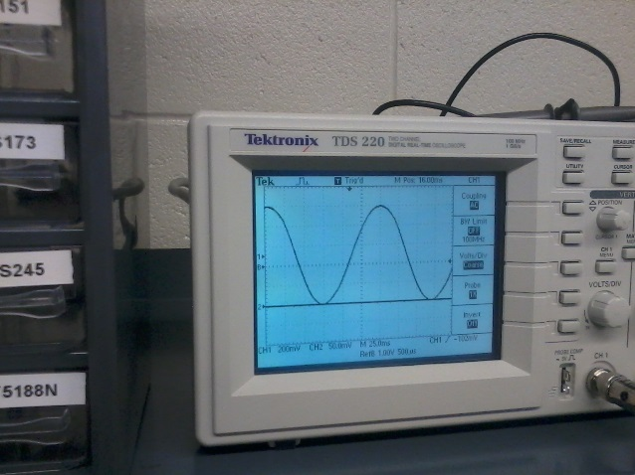
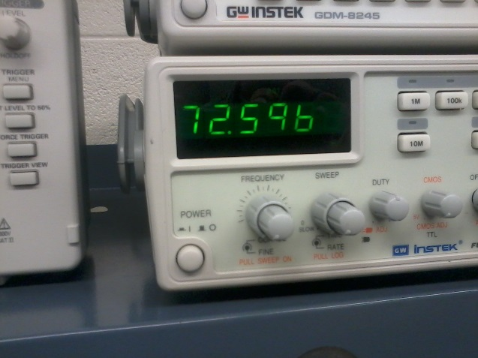
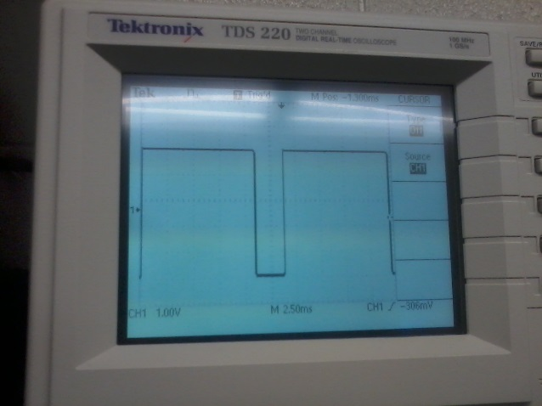
Lab 4 – Using the Oscilloscope and Function Generator

Slide 21
Lab 4 – Using the Oscilloscope and Function Generator
Summary and Conclusions
This lab I learned a lot about these tools, especially the oscilloscope. As I have never heard of them before, I first learned what they are. I learned that the oscilloscope especially is an important tool. The oscilloscope takes the electrical readings from whatever is on the leads and gives a graph on the screen showing what the electricity is doing. The function generator on the other hand generates the waves that are shown on the function generator, giving a small electrical signal at different frequencies and in different waveforms. Before this lab I had never heard of either of these tools before or what they do.

Slide 22
Lab 5 – Inductors and Capacitors

Slide 23
Lab 5 – Inductors and Capacitors
Objective
  To learn what an inductor and a capacitor does when placed in a circuit.
Equipment and Materials
  Capacitors(4.7 pF, .0033 microF, .01 microF, 4.7 microF)
  Inductors(100 microH, 22 mH, 100 mH)
  152 T68 inductor core
  152 T80 inductor core
Research and Information
Tutorials on Youtube

Slide 24
Lab 5 – Inductors and Capacitors
Details, Procedures, etc.
Watch tutorials on Youtube about what inductors and capacitors do in a circuit.
Grabbed three pieces of wire and both types of inductor cores
Wrapped the wires around the cores 10/15/20 times while keeping the wire as tightly coiled and closely packed as possible.
Measured how thick the core is and how thick the coil itself is after winding.
Measured the inductivity of the wire from each end using the LCR meter.

Slide 25
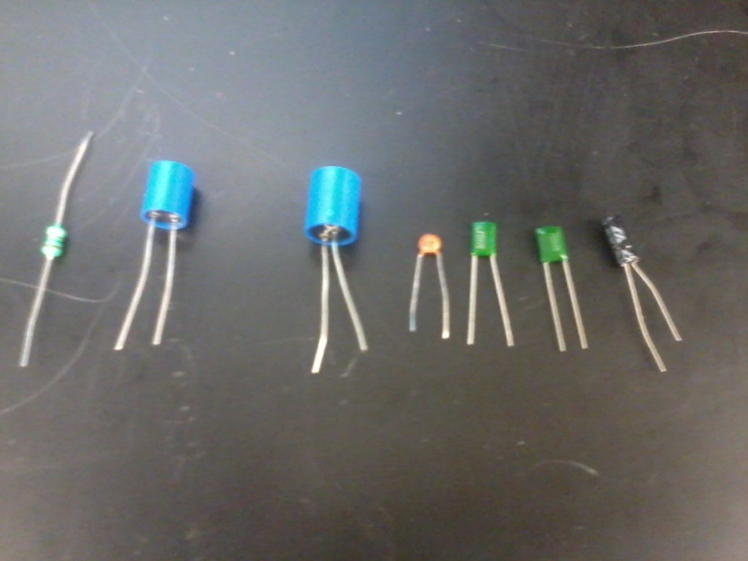
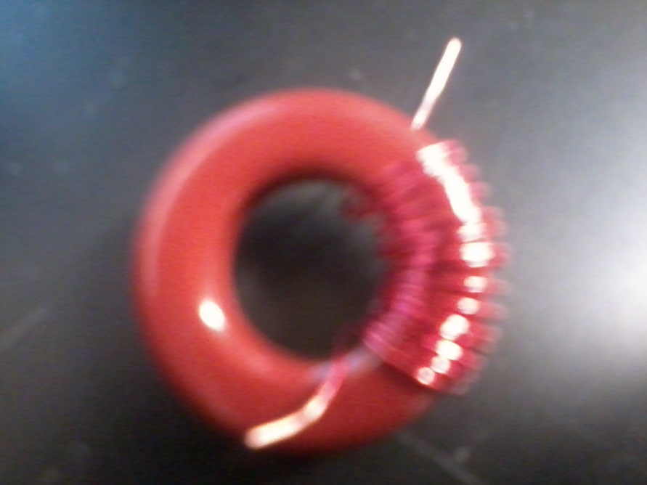
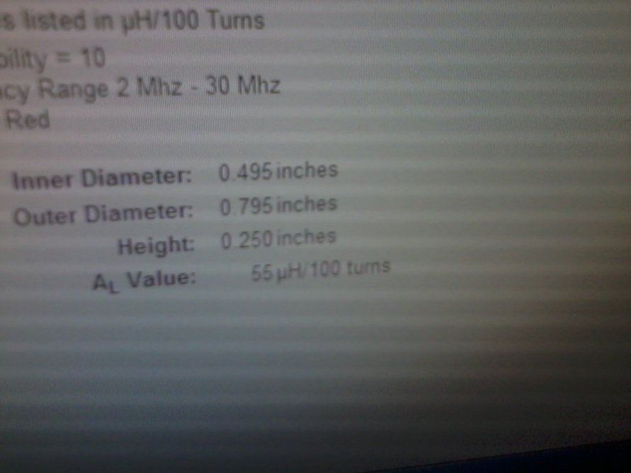
Lab 5 – Inductors and Capacitors
Capacitors Measured
Inductor made in class
Dimensions and Henrys of Inductor core

Slide 26
Lab 5 – Inductors and Capacitors
Summary and Conclusions
Everything watched and done this day was a new experience for me. I learned that an inductor charges the current going through it and a capacitor stores a charge for a very limited time. Before ever handling a capacitor one must discharge the stored electricity by attaching a resistor or touching the capacitor to a ground point for a second. All capacitors have a polarity, which is marked on the capacitor itself and must be soldered onto the board following the polarity or one risks a potential explosion.

Slide 27
Lab 6 – First Soldering Experience

Slide 28
Lab 6 – First Soldering Experience
Objective
  To solder the parts on the practice solder board.
Equipment and Materials
  Practice solder board
  3x resistors
  1x diode
  2x transistors
  3x capacitors
  1x inductor
Research and Information
Tutorials on Youtube and ivytechengineering.com

Slide 29
Lab 6 – First Soldering Experience
Details, Procedures, etc.
First gather all the materials and place the components into the board
Bend all the leads on the components so that they stay in the board for soldering
Start the soldering iron at a temperature of 750
Tin the iron with the solder
Place the soldering iron on the joint where the component meets the board, still on the pad
After a couple seconds place the solder on the other side of the lead and push it into the pad/lead as the solder melts onto the board

Slide 30
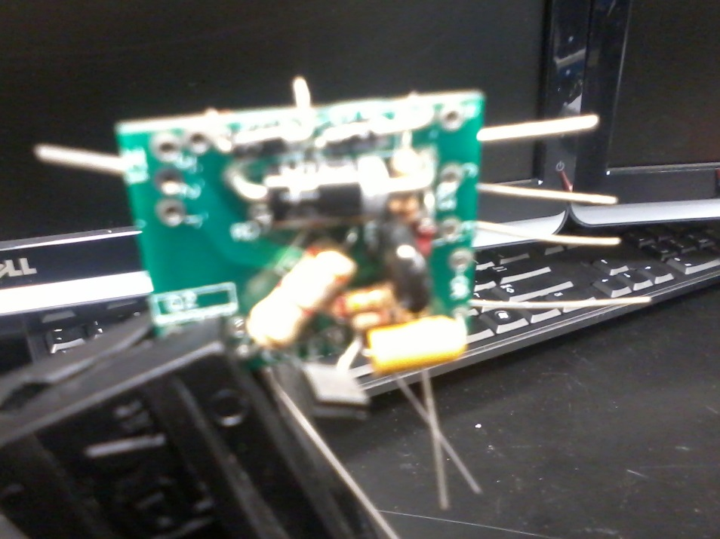
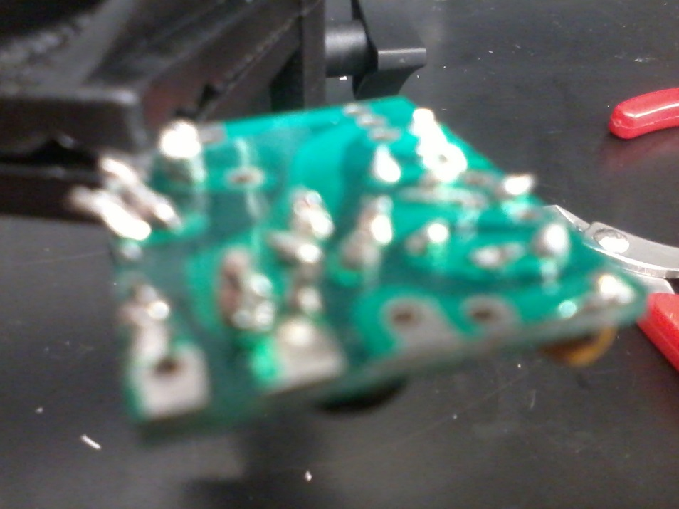
Lab 6 – First Soldering Experience

Slide 31
Lab 6 – First Soldering Experience
Summary and Conclusions
This lab was my first experience using a soldering iron, and thus I learned a lot. Before this lab I knew not what any of the technical terms for soldering meant(such as tinning an iron) or even how to use a soldering iron in general. I learned how to use an iron, what parts are more heat sensitive, how to attach parts to a board so that they do not fall off during the soldering process, and how to apply solder to the components so that they stay attached to the board. During the process I reached too far forward with my hand a couple times with the iron and had slight burns on my fingers. I also applied too much solder on some of the joints, making them a bit too spherical and not conical, as they should be. I attempted to remedy this on some of the joints using the desolderer, but due to inexperience just redid the process again. Some of the parts were also easy to identify as cold joints due to them being more grey and not a shiny silver. On the other end I did a good job of making sure all of the pads were fully covered with solder on the completed project. Overall I believe I had room for improvement, but did a good job for a first time solderer.

Slide 32
Lab 7 – Identifying Parts and Soldering Kit

Slide 33
Lab 7 – Identifying Parts and Soldering Kit
Objective
  To identify all parts inside a 1980 breadboard
  To solder the kit together and light the LEDs with a 9v battery
Equipment and Materials
  1980s soldering board
  Practice soldering kit
  Soldering iron
Research and Information
N/A

Slide 34
Lab 7 – Identifying Parts and Soldering Kit
Details, Procedures, etc.(Part identification)
First we unscrewed the faceplate from the breadboard and took the circuit board from the breadboard.
After removing the circuit board we looked at the board and all other attached mechanical parts and identified all of them.
After identifying the parts we reassembled the breadboard and moved on to the soldering kit.

Slide 35
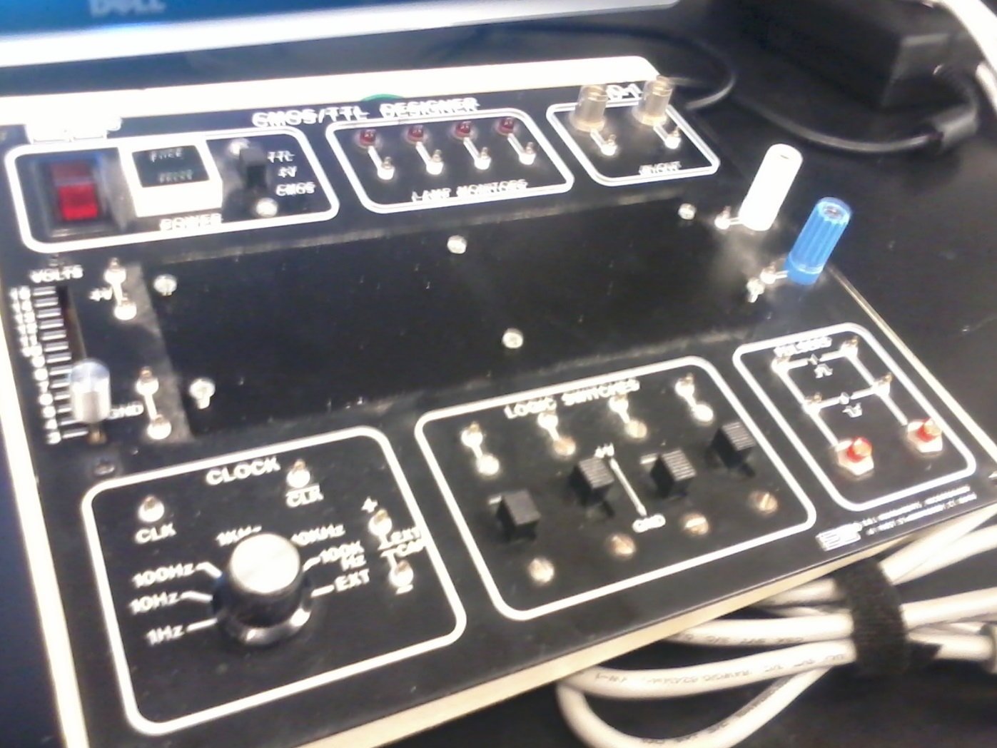
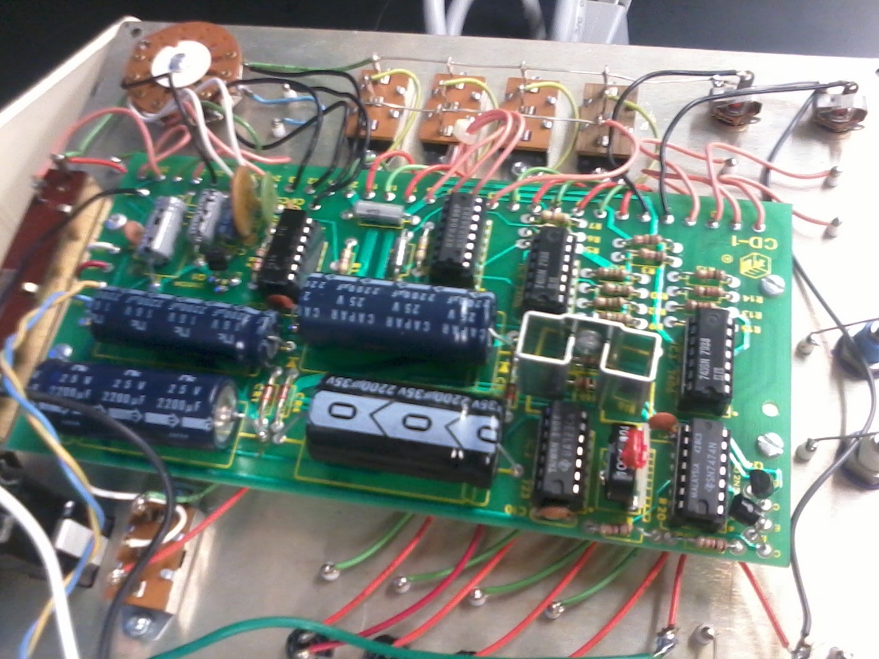
Lab 7 – Identifying Parts and Soldering Kit
Taking the breadboard apart

Slide 36
Lab 7 – Identifying Parts and Soldering kit
Details, Procedures, etc.(Soldering Kit)
First we removed the soldering kit from the package and laid the parts out.
Next, using the picture on the box and the design layout, we assembled the parts on the board, bending the leads as we learned in our first soldering experience.
Finally, using the soldering iron at a temperature of 750 degrees Fahrenheit we soldered all the parts onto the board, taking extra care with the LEDs to not burn them out.

Slide 37
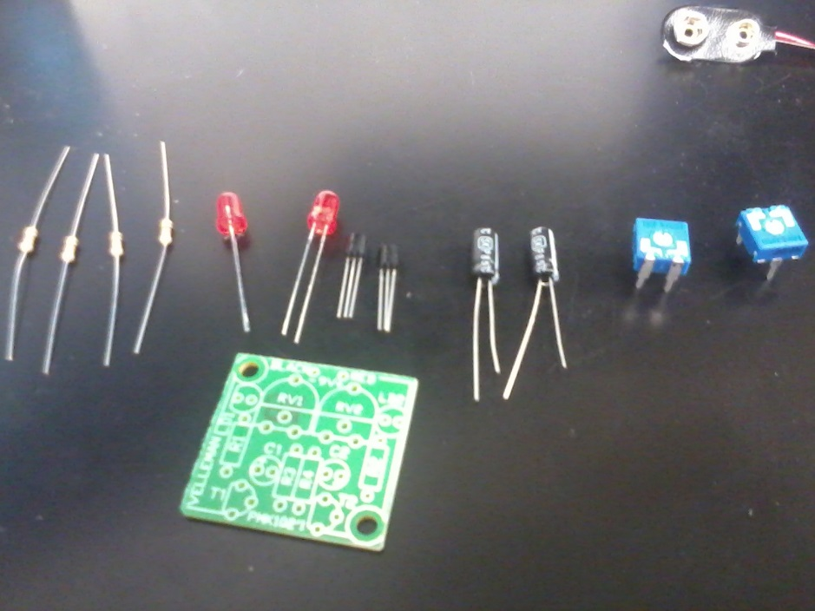
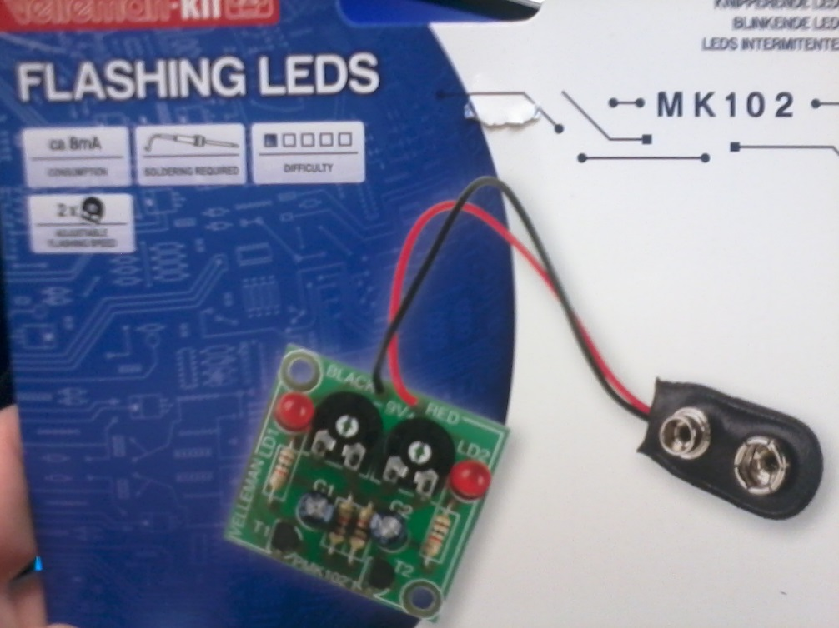
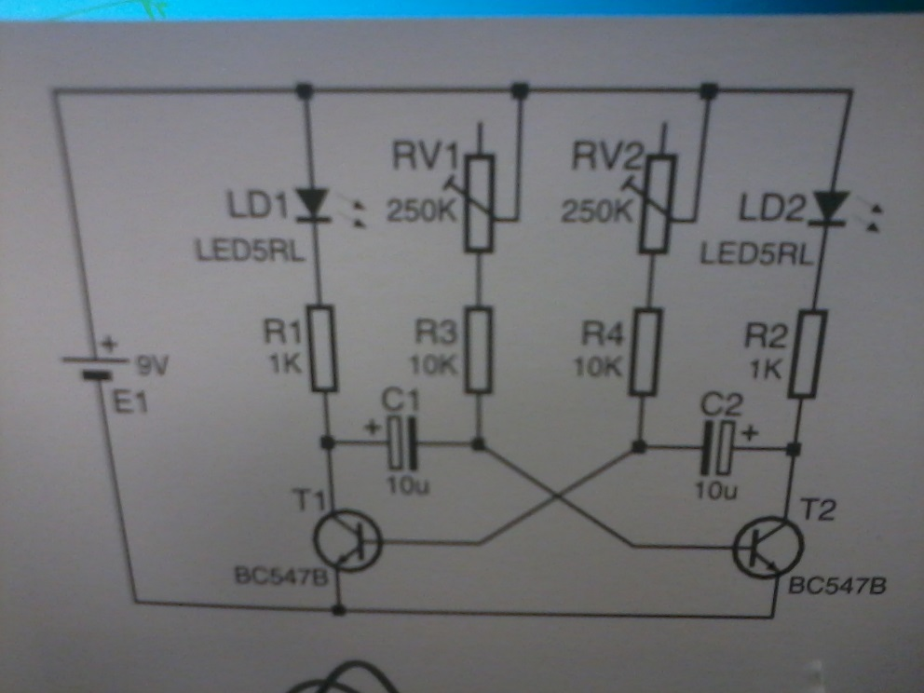
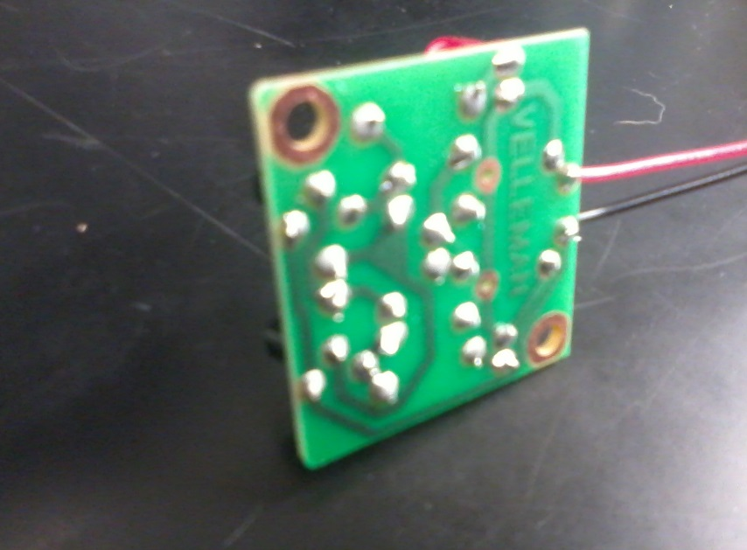
Lab 7 – Identifying Parts and Soldering Kit
Assembling the kit

Slide 38
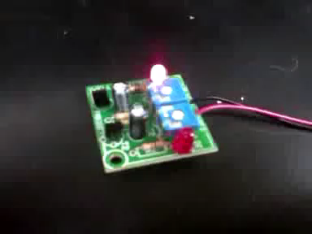
Lab 7 – Identifying Parts and Soldering Kit
Video of working solder kit

Slide 39
Lab 7 – Identifying Parts and Soldering Kit
Summary and Conclusions
For the part identification there wasn’t much to it. By this point we knew how to identify all the parts on the board and what they did. The only thing we did not do was trace the leads to see how the board itself works as you hit each switch or button. For the soldering kit this was a lot easier than the first soldering experience. The board itself had bigger pads on it, allowing the solder to more easily flow onto the board. Overall this soldering project was much easier and my soldering job was much better than last time due to practice.

Slide 40
Lab 8 – 555 Timer Chip

Slide 41
Lab 8 – 555 Timer Chip
Objective: To learn how to make an LED blink using a 555 timer chip
Equipment and Materials
1x 555 timer chip
1x LED
3x Resistors
1x capacitor
Research and Information
http://www.ti.com/lit/ds/symlink/ne555.pdf
http://www.bowdenshobbycircuits.info/555.htm
https://www.youtube.com/watch?v=Vbz_MKT7KnI
http://web.udl.es/usuaris/p7806757/555-calculadora/555%20Calculator.htm

Slide 42
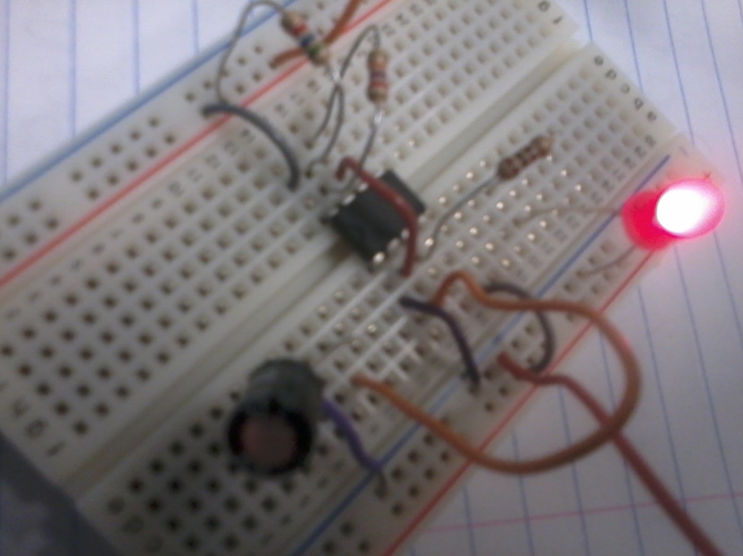
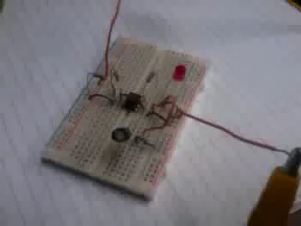
Lab 8 – 555 Timer Chip
555 Timer chip running an LED

Slide 43
Lab 8 – 555 Timer Chip
Details, Procedures, etc.
First we researched how to hook up the 555 timer chip, mostly using the youtube video.
Afterward we used the video to hook the 555 timer chip up as is shown in the picture in the previous slide.

Slide 44
Lab 8 – 555 Timer Chip
 | Breadboard a typical 555 Timer circuit to make an LED flash at different rates.
 | Calculate appropriate values of R and C for these rates:
 | 0.5 Hz | Ra = | 5.6 | Rb = | 27.98 | C = | 47 | T = _________2
 | 1 Hz | Ra = | 11.83 | Rb = | 14.96 | C = | 33 | T = ________.96
 | 2 Hz | Ra = | 2.16 | Rb = | 6.81 | C = | 47 | T = _______.51
 | Measure the output of the 555 Timer on an Oscilloscope to verify each of the frequencies.
 |  | Expected |  | Measured
 |  | 0.5 Hz |  | .51 Hz
 |  | 1 Hz |  | 1.04 Hz
 |  | 2 Hz |  | 1.94

Slide 45
Lab 8 – 555 Timer Chip
Summary and Conclusions
This lab I learned what a timer chip can do and a couple ways to hook one up. I believe I still have a lot to learn about timer chips though before I can think about hooking one up without a diagram.

Slide 46
Lab 9 – Filters

Slide 47
Lab 9 – Filters
Objective: To learn how to filter a sine wave
Equipment and Materials:
1x 1k ohm resistor
1x .47 microFahrad capacitor
Research and Information
Document in blackboard

Slide 48
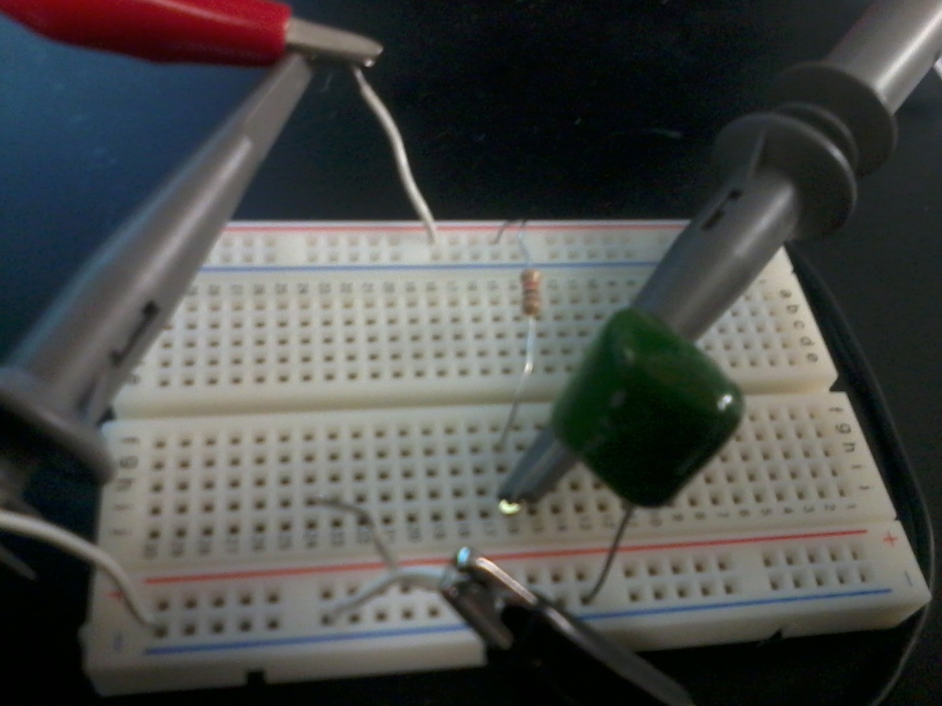
Lab 9 - Filters

Slide 49
Lab 9 – Filters
Details, Procedures, etc.
First we read the document on the blackboard page. Afterward there was a bit more research to do online.
Next we hooked up a capacitor and resistor in series to form a filter.
Using the function generator, we applied a sine wave through the filter and continued changing the frequency. We recorded what happened to the wave on the chart in the next slide.

Slide 50
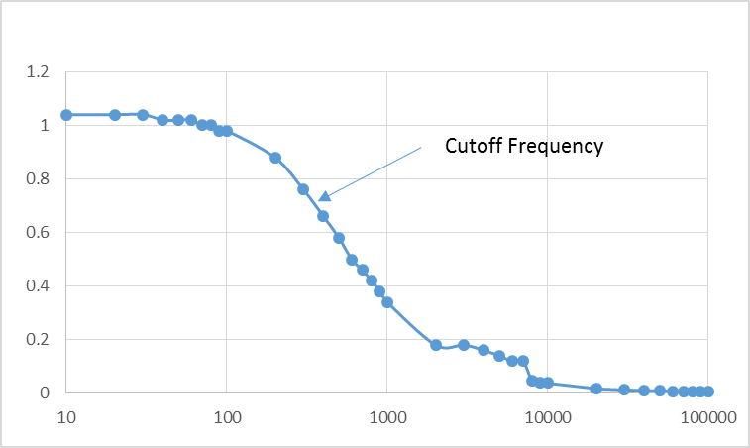
Lab 9 – Filters
Frequency | Vout
10 | 1.04 |  | R= | 983.6
20 | 1.04 |  | C= | 4.75E-07
30 | 1.04 |  | Fc= | 3.406E+02
40 | 1.02
50 | 1.02
60 | 1.02
70 | 1
80 | 1
90 | 0.98
100 | 0.98
200 | 0.88
300 | 0.76
400 | 0.66
500 | 0.58
600 | 0.5
700 | 0.46
800 | 0.42
900 | 0.38
1000 | 0.34
2000 | 0.18
3000 | 0.18
4000 | 0.16
5000 | 0.14
6000 | 0.12
7000 | 0.12
8000 | 0.046
9000 | 0.04
10000 | 0.038
20000 | 0.018
30000 | 0.0128
40000 | 0.0104
50000 | 0.0092
60000 | 0.008
70000 | 0.0072
80000 | 0.0068
90000 | 0.0064
100000 | 0.0064

Slide 51
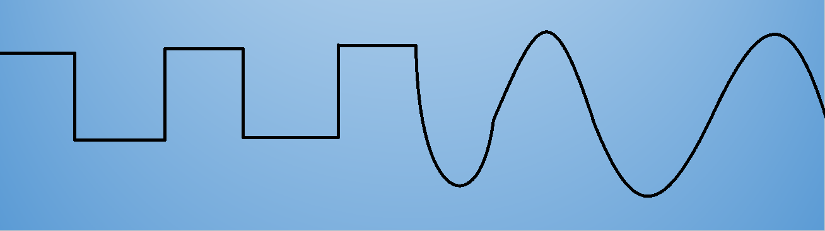
Week 10 – Converting a Square Wave to a Sine Wave

Slide 52
Week 10 – Converting a Square Wave to a Sine Wave
Objective
To research and learn how to convert a square wave to a sine wave, then do the conversion on a breadboard
Equipment and Materials
Function Generator: GwINSTEK, GFG-8210, S/N: C705254
Oscilloscope: Tektronix, TDS 220, S/N: B083259
Solderless Breadboard
3x 100 ohm resistors, 3x 4.7 microFahrad capacitors
Multisim
Research and Information
http://www.learnabout-electronics.org/Downloads/ac_theory_module08.pdf
change a square wave into a sine wave (3 pole R-C filter)
https://www.youtube.com/watch?v=IIDp0nfPrts
change a square wave into a sine wave, part 2 (low frequencies)
https://www.youtube.com/watch?v=Ly6X1ttNbdU

Slide 53
Week 10 – Converting a Square Wave to a Sine Wave
Details, Procedures, etc.
Begin by looking up tutorials on youtube
Loaded up multisim and tested a series of resistors and capacitors of varying resistances and fahrads to give a sine wave as close to a round, even sine wave as possible.
After much testing I found that using 100 ohm resistors and 4.7 microFahrad capacitors gave a wave very close to a sine wave.
Proceeded to hook up the circuit from multisim on a solderless breadboard to test the application in action.

Slide 54
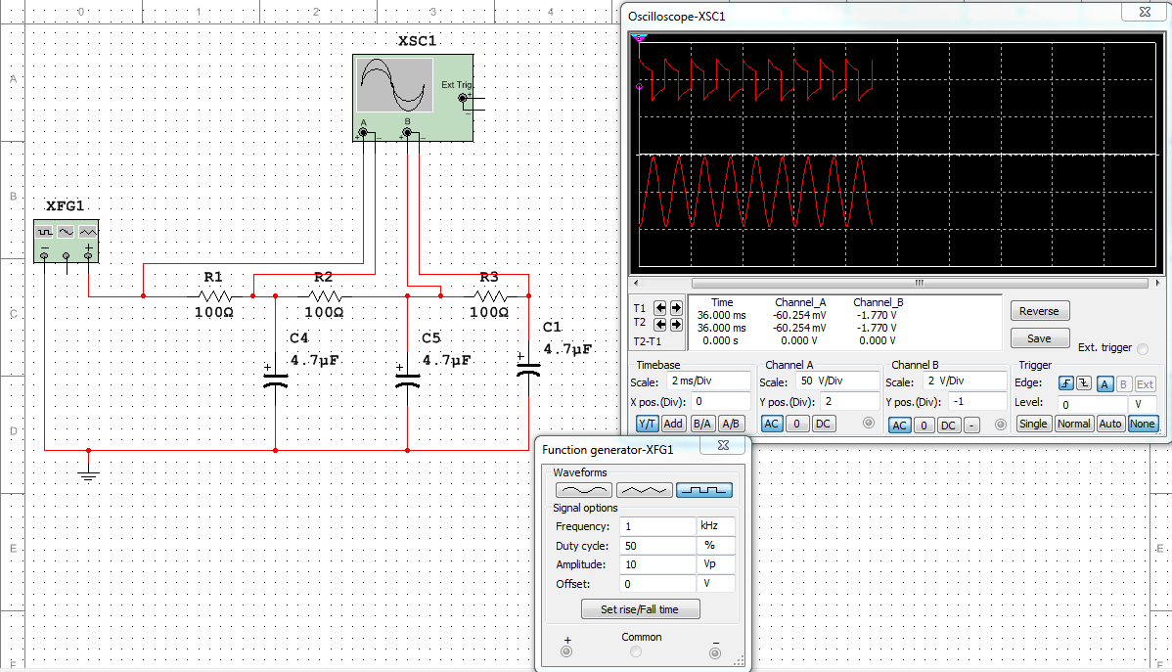
Week 10 – Converting a Square Wave to a Sine Wave
Multisim Graphic

Slide 55
Week 10 – Converting a Square Wave to a Sine Wave
Summary and Conclusions
This lab I learned that it is possible to turn one waveform into another with very little effort. It took quite a while, but I figured out this lab was just a continuation of the lab from the week before where we made a filter for certain frequencies. Using multiple filters in a series will give you a new waveform altogether. While using the simulator the peak-to-peak voltage of the sine wave at the end was 2 volts. During the actual testing it came out to be only 200 millivolts. I believe this discrepancy is due to not having the same voltage output on the simulator as the function generator actually has in the lab.

Slide 56
Week 11 – Testing 74xx series chips

Slide 57
Week 11 – Testing 74xx series chips
Objective
To test a series of 74xx series chips after they have set for many years
Equipment and Materials
1x drawer 7432 series chips
1x drawer 7402 series chips
1x breadboard
5x 08L32 LED
1x 08L56BID LED
RSR HY1802D S/N: 022510028 Power Supply
Research and Information
http://ivytechengineering.com/stores/74ls/files/74ls02.pdf
http://ivytechengineering.com/stores/74ls/files/74ls32.pdf

Slide 58
Week 11 – Testing 74xx series chips
Details, Procedures, etc.
Retrieve the breadboard, LEDs and chips that were to be tested
Looked up the schematics for each chip on ivytechengineering.com to confirm how each chip was to be hooked up to the breadboard.
Proceed to hook up the chips on the breadboard, switching out which input has a 0 and 1
Discard faulty chips and an LED

Slide 59
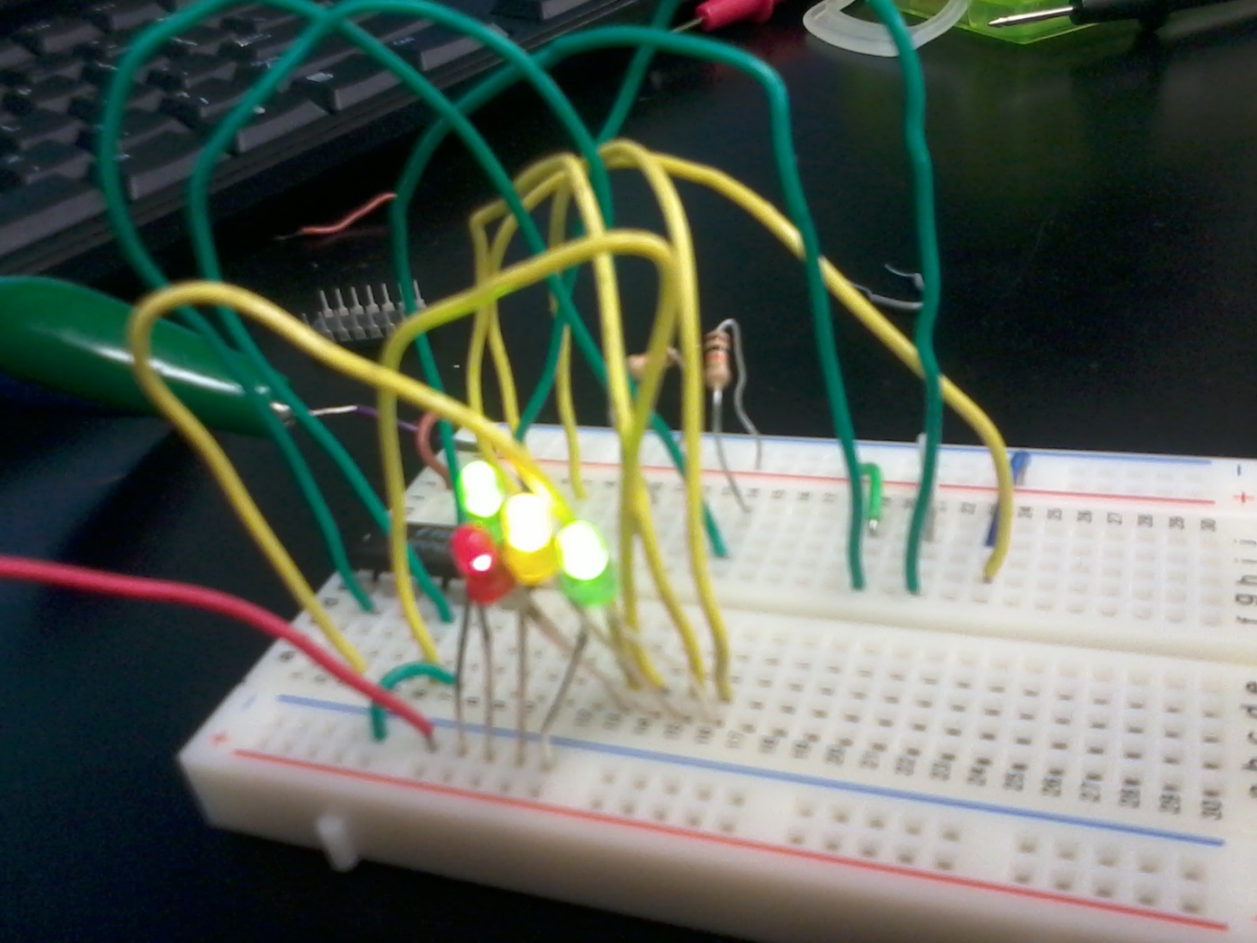
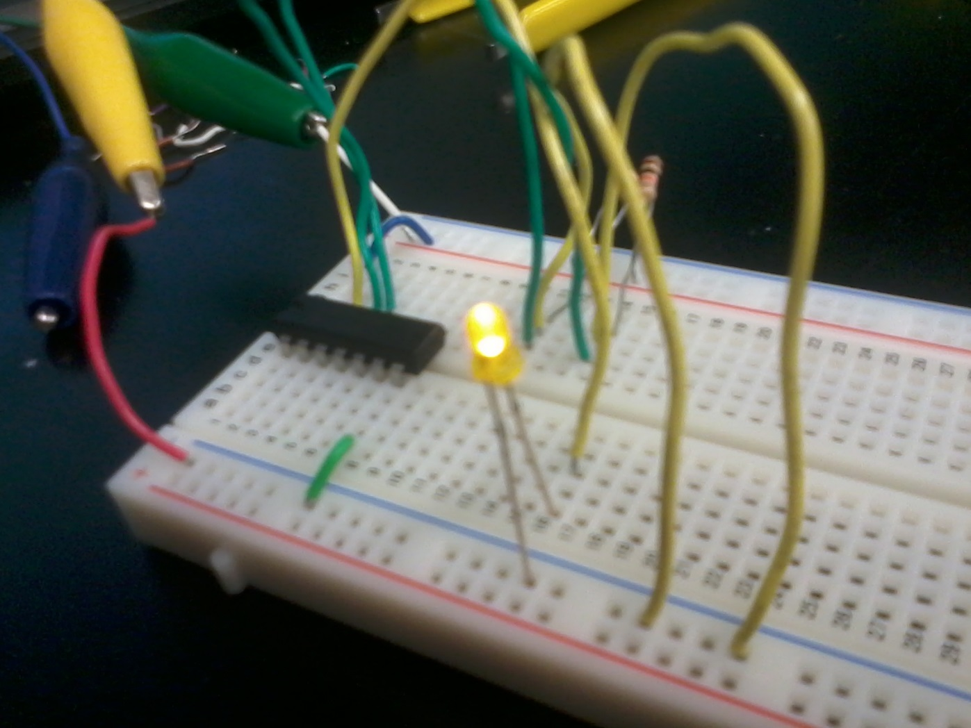
Week 11 – Testing 74xx series chips

Slide 60
Week 11 – Testing 74xx series chips
Summary and Conclusions
This lab I learned how to test the inputs of chips, and learned a few ways to do it more efficiently than going from a single output at a time. During the course of the testing I found one 7432 series chip that was faulty and would not produce a high output. Also during the testing I burned out one LED and had to discard that. Two chips I accidentally put on the board upside-down, but got them off before any severe damage was caused. After letting those cool down I proceeded to test them; both worked fine.

Slide 61
Week 12 – Lissajous Pattern and Sega Genesis repair

Slide 62
Week 12 – Lissajous Pattern and Sega Genesis repair
Objective
1) To make a circle or ellipsis on an oscilloscope.
2) To repair the power input on the Sega Genesis
Equipment and Materials
Tektronix TDS 220 Oscilloscope S/N: B083259
GwInstek GFG-8210 Function Generator S/N: C705254
GwInstek GFG-8210 Function Generator S/N: C705255
Sega Genesis MK-1631 S/N: B30574711
Research and Information
how to make lissajous figures on oscilloscope - philips PM3256 - brainz90
https://www.youtube.com/watch?v=pSyitNgy8hE
#48: Basics of Lissajous Patterns on an Oscilloscope - w2aew
https://www.youtube.com/watch?v=t6nGiBzGLD8
How to Make Phase Shift Measurements Using X-Y Mode on a Oscilloscope - B&K Precision Corporation
https://www.youtube.com/watch?v=NURCFN0N-KE

Slide 63
Week 12 – Lissajous Pattern and Sega Genesis repair
Details, Procedures, etc.
Lissajous Pattern:
Research on youtube what a lissajous pattern is and how to make one.
Hook the Oscilloscope to the Function Generator and power both on.
Set the Function Generator to produce a sine wave at 1k Hz.
Set the Oscilloscope to X-Y mode through the display menu
The Function Generator produced a straight line on the Oscilloscope.
Hooked up the second Function Generator to the second input of the Oscilloscope.
Adjusted the frequencies on both Function Generators to produce as similar results as possible; Resulting in an ellipsis on the Oscilloscope.
Sega Genesis Repair
Removed all screws from the outer shell and the inner heat sink of the Sega Genesis.
Removed the circuit board from the inside of the Sega Genesis
Desoldered the solder already on the power input chip
Applied new solder to the chip, covering everything that was not before the repair
Powered on the console, worked perfectly.

Slide 64
Week 12 – Lissajous Pattern and Sega Genesis repair
Summary and Conclusions
I personally learned a lot this lab. Before tonight I had a vague idea that new things could form on an oscilloscope based on a video I watched earlier in the class, but had no idea how to form any of these patterns. I learned what a Lissajous pattern is and what it does. Measuring the differences between frequencies of two separate objects. For the Sega project there was not much to learn or do. I knew beforehand that the console was having problems with the power chip being held down. Before this class I likely would have thrown this system away eventually, but due to what I have learned here I was able to fix it. Testing it at home later proved that the repair worked perfectly.

Slide 65

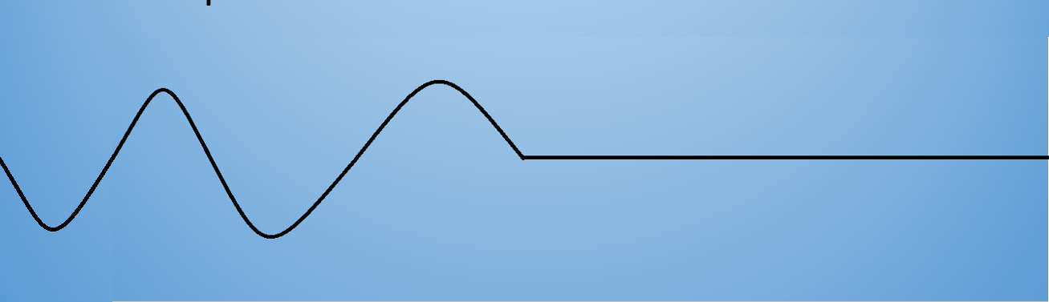
Week 13 – AC to DC Power Supplies

Slide 66
Week 13 – AC to DC Power Supplies
Objective: To learn how to convert AC power to DC power and build a converter in lab
Equipment and Materials:
Tektronix TDS 220 Oscilloscope S/N: B083259
Function Generator: GwINSTEK, GFG-8210, S/N: C705254
1x Breadboard
4x 47001 Diodes
1x 470microF capacitor
Research and Information:
Diode Tutorial & How to build an AC to DC power supply - Afrotechmods
https://www.youtube.com/watch?v=cyhzpFqXwdA

Slide 67
Week 13 – AC to DC Power Supplies
Details, Procedures, etc.
First research how to build a converter using a full-bridge rectifier and a capacitor. Next gather the materials and build the project on a breadboard.

Slide 68
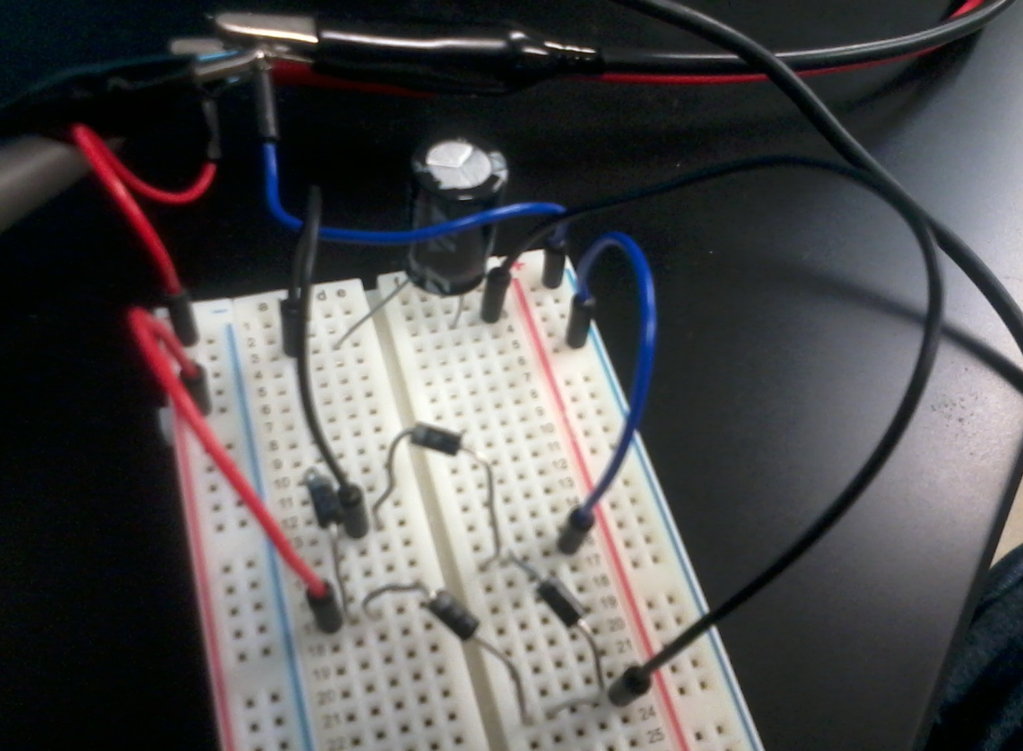
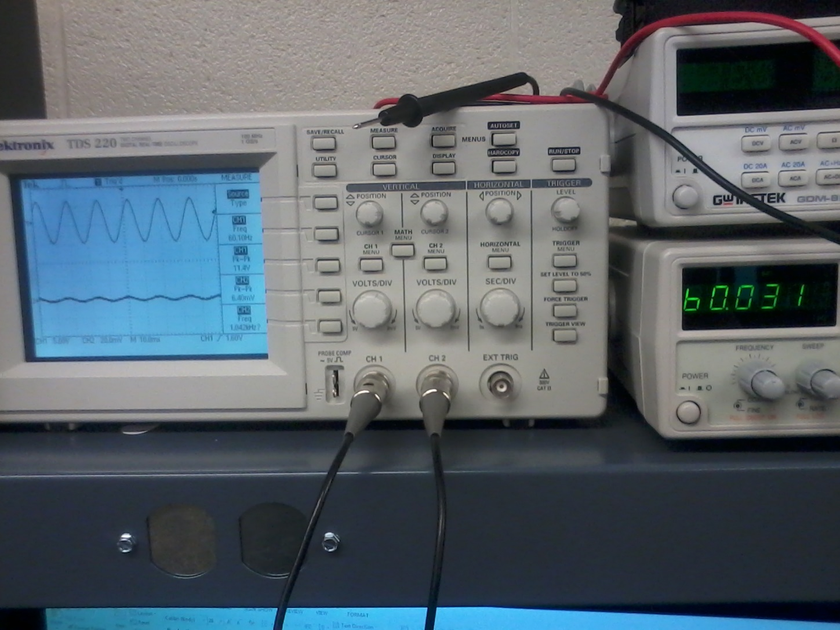
Week 13 – AC to DC Power Supply
Comparison of before and after the full bridge rectifier

Slide 69
Week 13 – AC to DC Power Supplies
Summary and Conclusions
This lab I learned what a full-bridge rectifier is and how it can be used in the conversion of AC power to DC power. I learned how to make a full bridge rectifier using only four diodes and how the electricity flows between everything to make it work.

Slide 70
Lab 14 – Electrostatic Discharge

Slide 71
Week 14 – Electrostatic Discharge
Objective: To learn what electrostatic discharge is, what causes it, what it does to electronics, and how to prevent it from damaging electronics.
Equipment and Materials: N/A
Research and Information:
PDF on electrostatic discharge
http://www.minicircuits.com/app/AN40-005.pdf
Video on what ESD is
https://www.youtube.com/watch?v=KY8yajgPWPo
Voltage generated by wool clothing
http://amasci.com/emotor/voltmeas.html
Voltage generated by scotch tape
http://literature.rockwellautomation.com/idc/groups/literature/documents/sb/8000-sb001_-en-p.pdf
Voltage generated by masking tape
https://books.google.com/books?id=lb92hGvztIgC&pg=PT253&lpg=PT253&dq=Tribocharges+masking+tape+voltage&source=bl&ots=lZRGPB05Oz&sig=E5e-xkC-mf7JR2Qs2chgJV2aZMQ&hl=en&sa=X&ei=bC84VaCfIsi5sAXegoHYAg&ved=0CCoQ6AEwAg#v=onepage&q=Tribocharges%20masking%20tape%20voltage&f=false

Slide 72
Week 14 – Electrostatic Discharge
Details, Procedures, etc.
Research online what electrostatic discharge is and what voltage is generated by four situations
Masking tape: Antistatic:Up to 37 volts at 10% humidity on stainless steel. >2000 volts when pulled from stainless steel w/ no electrolyte, corrosion inhibitor or crosslinker. Unable to charge above 50% humidity. 10,000-20,000 volts.
Scotch tape: up to 5,000 volts
Wool sweater: 9,000 volts above 50% humidity
Walking across the carpet in the winter: Based on the humidity outside the static varies. At a humidity level between 10% and 20% walking across a carpet can generate up to 35,000 V of discharge. Between 65% and 90% humidity a carpet can generate up to 1,500 volts of discharge.

Slide 73
Week 14 – Electrostatic Discharge
Summary and Conclusions
I learned that electrostatic discharge is actually air that catches on fire as it transfers charge to two close objects with opposite charges. ESD can get up to four times the temperature of the sun, but as it only exists for a fraction of a second it is not harmful to humans. Humans can’t usually feel ESD until it hits a minimum of 2000 volts, though electronics can start taking irreparable damage at only 100 volts. To protect against ESD companies can use a number of tools for their employees including air ionizers, ESD safe soldering irons, ESD protective tabletops, mats, wrist straps, and shoes. All ESD safe material must be grounded before and during use. At home a humidifier can help to reduce charges in the air and save electronic components. I finally also learned that static electricity is caused by contact and separation of dissimilar materials.

Slide 74
Lab 15 – Testing Solder Kits

Slide 75
Lab 15 – Testing Solder Kits
Objective: To build an outline for soldering kits next week and to test all parts in the solder kits for next week to ensure they work.
Equipment and Materials:
9x 360 ohm resistors
1x 470 ohm resistor
1x 5.6k ohm resistor
1x 22k ohm resistor
4x 100 microFahrad capacitors
1x 2.2 microFahrad capacitor
2x diode
2x .01 microfahrad capacitor
GWINSTEK GDM-8245 Digital Multimeter S/N: CL860333
GWINSTEK LCR-819 LCR meter S/N:
Research and Information:
http://www.electronicshub.org/how-555-timer-ic-testing-circuit-works/
How to test transistors with ANY multimeter! - Anamorphic Square
https://www.youtube.com/watch?v=b0jCUsenNsY

Slide 76
Lab 15 – Testing Solder Kits
Details, Procedures, etc.
Open Word and create a plan to test all items in the solder kit.
Test all resistors using a multimeter.
Test all capacitors using the LCR meter
Test both diodes
Research how to test transistors using a multimeter
Test both transistors using a multimeter
Research and attempt to hook up a 555 timer chip to make a blinking LED

Slide 77
Lab 15 – Testing Solder Kits
Summary and Conclusions
All resistors tested to be within tolerances.
All capacitors tested to be working
Both diodes tested to be working
Both transistors tested to be working
LEDs lit up
All components worked in this lab though I still need to review and learn how to test the 555 timer chips. According to the sheet that I made in the beginning of class soldering next week should be swift and everything should go well.

Slide 78
Lab 16 - Soldering

Slide 79
Lab 16 - Soldering
Equipment and Materials
9x 360 ohm resistors
1x 470 ohm resistor
1x 5.6k ohm resistor
1x 22k ohm resistor
2x 555CN timer series chips
2x transistors
4x 100 microFahrad capacitors
1x 2.2 microFahrad capacitor
2x diode
2x .01 microfahrad capacitor
Solderless breadboard

Slide 80
Lab 16 - Soldering
Details, Procedures, etc.
Begin by setting up and separating all parts of the solder kits.
Solder kits together taking caution of heat and time spent on each component on the board.
Once all the parts were connected I went back and tried the solder wick and desolderer to fix some of the joints.
After soldering is finished hook the project to a 9v battery to test out.
Testing out the kit, it worked perfectly.

Slide 81
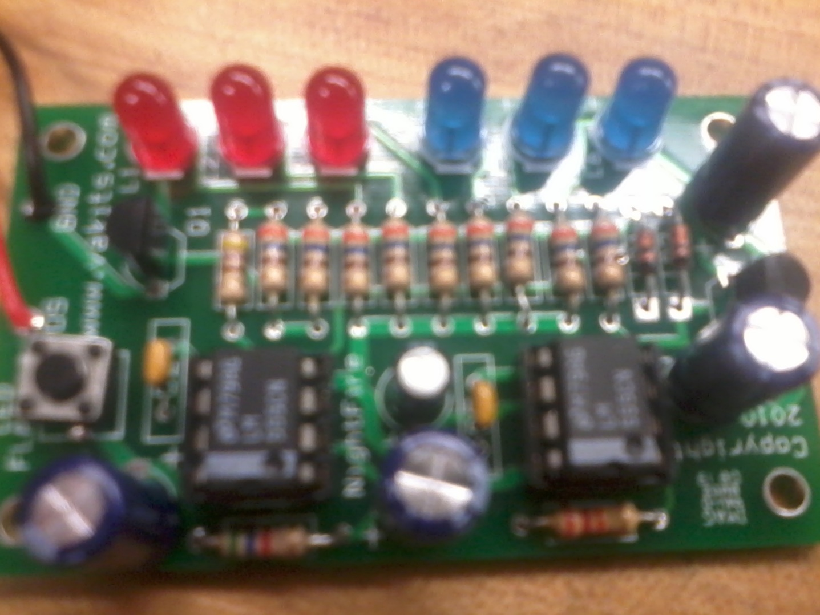
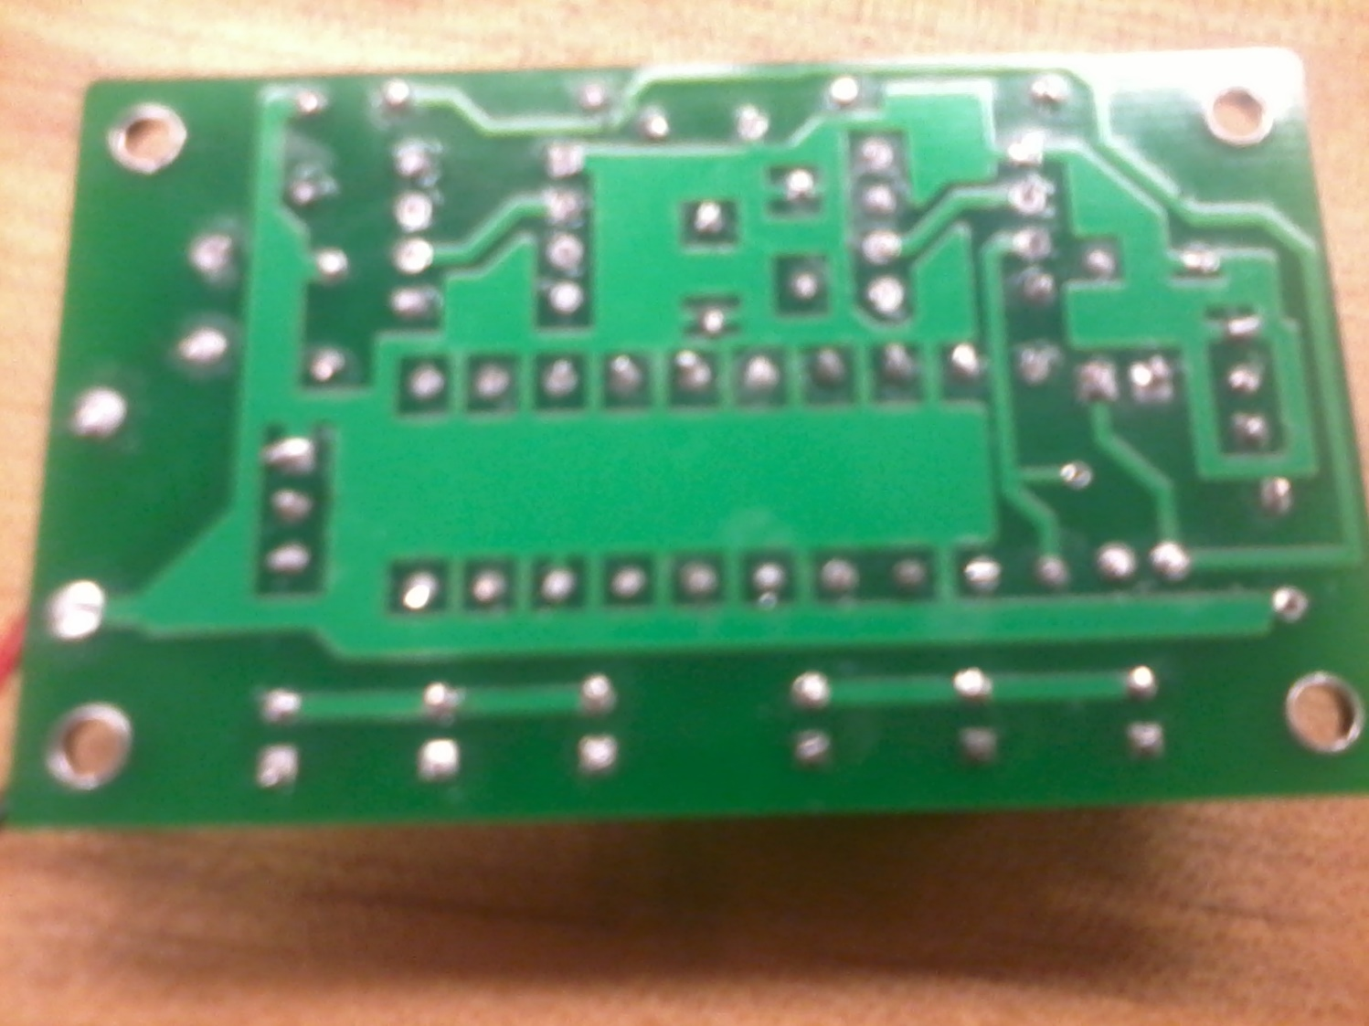
Lab 16 - Soldering

Slide 82
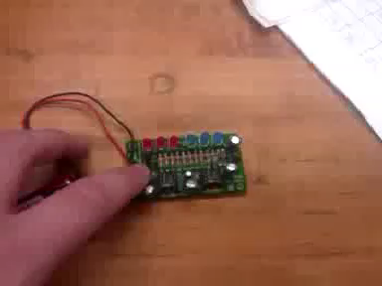
Lab 16 - Soldering

Slide 83
Lab 16 - Soldering
Summary and Conclusions
Overall this lab was very simple. I had tested my parts last week and knew that everything worked. All I had to do was solder all the parts on. I started with the least heat sensitive parts first and moved onto the parts such as transistors and the LEDs. Once I got all the less heat sensitive components on, such as the resistors and capacitors, I lowered the temperature from 750 down to about 680 to work on the heat sensitive parts. I tried using the solder wick, but could only get a small portion to stick to it. After I made sure the kit works and took pictures and a small video.

Slide 84
End of Class
Class conclusions
Over the course of this class I learned a ton of material. Before taking EECT 101 I didn’t know anything about circuit boards, how to make them, or how they worked. Going off that information, everything introduced every week in this class was new and exciting information for me. This class alone has inspired me to continue looking into electronics and electricity in general to gain as much knowledge as I can. I have already acquired myself a soldering iron as well as all the materials that go with one. I have also done a lot of out of class research using things such as the EEVBlog on youtube.

