Slide 1
Intro to circuits Lab notebook
Evan Wilson
Lab partner: Mustafa Smaili
Bench 5
Spring semester 2017

Slide 2
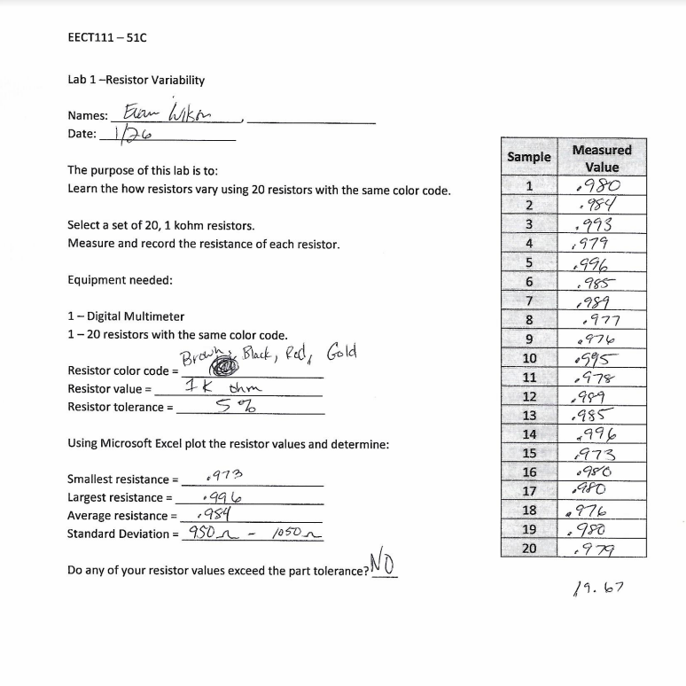
Lab 1 – resistor variability worksheet

Slide 3
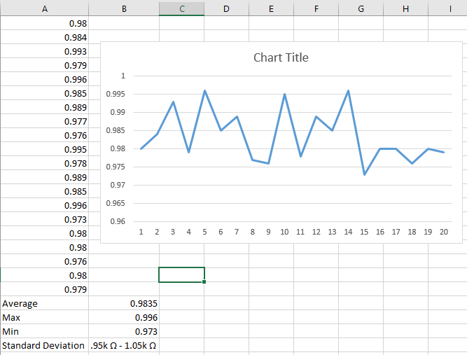
Lab 1 – resistor variability excel

Slide 4
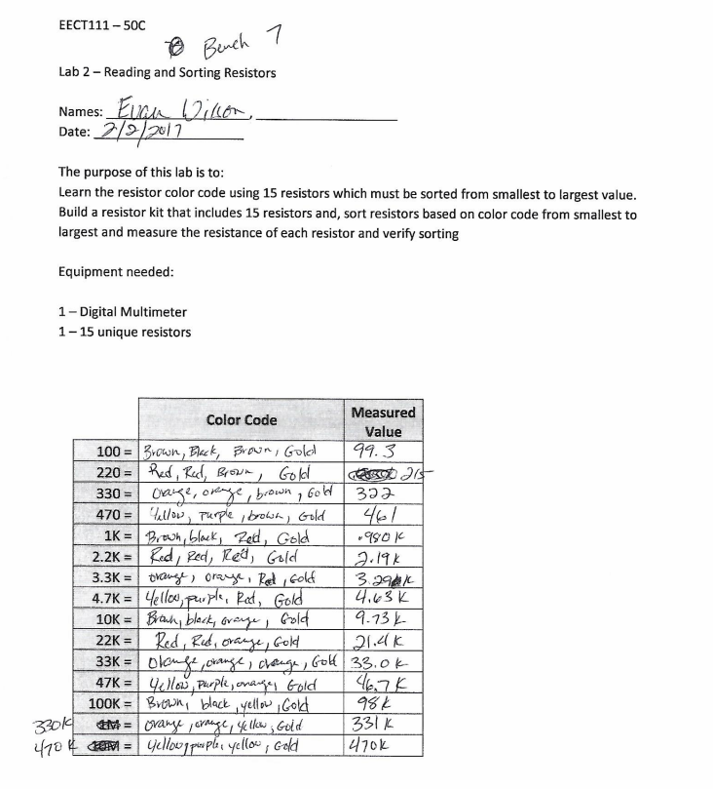
Lab 2 – reading and sorting resistors

Slide 5
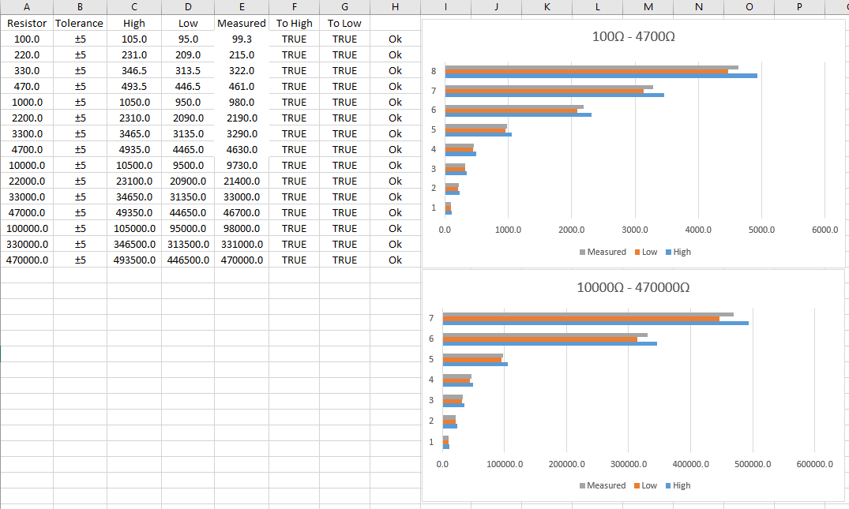
Lab 2 – reading and sorting resistors

Slide 6
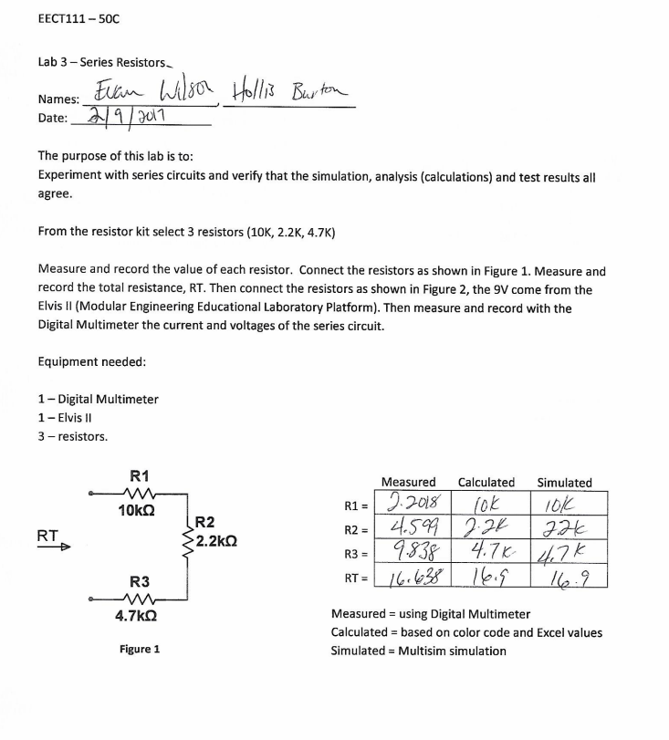
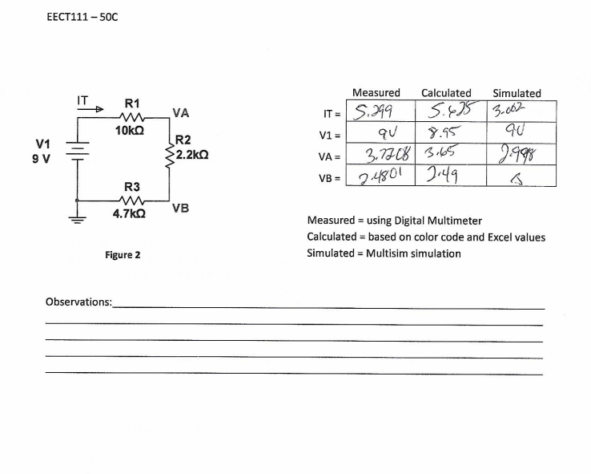
Lab 3 – series resistors

Slide 7
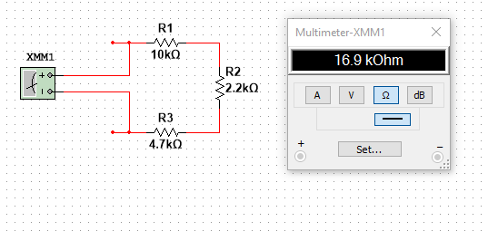
Lab 3 – series resistors

Slide 8
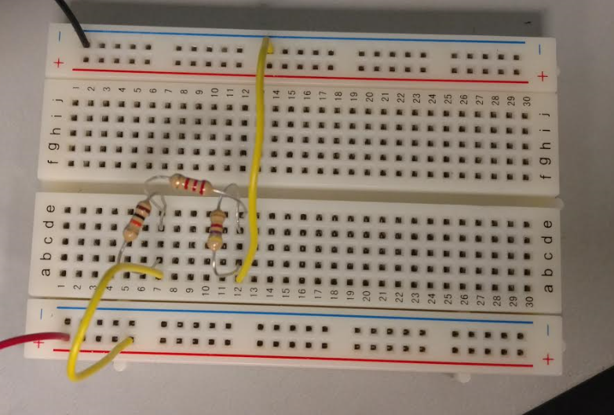
Lab 3 – series resistors

Slide 9
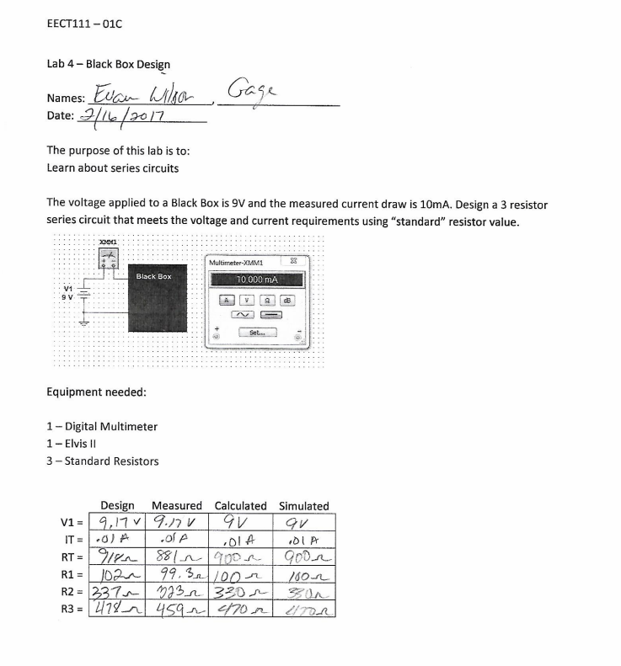
Lab 4 – black box design

Slide 10
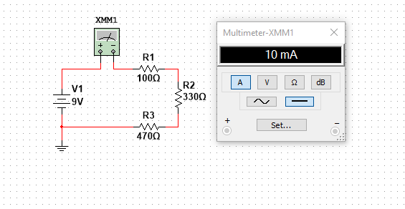
Lab 4 – black box design

Slide 11
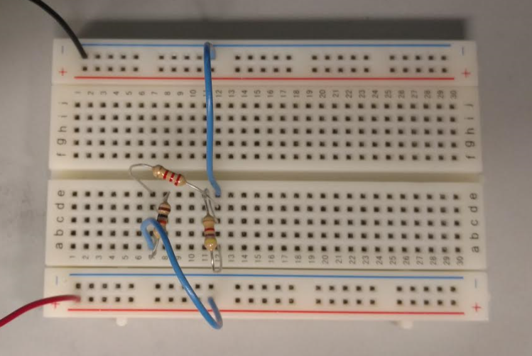
Lab 4 – black box design

Slide 12
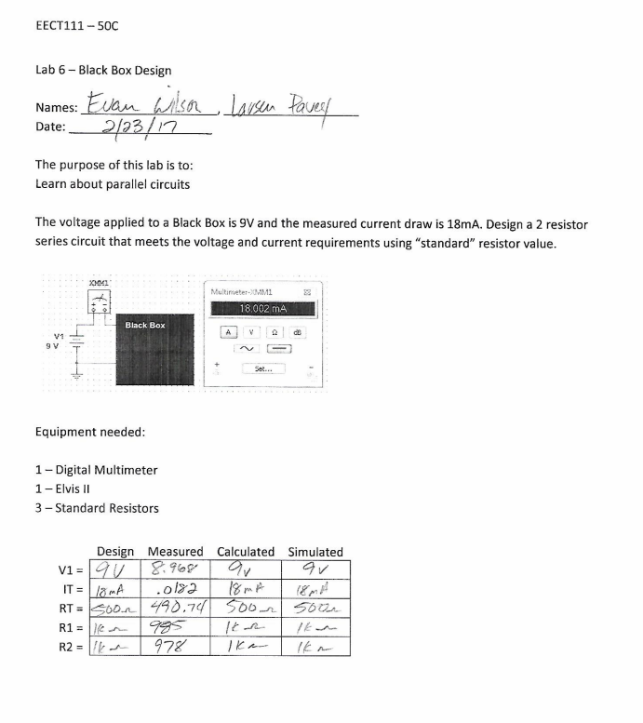
Lab 6 – black box design

Slide 13
Lab 6 – black box design

Slide 14
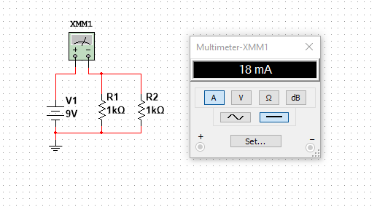
Lab 6 – black box design

Slide 15
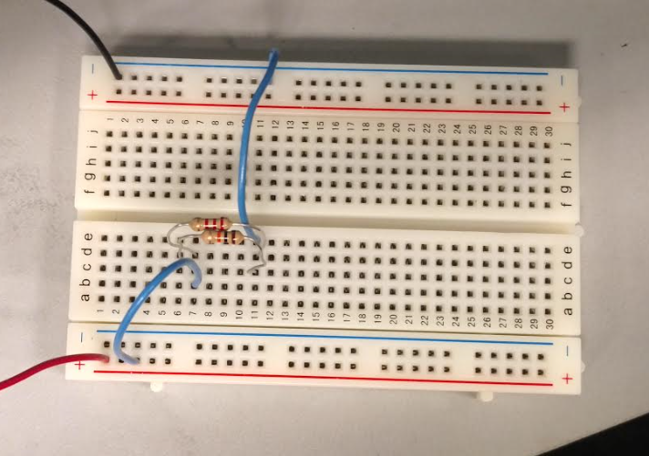
Lab 6 – black box design

Slide 16
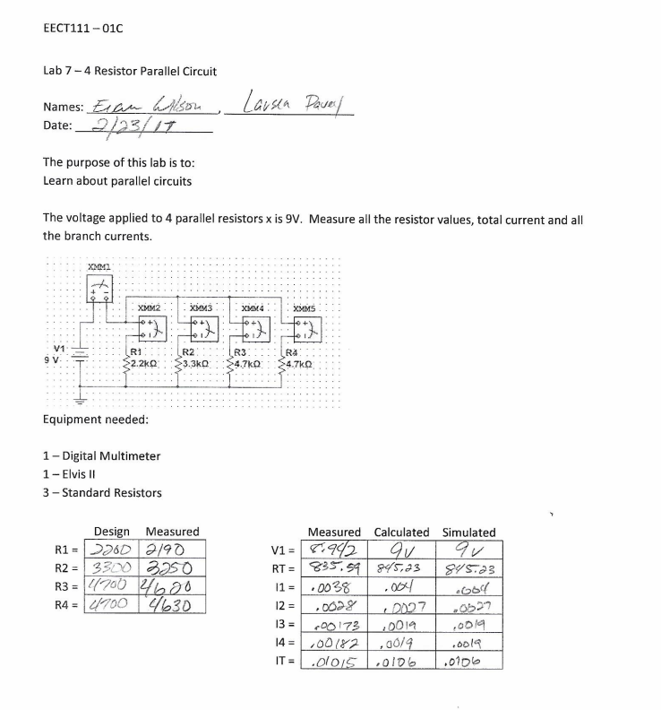
Lab 7 – 4 resistor parallel circuit

Slide 17
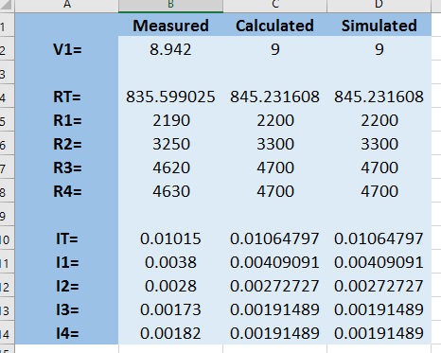
Lab 7 – 4 resistor parallel circuit

Slide 18
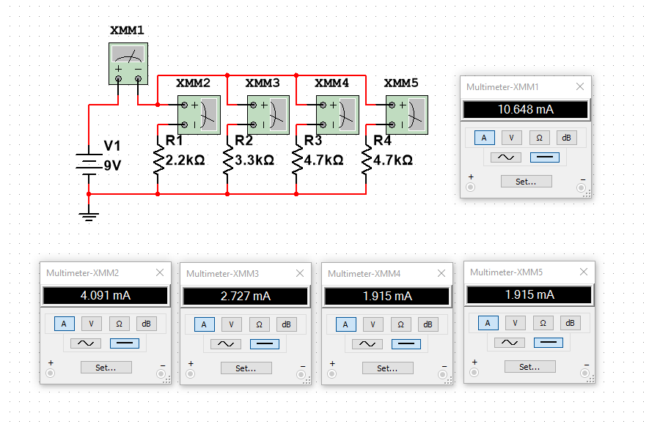
Lab 7 – 4 resistor parallel circuit

Slide 19
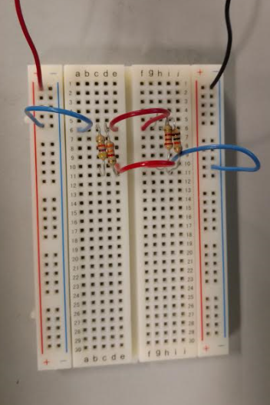
Lab 7 – 4 resistor parallel circuit

Slide 20
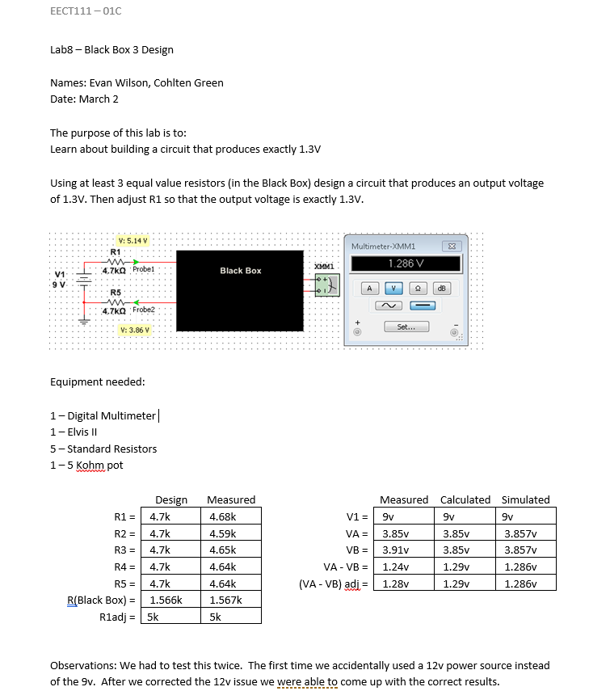
Lab 8 – black box design

Slide 21
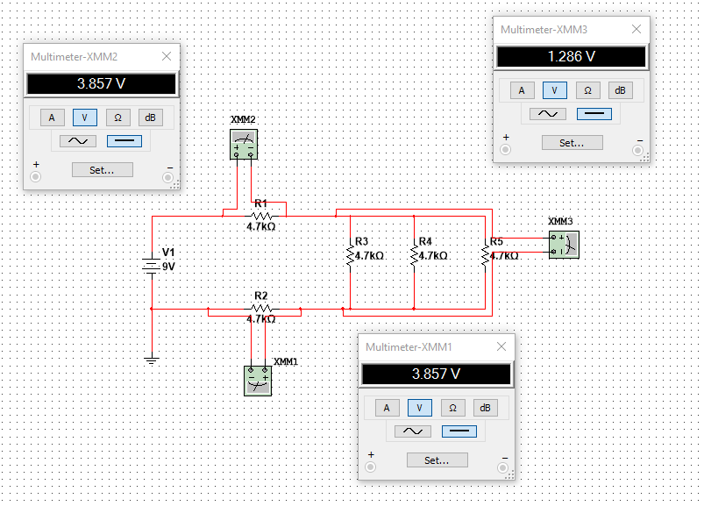
Lab 8 – black box design

Slide 22
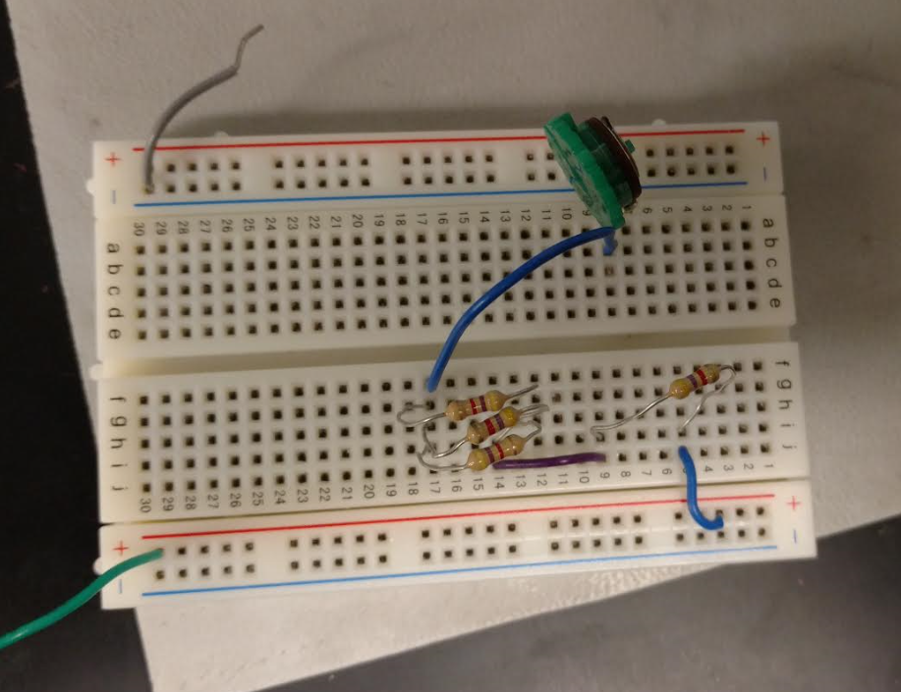
Lab 8 – black box design

Slide 23
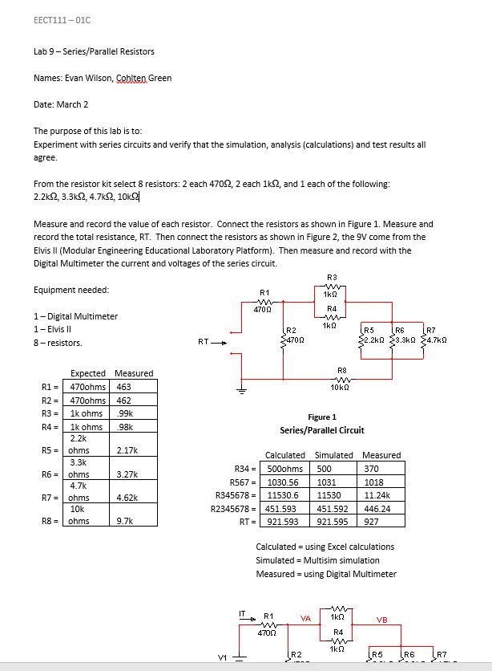
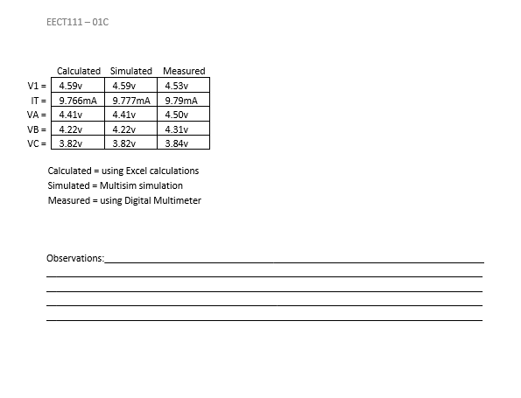
Lab 9 – series/parallel resistors

Slide 24
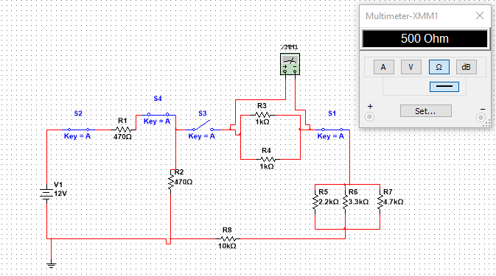
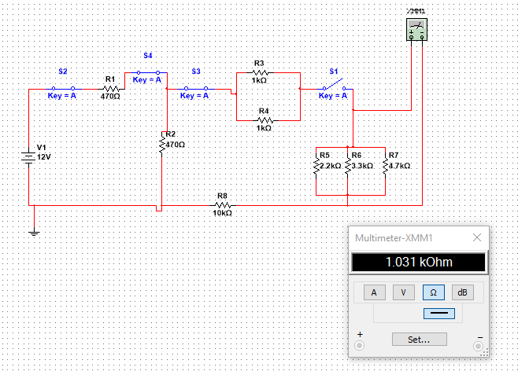
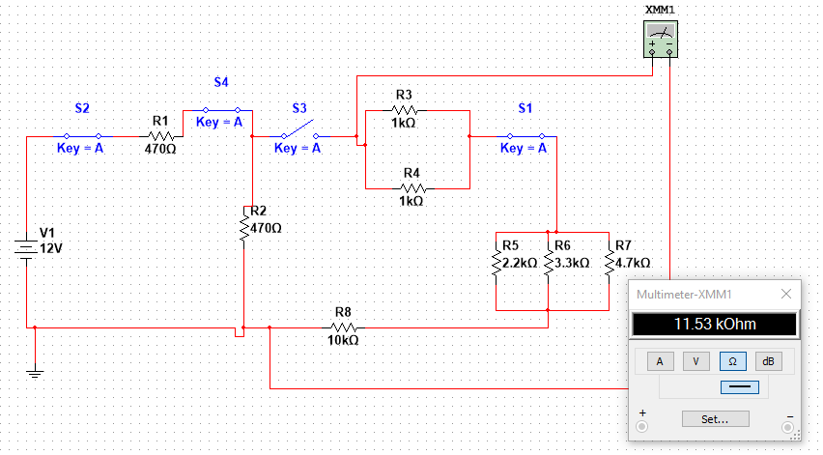
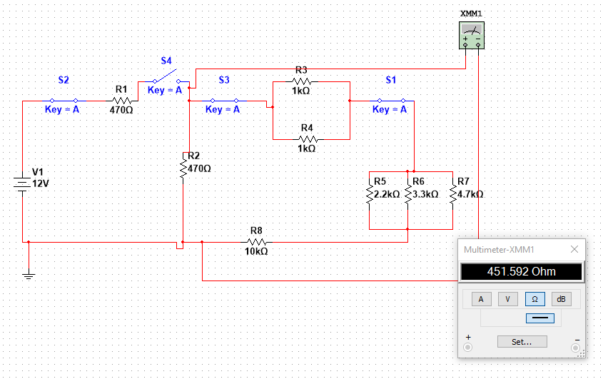
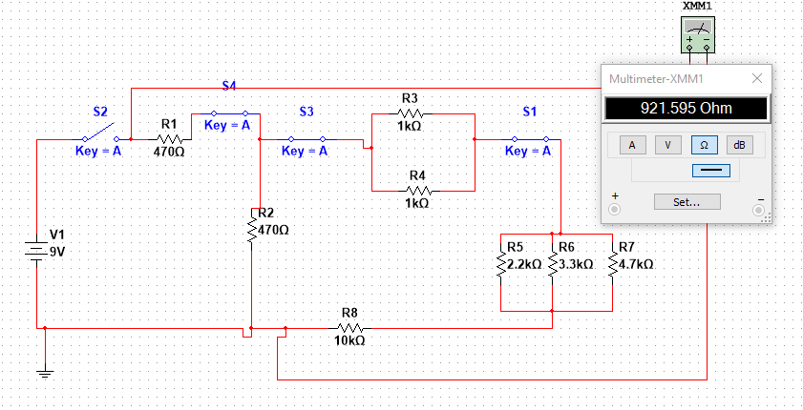
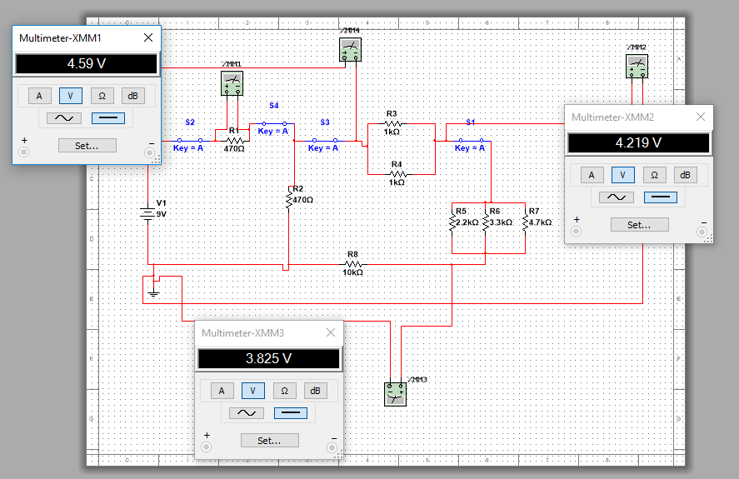
Lab 9 – series/parallel resistors

Slide 25
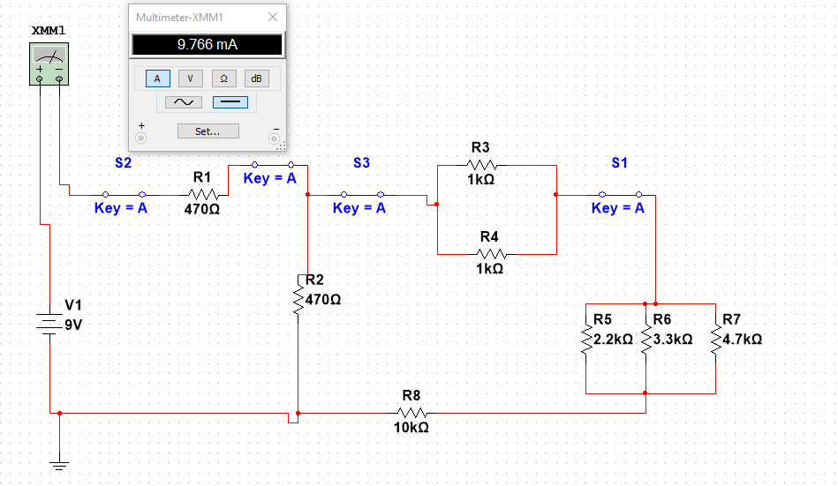
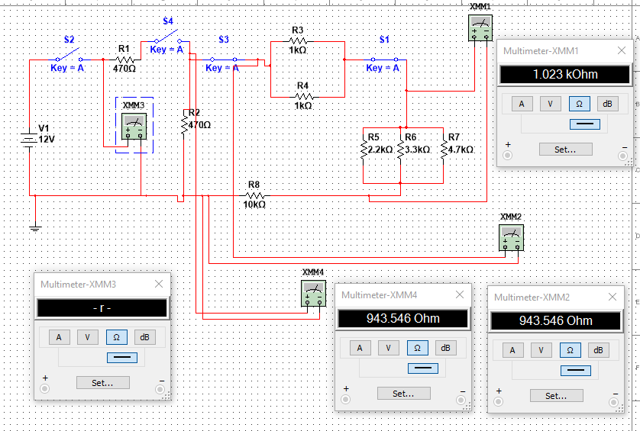
Lab 9 – series/parallel resistors

Slide 26
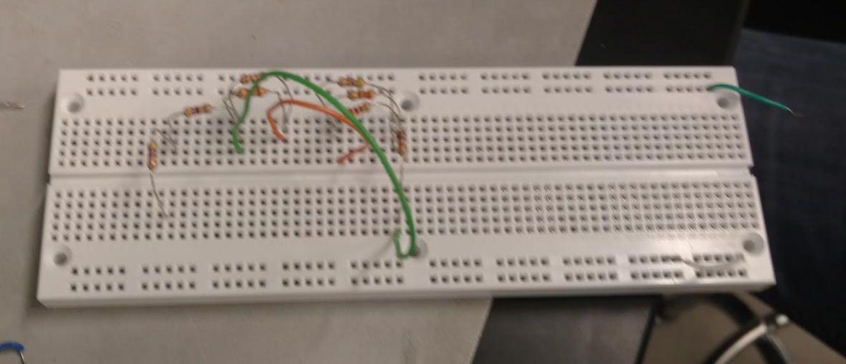
Lab 9 – series/parallel resistors

Slide 27
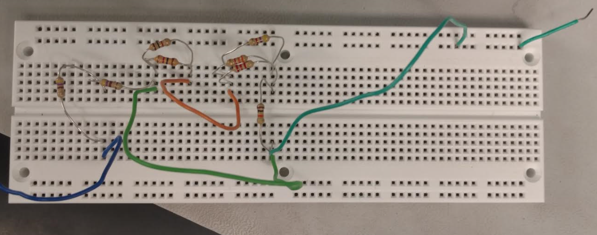
Lab 9 – series/parallel resistors

Slide 28
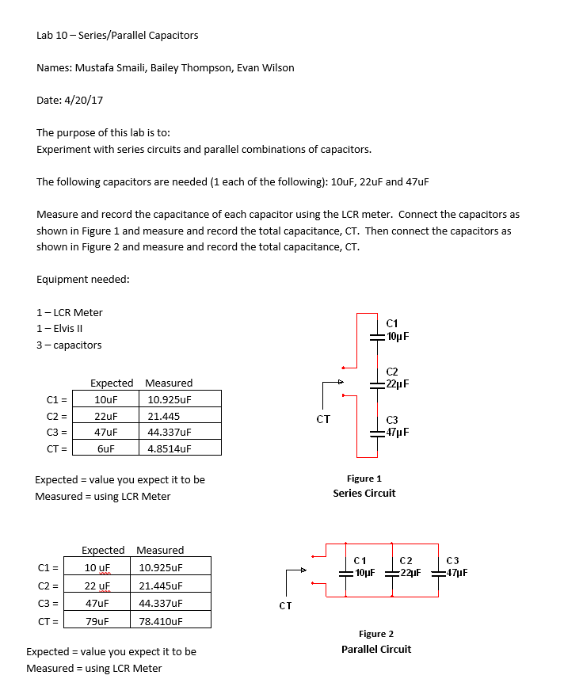
Lab 10 – series/parallel capacitors

Slide 29
Lab 10 – series/parallel capacitors

Slide 30
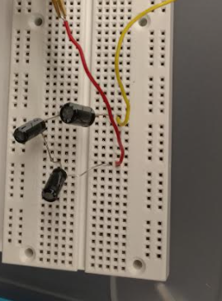
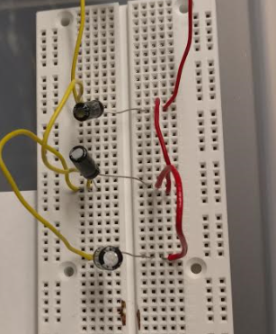
Lab 10 – series/parallel capacitors

Slide 31
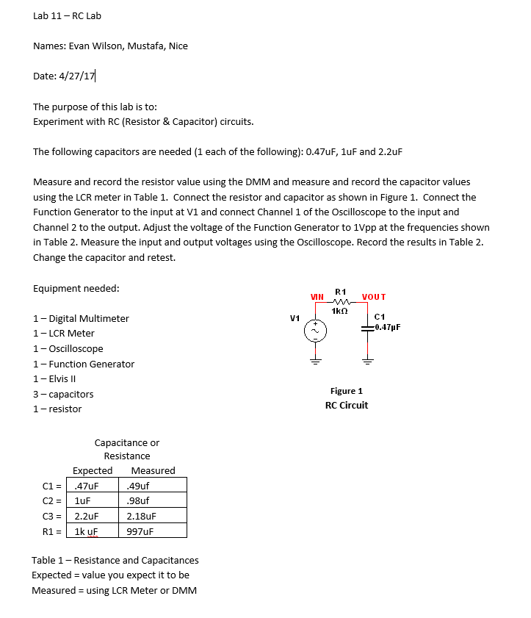
Lab 11 – experiment with rc circuits

Slide 32
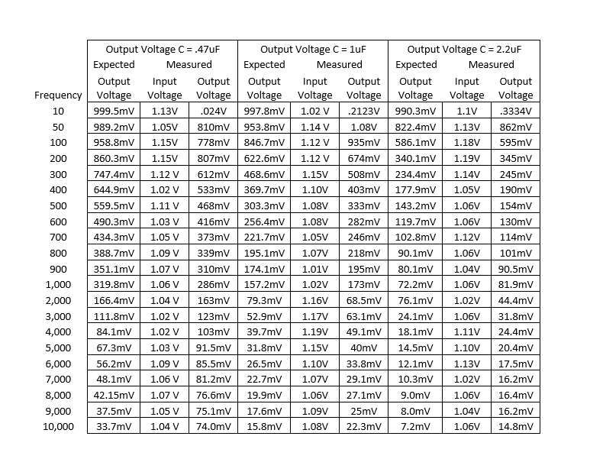
Lab 11 – experiment with rc circuits

Slide 33
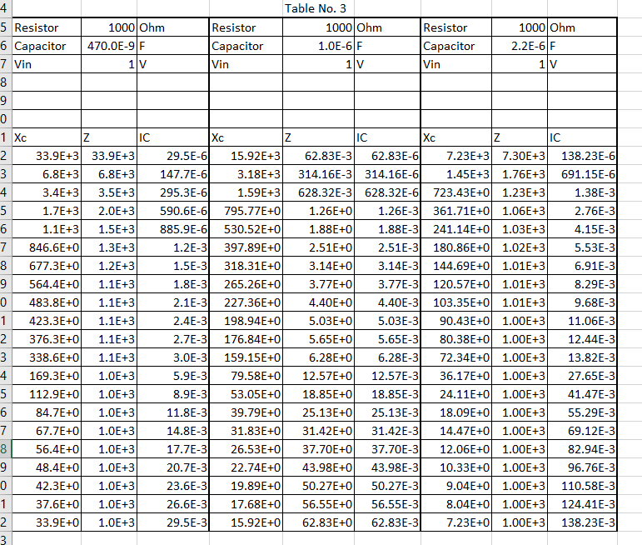
Lab 11 – experiment with rc circuits

Slide 34
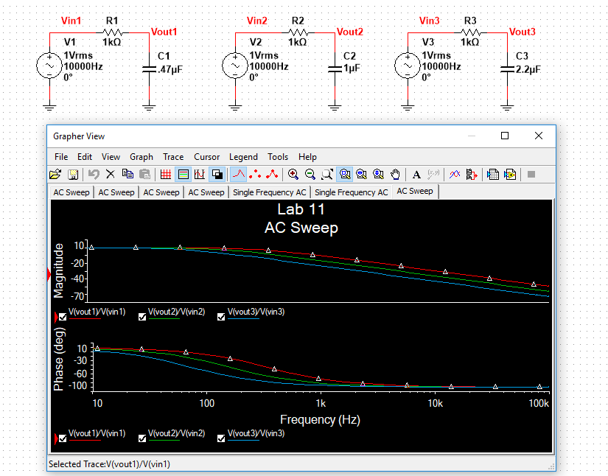
Lab 11 – experiment with rc circuits

Slide 35
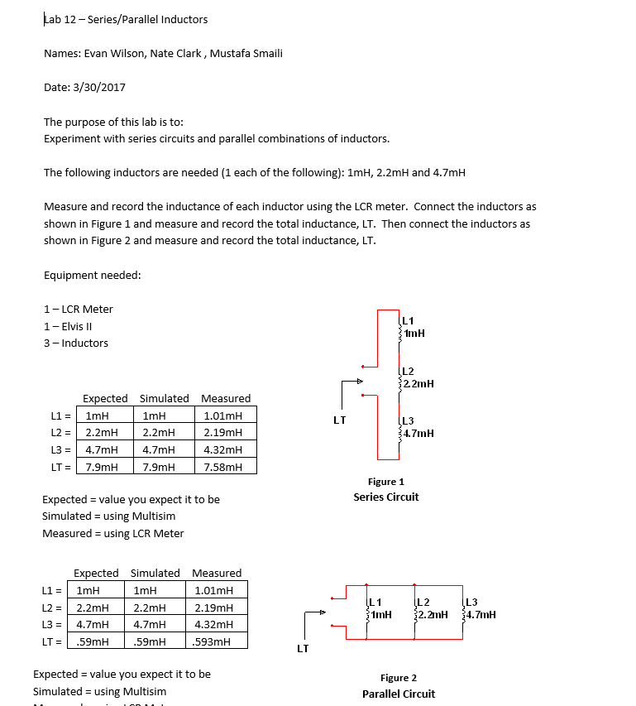
Lab 12 – series and parallel combinations

Slide 36
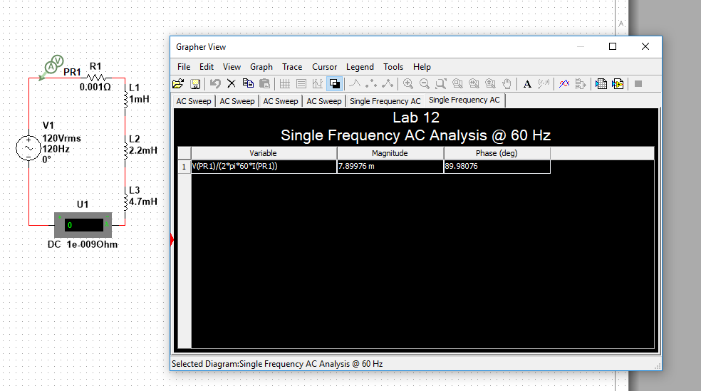
Lab 12 – series and parallel combinations

Slide 37
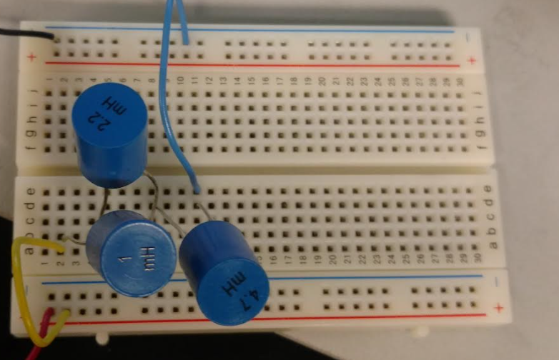
Lab 12 – series and parallel combinations

Slide 38
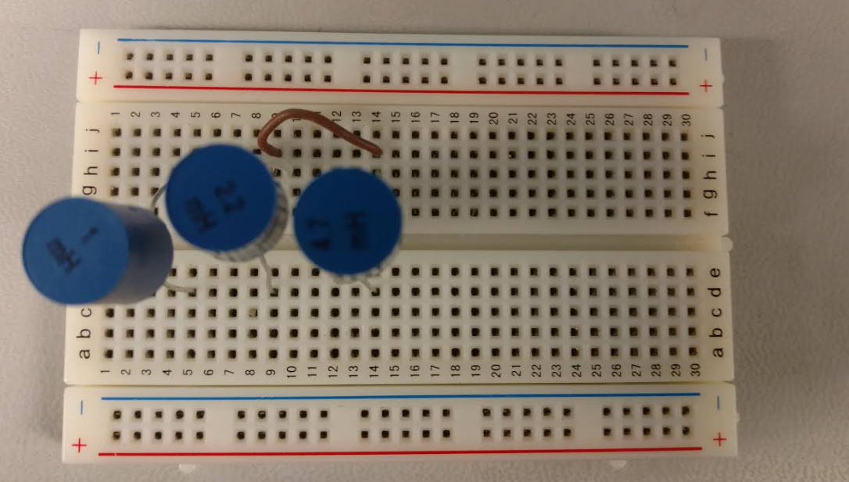
Lab 12 – series and parallel combinations

Slide 39
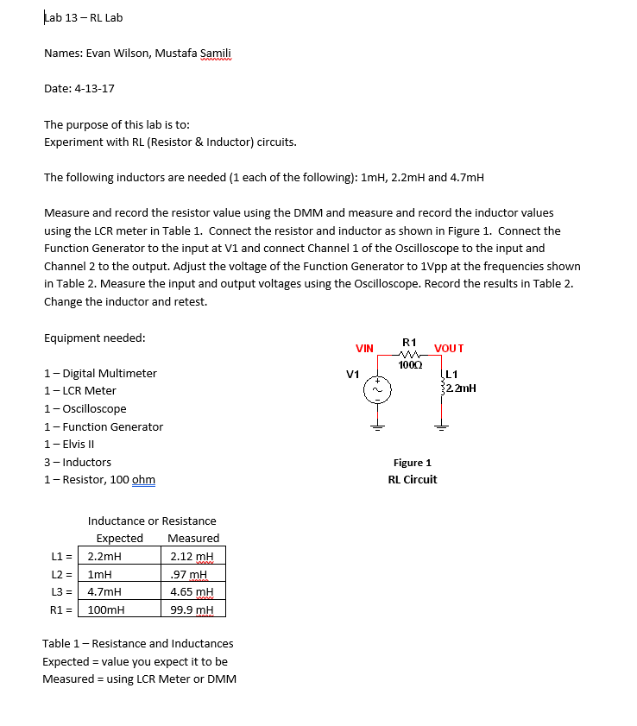
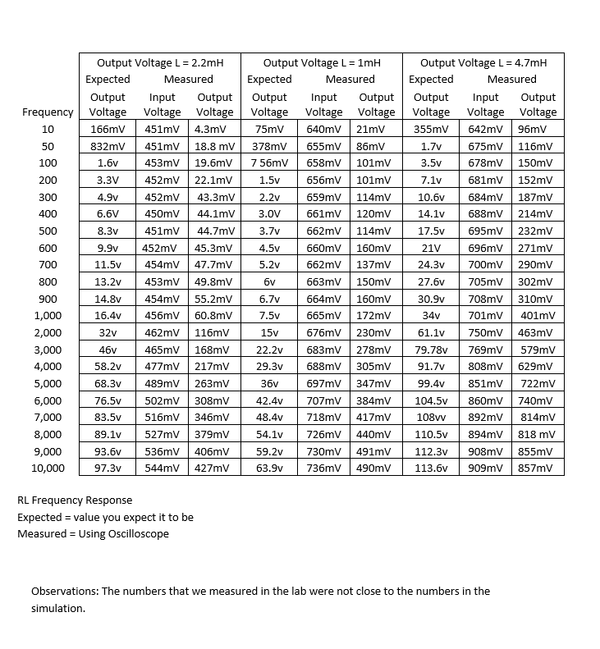
Lab 13 – experiment with rl circuits

Slide 40
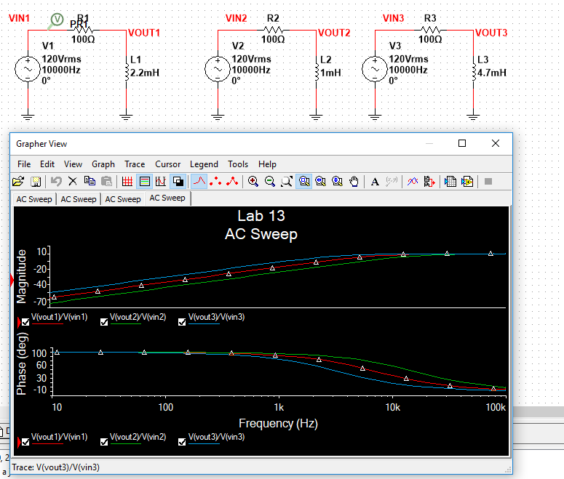
Lab 13 – experiment with rl circuits

Slide 41
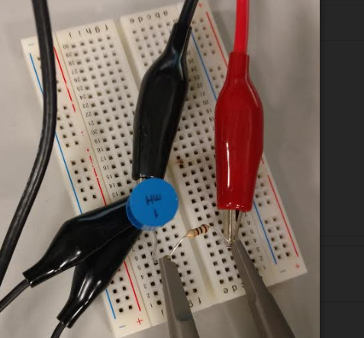
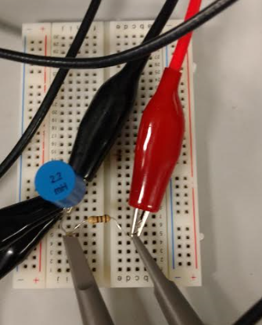
Lab 13 – experiment with rl circuits

