Slide 1

Lab Notebook:
EECT 121
Evan Wilson
Lab Partners: Colhten Green and Jonathan Johnston
Professor Bell
Fall 2017

Slide 2

Table of Contents
Lab 1
Switching Diodes
In this lab we experiment switching diodes using Multisim then built and tested for functionality with an oscilloscope.
Lab 2
Schottky Diodes
In this lab we experiment Schottky diodes using Multisim then built and tested for functionality with an oscilloscope.
Lab 3
Zener Diodes
In this lab we experiment Zener diodes using Multisim then built and tested for functionality with an oscilloscope.
Lab 4
+/- 9 Volt Power Supply
In this lab we researched how to build a Dual 9 volt power supply. We simulated or build in Multisim. We created a bill of materials in excel using components listed on RSR Electronics.
Lab 5
Bipolar Junction Transistors
In this lab we experimented with BJT’s used as a switch.
Lab 6
BJT Amplifier
In this lab we experimented with BJT’s used as an amplifier.
Lab 7
In this lab we experimented with JFET’s as a switch.
Junction Field Emitting Transistors
In this lab we experimented with JFET’s used as an Amplifier.
Lab 8
JFET Amplifier

Slide 3
Table of Contents
Lab 9
Low Pass Filter
The Low Pass filter is used to filter out lower frequencies from circuits. In this lab using excel we calculated the exact component values needed to filter a specific frequency then simulated it in Multisim 14.
Lab 10
High Pass Filter
The High Pass filter is used to filter all frequencies above a set range. In this lab using excel we calculated the exact component values needed to filter a specific frequency then simulated it in Multisim 14.
Lab 11
Mid-Pass Filter
Mid-pass filters, filter a mid range of frequencies. In this lab using excel we calculated the exact component values needed to filter a specific frequency then simulated it in Multisim 14.
Lab 12
Notch Filter
The Notch filter is used to isolate specific frequencies in a circuit and filter them out. In this lab using excel we calculated the exact component values needed to filter a specific frequency then simulated it in Multisim 14.

Slide 4
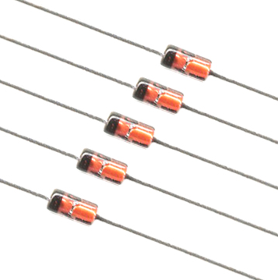
Lab 1: Switching Diodes
In this lab we experiment switching diodes using Multisim then built and tested for functionality with an oscilloscope.
We were also tasked with developing a procedure for characterizing this component

Slide 5
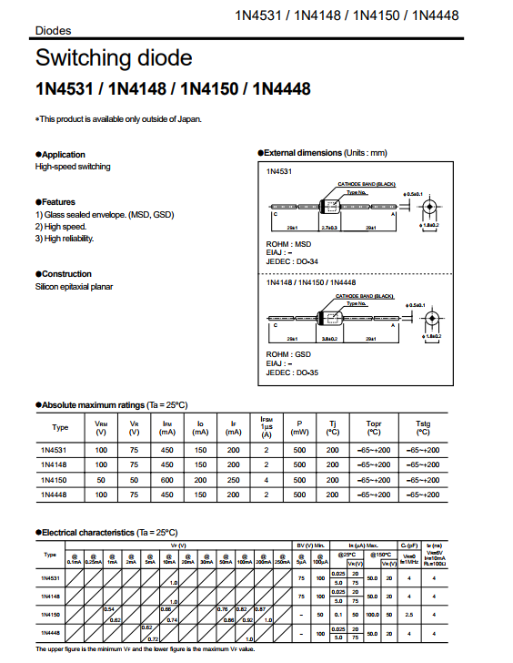
Resources and components
1 x 1N4148-http://ivytechengineering.com/info/stores/diodes/files/1n4148.pdf
1 x 1kΩ resistor
Ocilliscope and Function generator.

Slide 6
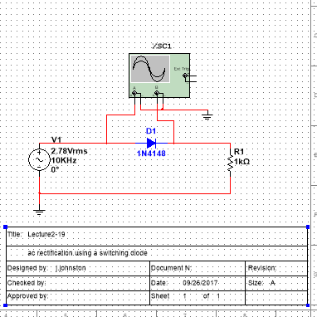
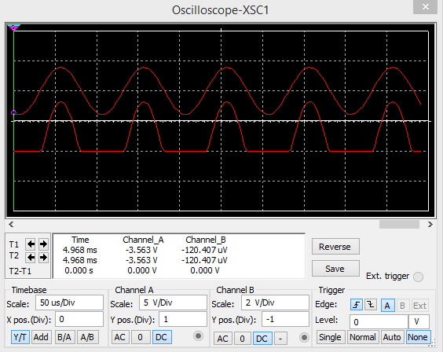
Multisim 14 Design

Slide 7
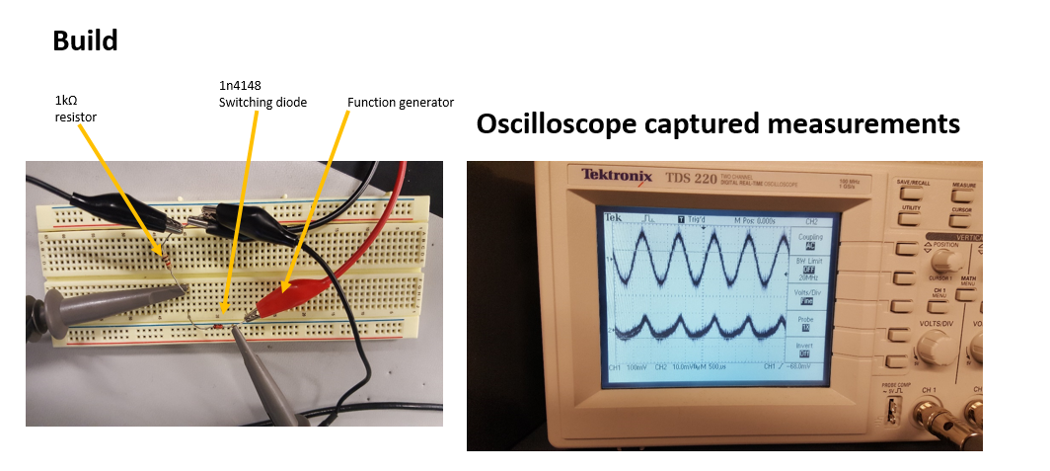
Build and test

Slide 8
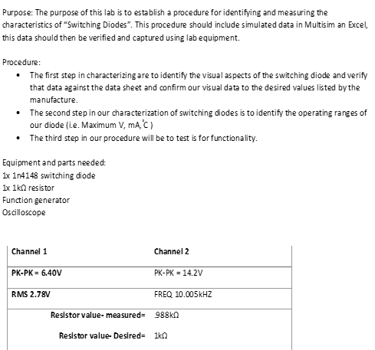
Conclusion and lab notes
Observations: Our component meets all expected measurements and values found in the data sheet. The was a simple lab build that required a lot of research and though in how to characterize our component the 1N4148.

Slide 9
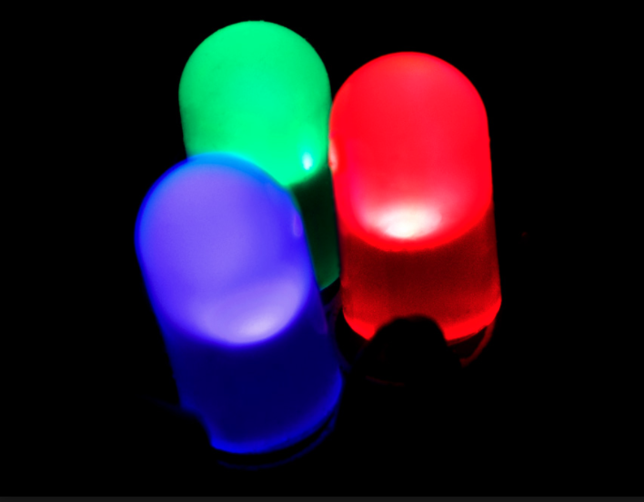
Lab 2: LED Diodes
In this lab we experiment LED diodes using Multisim then built and tested for functionality with an oscilloscope.
We were also tasked with developing a procedure for characterizing this component.

Slide 10
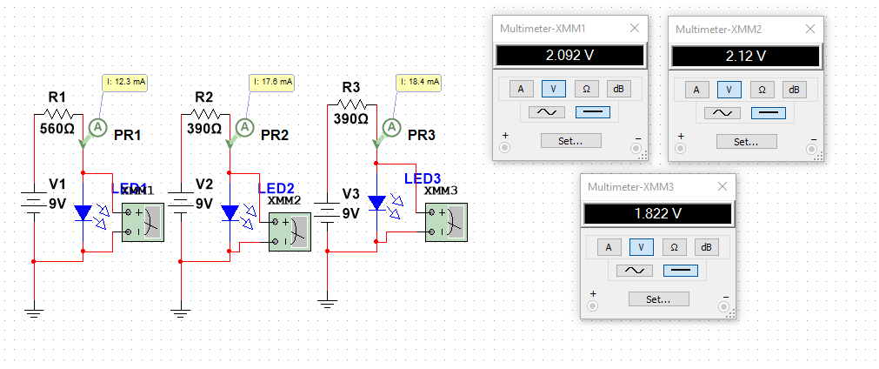
Multisim

Slide 11
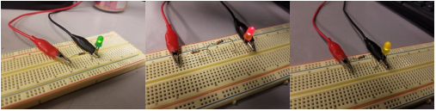
Build and Test:

Slide 12
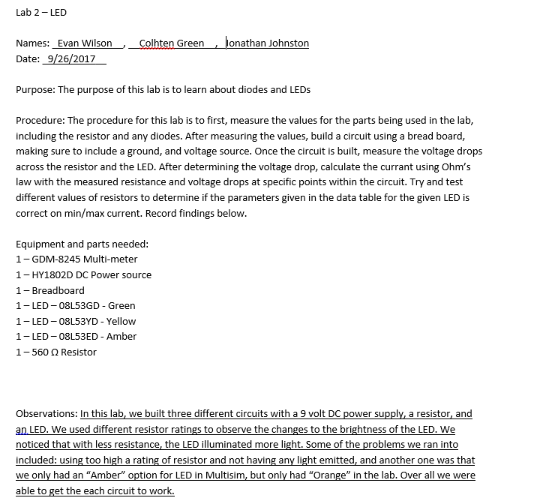
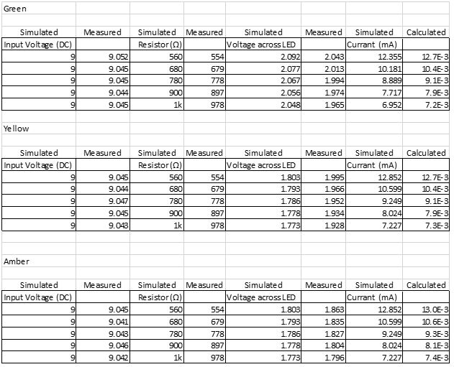
Conclusion and Lab Notes:

Slide 13
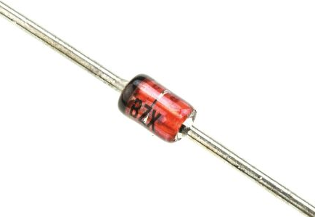
Lab 3: Zener Diodes
In this lab we experiment Zener diodes, (4728, 4732, 4733, 4735, 4736, 4739, 4742, 4744, 4747) using Multisim then built and tested for functionality with a digital multimeter.
We were also tasked with developing a procedure for characterizing this component

Slide 14
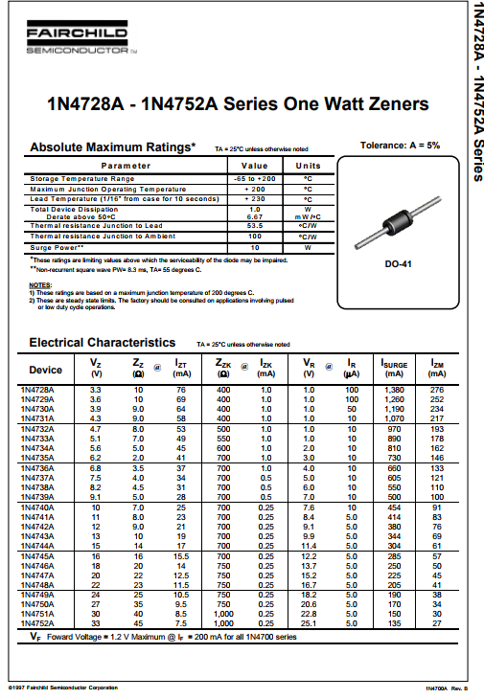
Resources and components:
1x – 1N4728
1x – 1N4732
1x – 1N4733
1x – 1N4735
1x – 1N4736
1x – 1N4739
1x – 1N4742
1x – 1N4744
1x – 1N4747
http://www.ivytechengineering.com/info/stores/diodes/files/zener.pdf
1x – 1k Ohm Resistor
1x - Breadboard

Slide 15
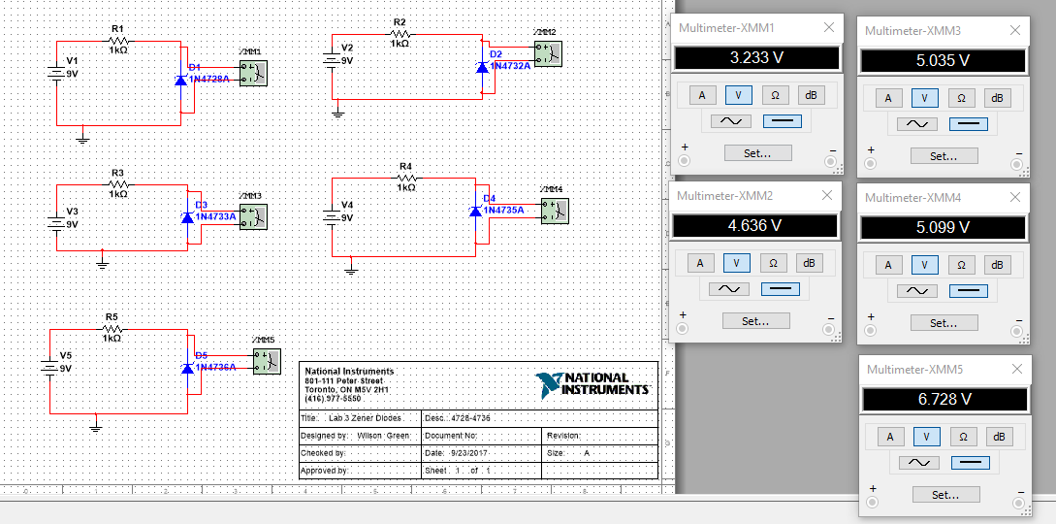
Multisim Design

Slide 16
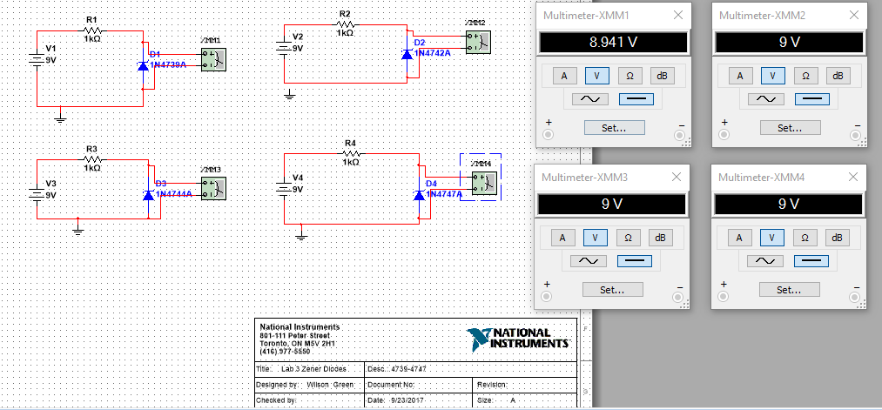
Multisim Design Continued

Slide 17
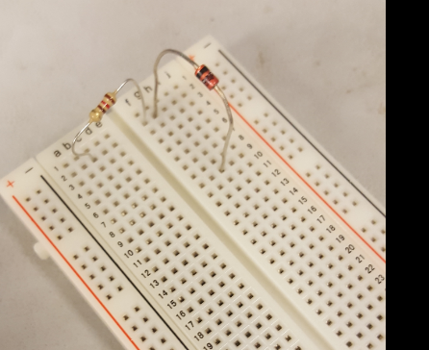
Build and Test:

Slide 18
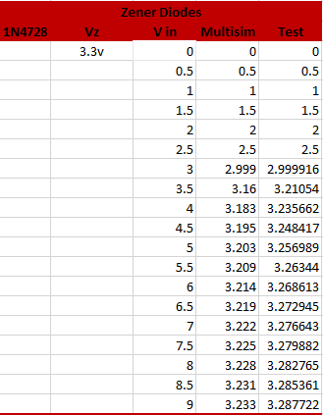
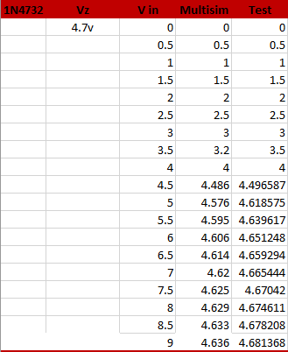
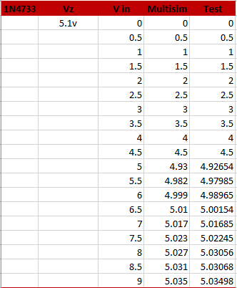
Conclusion and Lab Notes:

Slide 19
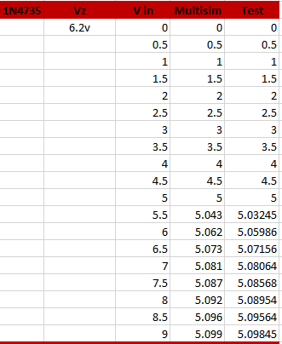
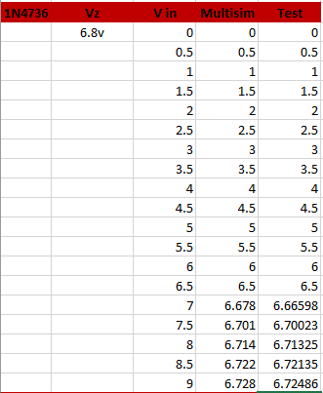
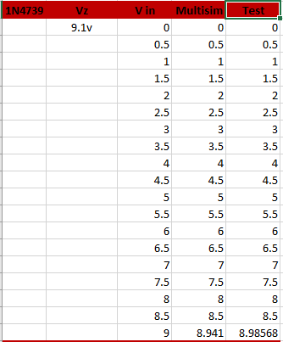
Conclusion and Lab Notes:

Slide 20
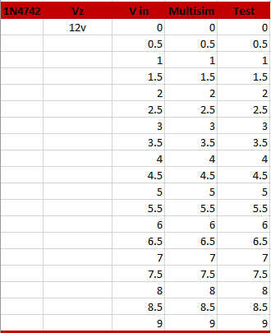
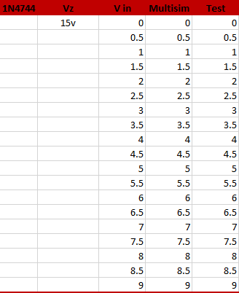
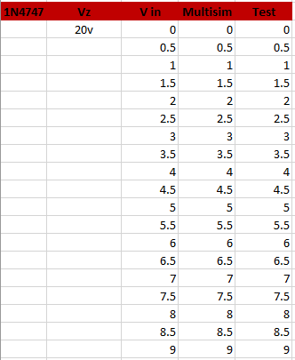
Conclusion and Lab Notes:

Slide 21
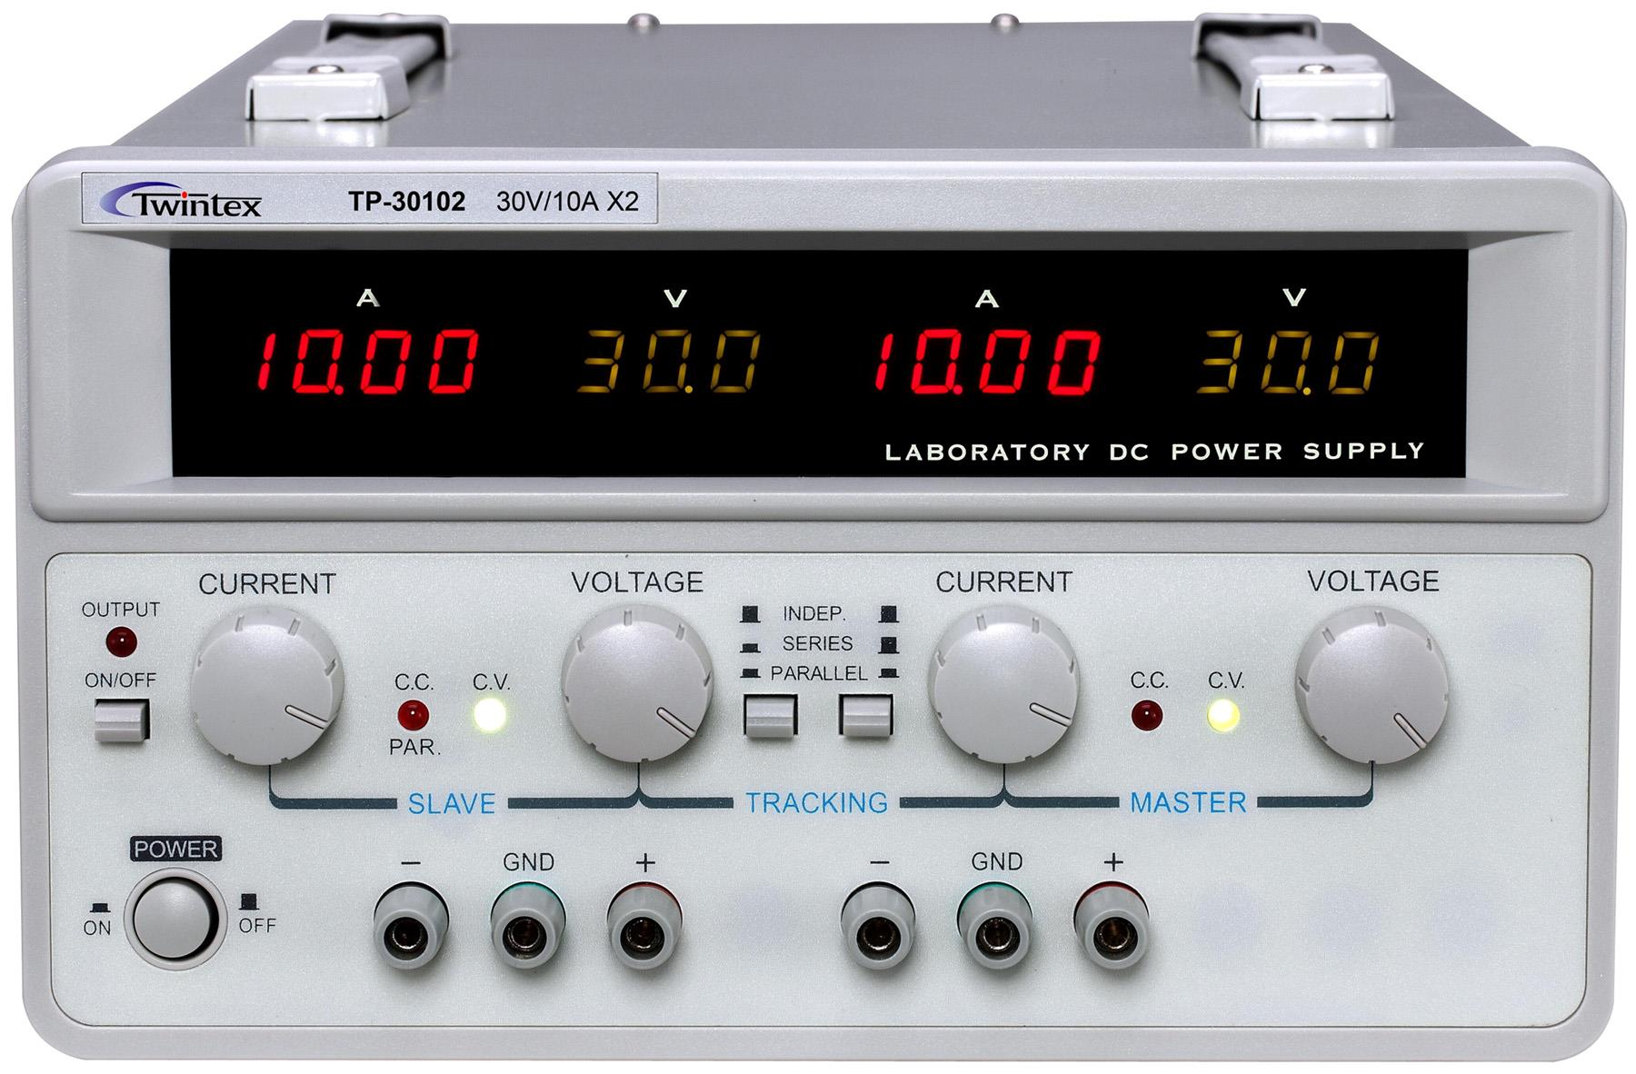
Lab 4: Dual voltage power supple
In this lab we researched how to build a Dual 9 volt power supply. We simulated or build in Multisim. We created a bill of materials in excel using components listed on RSR Electronics.

Slide 22
Resources and components
https://www.elexp.com This was our supplier.
http://www.circuitstoday.com This is were we found our circuit design.
http://ivytechengineering.com/info/stores/voltreg/files/lm317t.pdf
http://ivytechengineering.com/info/stores/voltreg/files/lm337.pdf

Slide 23
BOM

Slide 24
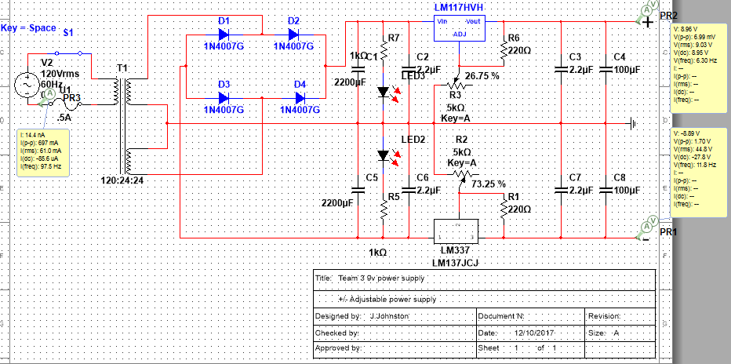
Multisim Design

Slide 25
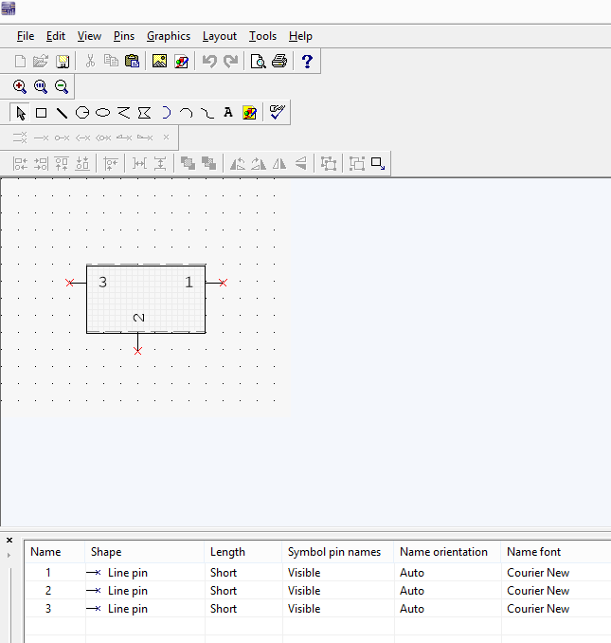
Spice model for LM337
* IN | | |
* OUT | |
* ADJ |
*
VREF 12 4 DC 1.25
EREG 3 12 1 2 0.0001981
IBIAS 4 1 DC 65U
RIN 4 20 100MEG
E1 5 1 20 4 600
R1 5 6 1561
RPZ 6 11 0.01
C1 11 1 1U
E2 7 1 6 1 1
RB1 7 17 25
RB2 17 8 50
DLIMIT 17 18 DMOD
ELIMIT 18 1 POLY (1) (2,1) .24 -0.0024
DFLDBCK 17 19 DMOD
EFLDBCK 19 1 POLY(1) (2,1) 1.0611 -0.0912 0.0026 -2.5E-5
CBC 8 9 1U
RBC 9 20 1561
QPASS 20 8 1 QMOD
RBOND 20 2 0.0063
.MODEL QMOD NPN(
+ IS = 1E-16
+ BF = 500
+ NF = 1
+ VAF = 150
+ IKF = 9.9999E+13
+ ISE = 0
+ NE = 1.5
+ BR = 1
+ NR = 1
+ VAR = 9.9999E+13
+ IKR = 9.9999E+13
+ ISC = 0
+ NC = 2
+ RB = 0
+ IRB = 9.9999E+13
+ RBM = 0
+ RE = 0
+ RC = 0
+ CJE = 0
+ VJE = .75
+ MJE = .33
+ TF = 0
+ XTF = 0
+ VTF = 9.9999E+13
+ ITF = 0
+ PTF = 0
+ CJC = 0
+ VJC = .75
+ MJC = .33
+ XCJC = 1
+ TR = 0
+ CJS = 0
+ VJS = .75
+ MJS = 0
+ XTB = 0
+ EG = 1.11
+ XTI = 3
+ KF = 0
+ AF = 1
+ FC = .5
+ )
.MODEL DMOD D(
+ IS = 1E-15.9
+ RS = 0
+ N = 1
+ TT = 0
+ CJO = 0
+ VJ = 1
+ M = .5
+ EG = 1.11
+ XTI = 3
+ KF = 0
+ AF = 1
+ FC = .5
+ BV = 9.9999E+13
+ IBV = .001
+ )
.ENDS LM137HVH
*$
This design required us to make a component in the “component wizard” do to the lm337 missing from the provided data base.

Slide 26
Conclusion and lab notes
Observations: This proved to be a very challenging lab for our group, requiring multiple redesigns of our spice model, our simulation, and our BOM. It took weeks of research to grasp the concepts and to find an adequate design that met the performance requirements of the design. Sadly though our material did not arrive in time to build the finished product, so we remain uncertain to the viability of our design.

Slide 27
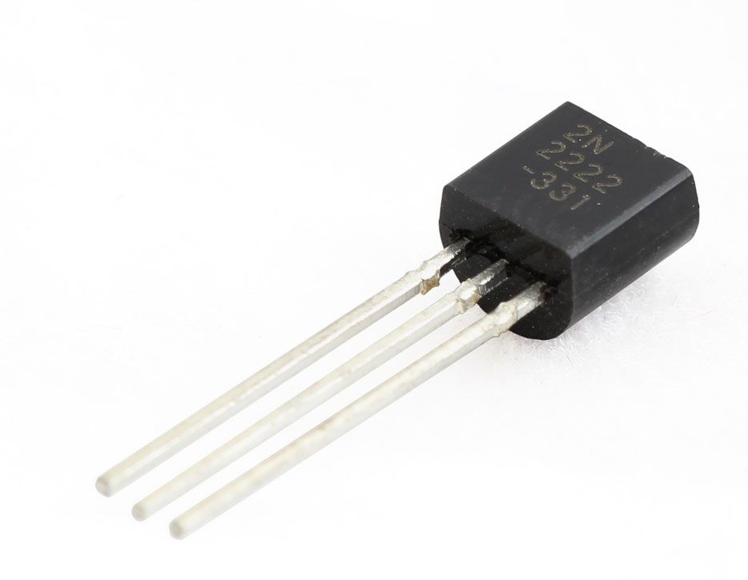
Lab 5: Bipolar Junction Transistors
In this lab we experimented with BJT’s used as a switch.

Slide 28
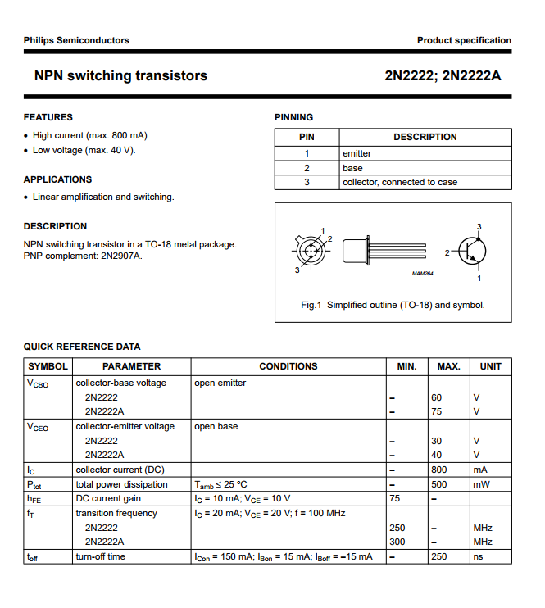
Resources and components
: LED, Breadboard, Function Generator, Multimeter, DC Power Supply, 2x 220 Ohm Resistors, 2N2222A NPN Transistor.
http://ivytechengineering.com/info/stores/transistors/files/2n2222.pdf

Slide 29
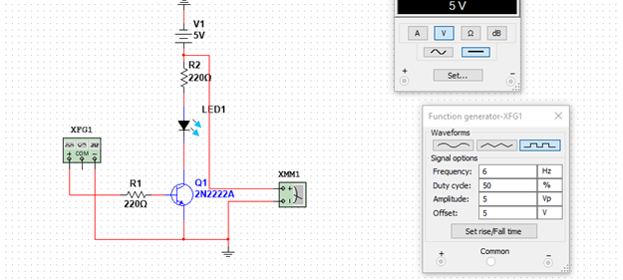
Multisim Design

Slide 30
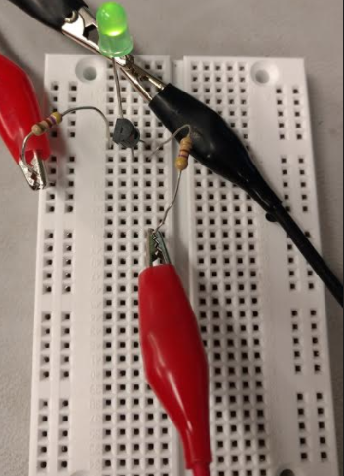
Build and Test:

Slide 31
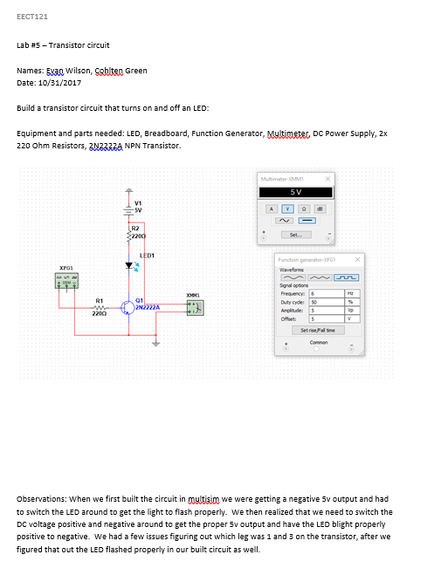
Conclusion and lab notes
Names: ­­­­­­­­­­­­­­­­Evan Wilson, ­­­­­­­­­­­­­­­­Cohlten Green, Jonathan Johnston.
Date: 10/31/2017
Observations: When we first built the circuit in multisim we were getting a negative 5v output and had to switch the LED around to get the light to flash properly. We then realized that we need to switch the DC voltage positive and negative around to get the proper 5v output and have the LED blight properly positive to negative. We had a few issues figuring out which leg was 1 and 3 on the transistor, after we figured that out the LED flashed properly in our built circuit as well.

Slide 32
Lab 6: BTJ’s as Amplifiers
In this lab we experimented with BJT’s used as an amplifier.

Slide 33

Resources and components
Breadboard, Function Generator, Multimeter, DC Power Supply, 2x 50 Ohm Resistors, 1x 22k Ohm Resistor, 1x 220k Ohm Resistor, 1x 1k Ohm Resistor, 47uF Capacitor, 2x 1uF Capacitors, 2N2222A NPN Transistor.
http://www.ivytechengineering.com/info/stores/transistors/files/2n2222.pdf

Slide 34
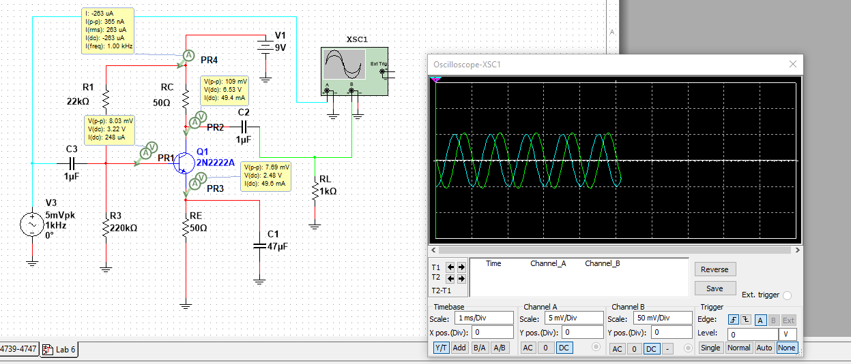
Multisim Design

Slide 35
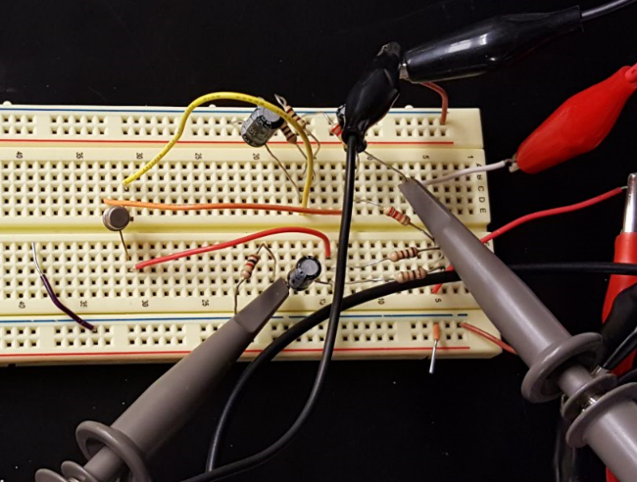
Build and Test:

Slide 36
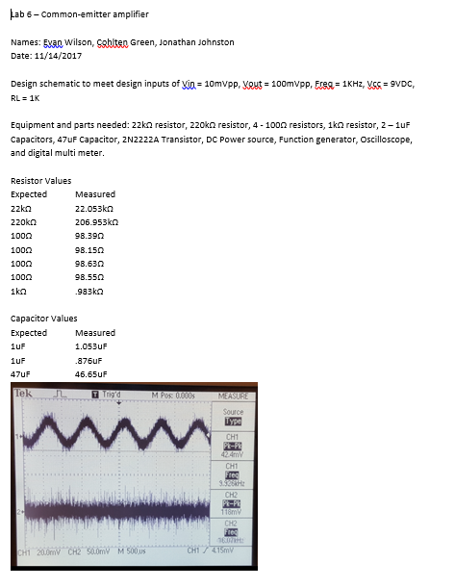
Conclusion and lab notes
Observations: We tested it several times and were unable to come up with the proper measurements. We found that we had wired in one of the resistors incorrectly, once corrected we were able to get the proper reading off of the oscilloscope.

Slide 37
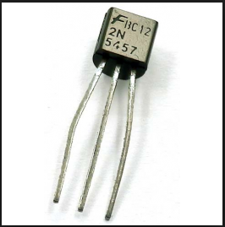
Lab 7: Junction Field Emitting Transistors
In this lab we experimented with JFET’s as a switch.

Slide 38
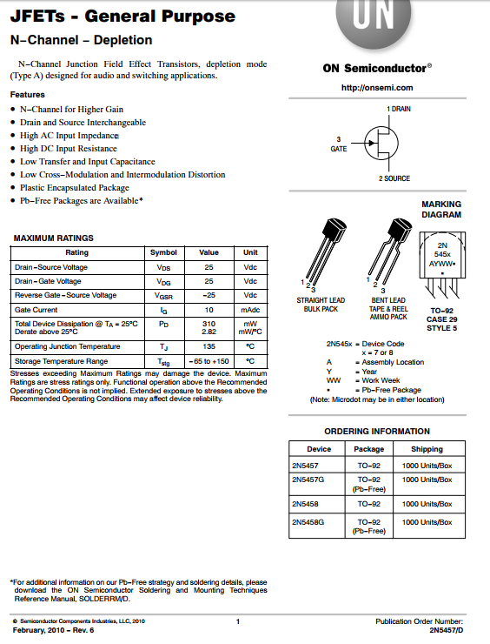
Resources and components
Function Generator, DC power supply, 470 Ohm Resistor, LED, 2N5457 JFET
https://www.onsemi.com/pub/Collateral/2N5457-D.PDF

Slide 39
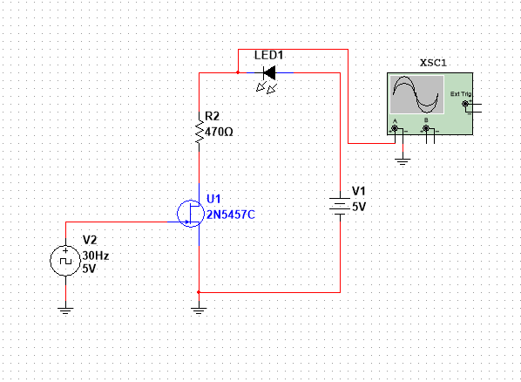
Multisim Design

Slide 40
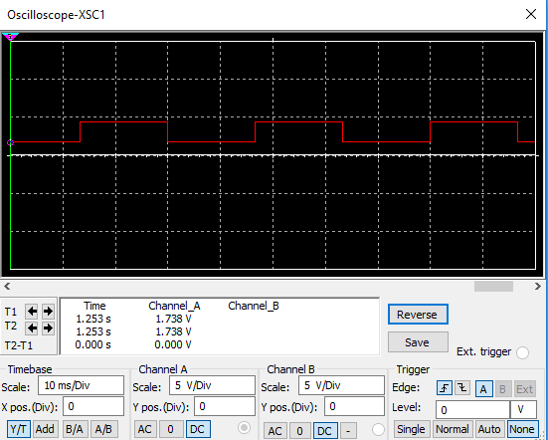
Multisim Oscilloscope:

Slide 41
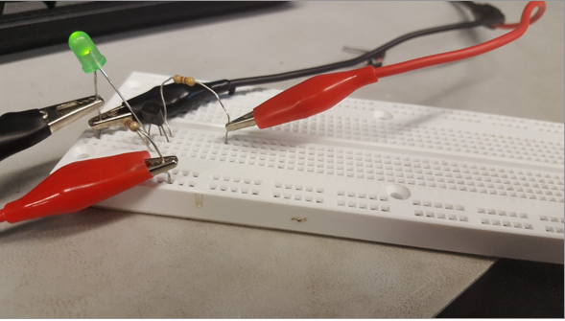
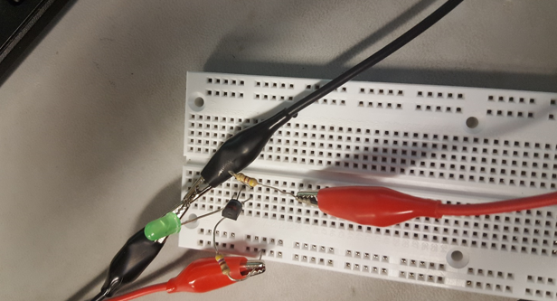
Build and Test:

Slide 42
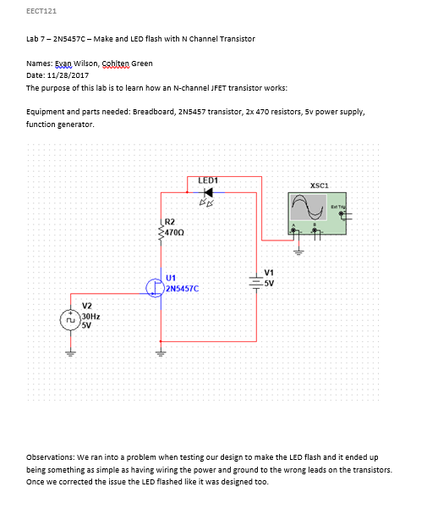
Conclusion and lab notes
Observations: We ran into a problem when testing our design to make the LED flash and it ended up being something as simple as having wiring the power and ground to the wrong leads on the transistors. Once we corrected the issue the LED flashed like it was designed too.

Slide 43
Lab 8: JFET’s as Amplifiers
In this lab we experimented with JFET’s used as an Amplifier.

Slide 44
Resources and components
Function Generator, DC power supply +9 and -5, 4.7k Ohm Resistor, 100k Ohm Resistor, 33k Ohm Resistor, 20k Ohm Resistor, 2x 1uF Capacitor, 2N5457 JFET
https://www.onsemi.com/pub/Collateral/2N5457-D.PDF

Slide 45
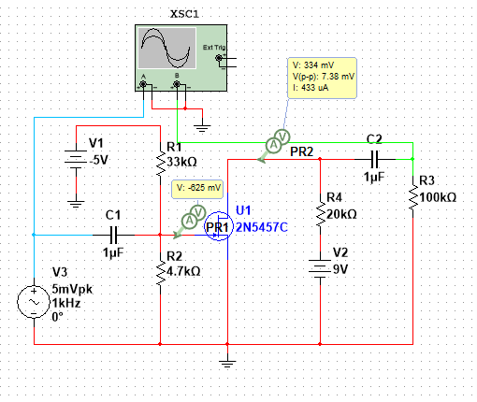
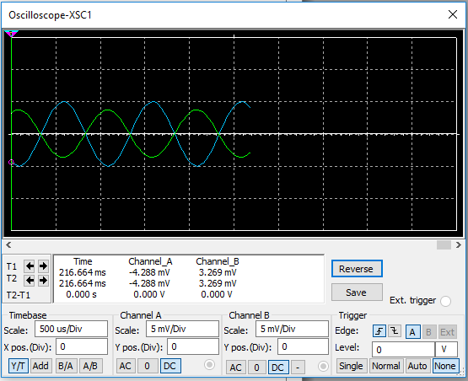
Multisim Design

Slide 46
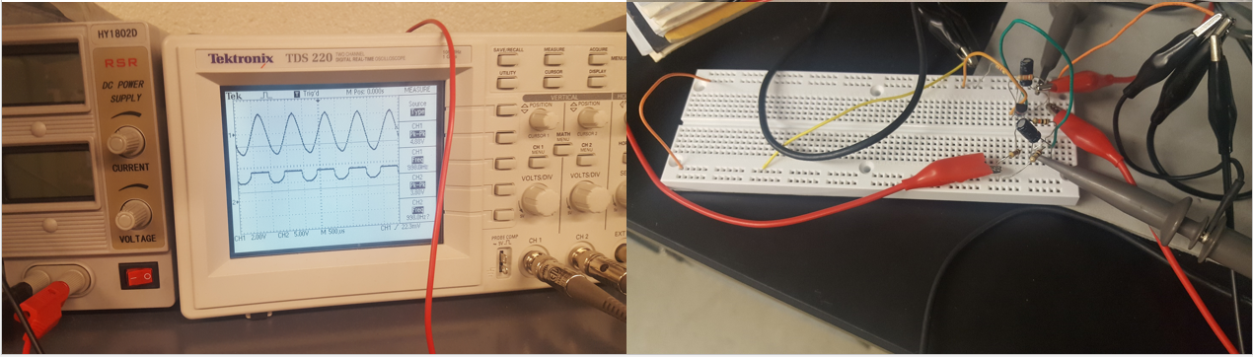
Build and Test:

Slide 47
Conclusion and lab notes
Observations: We had lots of trouble with this lab and were not able actually get it to work the way we were supposed too.

Slide 48
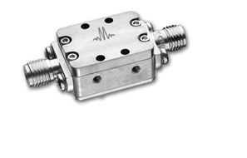
Lab 9: Low Pass Filters
The Low Pass filter is used to filter out lower frequencies from circuits. In this lab using excel we calculated the exact component values needed to filter a specific frequency then simulated it in Multisim.

Slide 49
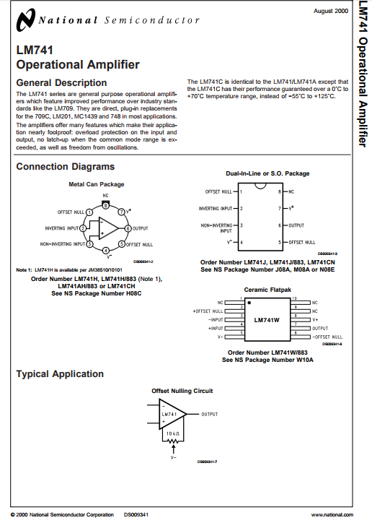
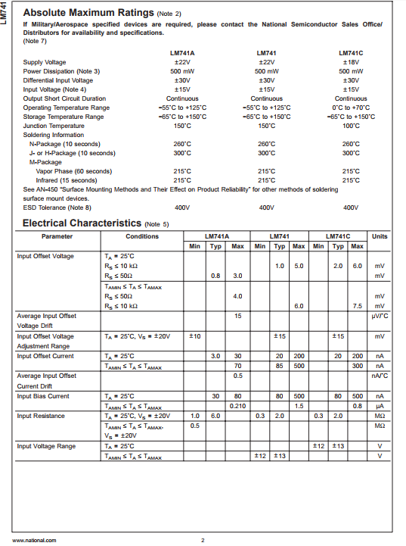
Resources and components
We did not use any resources or components for this lab. It was all completed in Multisim and Excel.
http://www.ivytechengineering.com/info/stores/linear/files/lm741.pdf

Slide 50
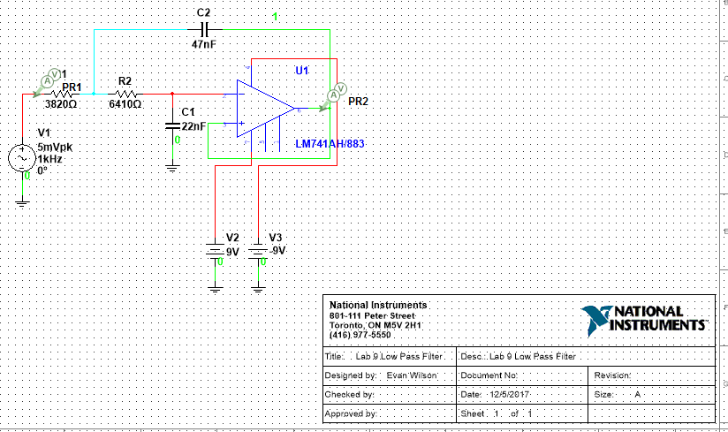
Multisim Design

Slide 51


Conclusion and lab notes
Observations: There were no observations for this lab since we did not physically build the design.
Low Pass filters are used as hiss filters in audio speakers to reduce the high frequency hiss produced in the system.
They are also used as inputs for sub woofers and in equalizers like the one pictured to the right.

Slide 52

Lab 10: High Pass Filters
The High Pass filter is used to filter all frequencies above a set range. In this lab using excel we calculated the exact component values needed to filter a specific frequency then simulated it in Multisim.

Slide 53
Resources and components
We did not use any resources or components for this lab. It was all completed in Multisim and Excel.
http://www.ivytechengineering.com/info/stores/linear/files/lm741.pdf

Slide 54

Multisim Design

Slide 55


Conclusion and lab notes
Observations: There were no observations for this lab since we did not physically build the design.
High pass filters are used in things like microphones in order to filter out certain low-cut sounds like wind or footsteps.
They reduce all outside noise in a microphone so you don’t get all the surrounding noises that you don’t want to record.

Slide 56

Lab 11: Mid-Pass Filter
Mid-pass filters, filter a mid range of frequencies. In this lab using excel we calculated the exact component values needed to filter a specific frequency then simulated it in Multisim.

Slide 57
Resources and components
We did not use any resources or components for this lab. It was all completed in Multisim and Excel.
http://www.ivytechengineering.com/info/stores/linear/files/lm741.pdf

Slide 58

Multisim Design

Slide 59


Conclusion and lab notes
Observations: There were no observations for this lab since we did not physically build the design.
Band pass filters are widely used in wireless transmitters and receivers.
The main function of such a filter in a transmitter is to limit the bandwidth of the output signal to the band allocated for the transmission.
This prevents the transmitter from interfering with other stations.

Slide 60

Lab 12: Notch Filter
The Notch filter is used to isolate specific frequencies in a circuit and filter them out. In this lab using excel we calculated the exact component values needed to filter a specific frequency then simulated it in Multisim.

Slide 61
Resources and components
We did not use any resources or components for this lab. It was all completed in Multisim and Excel.
http://www.ivytechengineering.com/info/stores/linear/files/lm741.pdf

Slide 62

Multisim Design

Slide 63

Conclusion and lab notes
Observations: There were no observations for this lab since we did not physically build the design.

Slide 64

Lab 13: Transformer
We tested several different transformers in this lab in order to determine which one we needed to build our + and – 9v power supplies.

Slide 65

Transformer data:

Slide 66

Resources:
12.6v @ 300MA, 24v @ 300MA, and a 12.6v @ 1Amp.
http://www.farnell.com/datasheets/1943951.pdf

