Slide 1
Lab 7 logic gates
Eect 112
Evan, Mustafa, nick

Slide 2
objective
This lab is intended to introduce the students to be more comfortable with using lab equipment: the logic designer, the test equipment, and the TTL chips.

Slide 3
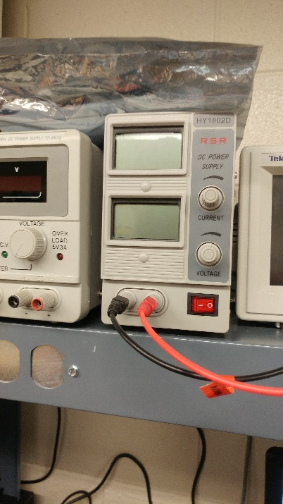
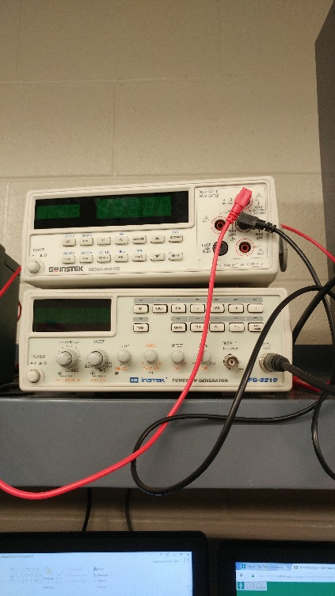
Equipment used
DC power supply – HY1802D
Multimeter – GDM-8245
Breadboard
LED
NOR Gate – SN7402
AND Gate – SN7408
330 Ohm Resistor, 1k Ohm Resistor (2)

Slide 4
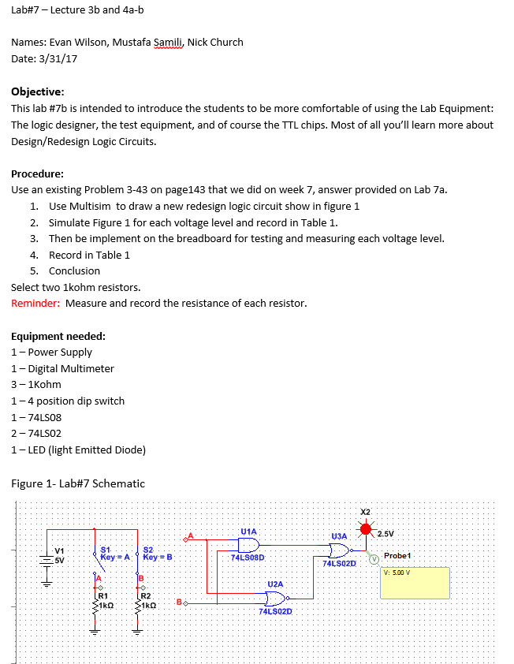
Lab instructions

Slide 5
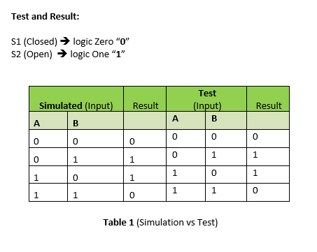
Truth table

Slide 6
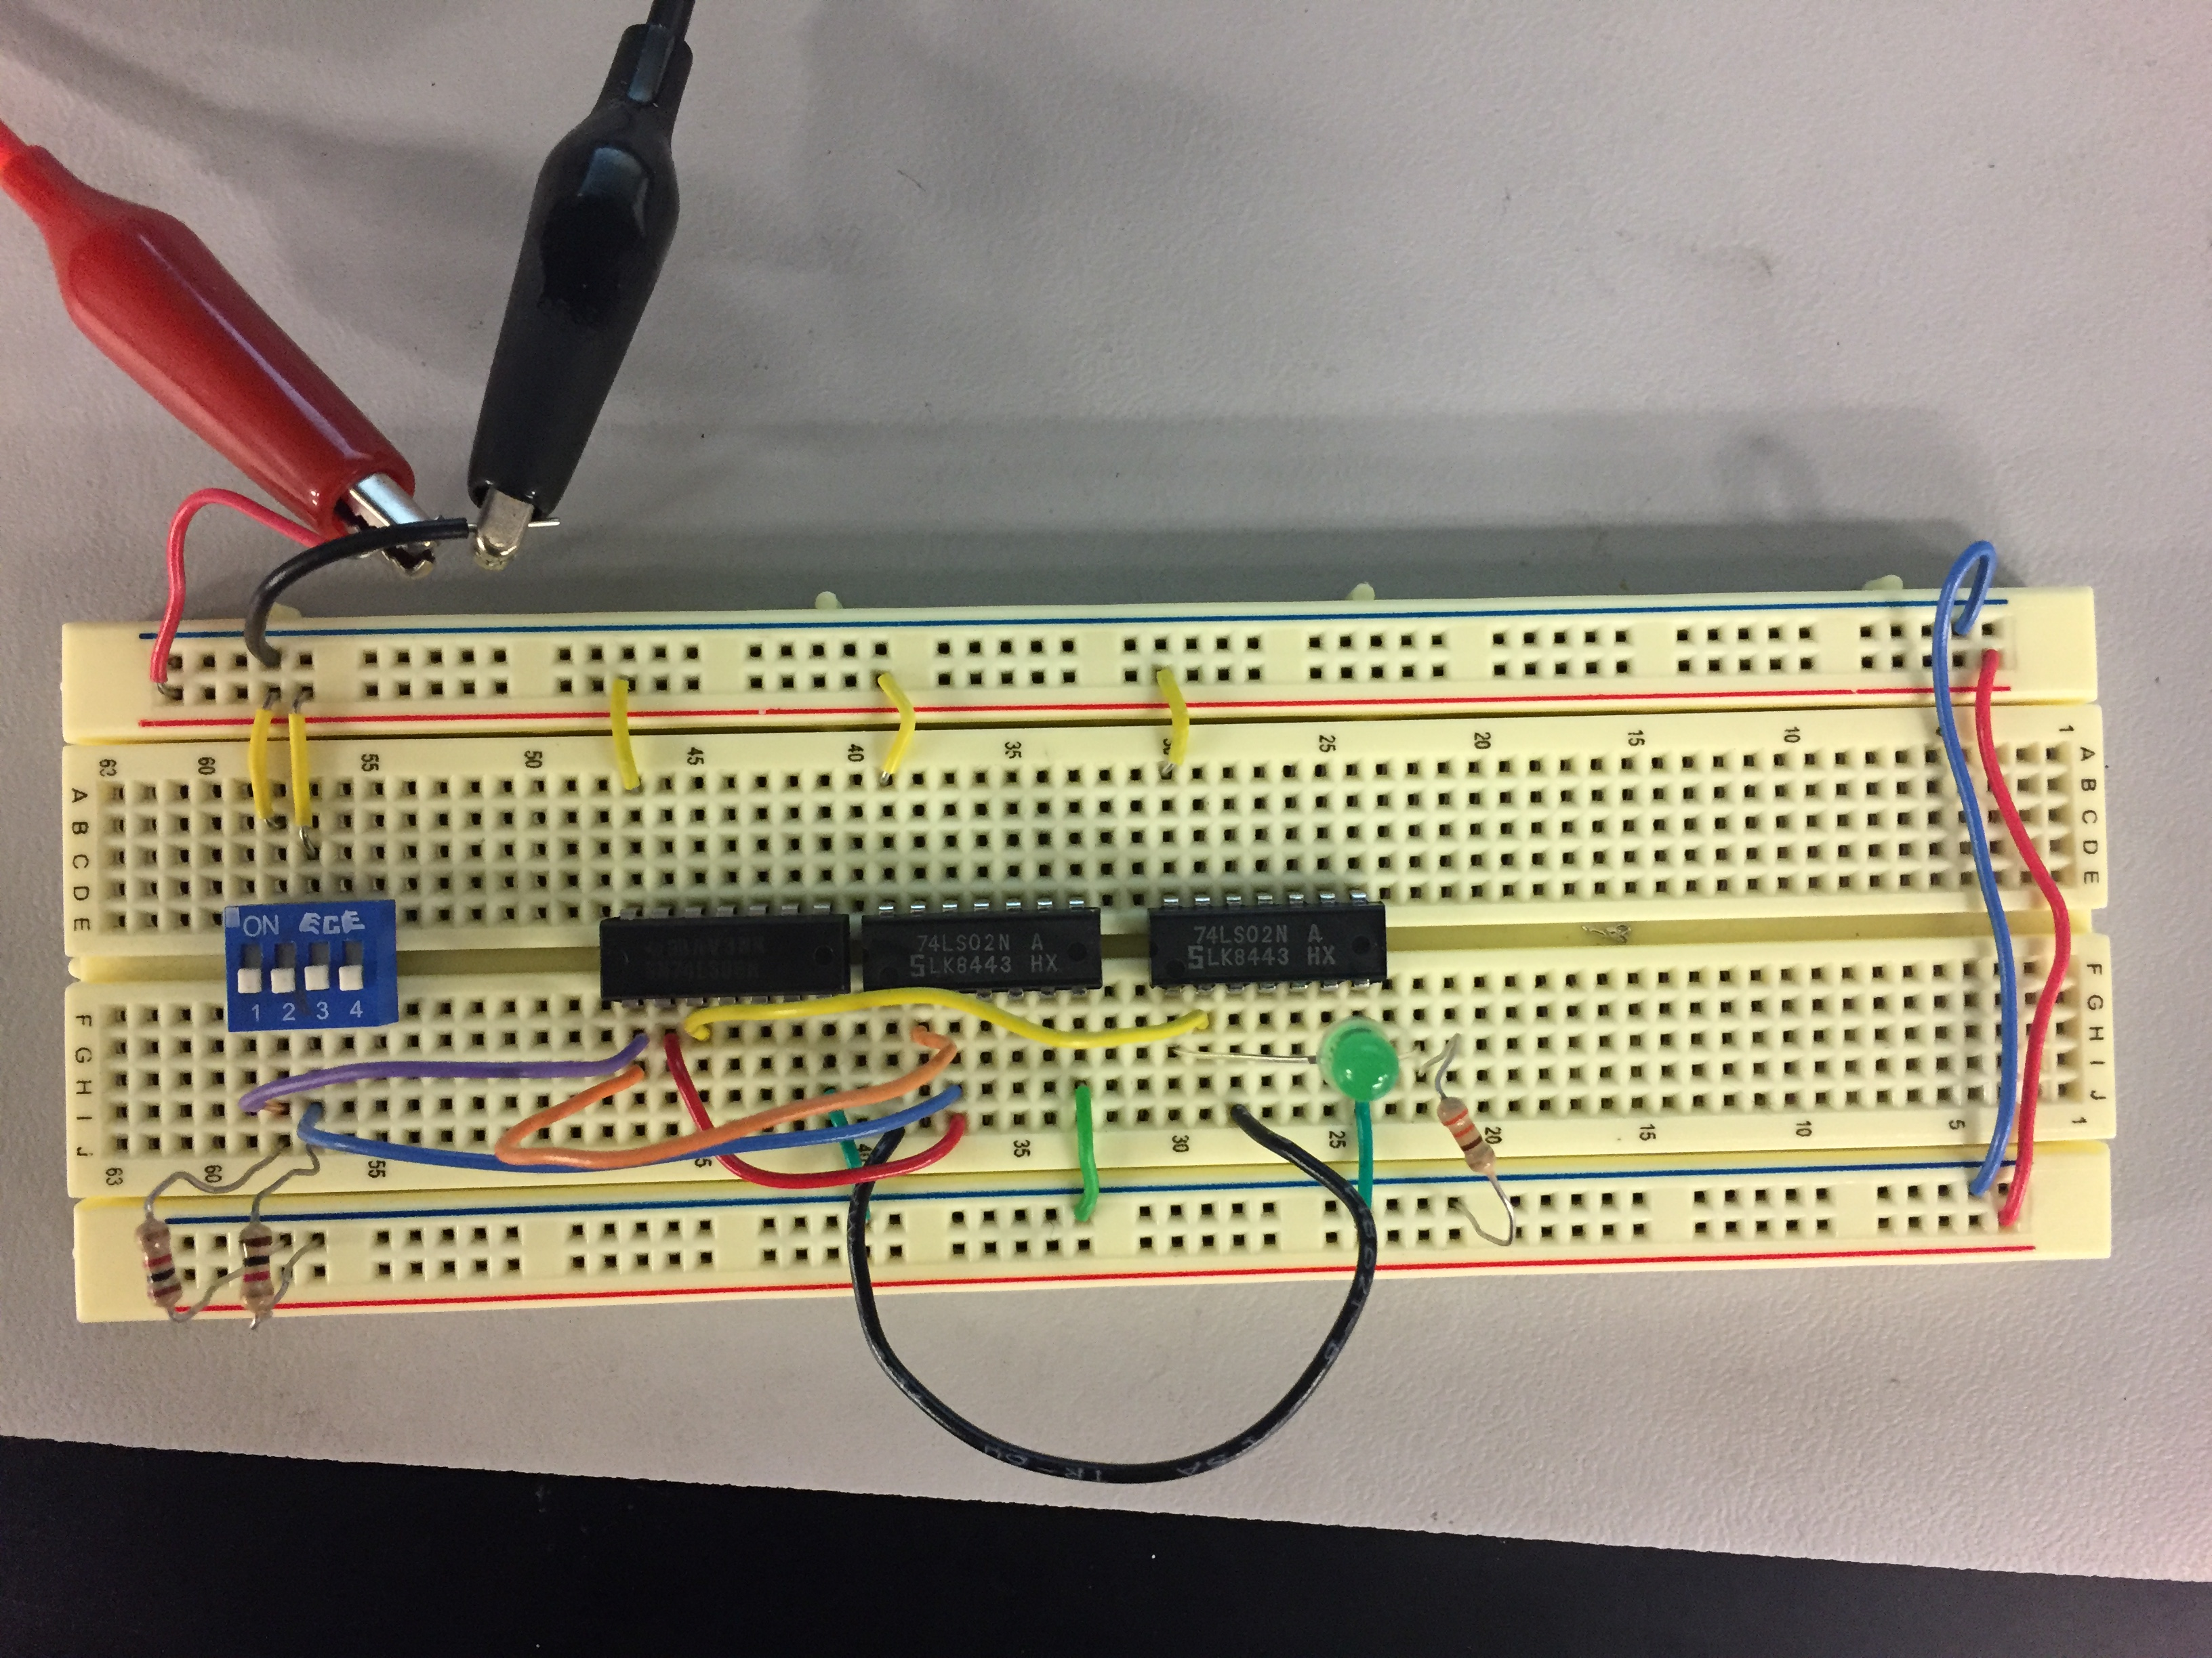
Input A low, input b low

Slide 7
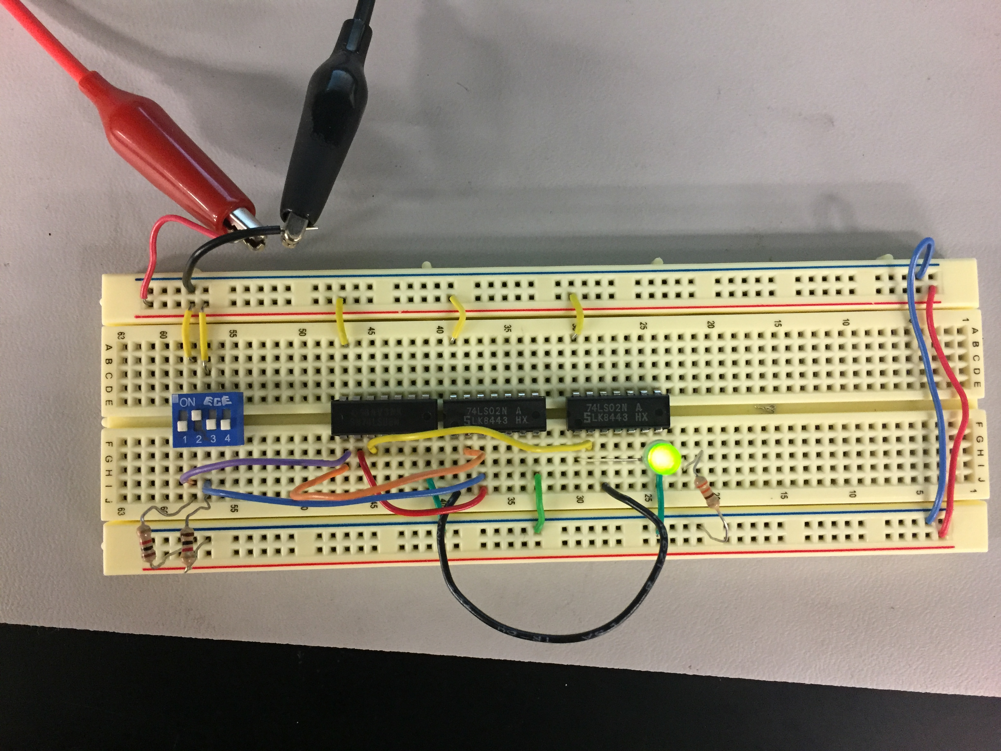
Input a low, input b high

Slide 8
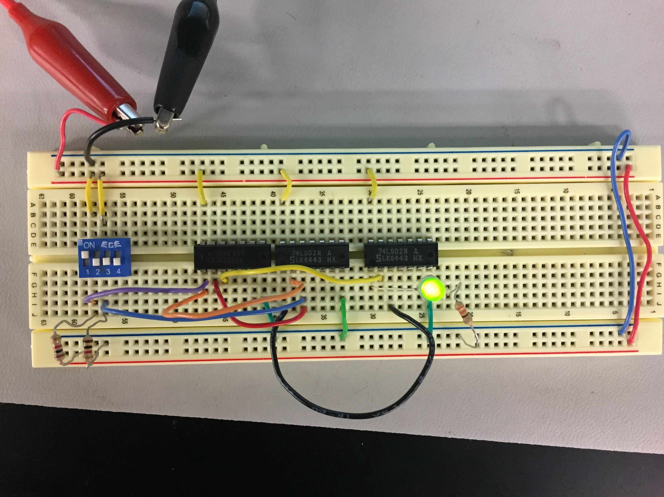
Input a high, input b low

Slide 9
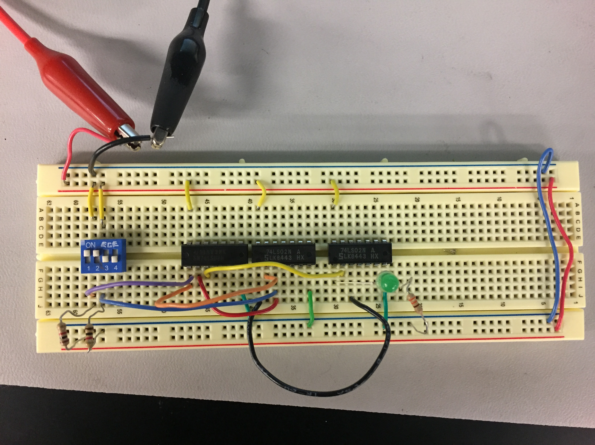
Input a high, input b high

Slide 10
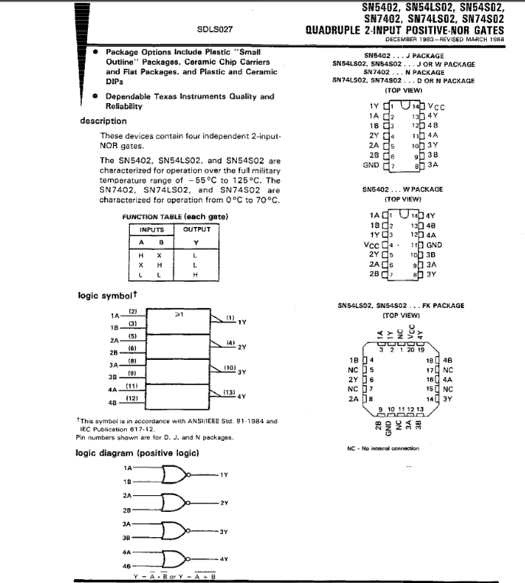
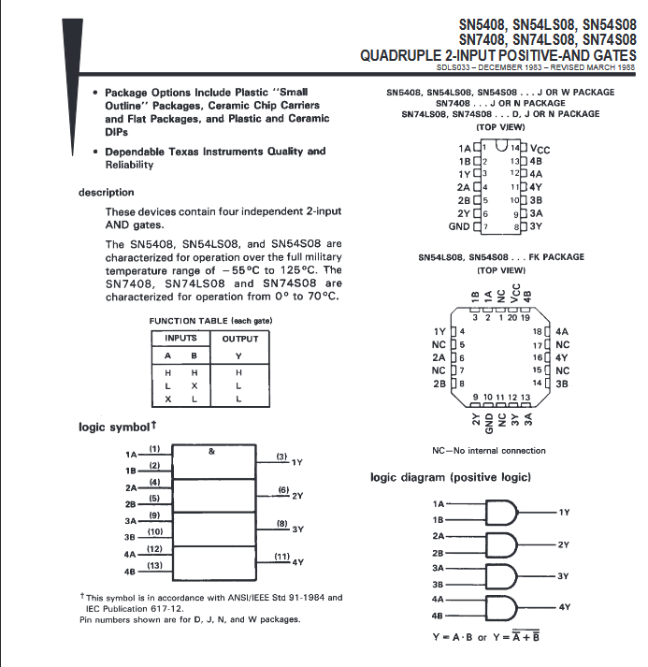
Data sheets

Slide 11
observations
When we first hooked everything up, we could not get the light to come on no matter what the input. We found that we had the LED positive and negative backwards. Once corrected the test worked properly as shown in the previous pictures.

Slide 12
resources
http://www.ivytechengineering.com/info/stores/74ls/index.html

