Slide 1
Lab 6 Kmap
Evan Wilson
March 24, 2017

Slide 2
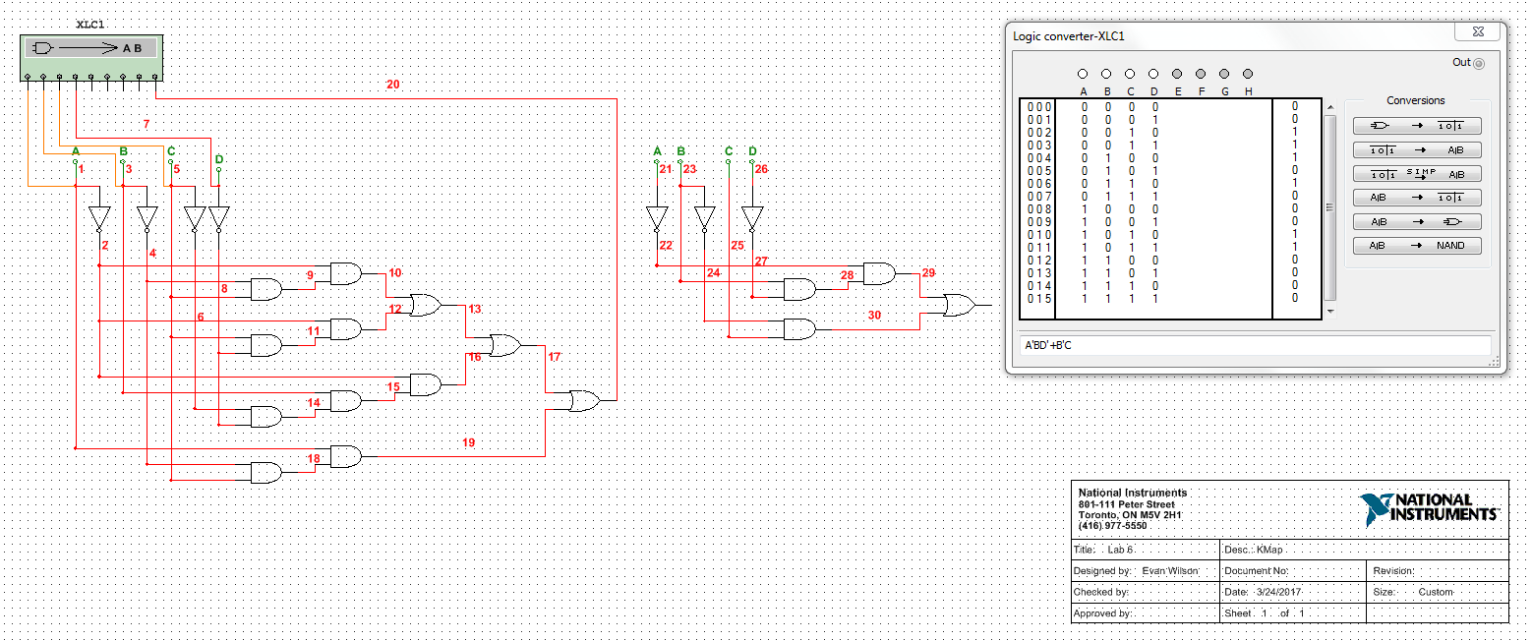
Multisim

