Slide 1
EECT121
Circuit Analysis
Lab Notebook
Fall Dec-15, 2015
Sue Hlaing
Lab Partner: Mike Roeback

Slide 2
Table of the Contents
Lab1-Diode
Lab2-Full Wave &Half Wave Bridge
Lab3-LED
Lab4-Power Supply Design
Lab5-NPN Transistor Switch
Lab6- CE Transistor Amplifier Circuit
Lab7-JFET LED Switch using 2N5457
Lab8-JFET Transistor Amplifier Circuit
Lab9-Band Pass
Lab10-Band Reject or Notch
Lab11-Low Pass
Lab12-High Pass

Slide 3
Project Power Supply Lab 4
Team Members: Sue Hlaing & Mike Roeback
Class: EECT121-50C Fall 2015
Professor: Andy Bell
Notes:
A few weeks ago Mr. Bell assigned us with the task to design, test and build a power supply. Mike and I chose to partner up for this assignment.

Slide 4
Requirements
±9 VDC Output (5% Tolerance), 120 VAC Input
Output Ripple ≤ 100mV
All Linear Components
Start-up time < 100ms
Included Circuit Protection
Maximum Material Cost $25
Schedule
Schematics (Due 9/29/2015)
Bill Of Materials (Due 10/06/2015)
Preliminary Design Review (Due 10/13/2015)
Layout (TBD)
Breadboard (TBD)
Analysis (TBD)
Test (TBD)

Slide 5
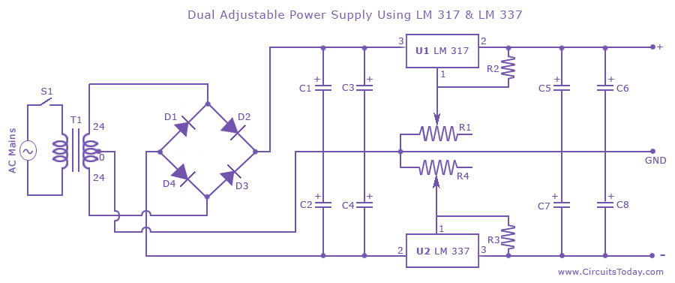
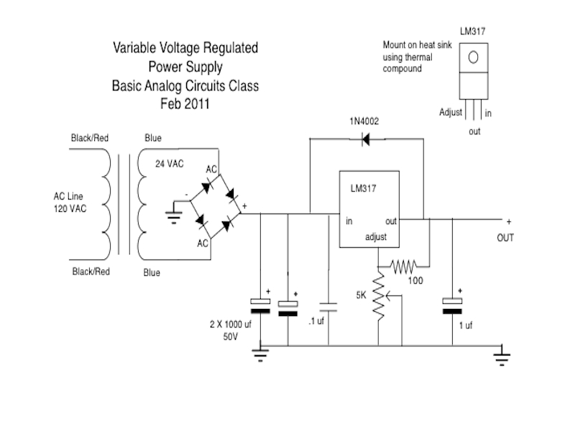
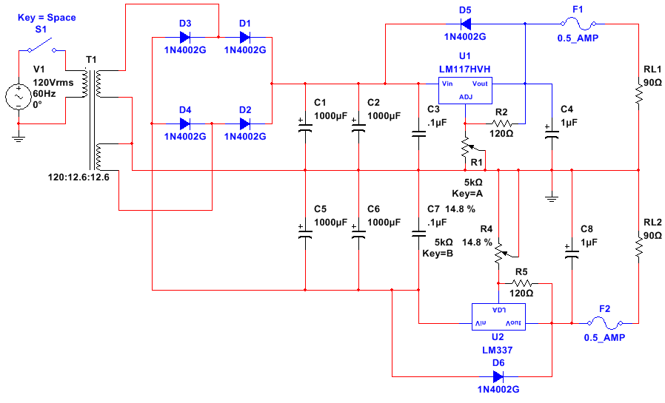
Existing Designs
Above Design located:
http://circuit-diagram.hqew.net/Dual-Adjustable-Power-Supply-Using-LM-317-_8273.html
Upper Right Design located:
http://www.kleebtronics.com/powersupply
Your Design
A Combination of the Two with some help from the LM317 & LM337 Data Sheet

Slide 6
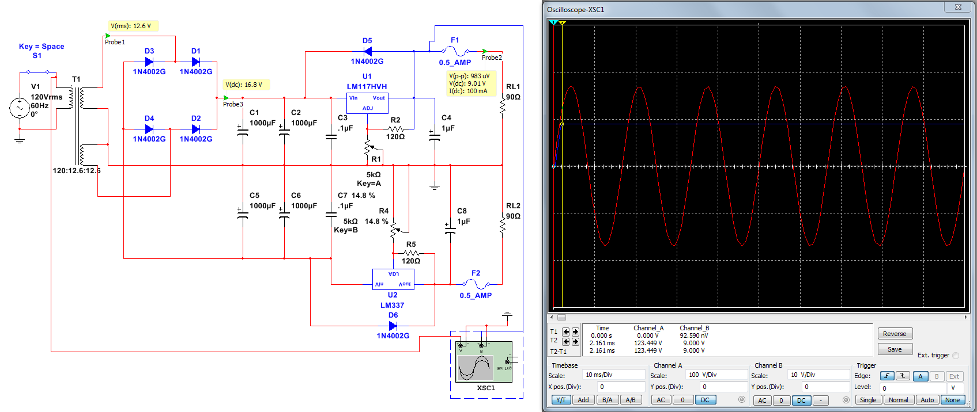
Analysis
Output Ripple ~ 1mV / Voltage Output +0.11% / 100mA Load-tested
Start-up ~ 2.2ms
(Requirement < 100ms)

Slide 7
Bill of Materials

Slide 8
Lab 5
NPN LED Switch using 2N2222
With 74LS04 interface

Slide 9
Objectives:
Equipment and Parts:
    GW Instek LCR meter model#: LCR-819 SN#: E120998
    DC Power Supply Model# HY1802D
    Digital Multi Meter Brand: GwInstek Model #: GDM-8245 SN: CL860332
    LM317 Voltage Regulator
    74LS04 Hex Inverter
    2N2222 NPN Transistor
3 – 1KΩ Resistor, 270 KΩ, 6.8KΩ
1 – Breadboard
1 – Wire kit
1 – Transistor 2N2222A
Hex inverters 74L504D

Slide 10
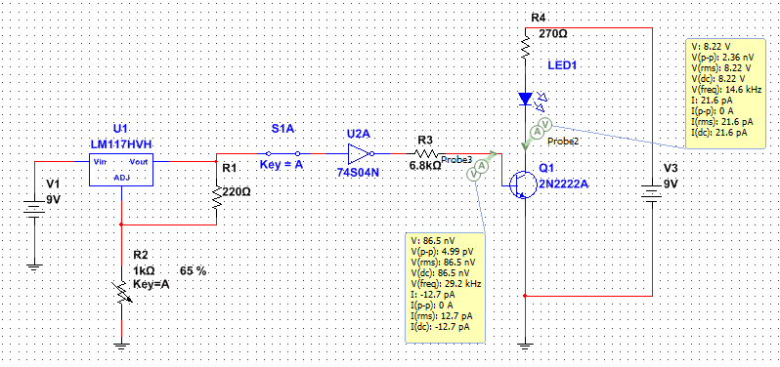
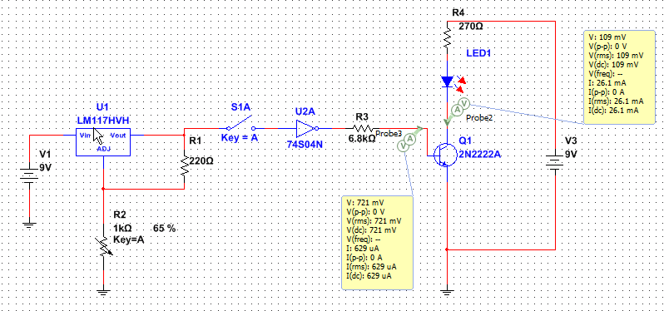
Data/Lab Results/Simulations/Schematics:
Multisim Schematics of the circuit.
Simulation of the circuit with the LED on.
Simulation of the circuit with the LED off.

Slide 11
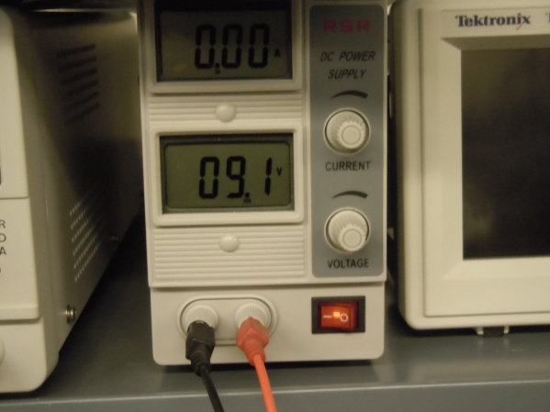
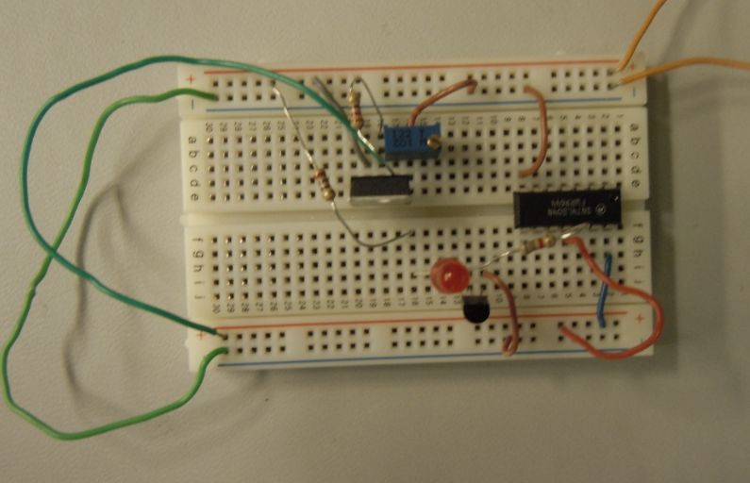
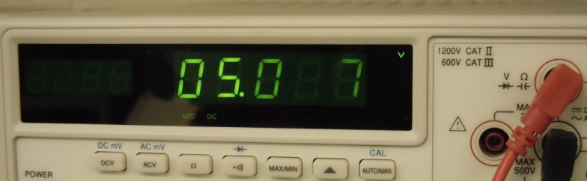
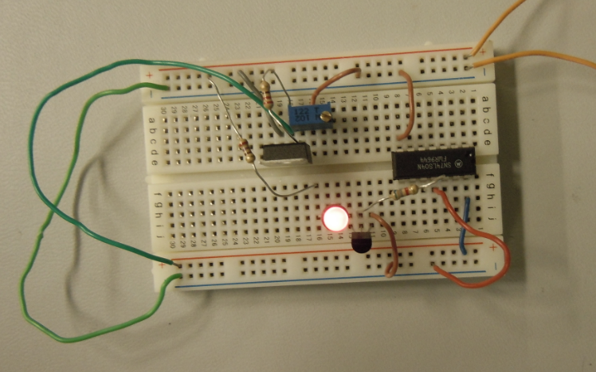
220Ω Resistor
LM317 Voltage Regulator
10kΩ Potentiometer
270Ω Resistor
74LS04 Hex Inverter
6.8kΩ Resistor
Voltage readings of 9V and 5V sources.
LED
2N2222 NPN Transistor
Component | Measured | Expected
Resistor | 26.9E+3 | 27.0E+3 | Ω
Resistor | 216 | 220 | Ω
Resistor | 326.87 | 330 | Ω
Potentiometer | 640 | N/A | Ω
Circuit with LED on
Circuit with LED off

Slide 12
Data Sheets:
2N2222A

Slide 13
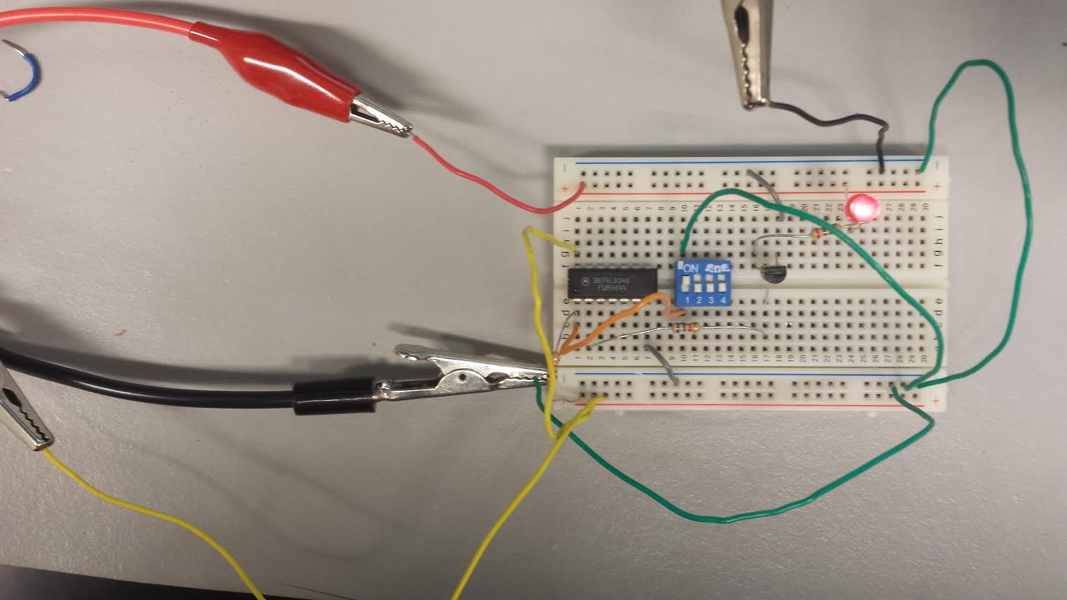
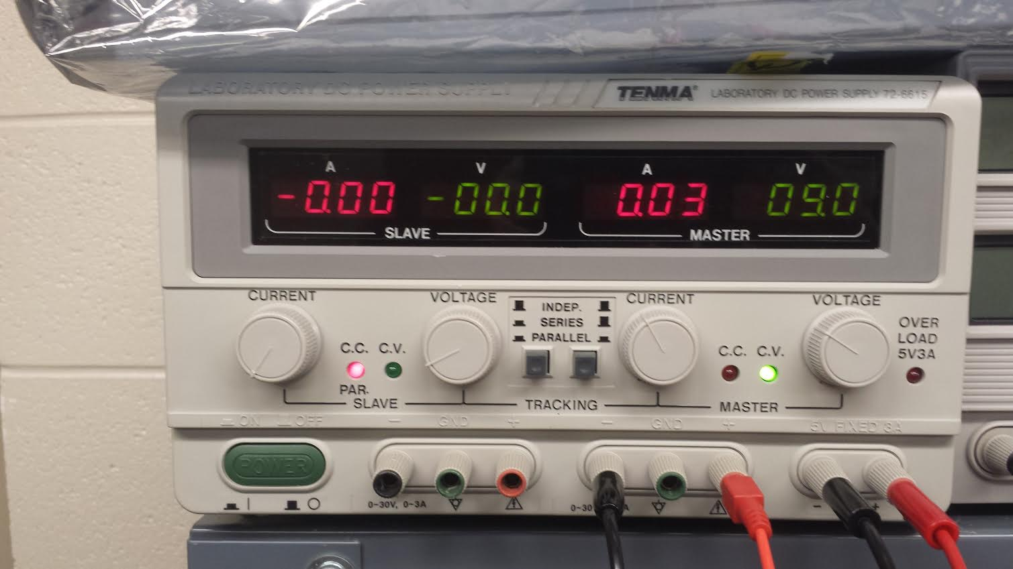
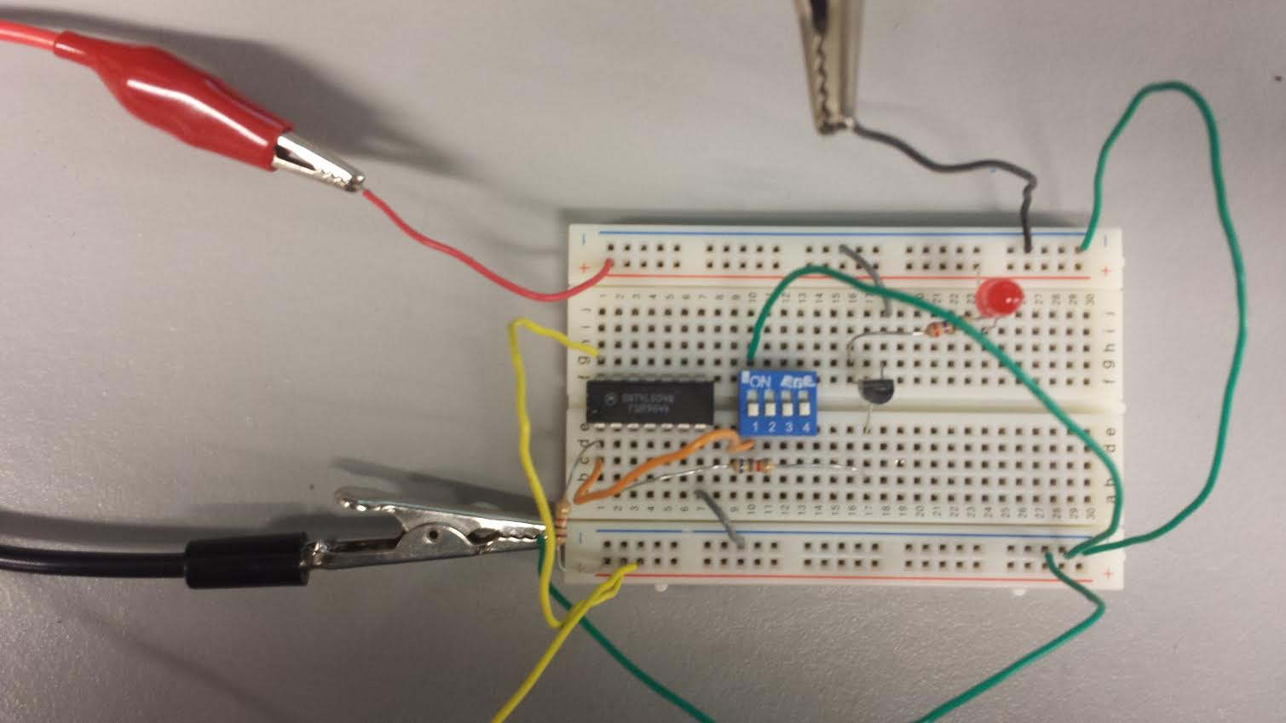
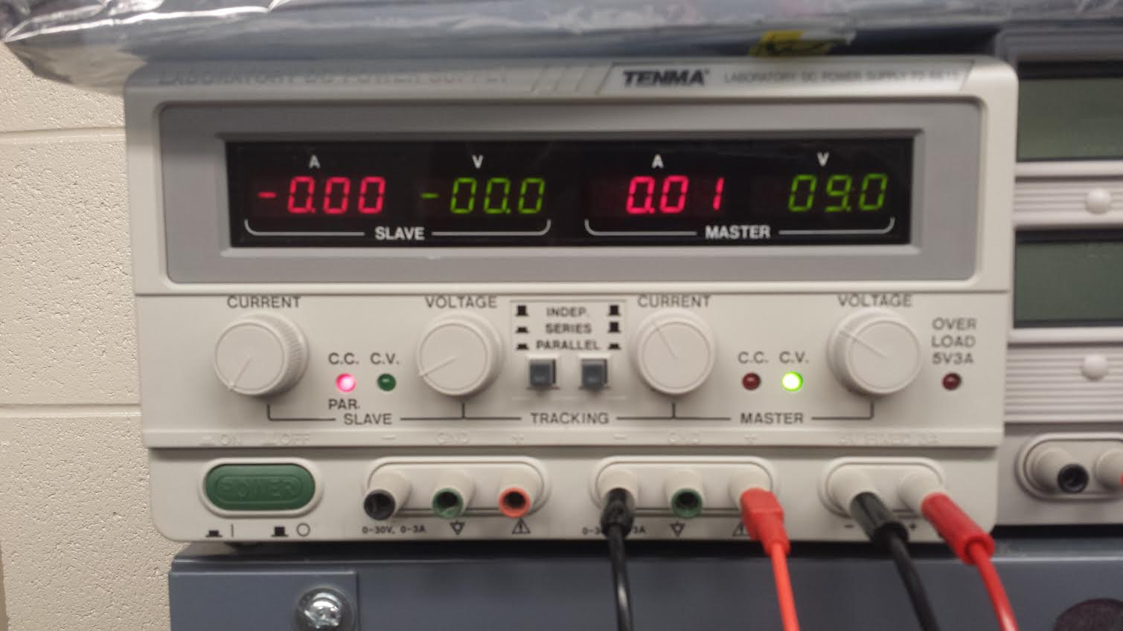

Slide 14
Troubleshooting:

Slide 15
Conclusion:
A transistor can be used as a switch

Slide 16
Lab6
Common-Emitter (CE) Amplifier

Slide 17
Objectives:
To understand the operational characteristics of a common emitter (CE) amplifier and be able determine the maximum output available from a basic CE amplifier
Equipment and Parts:
BENCH 4
Gw instek LCR METER LCR-819
DC power supply
Signal Generator
Oscilloscope
Digital multimeter
Breadboard and wire
    22kΩ Resistor
    47Ω Resistor
    1kΩ Resistor
    150kΩ Resistor
    1μF Capacitor
    22μF Capacitor
    47μF Capacitor
    2N2222 NPN Transistor

Slide 18
Procedures:
Run a baseline simulation to see exactly where you are at with circuit performance
To determine an appropriate load line
To design the RC and RC resistor values
To design the R1 and R2 resistor values
The output amplitude can be adjusted by modifying the value of the CE capacitator.

Slide 19
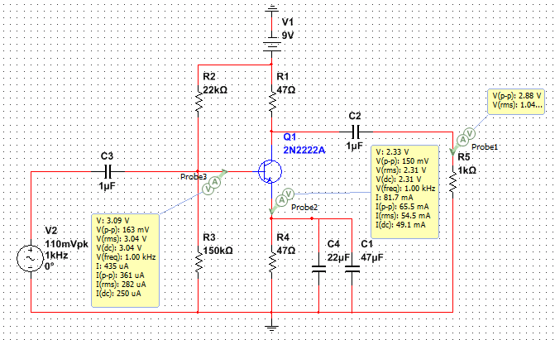
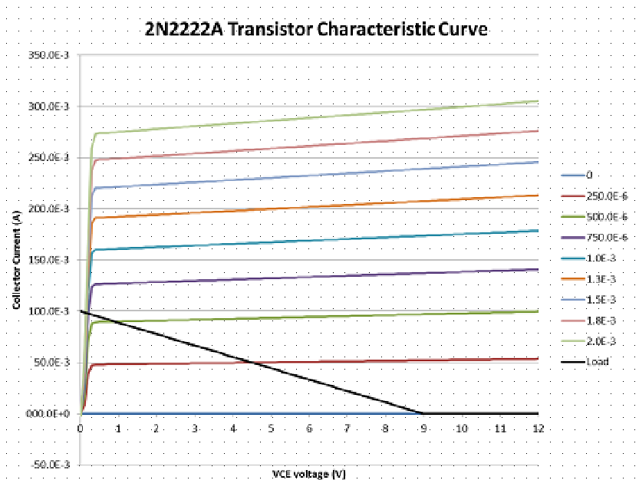
Multisim Schematics of the circuit.
Characteristic Curve for 2N2222 Transistor

Slide 20
Data/Lab Results/Simulations/Schematics:
V_{CE} | 0 | 250.0E-6 | 500.0E-6 | 750.0E-6 | 1.0E-3 | 1.3E-3 | 1.5E-3 | 1.8E-3 | 2.0E-3 | Load
0 | -2.4E-24 | -227.4E-6 | -444.3E-6 | -656.2E-6 | -864.4E-6 | -1.1E-3 | -1.3E-3 | -1.5E-3 | -1.7E-3 | 100.0E-3
0.1 | 1.8E-12 | 8.2E-3 | 16.8E-3 | 24.6E-3 | 31.5E-3 | 37.7E-3 | 43.2E-3 | 48.2E-3 | 52.8E-3 | 98.9E-3
0.2 | 53.3E-12 | 39.2E-3 | 71.3E-3 | 97.5E-3 | 119.2E-3 | 137.5E-3 | 153.1E-3 | 166.7E-3 | 178.5E-3 | 97.8E-3
0.3 | 398.9E-12 | 47.4E-3 | 88.1E-3 | 124.0E-3 | 156.8E-3 | 186.0E-3 | 212.8E-3 | 237.3E-3 | 259.8E-3 | 96.7E-3
0.4 | 533.8E-12 | 48.0E-3 | 89.4E-3 | 126.3E-3 | 160.0E-3 | 191.1E-3 | 220.1E-3 | 247.4E-3 | 273.2E-3 | 95.6E-3
0.5 | 546.8E-12 | 48.1E-3 | 89.6E-3 | 126.6E-3 | 160.3E-3 | 191.4E-3 | 220.5E-3 | 248.0E-3 | 274.1E-3 | 94.4E-3
0.6 | 550.6E-12 | 48.1E-3 | 89.7E-3 | 126.7E-3 | 160.4E-3 | 191.5E-3 | 220.6E-3 | 248.1E-3 | 274.0E-3 | 93.3E-3
0.7 | 552.1E-12 | 48.2E-3 | 89.7E-3 | 126.8E-3 | 160.6E-3 | 191.7E-3 | 220.9E-3 | 248.3E-3 | 274.3E-3 | 92.2E-3
0.8 | 554.2E-12 | 48.2E-3 | 89.8E-3 | 126.9E-3 | 160.7E-3 | 191.9E-3 | 221.1E-3 | 248.5E-3 | 274.6E-3 | 91.1E-3
0.9 | 556.6E-12 | 48.3E-3 | 89.9E-3 | 127.1E-3 | 160.9E-3 | 192.1E-3 | 221.3E-3 | 248.8E-3 | 274.8E-3 | 90.0E-3
1 | 558.9E-12 | 48.3E-3 | 90.0E-3 | 127.2E-3 | 161.0E-3 | 192.3E-3 | 221.5E-3 | 249.0E-3 | 275.1E-3 | 88.9E-3
1.1 | 561.3E-12 | 48.3E-3 | 90.1E-3 | 127.3E-3 | 161.2E-3 | 192.5E-3 | 221.7E-3 | 249.3E-3 | 275.4E-3 | 87.8E-3
1.2 | 563.6E-12 | 48.4E-3 | 90.2E-3 | 127.4E-3 | 161.3E-3 | 192.7E-3 | 222.0E-3 | 249.5E-3 | 275.7E-3 | 86.7E-3
1.3 | 566.0E-12 | 48.4E-3 | 90.3E-3 | 127.6E-3 | 161.5E-3 | 192.9E-3 | 222.2E-3 | 249.8E-3 | 275.9E-3 | 85.6E-3
1.4 | 568.3E-12 | 48.5E-3 | 90.4E-3 | 127.7E-3 | 161.7E-3 | 193.1E-3 | 222.4E-3 | 250.0E-3 | 276.2E-3 | 84.4E-3
1.5 | 570.7E-12 | 48.5E-3 | 90.5E-3 | 127.8E-3 | 161.8E-3 | 193.3E-3 | 222.6E-3 | 250.3E-3 | 276.5E-3 | 83.3E-3
1.6 | 573.0E-12 | 48.6E-3 | 90.5E-3 | 127.9E-3 | 162.0E-3 | 193.4E-3 | 222.8E-3 | 250.5E-3 | 276.7E-3 | 82.2E-3
1.7 | 575.4E-12 | 48.6E-3 | 90.6E-3 | 128.1E-3 | 162.1E-3 | 193.6E-3 | 223.1E-3 | 250.8E-3 | 277.0E-3 | 81.1E-3
1.8 | 577.7E-12 | 48.7E-3 | 90.7E-3 | 128.2E-3 | 162.3E-3 | 193.8E-3 | 223.3E-3 | 251.0E-3 | 277.3E-3 | 80.0E-3
1.9 | 580.1E-12 | 48.7E-3 | 90.8E-3 | 128.3E-3 | 162.5E-3 | 194.0E-3 | 223.5E-3 | 251.2E-3 | 277.6E-3 | 78.9E-3
2 | 582.5E-12 | 48.8E-3 | 90.9E-3 | 128.4E-3 | 162.6E-3 | 194.2E-3 | 223.7E-3 | 251.5E-3 | 277.8E-3 | 77.8E-3
2.1 | 584.9E-12 | 48.8E-3 | 91.0E-3 | 128.6E-3 | 162.8E-3 | 194.4E-3 | 223.9E-3 | 251.7E-3 | 278.1E-3 | 76.7E-3
2.2 | 587.3E-12 | 48.9E-3 | 91.1E-3 | 128.7E-3 | 162.9E-3 | 194.6E-3 | 224.1E-3 | 252.0E-3 | 278.4E-3 | 75.6E-3
2.3 | 589.6E-12 | 48.9E-3 | 91.2E-3 | 128.8E-3 | 163.1E-3 | 194.8E-3 | 224.4E-3 | 252.2E-3 | 278.6E-3 | 74.4E-3
2.4 | 592.0E-12 | 49.0E-3 | 91.2E-3 | 128.9E-3 | 163.3E-3 | 195.0E-3 | 224.6E-3 | 252.5E-3 | 278.9E-3 | 73.3E-3
2.5 | 594.4E-12 | 49.0E-3 | 91.3E-3 | 129.1E-3 | 163.4E-3 | 195.2E-3 | 224.8E-3 | 252.7E-3 | 279.2E-3 | 72.2E-3
2.6 | 596.8E-12 | 49.1E-3 | 91.4E-3 | 129.2E-3 | 163.6E-3 | 195.3E-3 | 225.0E-3 | 253.0E-3 | 279.5E-3 | 71.1E-3
2.7 | 599.3E-12 | 49.1E-3 | 91.5E-3 | 129.3E-3 | 163.7E-3 | 195.5E-3 | 225.2E-3 | 253.2E-3 | 279.7E-3 | 70.0E-3
2.8 | 601.7E-12 | 49.2E-3 | 91.6E-3 | 129.4E-3 | 163.9E-3 | 195.7E-3 | 225.5E-3 | 253.5E-3 | 280.0E-3 | 68.9E-3
2.9 | 604.1E-12 | 49.2E-3 | 91.7E-3 | 129.6E-3 | 164.0E-3 | 195.9E-3 | 225.7E-3 | 253.7E-3 | 280.3E-3 | 67.8E-3
3 | 606.5E-12 | 49.3E-3 | 91.8E-3 | 129.7E-3 | 164.2E-3 | 196.1E-3 | 225.9E-3 | 254.0E-3 | 280.5E-3 | 66.7E-3
3.1 | 608.9E-12 | 49.3E-3 | 91.9E-3 | 129.8E-3 | 164.4E-3 | 196.3E-3 | 226.1E-3 | 254.2E-3 | 280.8E-3 | 65.6E-3
3.2 | 611.4E-12 | 49.3E-3 | 92.0E-3 | 129.9E-3 | 164.5E-3 | 196.5E-3 | 226.3E-3 | 254.4E-3 | 281.1E-3 | 64.4E-3
3.3 | 613.8E-12 | 49.4E-3 | 92.0E-3 | 130.1E-3 | 164.7E-3 | 196.7E-3 | 226.6E-3 | 254.7E-3 | 281.4E-3 | 63.3E-3
3.4 | 616.2E-12 | 49.4E-3 | 92.1E-3 | 130.2E-3 | 164.8E-3 | 196.9E-3 | 226.8E-3 | 254.9E-3 | 281.6E-3 | 62.2E-3
3.5 | 618.7E-12 | 49.5E-3 | 92.2E-3 | 130.3E-3 | 165.0E-3 | 197.0E-3 | 227.0E-3 | 255.2E-3 | 281.9E-3 | 61.1E-3
3.6 | 621.1E-12 | 49.5E-3 | 92.3E-3 | 130.4E-3 | 165.2E-3 | 197.2E-3 | 227.2E-3 | 255.4E-3 | 282.2E-3 | 60.0E-3
3.7 | 623.6E-12 | 49.6E-3 | 92.4E-3 | 130.6E-3 | 165.3E-3 | 197.4E-3 | 227.4E-3 | 255.7E-3 | 282.4E-3 | 58.9E-3
3.8 | 626.0E-12 | 49.6E-3 | 92.5E-3 | 130.7E-3 | 165.5E-3 | 197.6E-3 | 227.6E-3 | 255.9E-3 | 282.7E-3 | 57.8E-3
3.9 | 628.5E-12 | 49.7E-3 | 92.6E-3 | 130.8E-3 | 165.6E-3 | 197.8E-3 | 227.9E-3 | 256.2E-3 | 283.0E-3 | 56.7E-3
4 | 631.0E-12 | 49.7E-3 | 92.7E-3 | 130.9E-3 | 165.8E-3 | 198.0E-3 | 228.1E-3 | 256.4E-3 | 283.3E-3 | 55.6E-3
4.1 | 633.4E-12 | 49.8E-3 | 92.8E-3 | 131.1E-3 | 166.0E-3 | 198.2E-3 | 228.3E-3 | 256.7E-3 | 283.5E-3 | 54.4E-3
4.2 | 635.9E-12 | 49.8E-3 | 92.8E-3 | 131.2E-3 | 166.1E-3 | 198.4E-3 | 228.5E-3 | 256.9E-3 | 283.8E-3 | 53.3E-3
4.3 | 638.4E-12 | 49.9E-3 | 92.9E-3 | 131.3E-3 | 166.3E-3 | 198.6E-3 | 228.7E-3 | 257.1E-3 | 284.1E-3 | 52.2E-3
4.4 | 640.9E-12 | 49.9E-3 | 93.0E-3 | 131.4E-3 | 166.4E-3 | 198.8E-3 | 229.0E-3 | 257.4E-3 | 284.3E-3 | 51.1E-3
4.5 | 643.4E-12 | 50.0E-3 | 93.1E-3 | 131.6E-3 | 166.6E-3 | 198.9E-3 | 229.2E-3 | 257.6E-3 | 284.6E-3 | 50.0E-3
4.6 | 645.8E-12 | 50.0E-3 | 93.2E-3 | 131.7E-3 | 166.7E-3 | 199.1E-3 | 229.4E-3 | 257.9E-3 | 284.9E-3 | 48.9E-3
4.7 | 648.4E-12 | 50.1E-3 | 93.3E-3 | 131.8E-3 | 166.9E-3 | 199.3E-3 | 229.6E-3 | 258.1E-3 | 285.2E-3 | 47.8E-3
4.8 | 650.9E-12 | 50.1E-3 | 93.4E-3 | 131.9E-3 | 167.1E-3 | 199.5E-3 | 229.8E-3 | 258.4E-3 | 285.4E-3 | 46.7E-3
4.9 | 653.4E-12 | 50.2E-3 | 93.5E-3 | 132.1E-3 | 167.2E-3 | 199.7E-3 | 230.0E-3 | 258.6E-3 | 285.7E-3 | 45.6E-3
5 | 655.9E-12 | 50.2E-3 | 93.6E-3 | 132.2E-3 | 167.4E-3 | 199.9E-3 | 230.3E-3 | 258.9E-3 | 286.0E-3 | 44.4E-3
5.1 | 658.4E-12 | 50.3E-3 | 93.6E-3 | 132.3E-3 | 167.5E-3 | 200.1E-3 | 230.5E-3 | 259.1E-3 | 286.2E-3 | 43.3E-3
5.2 | 660.9E-12 | 50.3E-3 | 93.7E-3 | 132.4E-3 | 167.7E-3 | 200.3E-3 | 230.7E-3 | 259.4E-3 | 286.5E-3 | 42.2E-3
5.3 | 663.5E-12 | 50.3E-3 | 93.8E-3 | 132.6E-3 | 167.9E-3 | 200.5E-3 | 230.9E-3 | 259.6E-3 | 286.8E-3 | 41.1E-3
5.4 | 666.0E-12 | 50.4E-3 | 93.9E-3 | 132.7E-3 | 168.0E-3 | 200.7E-3 | 231.1E-3 | 259.8E-3 | 287.1E-3 | 40.0E-3
5.5 | 668.5E-12 | 50.4E-3 | 94.0E-3 | 132.8E-3 | 168.2E-3 | 200.8E-3 | 231.4E-3 | 260.1E-3 | 287.3E-3 | 38.9E-3
5.6 | 671.0E-12 | 50.5E-3 | 94.1E-3 | 132.9E-3 | 168.3E-3 | 201.0E-3 | 231.6E-3 | 260.3E-3 | 287.6E-3 | 37.8E-3
5.7 | 673.6E-12 | 50.5E-3 | 94.2E-3 | 133.1E-3 | 168.5E-3 | 201.2E-3 | 231.8E-3 | 260.6E-3 | 287.9E-3 | 36.7E-3
5.8 | 676.1E-12 | 50.6E-3 | 94.3E-3 | 133.2E-3 | 168.7E-3 | 201.4E-3 | 232.0E-3 | 260.8E-3 | 288.1E-3 | 35.6E-3
5.9 | 678.7E-12 | 50.6E-3 | 94.4E-3 | 133.3E-3 | 168.8E-3 | 201.6E-3 | 232.2E-3 | 261.1E-3 | 288.4E-3 | 34.4E-3
6 | 681.3E-12 | 50.7E-3 | 94.4E-3 | 133.4E-3 | 169.0E-3 | 201.8E-3 | 232.5E-3 | 261.3E-3 | 288.7E-3 | 33.3E-3
6.1 | 683.8E-12 | 50.7E-3 | 94.5E-3 | 133.6E-3 | 169.1E-3 | 202.0E-3 | 232.7E-3 | 261.6E-3 | 289.0E-3 | 32.2E-3
6.2 | 686.4E-12 | 50.8E-3 | 94.6E-3 | 133.7E-3 | 169.3E-3 | 202.2E-3 | 232.9E-3 | 261.8E-3 | 289.2E-3 | 31.1E-3
6.3 | 688.9E-12 | 50.8E-3 | 94.7E-3 | 133.8E-3 | 169.4E-3 | 202.4E-3 | 233.1E-3 | 262.1E-3 | 289.5E-3 | 30.0E-3
6.4 | 691.5E-12 | 50.9E-3 | 94.8E-3 | 134.0E-3 | 169.6E-3 | 202.6E-3 | 233.3E-3 | 262.3E-3 | 289.8E-3 | 28.9E-3
6.5 | 694.1E-12 | 50.9E-3 | 94.9E-3 | 134.1E-3 | 169.8E-3 | 202.7E-3 | 233.5E-3 | 262.6E-3 | 290.0E-3 | 27.8E-3
6.6 | 696.7E-12 | 51.0E-3 | 95.0E-3 | 134.2E-3 | 169.9E-3 | 202.9E-3 | 233.8E-3 | 262.8E-3 | 290.3E-3 | 26.7E-3
6.7 | 699.3E-12 | 51.0E-3 | 95.1E-3 | 134.3E-3 | 170.1E-3 | 203.1E-3 | 234.0E-3 | 263.0E-3 | 290.6E-3 | 25.6E-3
6.8 | 701.9E-12 | 51.1E-3 | 95.2E-3 | 134.5E-3 | 170.2E-3 | 203.3E-3 | 234.2E-3 | 263.3E-3 | 290.9E-3 | 24.4E-3
6.9 | 704.5E-12 | 51.1E-3 | 95.2E-3 | 134.6E-3 | 170.4E-3 | 203.5E-3 | 234.4E-3 | 263.5E-3 | 291.1E-3 | 23.3E-3
7 | 707.1E-12 | 51.2E-3 | 95.3E-3 | 134.7E-3 | 170.6E-3 | 203.7E-3 | 234.6E-3 | 263.8E-3 | 291.4E-3 | 22.2E-3
7.1 | 709.7E-12 | 51.2E-3 | 95.4E-3 | 134.8E-3 | 170.7E-3 | 203.9E-3 | 234.9E-3 | 264.0E-3 | 291.7E-3 | 21.1E-3
7.2 | 712.3E-12 | 51.3E-3 | 95.5E-3 | 135.0E-3 | 170.9E-3 | 204.1E-3 | 235.1E-3 | 264.3E-3 | 291.9E-3 | 20.0E-3
7.3 | 714.9E-12 | 51.3E-3 | 95.6E-3 | 135.1E-3 | 171.0E-3 | 204.3E-3 | 235.3E-3 | 264.5E-3 | 292.2E-3 | 18.9E-3
7.4 | 717.5E-12 | 51.3E-3 | 95.7E-3 | 135.2E-3 | 171.2E-3 | 204.4E-3 | 235.5E-3 | 264.8E-3 | 292.5E-3 | 17.8E-3
7.5 | 720.2E-12 | 51.4E-3 | 95.8E-3 | 135.3E-3 | 171.4E-3 | 204.6E-3 | 235.7E-3 | 265.0E-3 | 292.8E-3 | 16.7E-3
7.6 | 722.8E-12 | 51.4E-3 | 95.9E-3 | 135.5E-3 | 171.5E-3 | 204.8E-3 | 235.9E-3 | 265.3E-3 | 293.0E-3 | 15.6E-3
7.7 | 725.4E-12 | 51.5E-3 | 96.0E-3 | 135.6E-3 | 171.7E-3 | 205.0E-3 | 236.2E-3 | 265.5E-3 | 293.3E-3 | 14.4E-3
7.8 | 728.1E-12 | 51.5E-3 | 96.0E-3 | 135.7E-3 | 171.8E-3 | 205.2E-3 | 236.4E-3 | 265.7E-3 | 293.6E-3 | 13.3E-3
7.9 | 730.7E-12 | 51.6E-3 | 96.1E-3 | 135.8E-3 | 172.0E-3 | 205.4E-3 | 236.6E-3 | 266.0E-3 | 293.8E-3 | 12.2E-3
8 | 733.3E-12 | 51.6E-3 | 96.2E-3 | 136.0E-3 | 172.1E-3 | 205.6E-3 | 236.8E-3 | 266.2E-3 | 294.1E-3 | 11.1E-3
8.1 | 736.0E-12 | 51.7E-3 | 96.3E-3 | 136.1E-3 | 172.3E-3 | 205.8E-3 | 237.0E-3 | 266.5E-3 | 294.4E-3 | 10.0E-3
8.2 | 738.7E-12 | 51.7E-3 | 96.4E-3 | 136.2E-3 | 172.5E-3 | 206.0E-3 | 237.3E-3 | 266.7E-3 | 294.7E-3 | 8.9E-3
8.3 | 741.3E-12 | 51.8E-3 | 96.5E-3 | 136.3E-3 | 172.6E-3 | 206.2E-3 | 237.5E-3 | 267.0E-3 | 294.9E-3 | 7.8E-3
8.4 | 744.0E-12 | 51.8E-3 | 96.6E-3 | 136.5E-3 | 172.8E-3 | 206.3E-3 | 237.7E-3 | 267.2E-3 | 295.2E-3 | 6.7E-3
8.5 | 746.7E-12 | 51.9E-3 | 96.7E-3 | 136.6E-3 | 172.9E-3 | 206.5E-3 | 237.9E-3 | 267.5E-3 | 295.5E-3 | 5.6E-3
8.6 | 749.3E-12 | 51.9E-3 | 96.7E-3 | 136.7E-3 | 173.1E-3 | 206.7E-3 | 238.1E-3 | 267.7E-3 | 295.7E-3 | 4.4E-3
8.7 | 752.0E-12 | 52.0E-3 | 96.8E-3 | 136.8E-3 | 173.3E-3 | 206.9E-3 | 238.4E-3 | 268.0E-3 | 296.0E-3 | 3.3E-3
8.8 | 754.7E-12 | 52.0E-3 | 96.9E-3 | 137.0E-3 | 173.4E-3 | 207.1E-3 | 238.6E-3 | 268.2E-3 | 296.3E-3 | 2.2E-3
8.9 | 757.4E-12 | 52.1E-3 | 97.0E-3 | 137.1E-3 | 173.6E-3 | 207.3E-3 | 238.8E-3 | 268.5E-3 | 296.6E-3 | 1.1E-3
9 | 760.1E-12 | 52.1E-3 | 97.1E-3 | 137.2E-3 | 173.7E-3 | 207.5E-3 | 239.0E-3 | 268.7E-3 | 296.8E-3 | 0.0
9.1 | 762.8E-12 | 52.2E-3 | 97.2E-3 | 137.3E-3 | 173.9E-3 | 207.7E-3 | 239.2E-3 | 268.9E-3 | 297.1E-3 | 0.0
9.2 | 765.5E-12 | 52.2E-3 | 97.3E-3 | 137.5E-3 | 174.1E-3 | 207.9E-3 | 239.4E-3 | 269.2E-3 | 297.4E-3 | 0.0
9.3 | 768.2E-12 | 52.2E-3 | 97.4E-3 | 137.6E-3 | 174.2E-3 | 208.1E-3 | 239.7E-3 | 269.4E-3 | 297.6E-3 | 0.0
9.4 | 770.9E-12 | 52.3E-3 | 97.5E-3 | 137.7E-3 | 174.4E-3 | 208.2E-3 | 239.9E-3 | 269.7E-3 | 297.9E-3 | 0.0
9.5 | 773.6E-12 | 52.3E-3 | 97.5E-3 | 137.8E-3 | 174.5E-3 | 208.4E-3 | 240.1E-3 | 269.9E-3 | 298.2E-3 | 0.0
9.6 | 776.3E-12 | 52.4E-3 | 97.6E-3 | 138.0E-3 | 174.7E-3 | 208.6E-3 | 240.3E-3 | 270.2E-3 | 298.5E-3 | 0.0
9.7 | 779.1E-12 | 52.4E-3 | 97.7E-3 | 138.1E-3 | 174.8E-3 | 208.8E-3 | 240.5E-3 | 270.4E-3 | 298.7E-3 | 0.0
9.8 | 781.8E-12 | 52.5E-3 | 97.8E-3 | 138.2E-3 | 175.0E-3 | 209.0E-3 | 240.8E-3 | 270.7E-3 | 299.0E-3 | 0.0
9.9 | 784.5E-12 | 52.5E-3 | 97.9E-3 | 138.3E-3 | 175.2E-3 | 209.2E-3 | 241.0E-3 | 270.9E-3 | 299.3E-3 | 0.0
10 | 787.3E-12 | 52.6E-3 | 98.0E-3 | 138.5E-3 | 175.3E-3 | 209.4E-3 | 241.2E-3 | 271.2E-3 | 299.6E-3 | 0.0
10.1 | 790.0E-12 | 52.6E-3 | 98.1E-3 | 138.6E-3 | 175.5E-3 | 209.6E-3 | 241.4E-3 | 271.4E-3 | 299.8E-3 | 0.0
10.2 | 792.8E-12 | 52.7E-3 | 98.2E-3 | 138.7E-3 | 175.6E-3 | 209.8E-3 | 241.6E-3 | 271.6E-3 | 300.1E-3 | 0.0
10.3 | 795.5E-12 | 52.7E-3 | 98.3E-3 | 138.8E-3 | 175.8E-3 | 210.0E-3 | 241.9E-3 | 271.9E-3 | 300.4E-3 | 0.0
10.4 | 798.3E-12 | 52.8E-3 | 98.3E-3 | 139.0E-3 | 176.0E-3 | 210.1E-3 | 242.1E-3 | 272.1E-3 | 300.6E-3 | 0.0
10.5 | 801.0E-12 | 52.8E-3 | 98.4E-3 | 139.1E-3 | 176.1E-3 | 210.3E-3 | 242.3E-3 | 272.4E-3 | 300.9E-3 | 0.0
10.6 | 803.8E-12 | 52.9E-3 | 98.5E-3 | 139.2E-3 | 176.3E-3 | 210.5E-3 | 242.5E-3 | 272.6E-3 | 301.2E-3 | 0.0
10.7 | 806.6E-12 | 52.9E-3 | 98.6E-3 | 139.3E-3 | 176.4E-3 | 210.7E-3 | 242.7E-3 | 272.9E-3 | 301.5E-3 | 0.0
10.8 | 809.4E-12 | 53.0E-3 | 98.7E-3 | 139.5E-3 | 176.6E-3 | 210.9E-3 | 242.9E-3 | 273.1E-3 | 301.7E-3 | 0.0
10.9 | 812.1E-12 | 53.0E-3 | 98.8E-3 | 139.6E-3 | 176.8E-3 | 211.1E-3 | 243.2E-3 | 273.4E-3 | 302.0E-3 | 0.0
11 | 814.9E-12 | 53.1E-3 | 98.9E-3 | 139.7E-3 | 176.9E-3 | 211.3E-3 | 243.4E-3 | 273.6E-3 | 302.3E-3 | 0.0
11.1 | 817.7E-12 | 53.1E-3 | 99.0E-3 | 139.8E-3 | 177.1E-3 | 211.5E-3 | 243.6E-3 | 273.9E-3 | 302.5E-3 | 0.0
11.2 | 820.5E-12 | 53.2E-3 | 99.1E-3 | 140.0E-3 | 177.2E-3 | 211.7E-3 | 243.8E-3 | 274.1E-3 | 302.8E-3 | 0.0
11.3 | 823.3E-12 | 53.2E-3 | 99.1E-3 | 140.1E-3 | 177.4E-3 | 211.8E-3 | 244.0E-3 | 274.4E-3 | 303.1E-3 | 0.0
11.4 | 826.1E-12 | 53.2E-3 | 99.2E-3 | 140.2E-3 | 177.5E-3 | 212.0E-3 | 244.3E-3 | 274.6E-3 | 303.4E-3 | 0.0
11.5 | 828.9E-12 | 53.3E-3 | 99.3E-3 | 140.3E-3 | 177.7E-3 | 212.2E-3 | 244.5E-3 | 274.8E-3 | 303.6E-3 | 0.0
11.6 | 831.7E-12 | 53.3E-3 | 99.4E-3 | 140.5E-3 | 177.9E-3 | 212.4E-3 | 244.7E-3 | 275.1E-3 | 303.9E-3 | 0.0
11.7 | 834.5E-12 | 53.4E-3 | 99.5E-3 | 140.6E-3 | 178.0E-3 | 212.6E-3 | 244.9E-3 | 275.3E-3 | 304.2E-3 | 0.0
11.8 | 837.3E-12 | 53.4E-3 | 99.6E-3 | 140.7E-3 | 178.2E-3 | 212.8E-3 | 245.1E-3 | 275.6E-3 | 304.4E-3 | 0.0
11.9 | 840.2E-12 | 53.5E-3 | 99.7E-3 | 140.8E-3 | 178.3E-3 | 213.0E-3 | 245.3E-3 | 275.8E-3 | 304.7E-3 | 0.0
12 | 843.0E-12 | 53.5E-3 | 99.8E-3 | 141.0E-3 | 178.5E-3 | 213.2E-3 | 245.6E-3 | 276.1E-3 | 305.0E-3 | 0.0
Data from Characteristic Curve

Slide 21
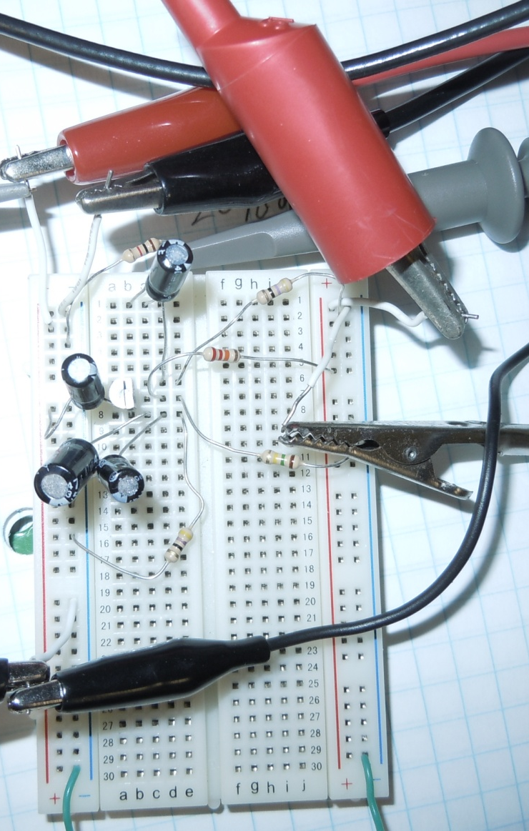
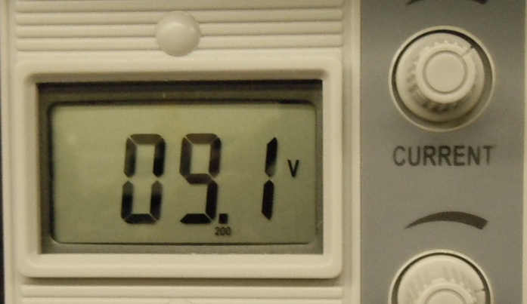
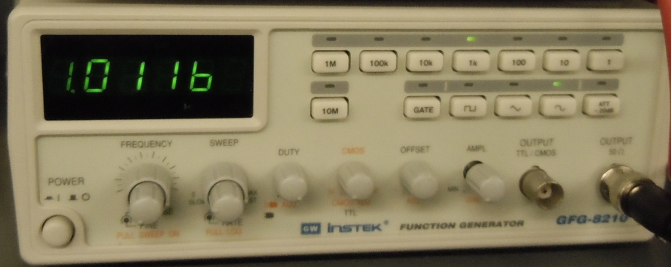
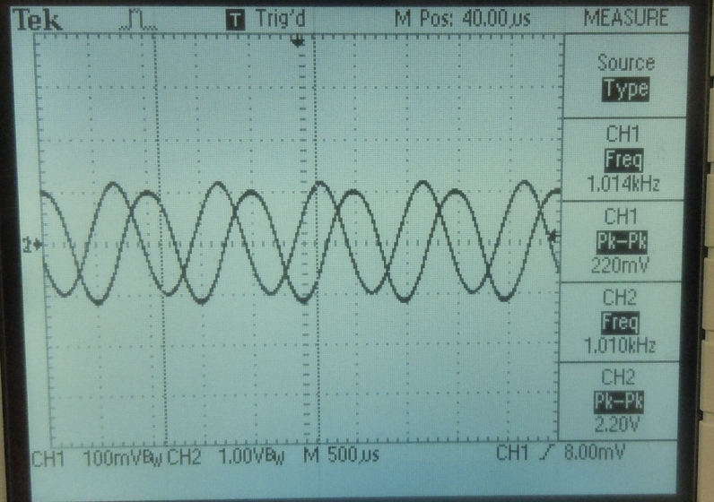
1kΩ Resistor
47Ω Resistor
Voltage and frequency settings.
1μF Capacitor
22kΩ Resistor
47μF Capacitor
2N2222 NPN Transistor
22μF Capacitor
150kΩ Resistor
47Ω Resistor
 | Measured | Expected
Capacitor | 1.008 | 1 | μF
Capacitor | 1.029 | 1 | μF
Capacitor | 37.92 | 47 | μF
Capacitor | 18.474 | 22 | μF
Resistors | 983.0E+0 | 1.0E+3 | Ω
Resistors | 21.6E+3 | 22.0E+3 | Ω
Resistors | 152.1E+3 | 150.0E+3 | Ω
Resistors | 49.7E+0 | 47.0E+0 | Ω
Resistors | 46.3E+0 | 47.0E+0 | Ω
Vb | 220.0E-3 | 220.0E-3 | V
Vcc | 9.0E+0 | 9.0E+0 | V
Vout | 2.87E-03 | 2.20E-03 | V
β | 10.0E+0 | 13.0E+0 | V
Freq | 1014 | 1000 | Hz
Oscilloscope reading of Vb and Vout.

Slide 22
Data Sheets:
2N2222

Slide 23
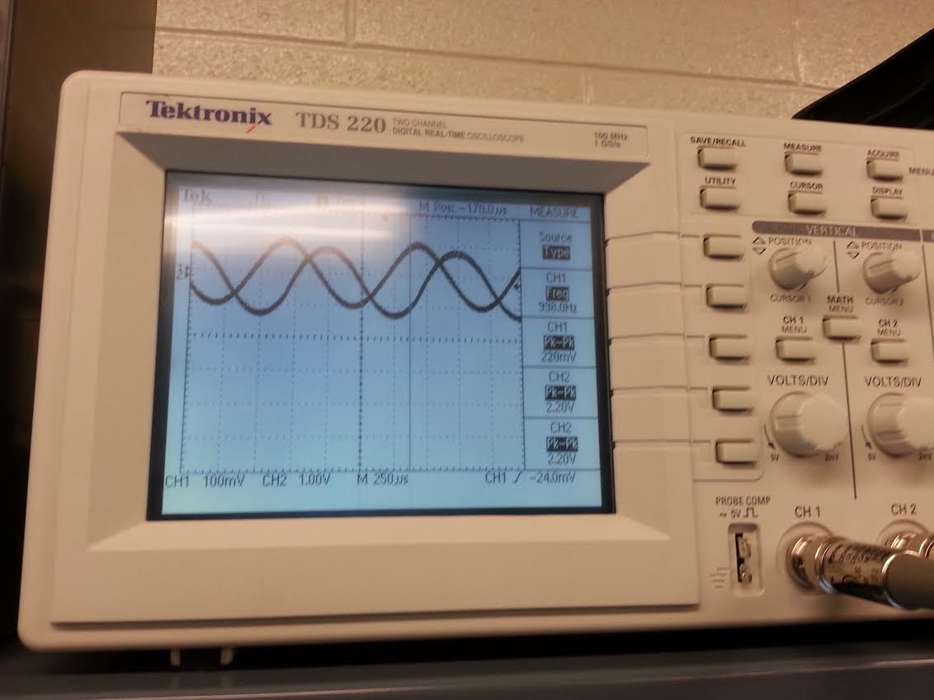
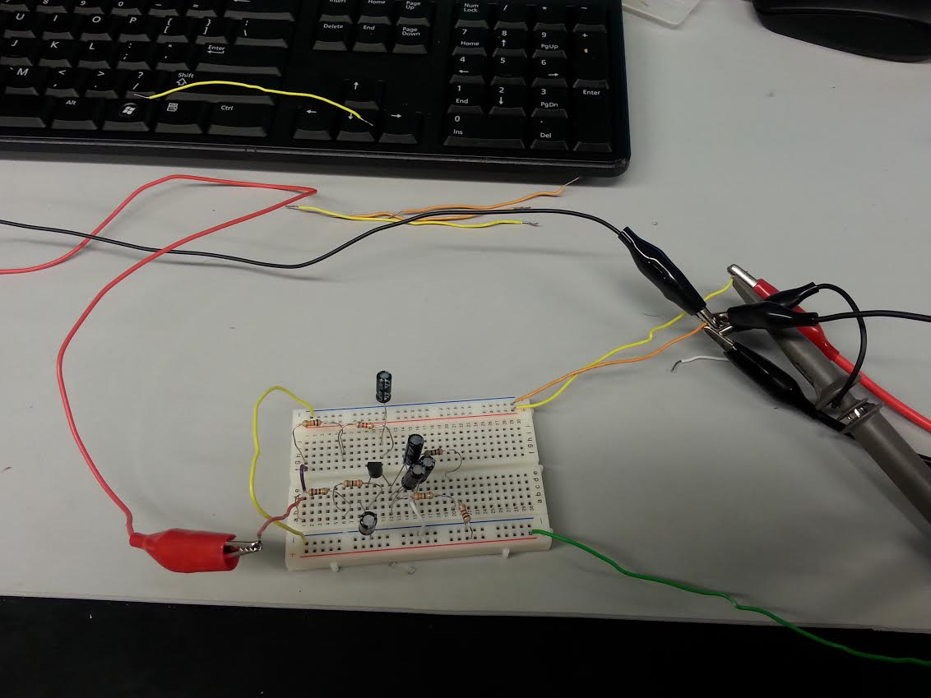
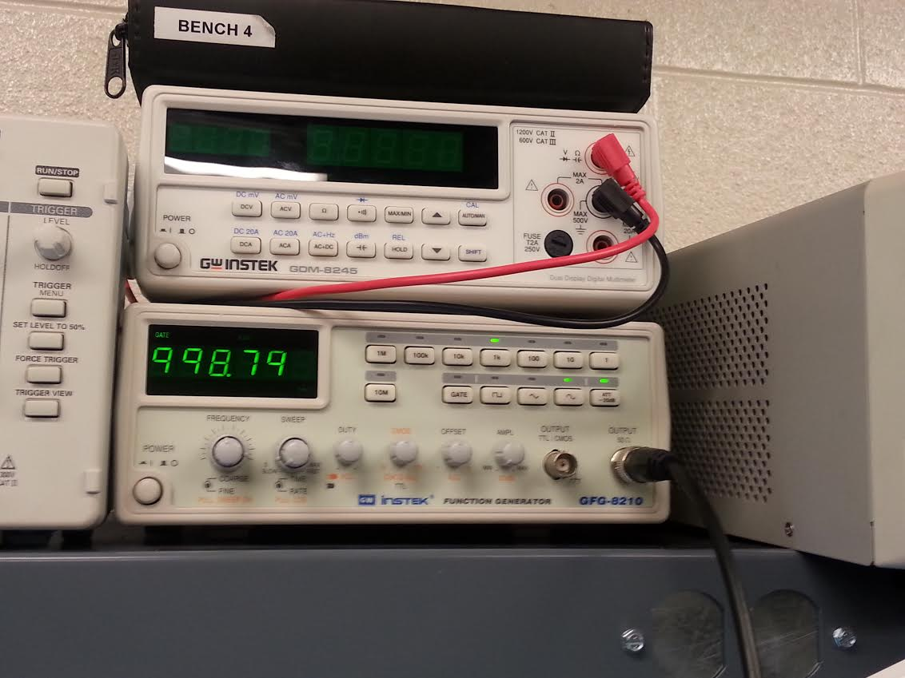
Pictures:

Slide 24
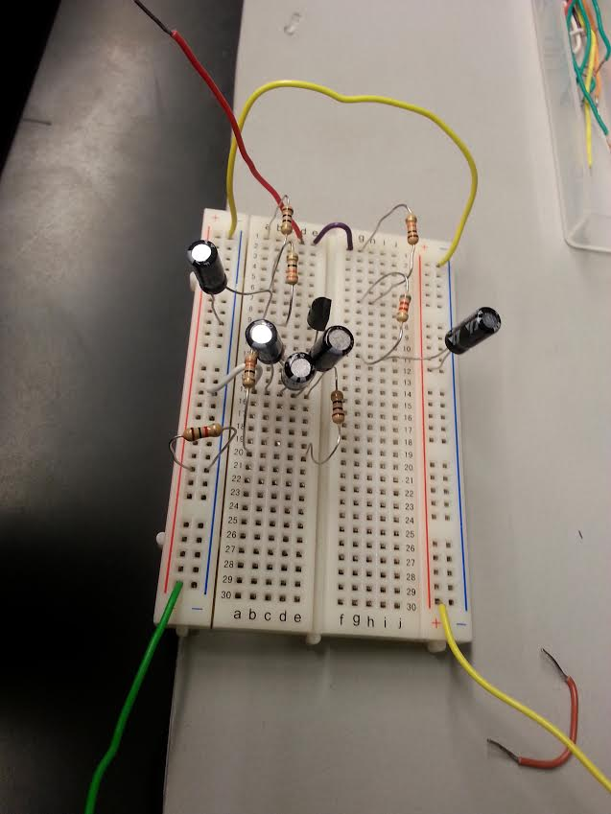
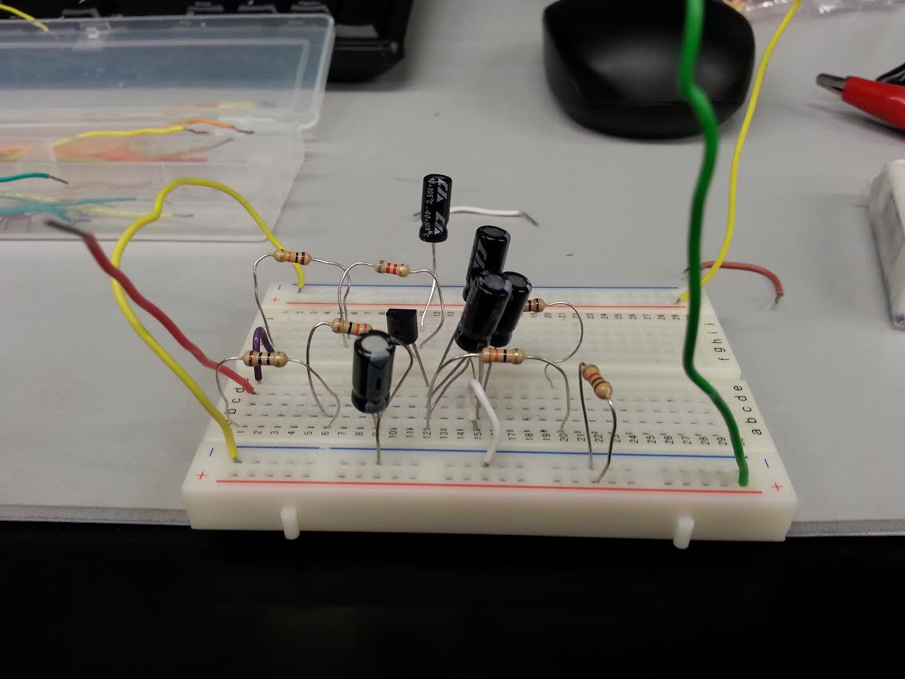
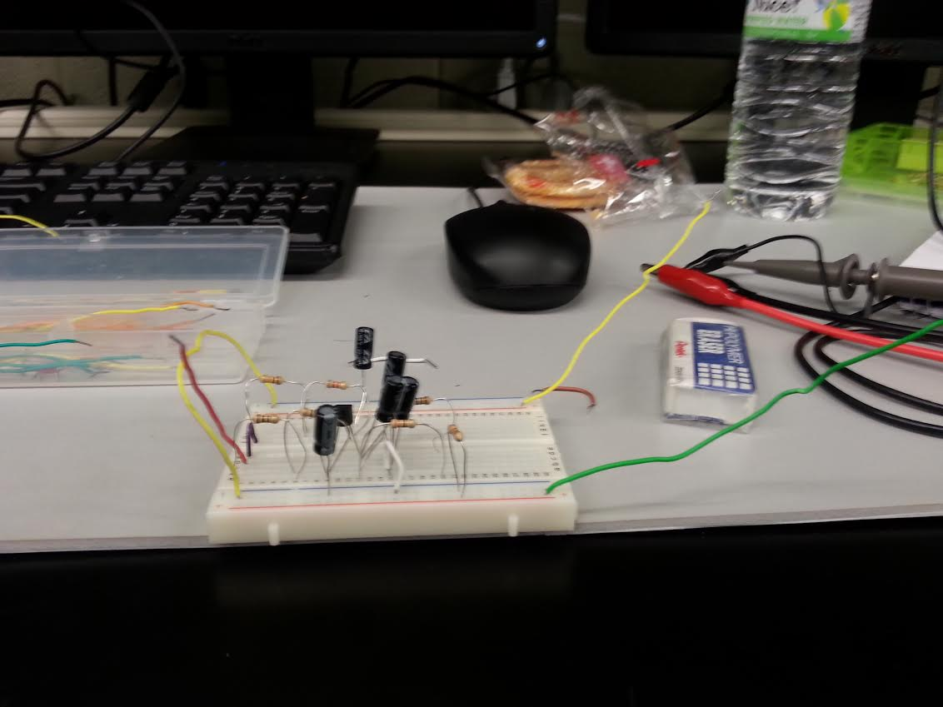

Slide 25
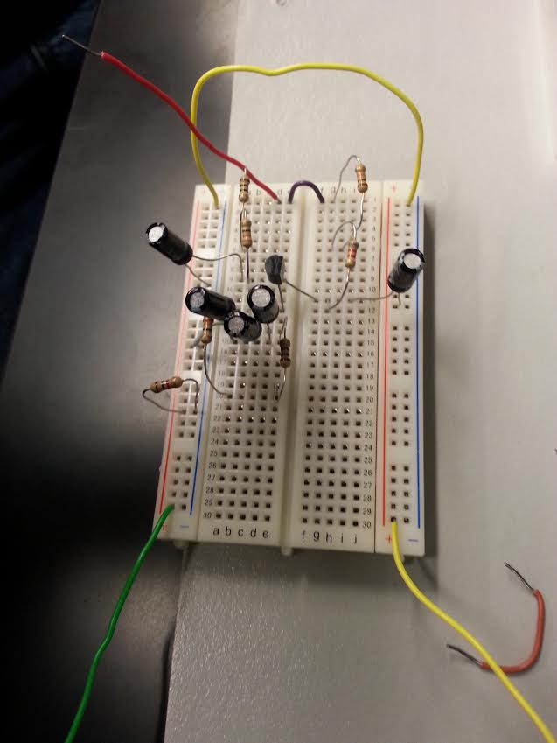
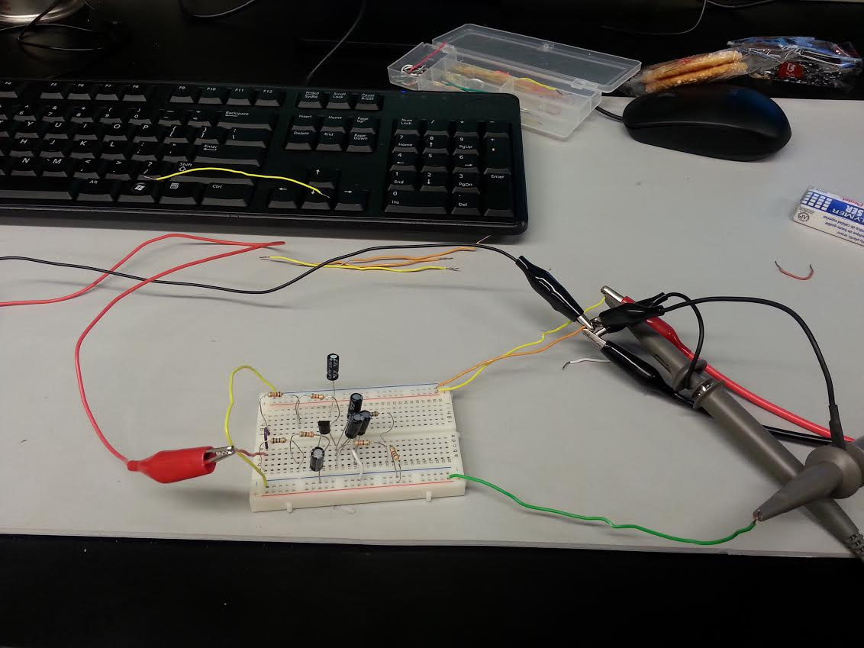
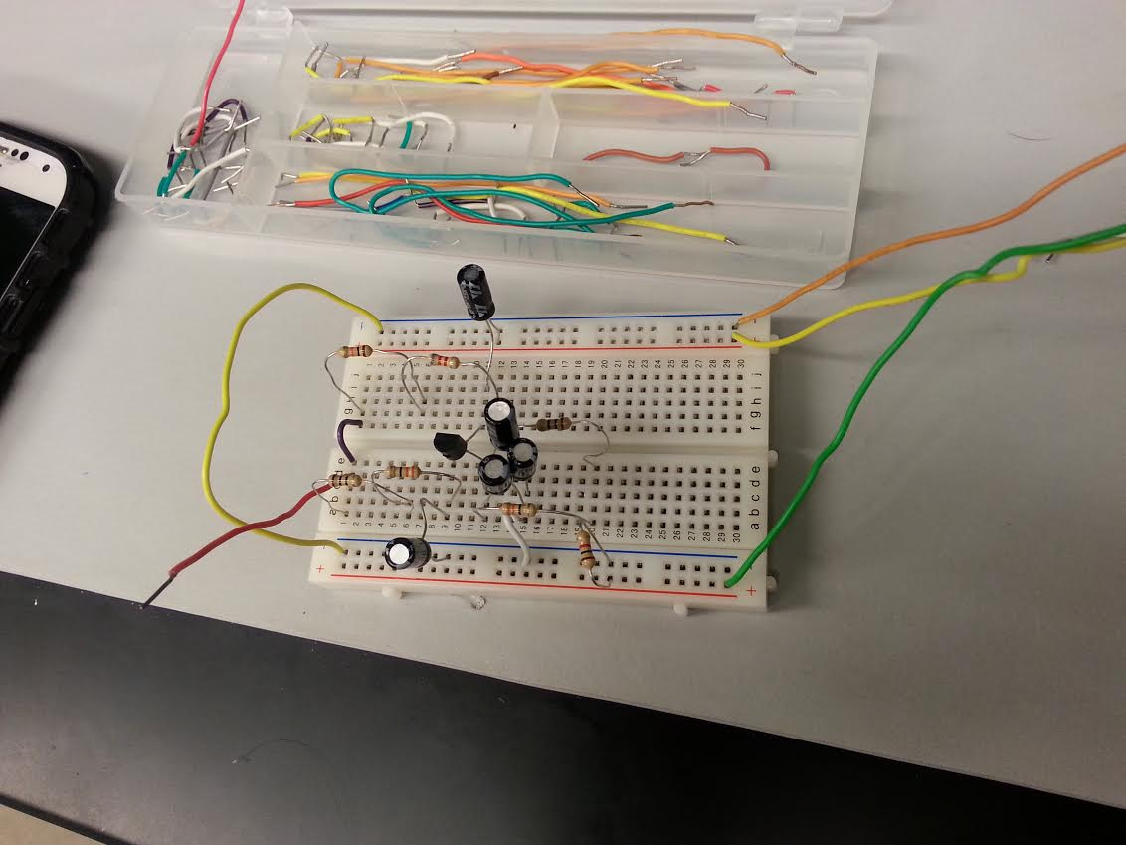

Slide 26
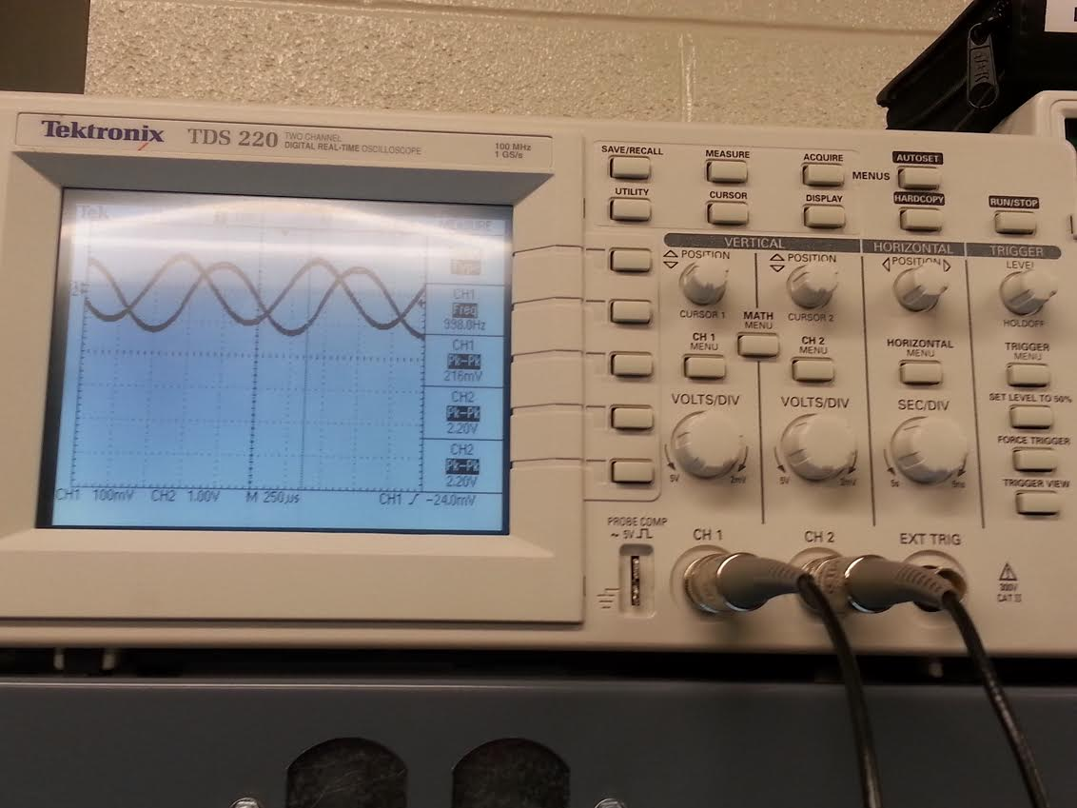
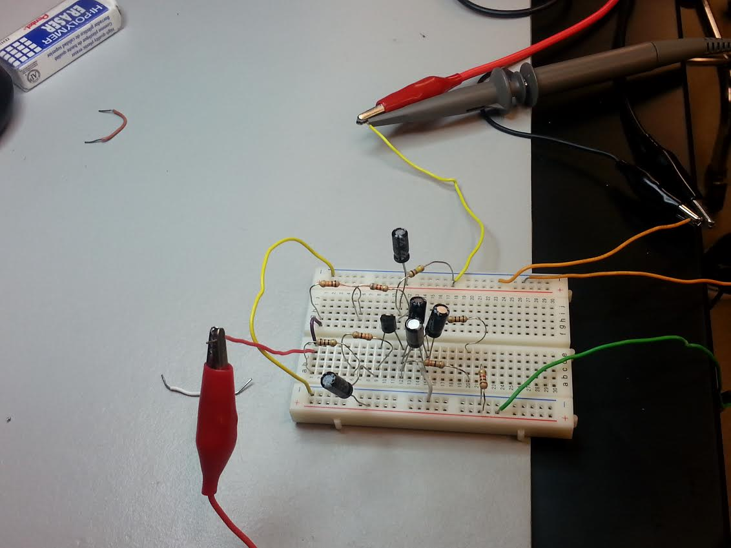

Slide 27
Troubleshooting:
  The function generator could not create a 10mV wave that the circuit was originally designed for. This was fixed by finding out the lowest voltage that the function generator could produce and the schematic was redesigned for that voltage.

Slide 28
Conclusion:
The Common Emitter Amplifier circuit has a resistor in its Collector circuit. The current flowing through this resistor produces the voltage output of the amplifier.
The circuit was able to produce a voltage gain of 10.

Slide 29
Lab 7
JFET LED Switch using 2N5457

Slide 30
Objectives:
Equipment and Parts:
BENCH 4
Function Generator
1 resistors –4.7KΩ
1 – Breadboard
1 – Wire kit
1 – Transistor 2N5457
LED

Slide 31
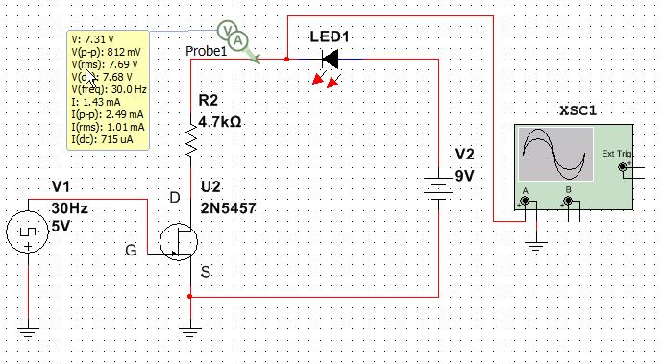
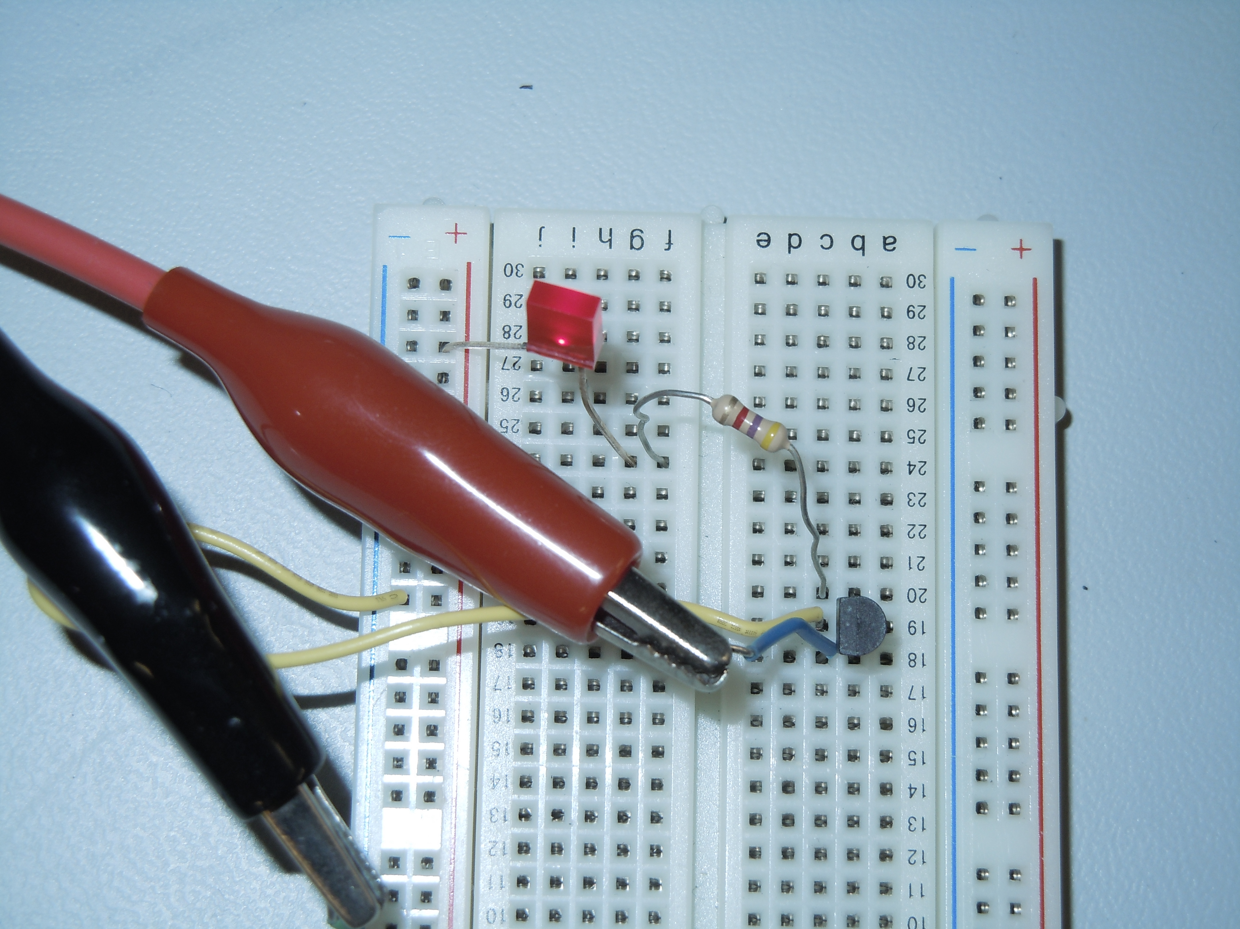
Data/Lab Results/Simulations/Schematics:
LED OFF

Slide 32

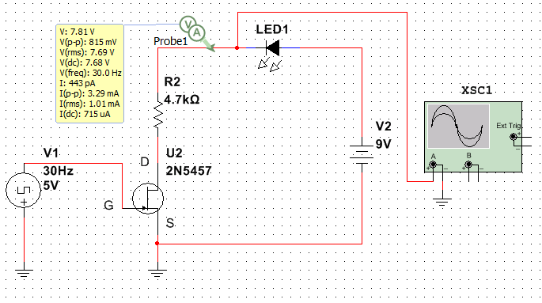
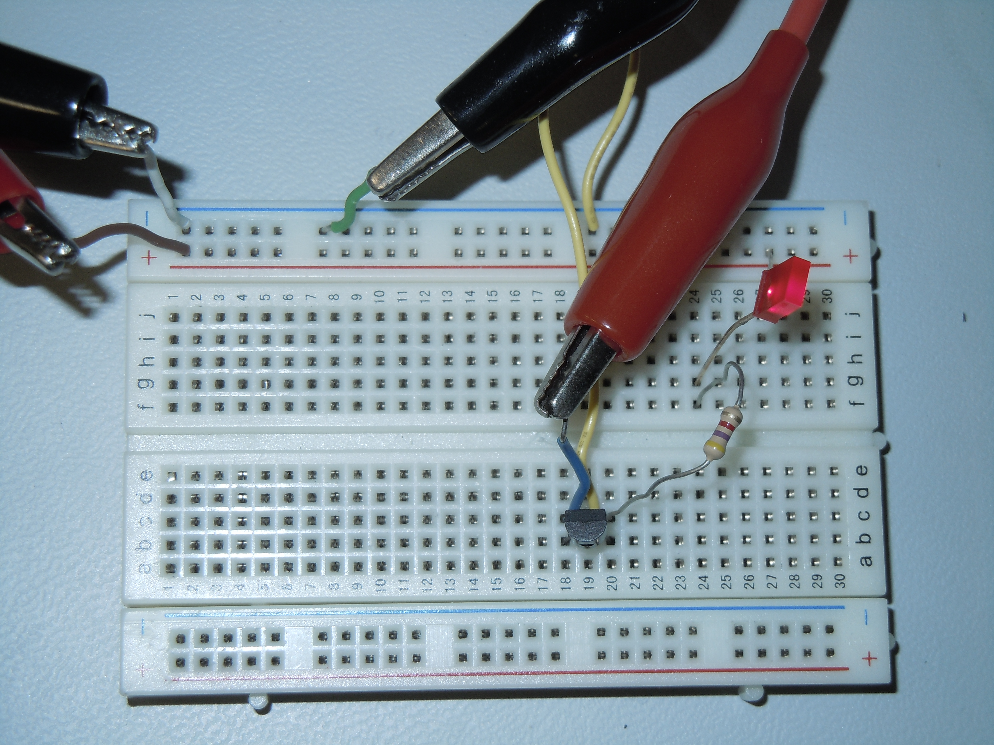
LED ON

Slide 33

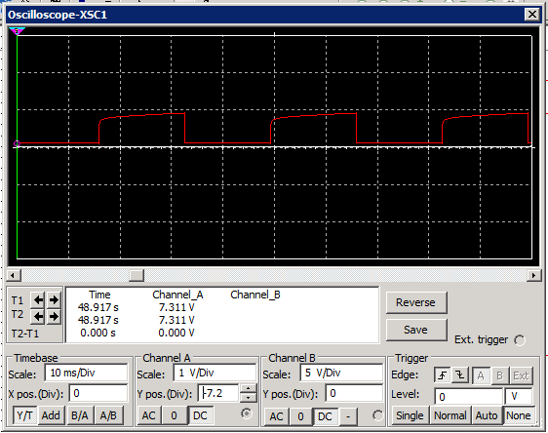
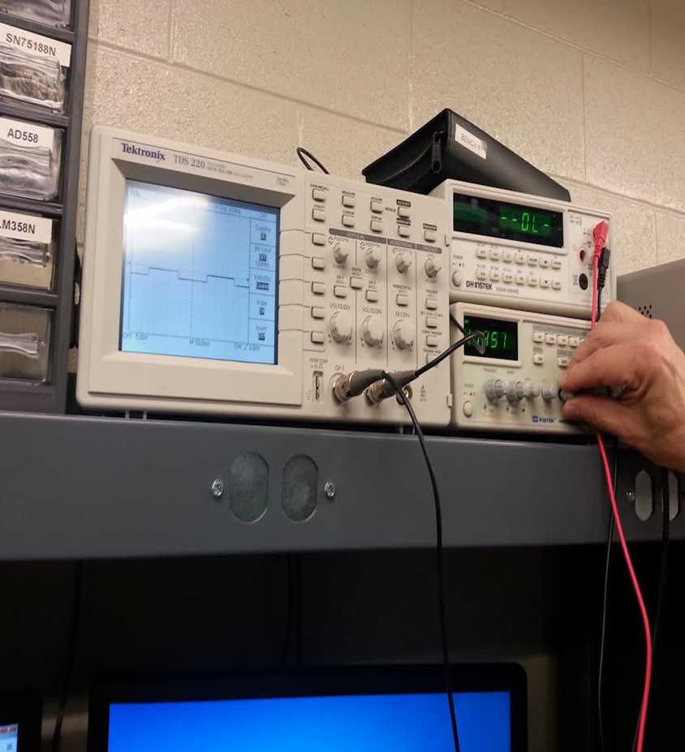

Slide 34
Data Sheets:
2N5457 Datasheet

Slide 35
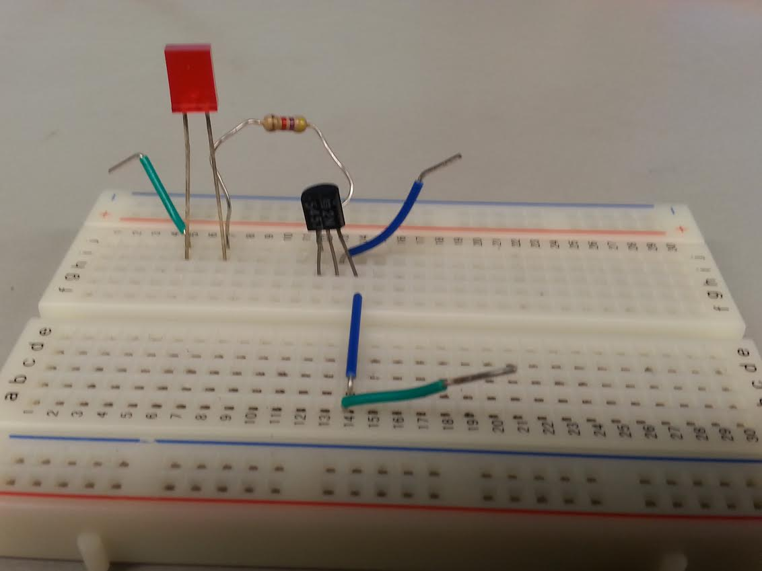
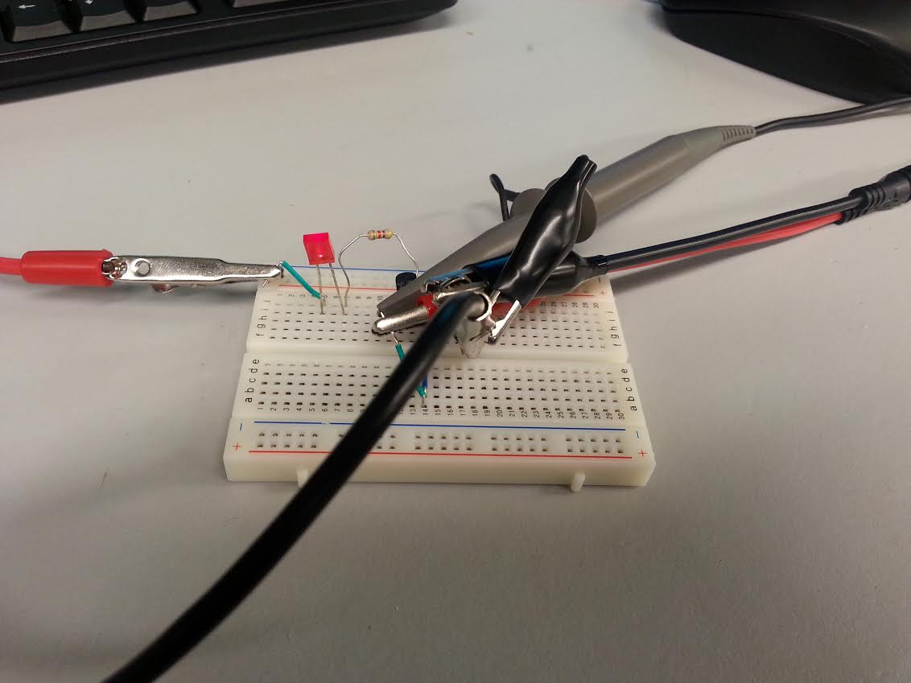

Slide 36
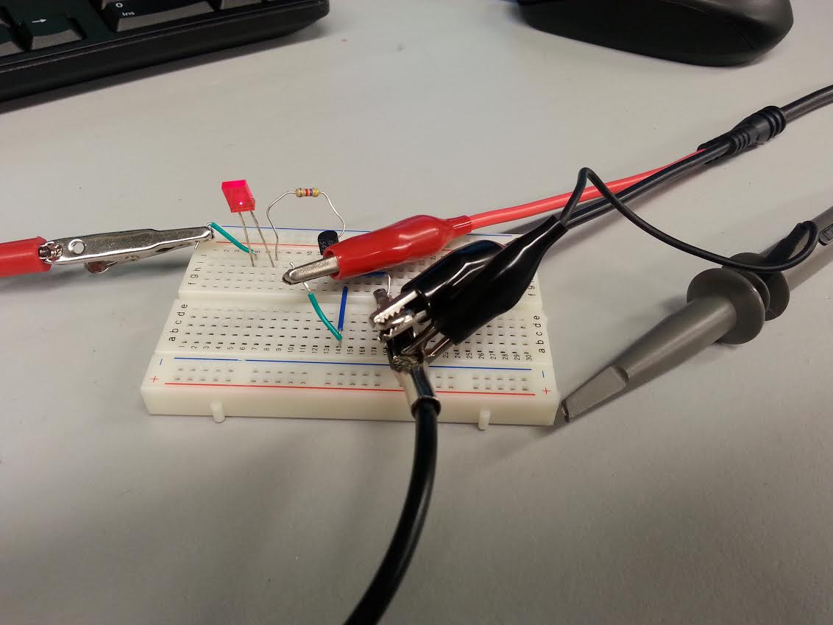
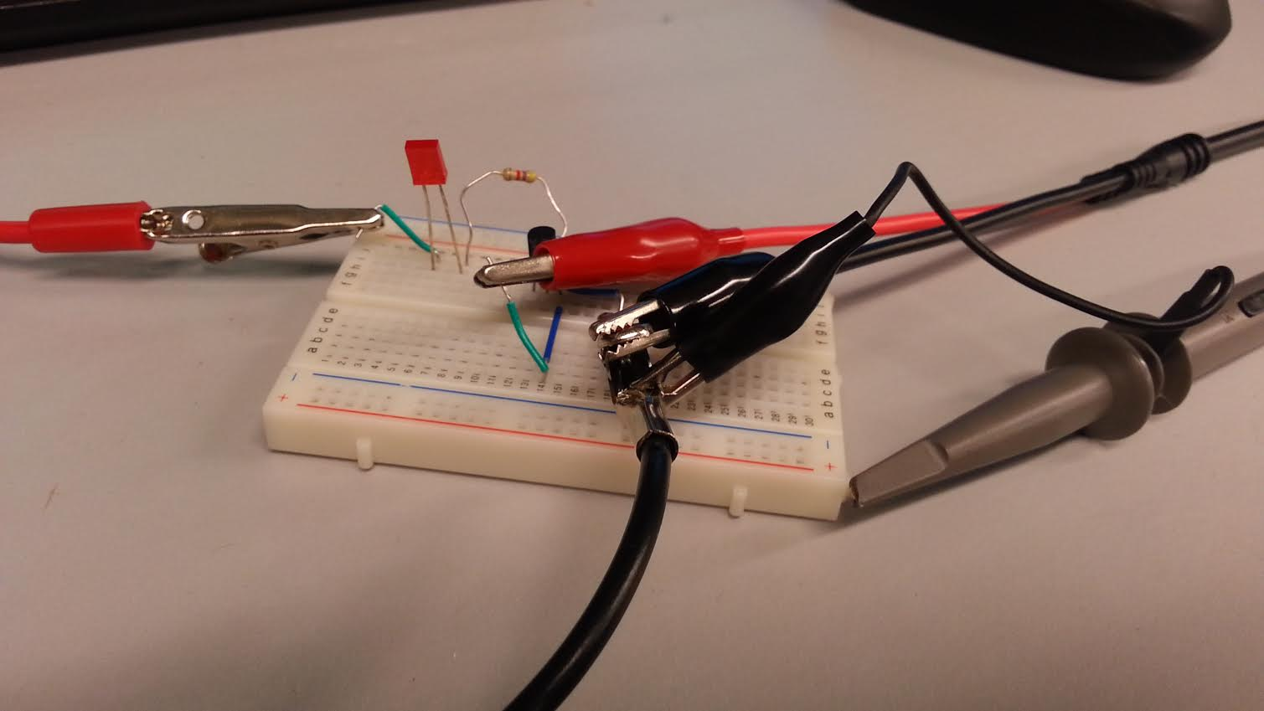

Slide 37

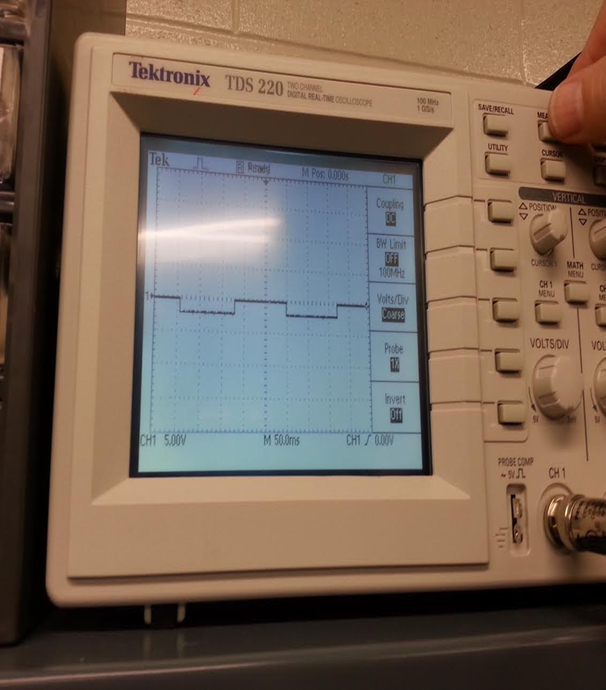

Slide 38
Troubleshooting:

Slide 39
Conclusion:

Slide 40
Lab 8
JFET Transistor Amplifier Circuit

Slide 41
Objectives:
Build a circuit using N-Type JFET that produces a voltage gain of 10.
    Oscilloscope Brand: Tektronix Model #: TDS220 SN: B083266
    Digital Multi Meter Brand: GwInstek Model #: GDM-8245 SN: CL860332
    Function Generator Brand: GwInstek Model #: GFG-8210 SN: C705245
    GW Instek LCR meter model#: LCR-819 SN#: E120998
    DC Power Supply Model# HY1802D
Equipment and Parts:

Slide 42
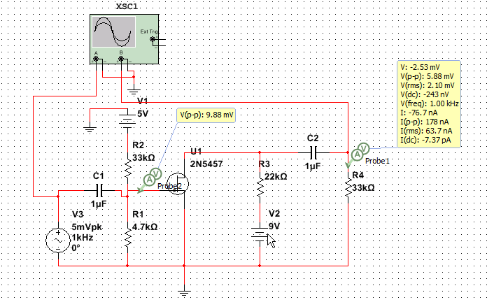
Data/Lab Results/Simulations/Schematics:
.model 2N5457DHJ NJF(Vto=-1.372 Beta=1.125m Lambda=2.3m
+ Vtotc=-2.5m Is=181.3f Isr=1.747p N=1 Nr=2 Xti=3 Alpha=2.543u
+ Vk=152.2 Cgd=4p M=.3114 Pb=.5 Fc=.5 Cgs=4.627p Kf=10.45E-18
+ Betatce=-.5 Rd=1 Rs=1 Af=1)
Model of 2N5457 used in the simulations
Multisim Schematics of the circuit.

Slide 43
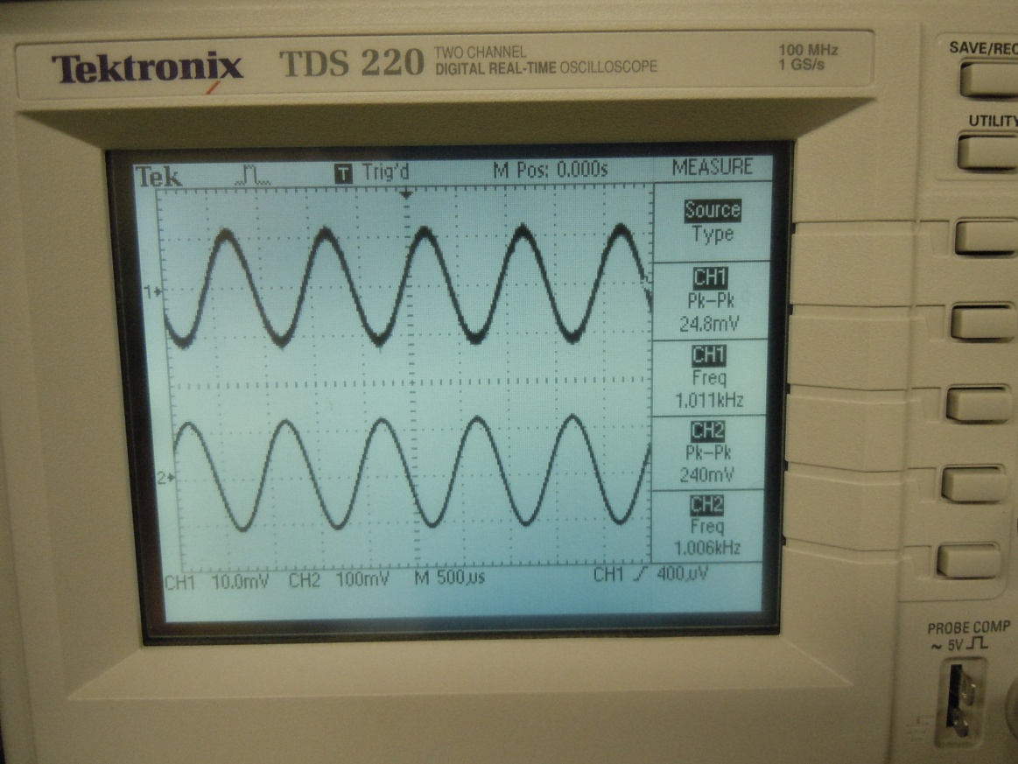
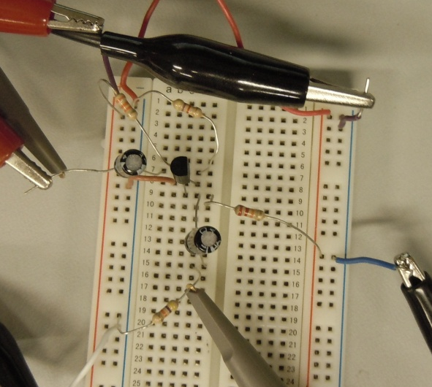
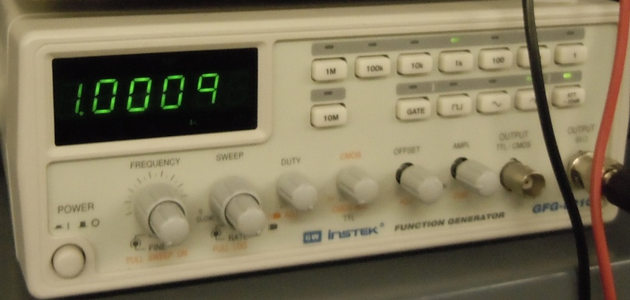
4.7kΩ Resistor
33kΩ Resistor
2N5457 N-Type JFET Transistor
22kΩ Resistor
1μF Capacitor
Oscilloscope reading of input and output voltage
 | Measured | Expected
V1 | -5.071 | -5 | V
V2 | 9.043 | 9 | V
Vin | 24.8 | 5 | mV Pk-Pk
Freq | 1 | 1 | kHz
C1 | 1.01 | 1 | μF
C2 | 0.948 | 1 | μF
R1 | 4.67 | 4.7 | kΩ
R2 | 32.6 | 33 | kΩ
R3 | 21.98 | 22 | kΩ
R4 | 32.89 | 33 | kΩ
Vout | 240 | 5.88 | mV Pk-Pk
β | 9.677419 | 1.176
33kΩ Resistor
Function generator settings

Slide 44
Data Sheets:
2N5457

Slide 45
Troubleshooting:
  The first simulation was working correctly but when the circuit was built in the lab with the simulations specifications the gain was only 3. The circuit was fixed by changing resistors R3 and R4 until a gain of 10 was achieved. This set up was then simulated and it was concluded that the part model used did not represent the actual part fully.

Slide 46
Conclusion:
The circuit was able to produce a voltage gain of 10.

