Slide 1
Formulas
Sum(F) = 0
F=ma
Sin(a)/A = Sin(b)/B = Sin(c)/C
Cos^2(a) + Cos^2(b) + Cos^2(c) = 1
A^2 + B^2 -2*A*b*cos(c) = C^2
A dot B = A*B*cos(theta)

Slide 2
Problem 1
5 pts
y
Resolve F along x and y axes and write it in vector form. F = { ___________ } N
A) 1000 cos (20°) i – 100 sin (20°) j
B) 100 sin (20°) i + 100 cos (20°) j
C) 100 sin (20°) i – 100 cos (20°) j
D) 810 cos (20°) i + 100 sin (20°) j
x
20°
F = 100 N
Problem 2
5 pts
If a dot product of two non-zero vectors is 0, then the two vectors must be _____________ to each other.
A) Parallel (pointing in the same direction)
B) Parallel (pointing in the opposite direction)
C) Perpendicular
D) Cannot be determined.

Slide 3
5 pts
Problem 3
You are nearly finshed working a problem
Excel, or your calculator, shows the answer to be 14158.6 g
<<<g here is for grams
3a
If asked for the mass in SI units, your answer would be:
a | 14158.6
b | 14158.6 | g
c | 14200. | g
d | 14.2 | kg
e | 139 | kN
3b
If asked for the mass in US Customary units (FPS), your answer would be:
a | 0.973269 | Slugs
b | 31.3 | lbf
c | 457 | Slugs
d | 0.973 | Slugs
e | 0.0313 | 10^3 lbf
Problem 4
5 pts
In 3-D, when you know the magnitude of a force but not its direction, how many unknowns corresponding to that force remain?
Zero
One
Two
Three
Four

Slide 4
Problem 5
5 pts
In class we defined a 3 step approach to problem solving called IPE.
The P stands for:
a | Position
b | Plan
c | Problem
d | Practical
e | Possible
Problem 6
5 pts
A new system of units was developed.
The base units are mass, weight, and time.
Is this system:
a | Not a valid system of units
b | A valid system of units
c | A valid system of units, but only if time is in seconds.

Slide 5
Problem 7
5 pts
When working with Vectors, which of the following are true
P, Q, V are vectors, S is a scalor
a | P+Q = Q+P
b | P+Q +V= Q+P+V
c | S*(P+Q) = S*P+S*Q
d | P-Q = P+(-Q)
e | P-Q=Q-P
Problem 8
5 pts
If F and r are force and position vectors, respectively, in SI units, what are the units of the expression (r * (F / F)) ?
A) Newton B) Dimensionless
C) Meter D) Newton - Meter
E) The expression is algebraically illegal.

Slide 6
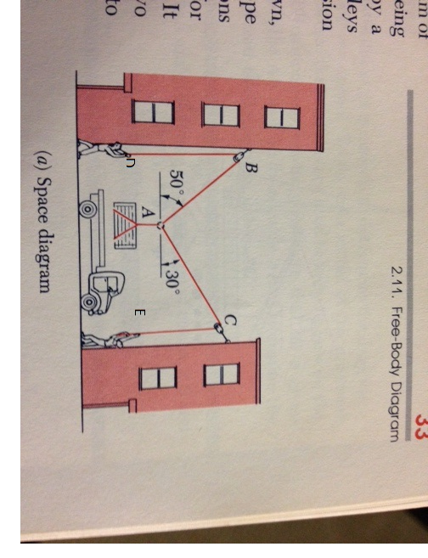
20 pts
Problem 9
2 cables, ABD and ACE are attached to weight A as shown. Two people, one 250 lbf and one 150 lbf want to support the weight.
9a: To support the maximum weight, should the 250 lbf person be at D or E? Why?
D. Because a greater angle means that there will be a greater force.
9b: For your answer to 9a, determine maximum weight they can lift.
266.51lbf
9c: Can they lower the maximum weight from 9b without being lifted off the ground? Why?
Yes. Because the weight in 9b was the maximum weight the box can be and still be in equilibrium so the men’s feet should remain on the ground.

Slide 7
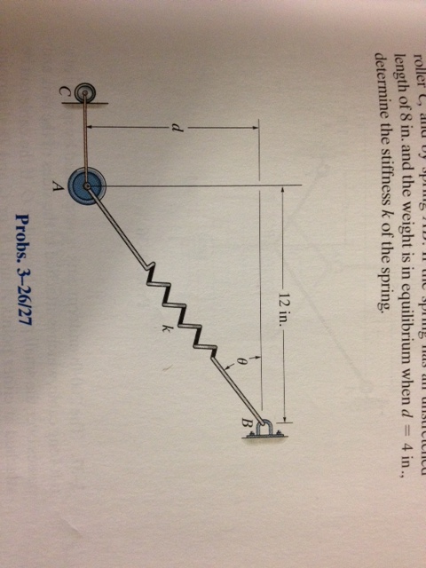
20 pts
Problem 10
Weight A is support by cord AC and spring AB. AC is constrained at C by a frictionless roller. Given:
Weight of A is 50N,
Dimension d=100 mm
Un-stretched length of the spring is 200 mm.
For the horizontal distance, use 300 mm (not 12 in).
Find:
Angle Theta
18.4 degrees
Spring rate of AB
1362.83
Tension in cable AC
-150.3N
300 mm

Slide 8
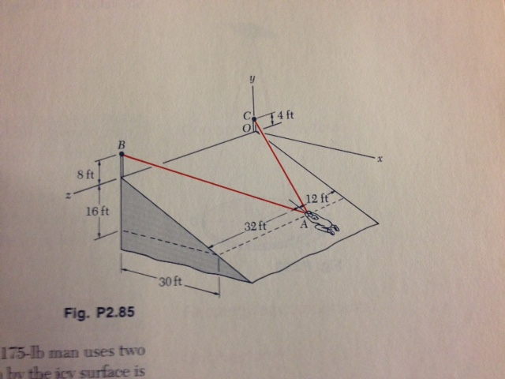
20 pts
Problem 11
A 175 pound man tries to move across a icy surface (friction =0) using 2 ropes, AB and AC. Determine the tension in each rope for the position shown below.
AB=64.7lbs
AC=131lbs

