Slide 1
Lab FF – Lou’s Design
By: Dakota Johnson
Lab Partner: Josiah Abel
Instructor: Andy Bell
Bench Number: N/A
Class: EECT 122-20C
Date: 5-6-2015

Slide 2
Objectives:
To Reverse engineer a Four bit binary Adder and subtract machine built By senior instructor Lou Toth.
To study how the Integrated Circuits are connected.
To create part of an electronic schematic to simulate the assembly’s function, the whole class will combine section’s of the schematic to create the whole thing.
Parts of Lou’s Design that Team 3 Charted:
Part | Amount
74LS10 | 1 Chip
74LS283 | 2 Chips
74LS04 | 1 Chip
74LS00 | 1 Chip

Slide 3
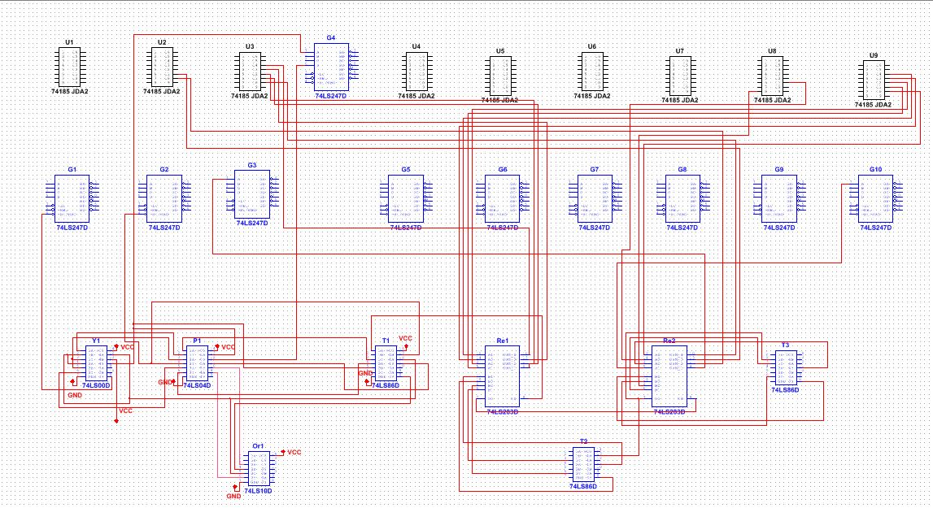
Data/Lab Results/Simulations/Schematics:

Slide 4
Troubleshooting:
the 74185 parts on the assembly were older IC’s which didn’t exist in the Multisim 13.0 program. So the part’s datasheet was researched and the function table was analyzed. Using the Component Wizard function in Multisim the input and output pins of the chip were defined to match the 74185 function table. The function table itself was also inserted into the new 74185 model. The part was saved to the user database.

Slide 5
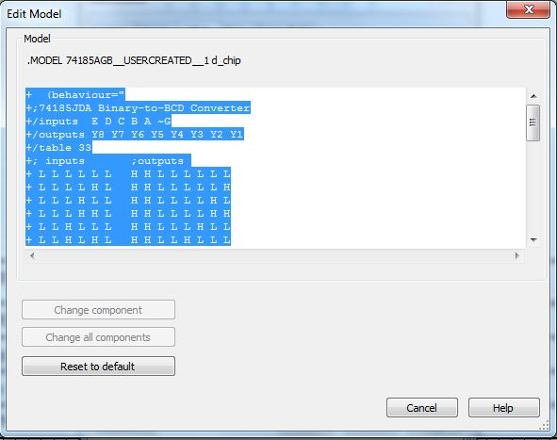
74185 Model
Inserting the data sheet function table into the Component Wizard to create the 74185 model. The text had to be formatted correctly to properly define inputs and outputs of the new chip in Multisim.

Slide 6
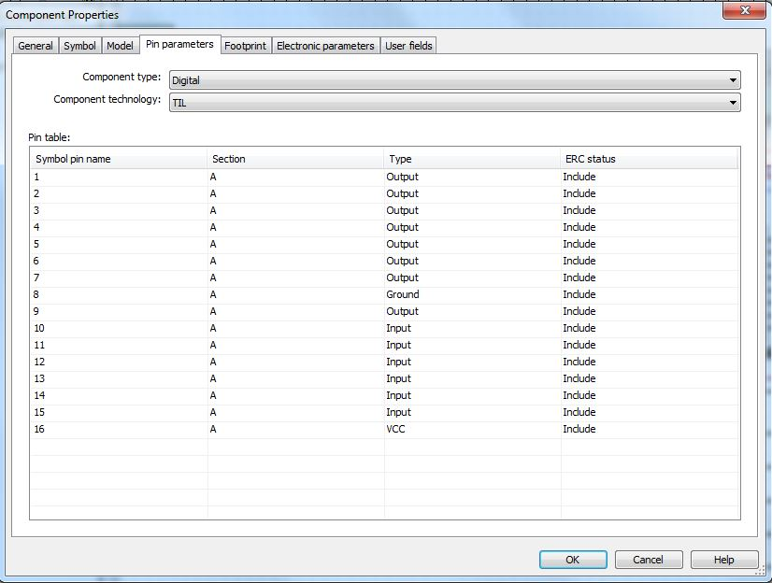
74185 Model
The Input and output pins being defined for the new 74185 model.

Slide 7
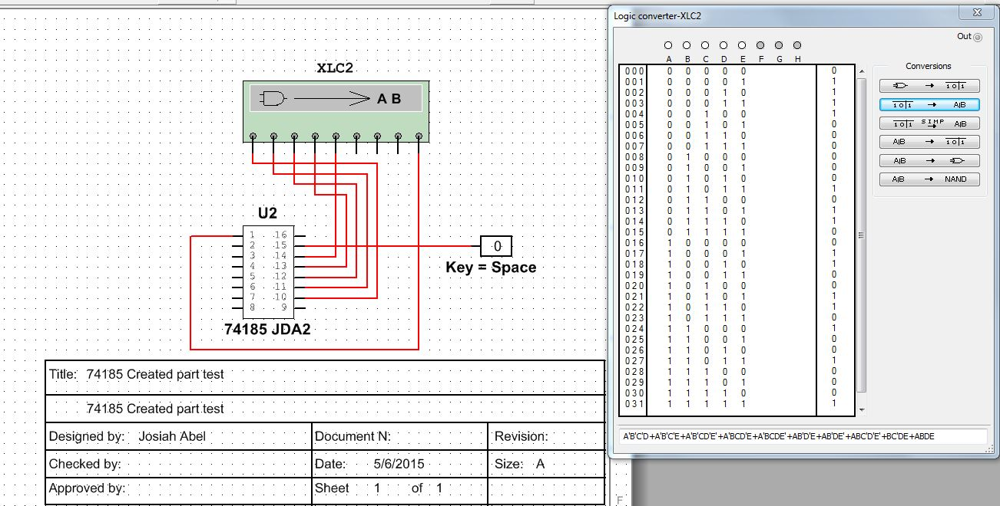
74185 Model

Slide 8
Conclusion:
The Final Schematic was not entirely finished due to an oversight and other assignments taking priority.
However team 3 did manage to create a partial simulation file demonstrating how their assigned parts connected to others in the circuit.

Slide 9
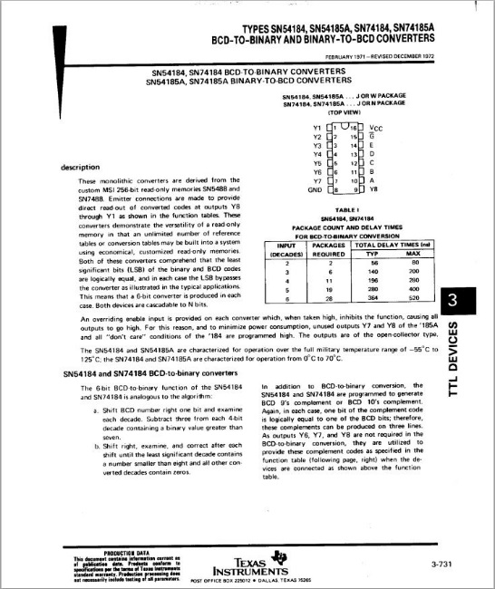
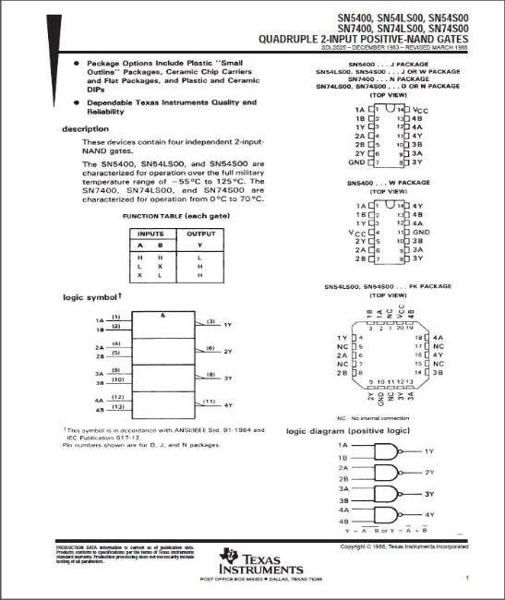
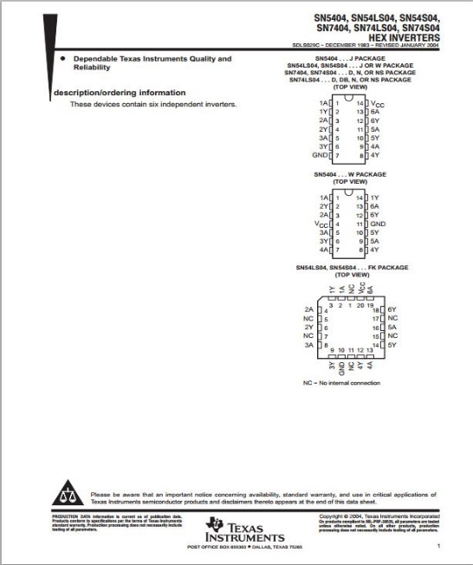
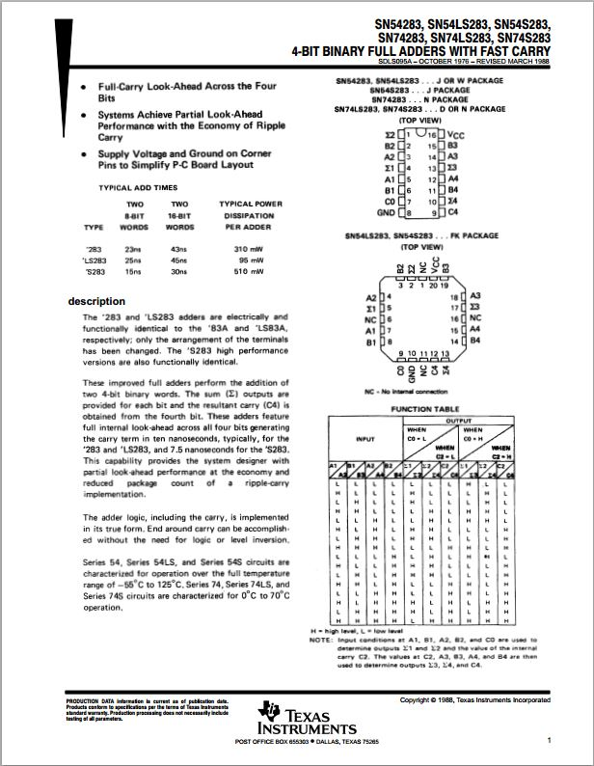
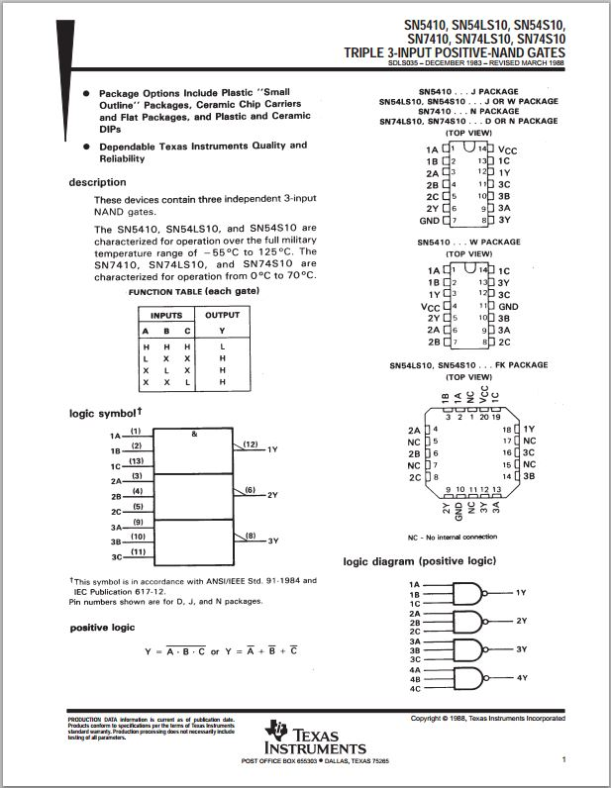
Data Sheets:
74185
74LS00
74LS04
74LS283
74LS10

