Slide 1
Lab 6
By: Dakota Johnson
Lab Partner: Josiah Abel
Instructor: Andy Bell
Bench Number: 6
Class: EECT 122-20C
Date: 2/192015

Slide 2
Objectives:
To Build a circuit that can find the 2’s complement of a number.
Equipment and Parts:
There was no equipment or parts used in this lab.

Slide 3
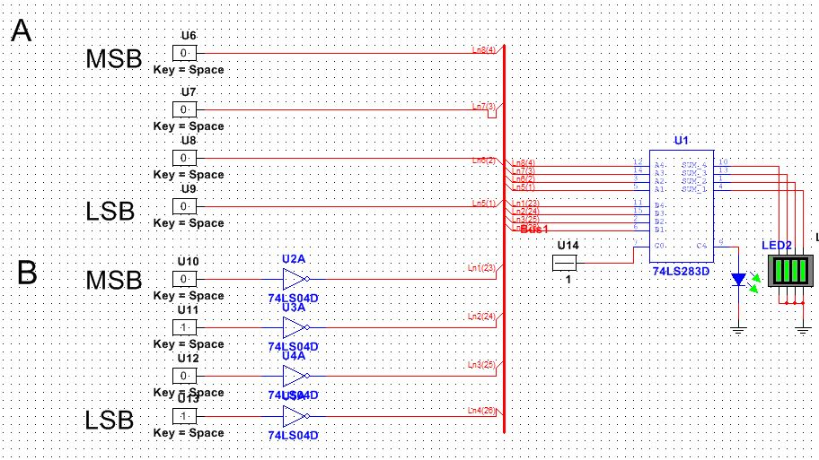
Data/Lab Results/Simulations/Schematics:

Slide 4
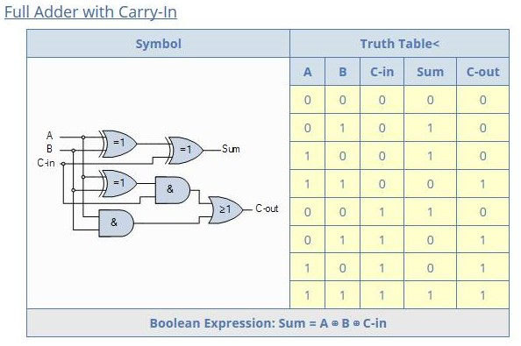
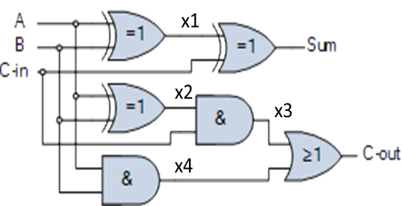
Step 1 - This is the truth table for a Full Adder
Step 2 - Using Excel functions determine the code required to generate AND, OR and XOR booleans
A | B | C | Sum | Carry
0 | 0 | 0 | 0 | 0
1 | 0 | 0 | 1 | 0
0 | 1 | 0 | 1 | 0
1 | 1 | 0 | 0 | 1
0 | 0 | 1 | 1 | 0
1 | 0 | 1 | 0 | 1
0 | 1 | 1 | 0 | 1
1 | 1 | 1 | 1 | 1
Building a Full Adder in Excel using Excel built in functions
AND | OR | XOR
0 | 0 | 0
0 | 1 | 1
0 | 1 | 1
1 | 1 | 0
0 | 0 | 0
0 | 1 | 1
0 | 1 | 1
1 | 1 | 0
Sign | 5 | 4 | 3 | 2 | 1 | 0
 | 32 | 16 | 8 | 4 | 2 | 1
A6 | A5 | A5 | A3 | A2 | A1 | A0
0 | 1 | 1 | 0 | 1 | 0 | 0 | 52 | < = initial binary count
0 | 0 | 0 | 1 | 0 | 1 | 1 | 11 | < = take the complement
0 | 0 | 0 | 0 | 0 | 0 | 1 |  | < = add one
Cin | 0 | 0 | 0 | 1 | 1 | 0 |  | < = Cin if previous sum
Sum | 0 | 0 | 1 | 1 | 0 | 0 | 12 | < = sum
Cout | 0 | 0 | 0 | 0 | 1 | 1 |  | < = Carry?
Step 3 - Next, we solve for the intermediate gate outputs using the code developed for each gate .
Step 4 - Verify the truth table of the Full Adder
X1 | X2 | X3 | X4
0 | 0 | 0 | 0
1 | 1 | 0 | 0
1 | 1 | 0 | 0
0 | 0 | 0 | 1
0 | 0 | 0 | 0
1 | 1 | 1 | 0
1 | 1 | 1 | 0
0 | 0 | 0 | 1
A | B | C | Sum | Carry
0 | 0 | 0 | 0 | 0
1 | 0 | 0 | 1 | 0
0 | 1 | 0 | 1 | 0
1 | 1 | 0 | 0 | 1
0 | 0 | 1 | 1 | 0
1 | 0 | 1 | 0 | 1
0 | 1 | 1 | 0 | 1
1 | 1 | 1 | 1 | 1
Step 5 - Flip it so the code can be easily implemented in the spreadsheet.
A | 0 | 1 | 0 | 1 | 0 | 1 | 0 | 1
B | 0 | 0 | 1 | 1 | 0 | 0 | 1 | 1
C | 0 | 0 | 0 | 0 | 1 | 1 | 1 | 1
Sum | 0 | 1 | 1 | 0 | 1 | 0 | 0 | 1
Carry | 0 | 0 | 0 | 1 | 0 | 1 | 1 | 1

Slide 5
Troubleshooting:
The Part necessary to build the circuit was not available at the time so the circuit could not be built.

Slide 6
Conclusion:
A simulation of the circuit was built and an excel spreadsheet was also made to simulate the 2’s complement.

Slide 7
Data Sheets:

