Slide 1
Lab 4
By: Dakota Johnson
Lab Partner: Josiah Abel
Instructor: Andy Bell
Bench Number: 6
Class: EECT 122-20C
Date: 2/11/2015

Slide 2
Objectives:
To test the functionality of the D-Flip Flop, and to demonstrate that the output is synchronous with the leading edge of a clock.
Equipment and Parts:
Equipment | Model/Part Number | Serial Number
NI Elvis II+ | 19857OA-02L | 1677D1E
Digital Multimeter | GW INSTEK GDM-8245 | CL860332
Tektronix TDs 220 2-Channel Ocilloscope | TDS220 | B083266
Function Generator | GW INSTEK GFG -8210 | C705245

Slide 3
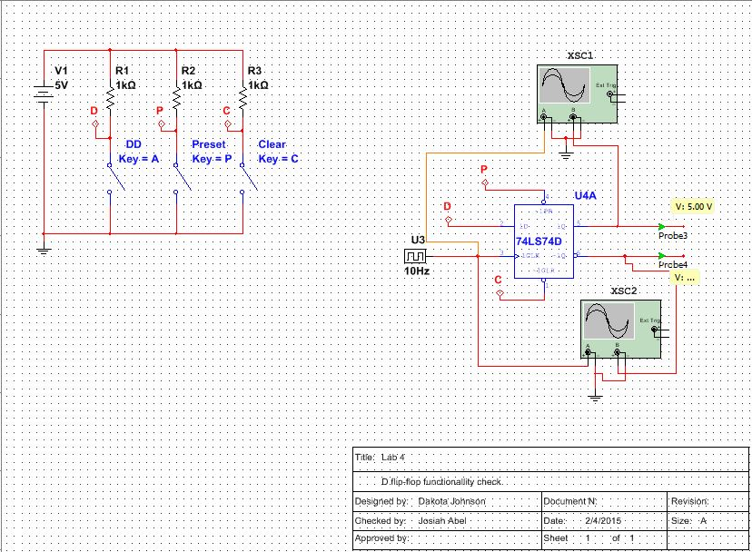
Data/Lab Results/Simulations/Schematics:
Compared simulation to function table located in the 74ls74 datasheet.
Construct a circuit on ELVIS using 74ls74 part and tested the same combinations located on the function table.(used pinout to place wires correctly.)
Measured each ELVIS combination using multimeter to confirm logic outputs.
The unstable state was not tested in the lab

Slide 4
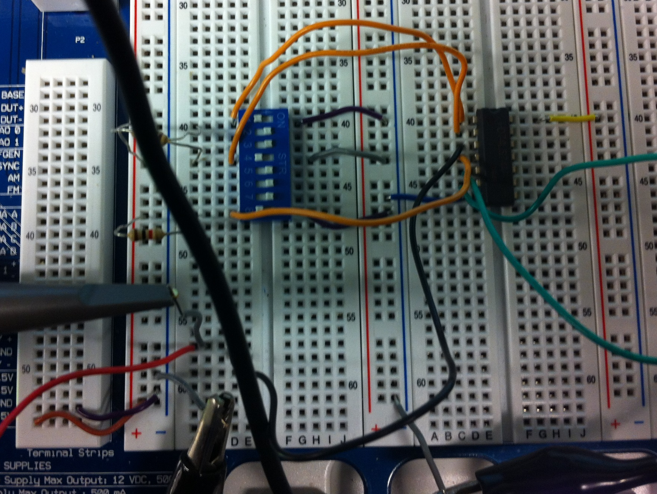
8-Input Dipswitch
1k Resistors
CLK input
74LS73

Slide 5
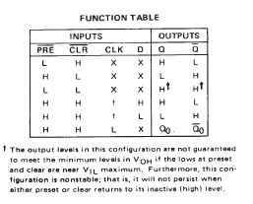
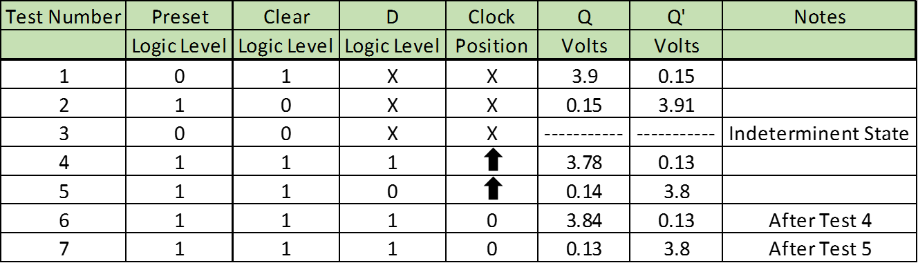
Data/Lab Results/Simulations/Schematics:
FUNCTION TABLE
MEASURED VOLTAGES
Data gathered Compared to the original Function table. The X indicates that the state of that input did not matter. The upwards arrow indicated that the clock is at its leading edge.

Slide 6
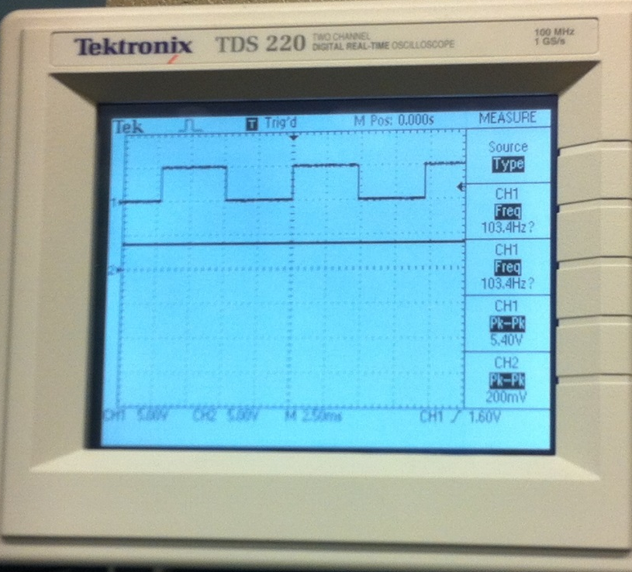
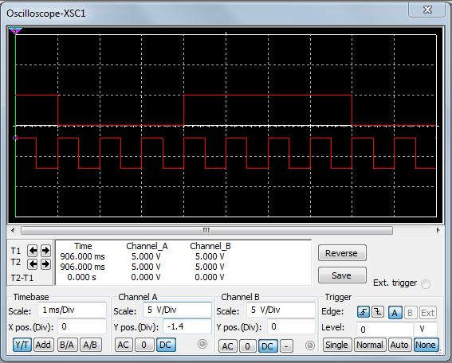
LAB Oscilloscope
Multisim Oscilloscope
Oscilloscope readings demonstrating that the 74ls74 triggers on the leading edge of the clock input.

Slide 7
Troubleshooting:
  We Did not experience any difficulties beyond adjusting our oscilloscope to trigger on the correct channel.

Slide 8
Conclusion:
The Multisim and Lab tests concurred with the original Function table of the 74LS74 Datasheet.
The change in outputs was synchronous to the clocks leading edge.

Slide 9
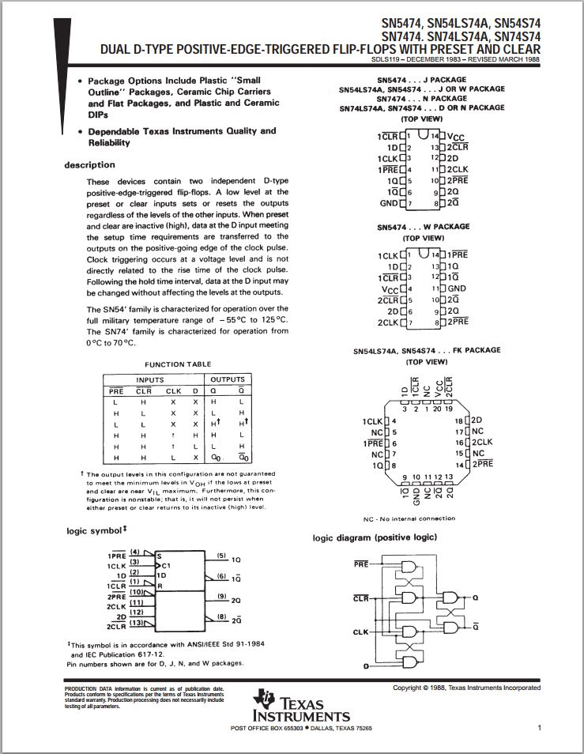
Data Sheets:

