Slide 1
Lab 2
By: Dakota Johnson
Lab Partner: Josiah Abel
Instructor: Andy Bell
Bench Number: 6
Class: EECT 122-20C
Date:2/4/2015

Slide 2
Objectives:
To test the functionality of a NAND gate latch.
Equipment and Parts:

Slide 3
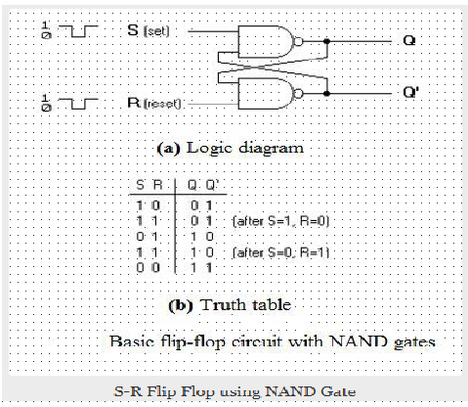
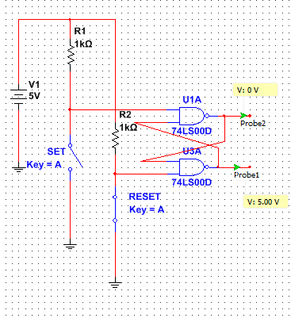
Data/Lab Results/Simulations/Schematics:

Slide 4
Data/Lab Results/Simulations/Schematics:
The Digital Multimeter was used to probe the voltage of the outputs Q and Q prime. These measurements were used to determine whether the output of each was high or low. When both of the inputs were “low” voltage the outputs from the latch were indeterminate.
When compared to the truth table provided the output states matched the expected output states for each input combination. The instance where both inputs are “high” voltage (1) has two different sets of outputs because this input state depends on what order the inputs were toggled in.

Slide 5
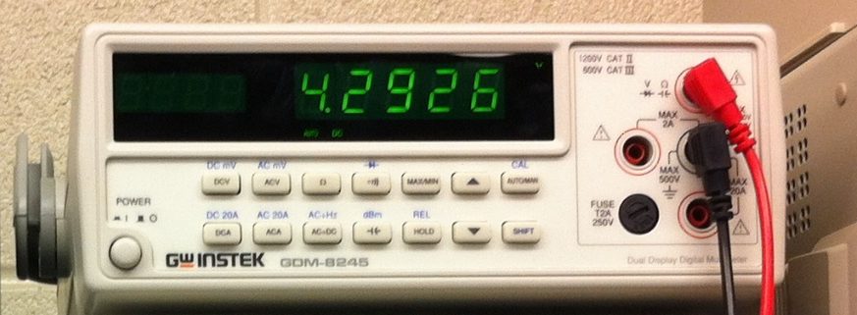
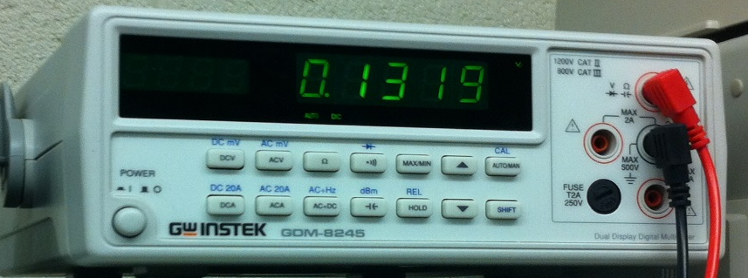
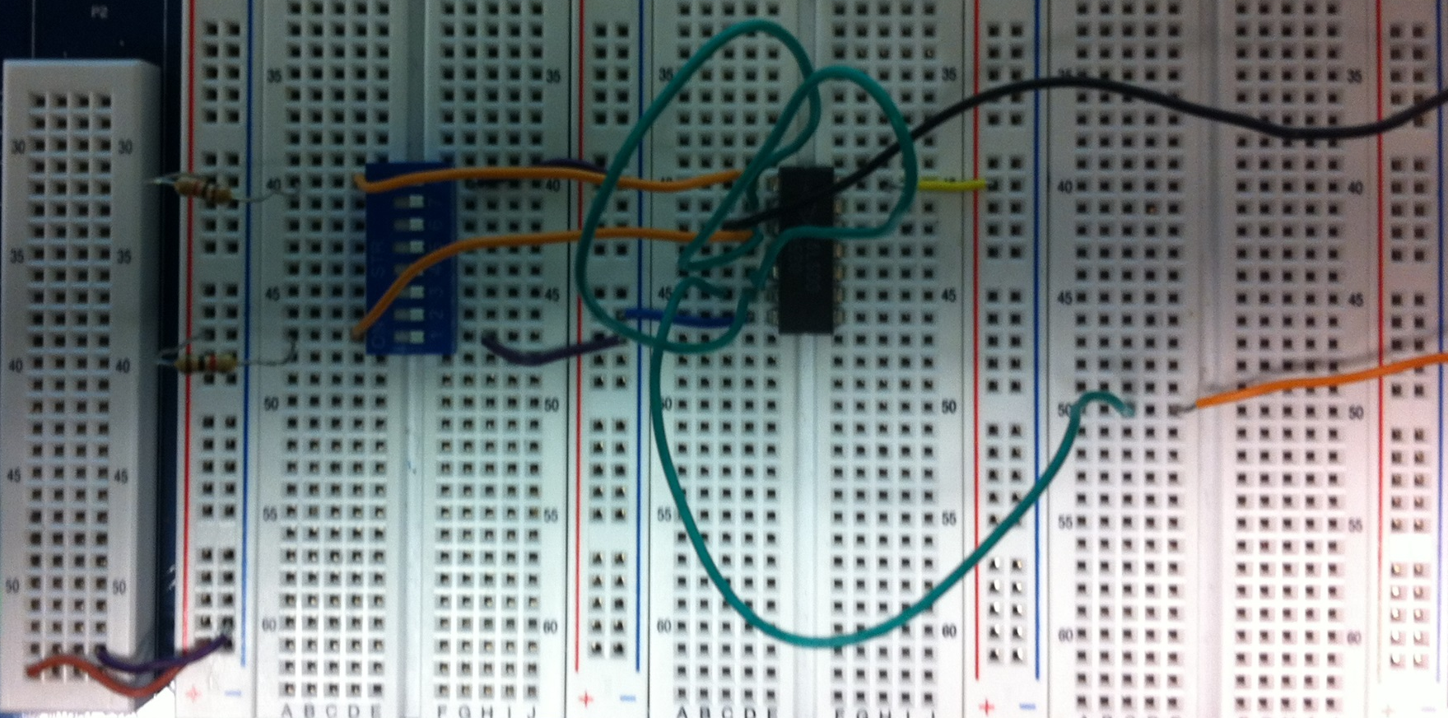
“High” Voltage Reading
“Low” Voltage Reading
8-IN Dipswitch
1k Resistors
74LS00 Chip

Slide 6
Troubleshooting:
  We had some difficulty with the initial setup. Our power into the chip was wired directly to ground. After discovering that the chip was not wired properly the situation was fixed.

Slide 7
Conclusion:
The Test of the NAND latch demonstrated its functionality accurately. The results demonstrated the capacity for the NAND latch to retain a fixed set of states for a circuit.

Slide 8
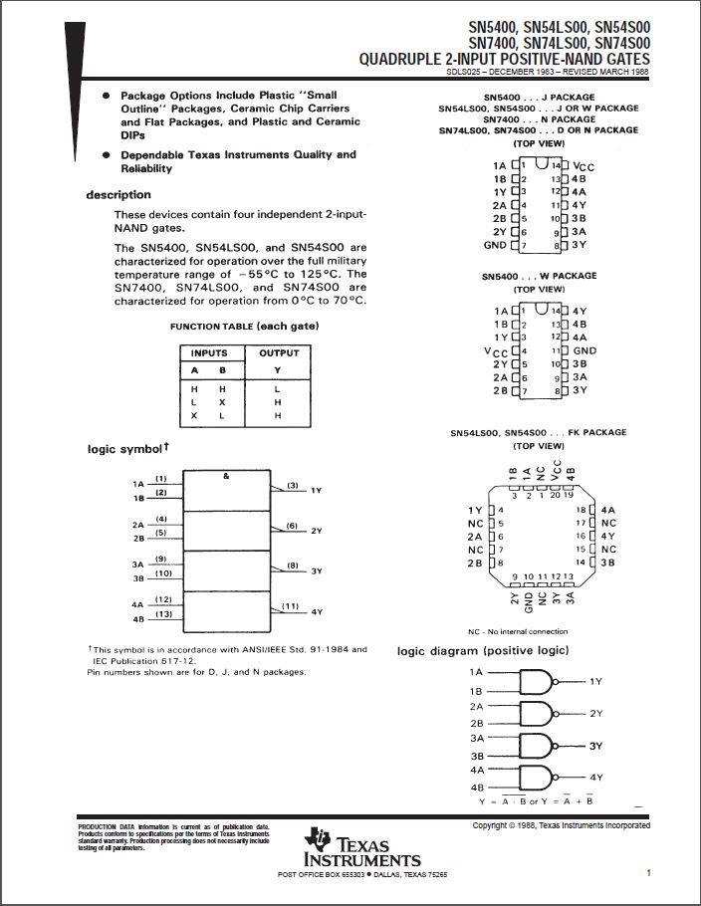
Data Sheets:
74LS00

