Slide 1
Lab 5 NPN Transistor Switch
By: Dakota Johnson
Lab Partner: Josiah Abel
Instructor: Andy Bell
Bench Number: 6
Class: EECT 121-50C
Date: 12/15/2015

Slide 2
Objectives:
To turn on an LED with an NPN transistor.
Equipment and Parts:
GW Instek LCR meter model#: LCR-819 SN#: E120998
DC Power Supply Model# HY1802D
Digital Multi Meter Brand: GwInstek Model #: GDM-8245 SN: CL860332
LM317 Voltage Regulator
74LS04 Hex Inverter
2N2222 NPN Transistor
LED
220Ω Resistor
6.8KΩ Resistor
270Ω Resistor
10kΩ potentiometer

Slide 3
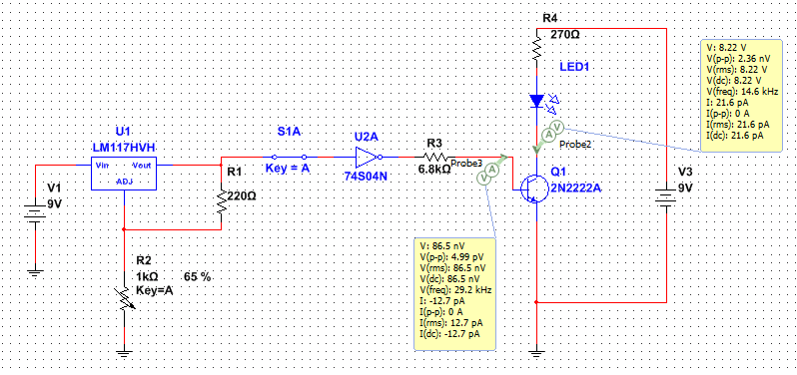
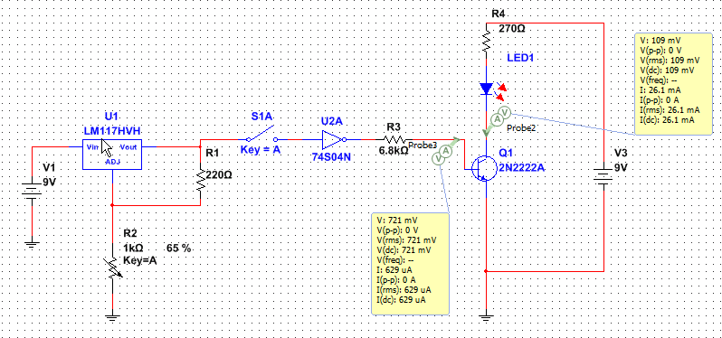
Data/Lab Results/Simulations/Schematics:
Multisim Schematics of the circuit.
Simulation of the circuit with the LED on.
Simulation of the circuit with the LED off.

Slide 4
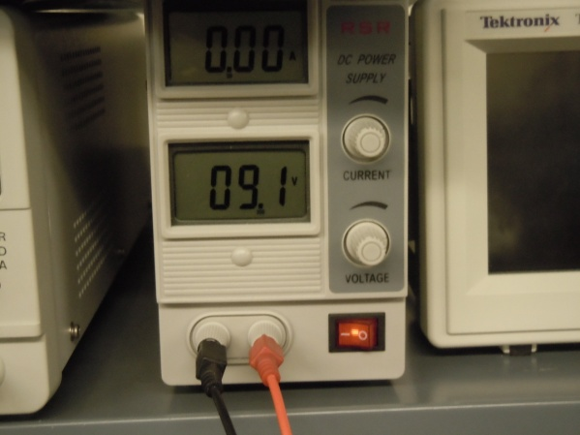
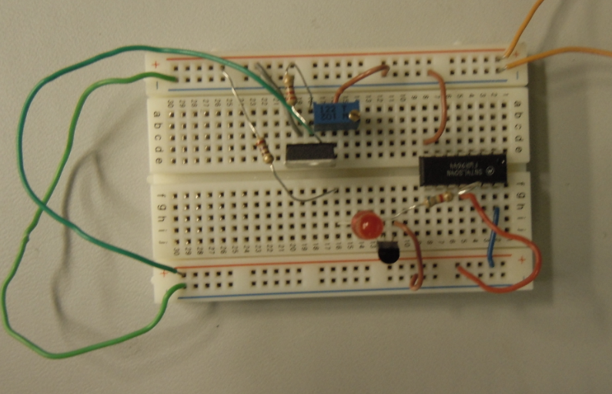
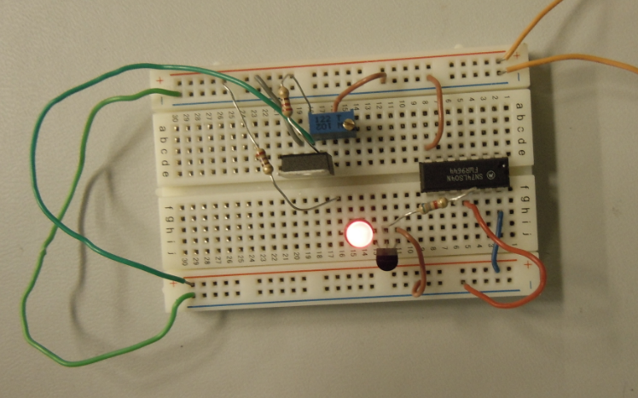
220Ω Resistor
LM317 Voltage Regulator
10kΩ Potentiometer
270Ω Resistor
74LS04 Hex Inverter
6.8kΩ Resistor
Voltage readings of 9V and 5V sources.
LED
2N2222 NPN Transistor
Component | Measured | Expected
Resistor | 26.9E+3 | 27.0E+3 | Ω
Resistor | 216 | 220 | Ω
Resistor | 326.87 | 330 | Ω
Potentiometer | 640 | N/A | Ω
Circuit with LED on
Circuit with LED off

Slide 5
Troubleshooting:
The switch for the inverter was left floating. Once the switch was properly grounded the circuit worked as planned.

Slide 6
Conclusion:
A transistor can be used as a switch

Slide 7
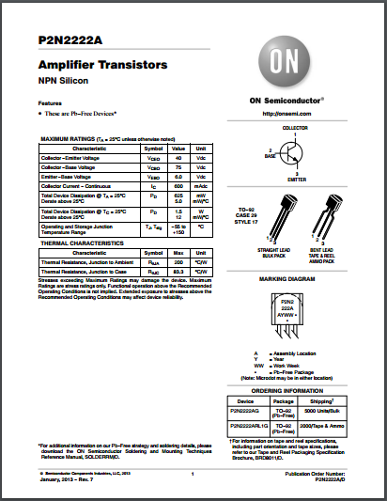
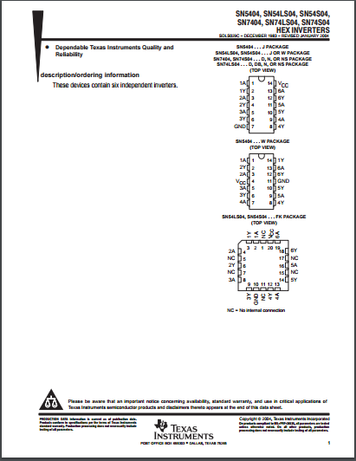
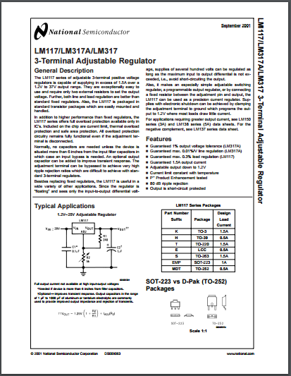
Data Sheets:
2N2222 NPN Transistor
74LS04 Hex Inverter
LM317 Voltage Regulator

