Slide 1
Lab 4 ±9 Volt Power Supply
By: Josiah Abel
Lab Partner: Dakota Johnson
Instructor: Andy Bell
Bench Number: 6
Class: EECT 121-50C
Date: 12/15/2015

Slide 2
Objectives:
Design a power supply with the following requirements:
produce a voltage of ±9V with a ±5% tolerance
carry a maximum current of 100mA
have an output ripple ≤ 100mV
all linear (no converters)
an input voltage of 120V AC
maximum start up time less than 100 ms
must contain a fuse
maximum cost cannot exceed $25.00.
Equipment and Parts:
Multisim 13.0

Slide 3
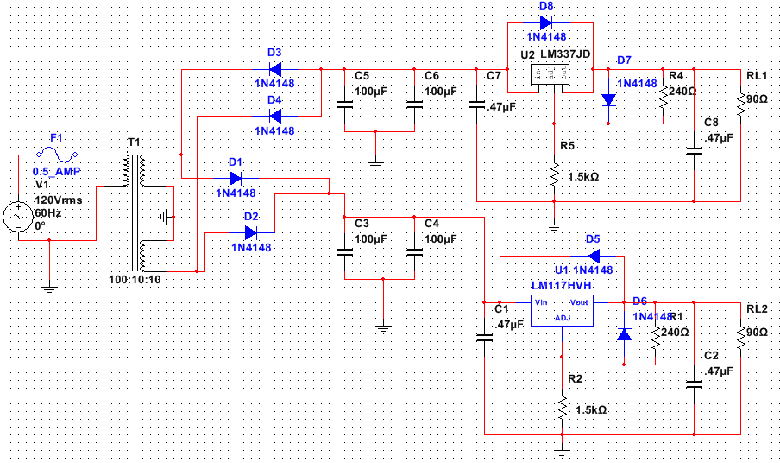
Data/Lab Results/Simulations/Schematics:
Multisim Schematics of the circuit.

Slide 4
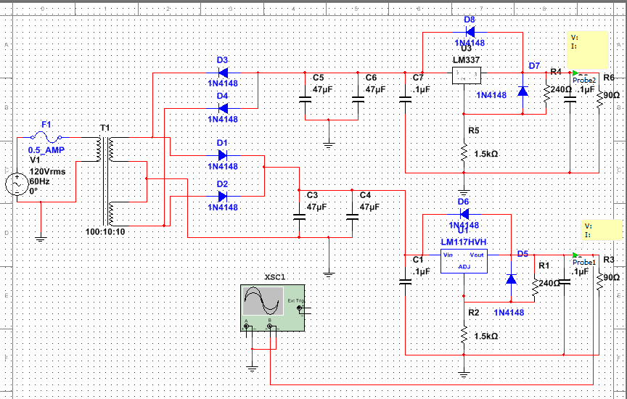
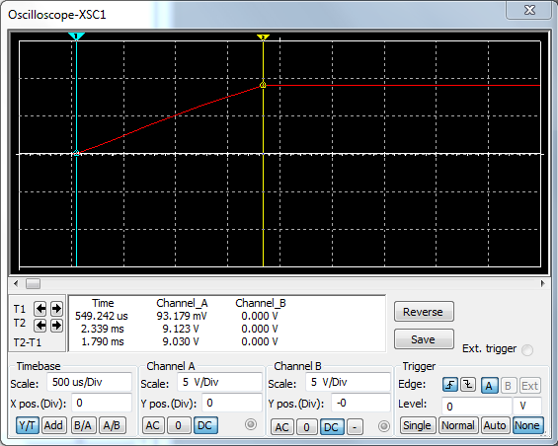
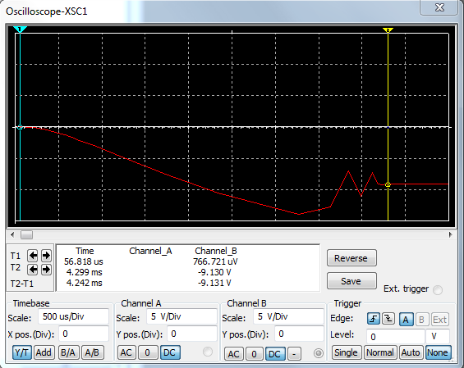
Voltage, voltage ripple, and current for -9 volts
Voltage, voltage ripple, and current for +9 volts
Start up time for +9 Volts
Start up time for -9 Volts

Slide 5
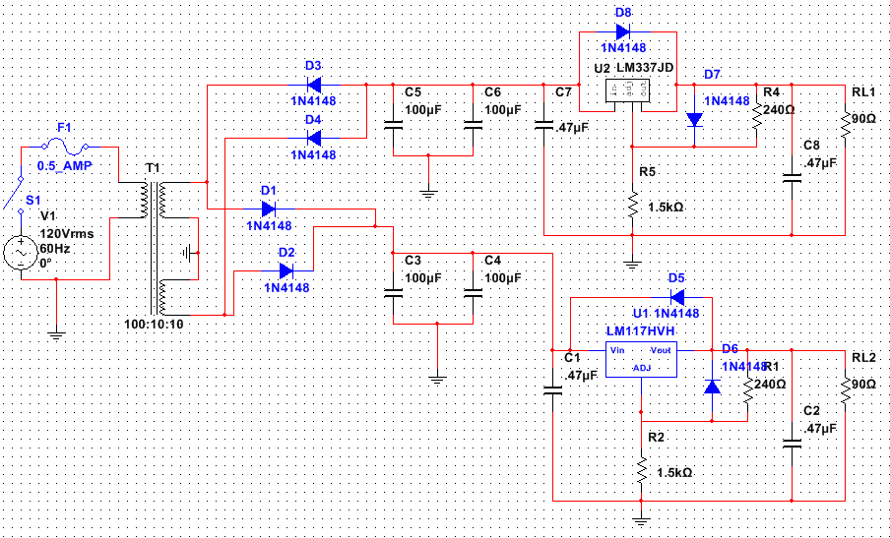
Item # | Express Part # | Part decription | Quantity | Unit Price | Sub Total
1 | 111N4148 | Switching Diode | 8 | 0.06 | 0.48
2 | 14ER025100U | Electrolytic Radial Lead Capacitors - 100 uf 25V | 4 | 0.19 | 0.76
3 | 14ER050.47U | Electrolytic Radial Lead Capacitors - .47 uf 50V | 4 | 0.15 | 0.6
4 | 13005240 | Carbon Film Resistors 5% 1/4 W - Value 240 | 2 | 0.06 | 0.12
5 | 130051.5K | Carbon Film Resistors 5% 1/4 W - Value 1.5K | 2 | 0.06 | 0.12
6 | 2000MYT1/2 | Slow Blow Fuses Economy Type 1/2 Amp | 1 | 0.5 | 0.5
7 | 2001LINL | In-Line Holder For 1-1- 4 x 1- 4 Fuses | 1 | 0.55 | 0.55
8 | 10317-T | Volt. Regulator Adjustable 1A | 1 | 0.35 | 0.35
9 | 10337-T | Volt. Regulator Adjustable 1A | 1 | 0.75 | 0.75
10 | 16P112-1 | Power Transformer 12.6 VCT 1A | 1 | 6.5 | 6.5
11 | 17SWTOGWR | SPST Toggle Switch with lead wires | 1 | 0.95 | 0.95
BILL OF MATERIALS
1
11
6
7
1
9
4
3
2
Total Price | $ | 11.68
5
2
1
10
8
5
4

Slide 6
Troubleshooting:
The part LM337 did not exist in the Multisim 13.0 computer program.
A spice model was located in a library on the internet. The text was copied and saved as a .cir file. Using the Component Wizard in Multisim 13.0, the part was constructed using the pinout of another regulator. The outputs and inputs were verified and the part was saved to the user database then placed in the simulation.
The design does not contain any potentiometers so it may cause problems later if any other parts are not within tolerance.

Slide 7
Conclusion:
The power supply was designed within the desired requirements and simulated successfully.
The Bill of materials is such that the budget for the power supply permitted two to be purchased

Slide 8
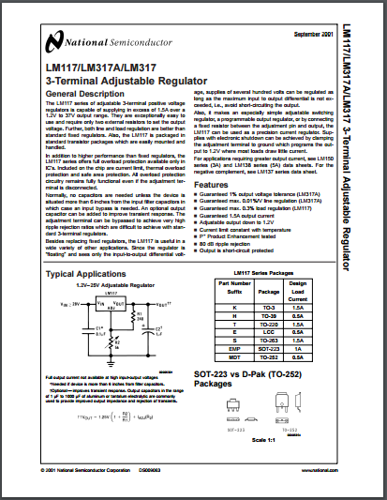
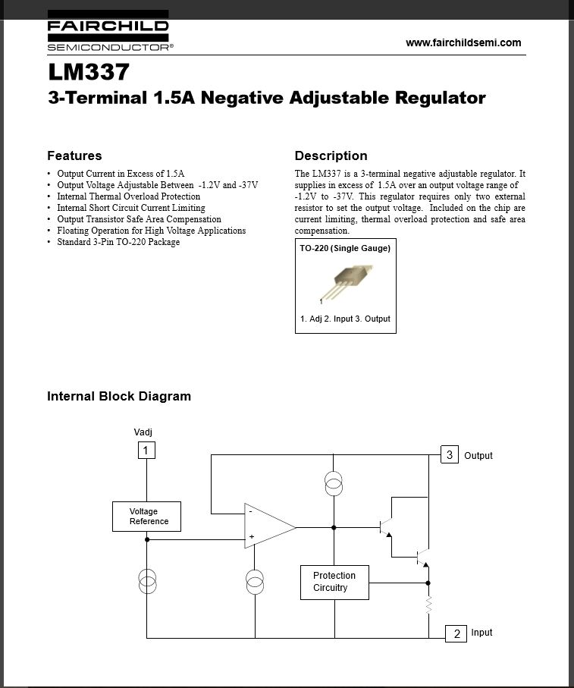
Data Sheets:
LM317 Voltage Regulator
LM337 Negative Voltage Regulator

