Slide 1
Lab 11
Band Pass Filter Using an OP Amp
By: Dakota Johnson
Lab Partner: Josiah Abel
Instructor: Andy Bell
Bench Number: 6
Class: EECT 121-50C
Date: 12/15/2015

Slide 2
Objectives:
Simulate a band pass filter that attenuates frequencies other than 1kHz with multisim
Equipment and Parts:
    Multisim 13

Slide 3

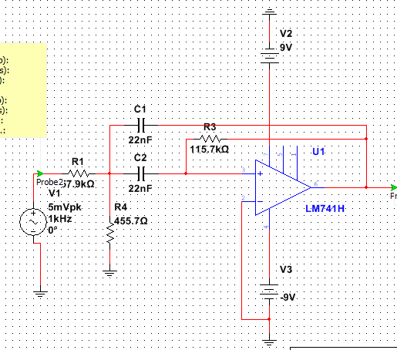
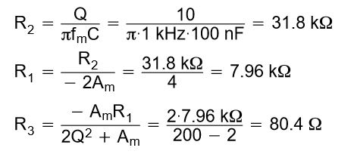
Data/Lab Results/Simulations/Schematics:
Circuit Type:
Multiple Feedback
Equation for bandwidth
Equation used to find R1, R2, and R3
fc | 1000 | Hz
A_{m} | -1
Q | 8
B | 125.0E+0
C | 22.0E-9 | F
R1 | 57.9E+3 | Ω
R2 | 115.7E+3 | Ω
R3 | 455.7E+0 | Ω
Multisim Schematics of the circuit.
Table of values for the simulation

Slide 4
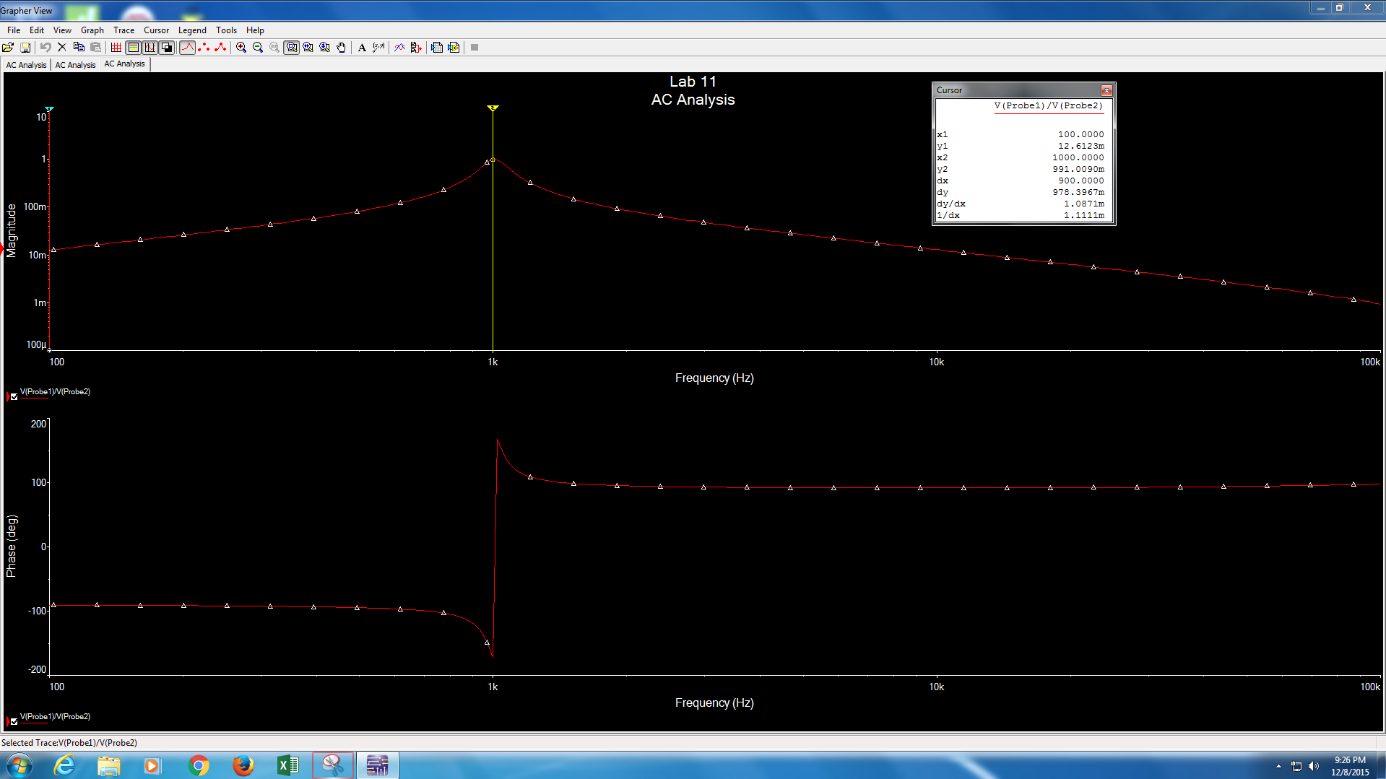
Data from the diagram x2 is in Hz
Frequency Response and phase shift diagrams for the band pass filter

Slide 5
Troubleshooting:
  A design was first made using the Sallen-Key topology. This design was not functioning correctly so a multiple feedback topology was used.

Slide 6
Conclusion:
A band pass filter that attenuates frequencies other than 1kHz was built.

