Slide 1
Lab 10 High Pass Filter Using an OP Amp
By: Dakota Johnson
Lab Partner: Josiah Abel
Instructor: Andy Bell
Bench Number: 6
Class: EECT 121-50C
Date: 12/15/2015

Slide 2
Objectives:
Simulate a high pass filter that attenuates frequencies below 1kHz with multisim
Equipment and Parts:
Multisim 13

Slide 3
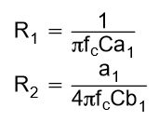
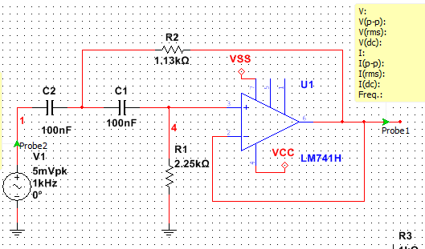
Data/Lab Results/Simulations/Schematics:
Circuit Type:
Sallen-Key
Tschebycheff
Equations used to find R1 and R2
fc | 1000 | Hz
A₀= | 1
a1= | 1.4142
b1 | 1
C | 100.0E-9 | F
R1 | 2.3E+3 | Ω
R2 | 3.2E+3 | Ω
Table of values for the simulation
Multisim Schematics of the circuit.

Slide 4
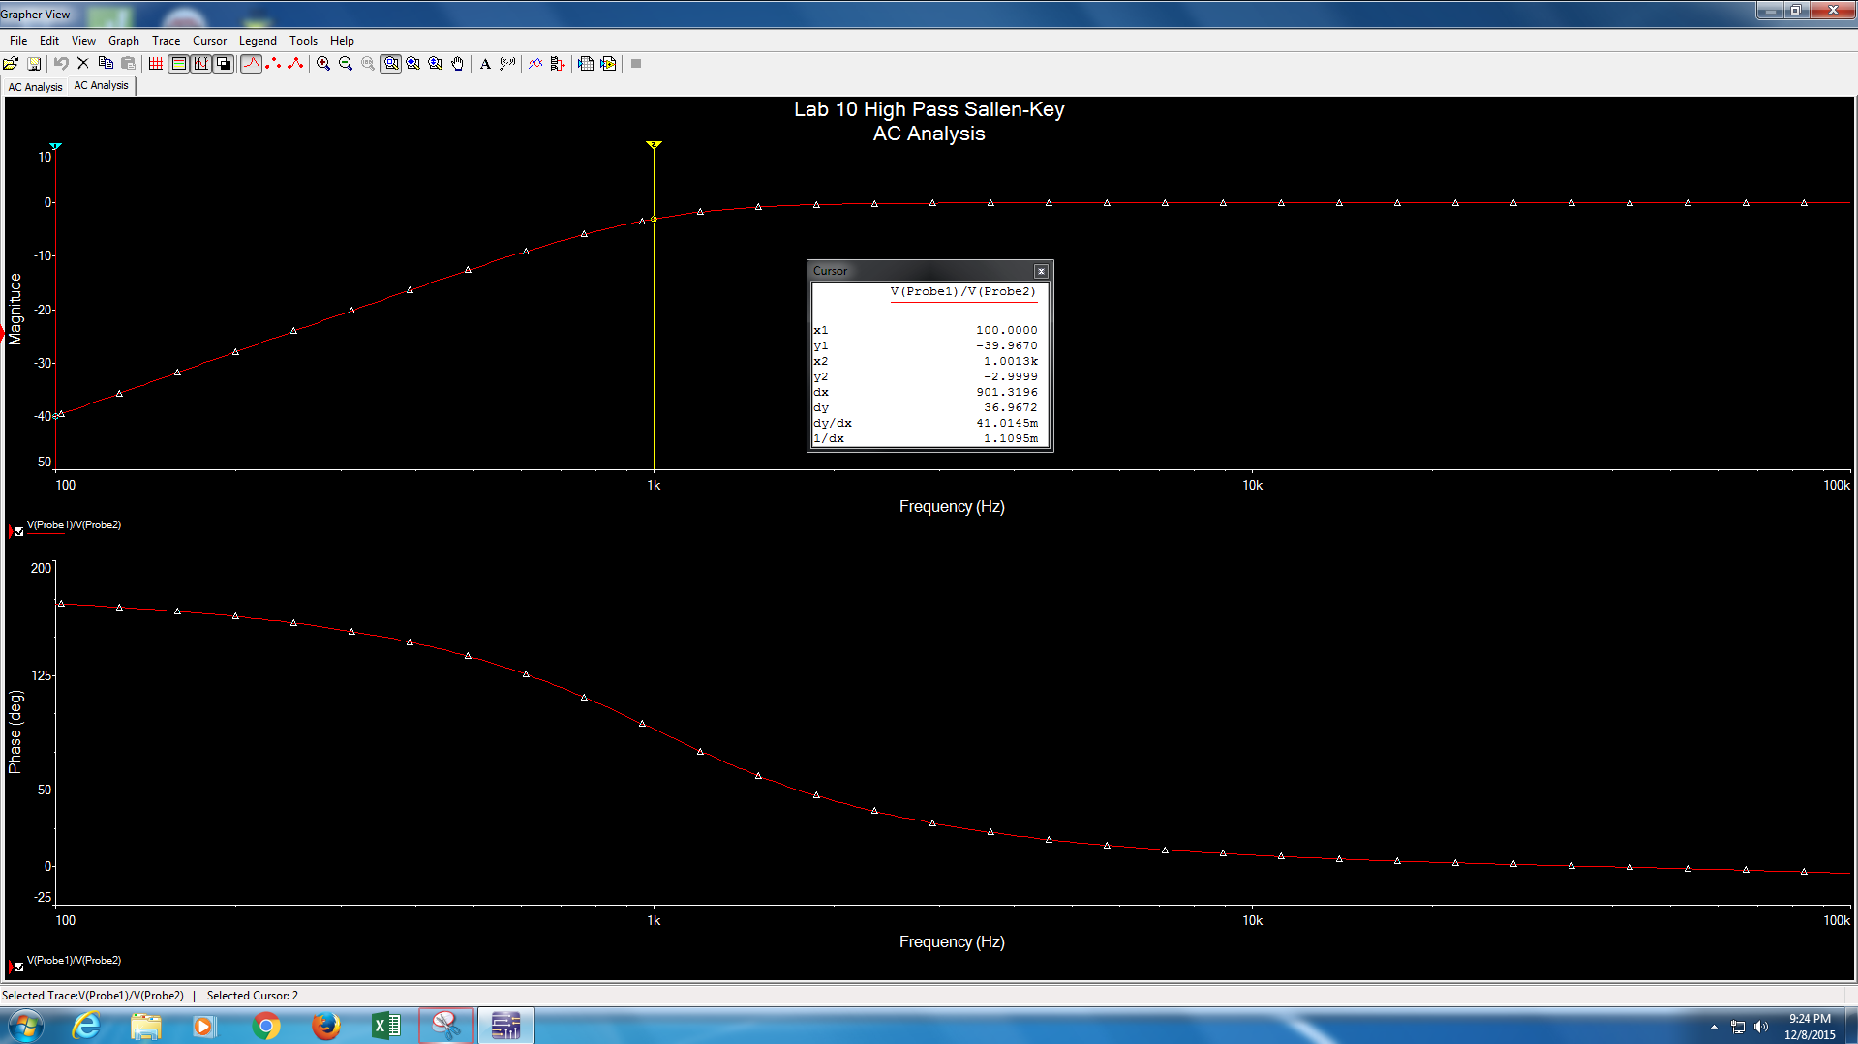
Data from the diagram x2 is in Hz and y2 is in dB.
Frequency Response and phase shift diagrams for the high pass filter

Slide 5
Troubleshooting:
The parameters for testing were not precise enough. To change this the parameters were changed from a maximum of 1MHz to 100kHz and it behaved as expected.

Slide 6
Conclusion:
A high pass filter that attenuates frequencies below 1kHz was built.

