Slide 1
Lab 0: Review and Support Material
By: Josiah Abel
Lab Partner: Dakota Johnson
Instructor: Andy Bell
Bench Number: 6
Class: EECT 121-50C
Date: 12/15/2015

Slide 2
Objectives:
To review material and basic topics learned in a previous course.
Equipment and Parts:
    Just Multisim 13.0 and Microsoft Excel were used in the production of Lab 0.
    There were no physical components involved besides sweat and tears.
(Note there are no Data Sheets because none of these were constructed physically in the electronics laboratory.)

Slide 3
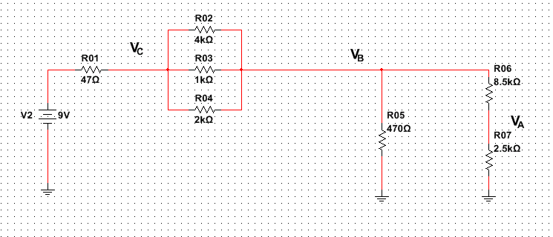
Objectives: Review 1
To Analyze the following circuit and perform the following steps
    Given the resistor values R1-R7 and the Voltage source, calculate the total current, branch currents, and voltages at VA, VB, and VC.
    Modify the circuit so that the new voltage reading at VA is 2.5X the old one.
    Determine the Wattage value for each part assuming 25% power.

Slide 4
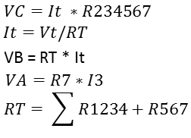
Step 1 Calculations:
Calculation results from the given Resistor and voltage Values.
Equations used to calculate the voltages at VA, VB, VC and the total resistance and currents.

Slide 5
Step 2, Voltage (VA) @ 2.5x: Calculations
Excel check to make sure the new voltage was 2.5X the old
By modifying R6 and R7 the new Voltage for VA was found so that the current remained the same

Slide 6
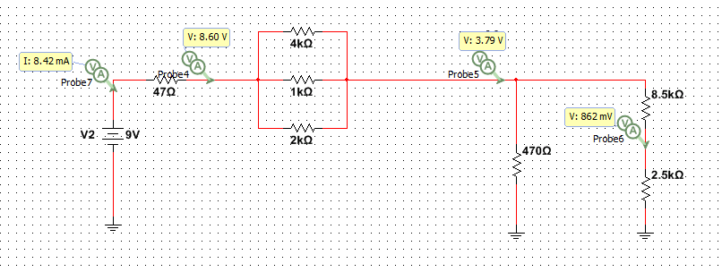
Step 2, Voltage (VA) @ 2.5x: Simulation

Slide 7
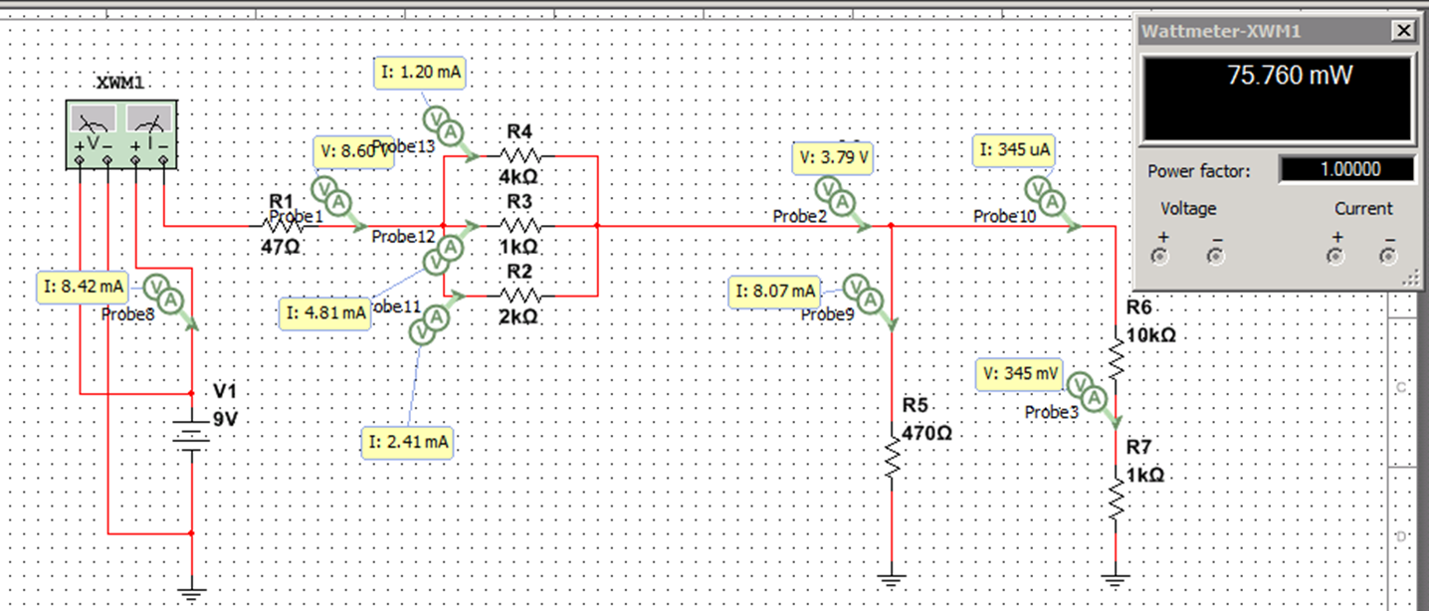
Step 3 Power Dissipation: Simulation

Slide 8
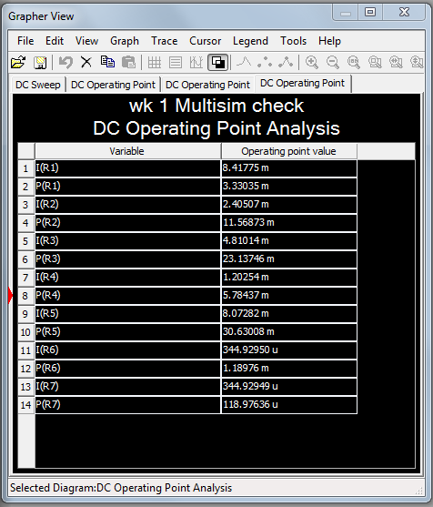
Step 3 Power Dissipation: Simulation and Calculations
Simulation results on the left match the power calculations for the resistors in the left column of excel.
The 25% power calculations are highlighted in yellow.

Slide 9
Conclusion: Review 1
The circuit was analyzed and the steps were performed adequately
The voltages, currents and resistances were determined
25% power dissipation was calculated

Slide 10
Objectives: Review 2
To Analyze the following circuit and perform the following steps
    Replace R1 , R2, and R3 with an equivalent capacitor and maintain the voltage reading of VA.
    Replace R1, R2, and R3 with equivalent inductors and maintain the voltage reading of VA.
    Calculate the Reactance (Z) of each scenario.
    Determine VB mathematically using capacitive reactance (Xc)
    (note the voltage source will be chanced to an AC 9Vrms)

Slide 11
Step 1 Replace With Capacitors: Calculations
Approximation to single capacitance value.

Slide 12
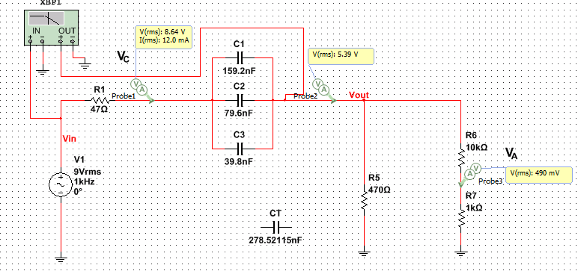
Step 1 Replace With Capacitors: Simulation

Slide 13
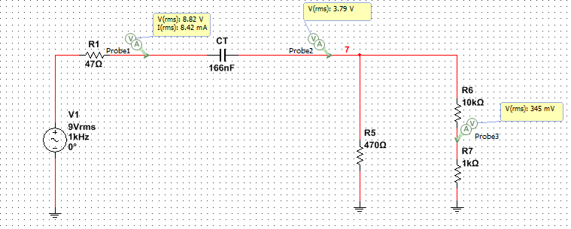
Step 1 Single Capacitor: Simulation

Slide 14
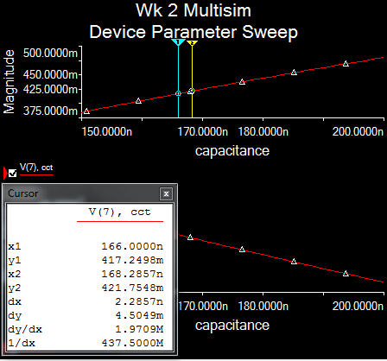
Step 1 Single Capacitor: Simulation

Slide 15
Step 2 Replace Resistors with Inductor: Calculations

Slide 16
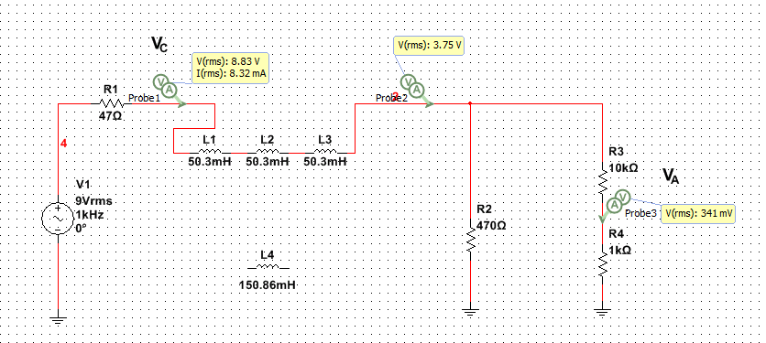
Step 2 Replace Resistors with Inductors: Simulation

Slide 17
Steps 3-4 Determine Z and Calculate Vb: Calculations

Slide 18
Conclusion: Review 2
The circuit was analyzed and the steps were performed adequately
The Capacitance and inductance Values were accurately determined
Reactance was found to be the same in both circuits. This makes sense because the capacitors and inductors were replacing the same resistors.

Slide 19
Objectives: Support 1, Bridge Rectifier
To Build a bridge rectifier

Slide 20
Support 1 :Calculations

Slide 21
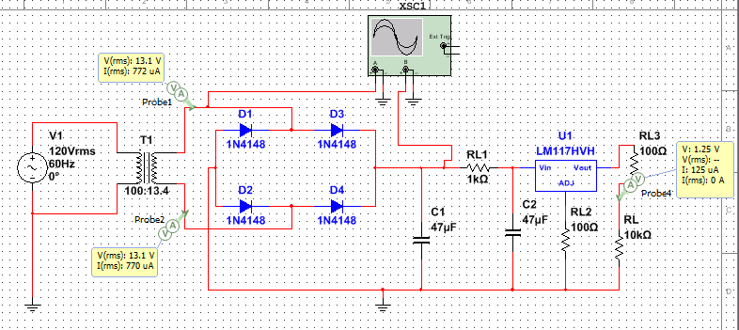
Support 1 : Simulation

Slide 22
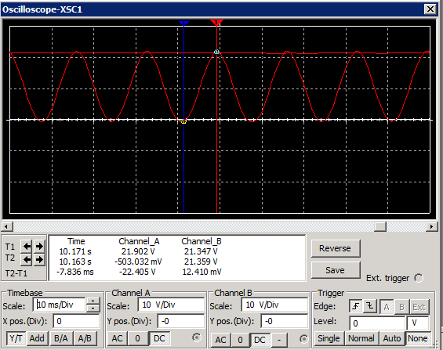
Support 1 : Simulation

Slide 23
Conclusion: Support 1
A working bridge rectifier was constructed utilizing the calculations performed.

Slide 24
Objectives: Support 2, Transistor Circuits
To construct three simulations of the examples located in chapter 25 in the textbook Foundations of Electronics: Circuits & Devices [Conventional Flow Version] 2nd edition.
To study behaviors of NPN and PNP transistors
    Constructed simulation of example 25-4
    Constructed simulation of example 25-5
    Constructed simulation of example 25-11

Slide 25
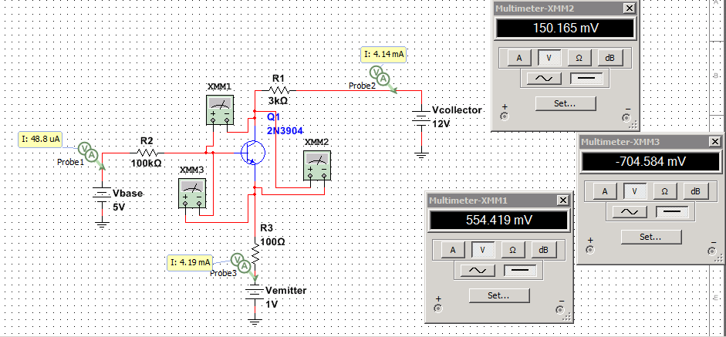
Support 2 : Simulation 25-4 (NPN)

Slide 26
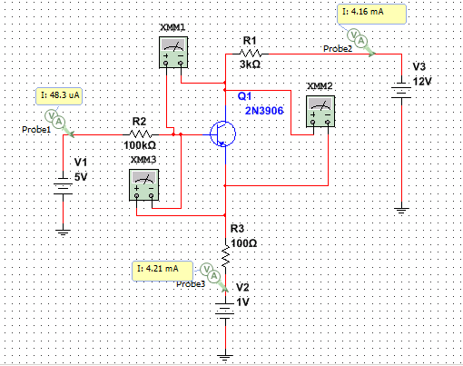
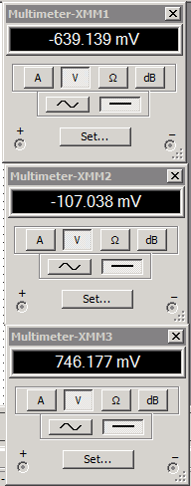
Support 2 : Simulation 25-5 (PNP)

Slide 27
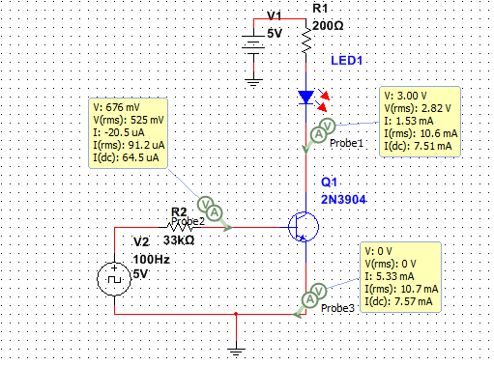
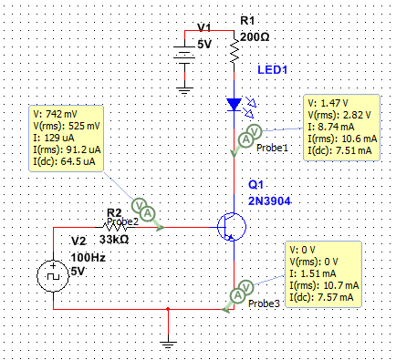
Support 2 : Simulation 25-11 (NPN)
LED ON
LED OFF

Slide 28
Conclusion: Support 2, Transistor Circuits
The simulations functioned as expected and demonstrated the difference between NPN and PNP transistor functionality.

Slide 29
Objectives: Support 3, Operational Amplifiers
To construct three simulations with operational amplifiers
To study some applications of operational amplifiers.
    Constructed a simulation of a basic amplifier circuit with a gain of 10
    Constructed a simulation of a non-inverting amplifier circuit with a gain of 10
    Constructed simulation of Buffer Amplifier circuit

Slide 30
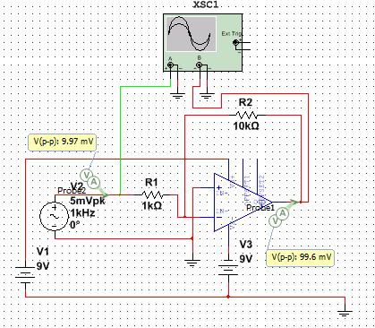
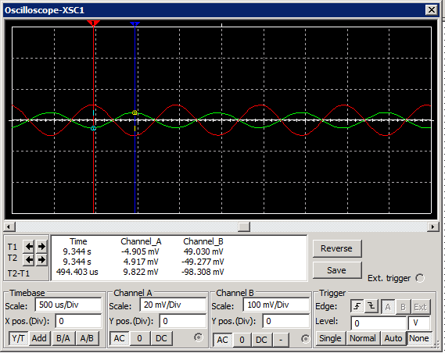
Support 3 : Simulation, Basic Amplifier

Slide 31
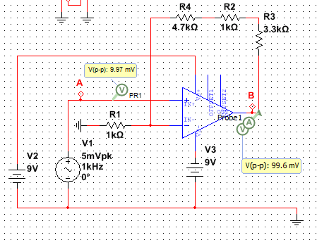
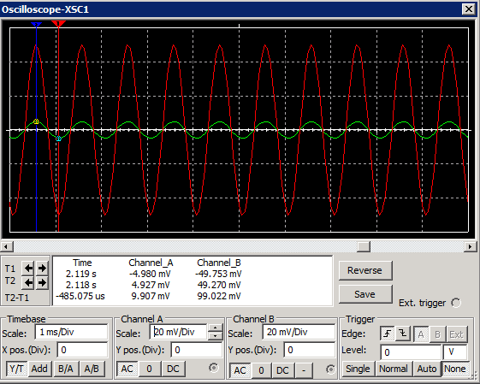
Support 2 : Simulation, Non-Inverting
The positive terminal of the op amp is wired differently in this setup. The output of the amplifier is represented by the red on the oscilloscope reading while the input is green.

Slide 32
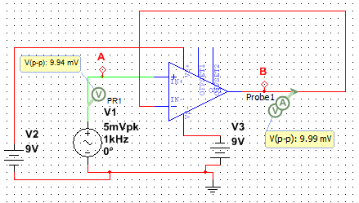
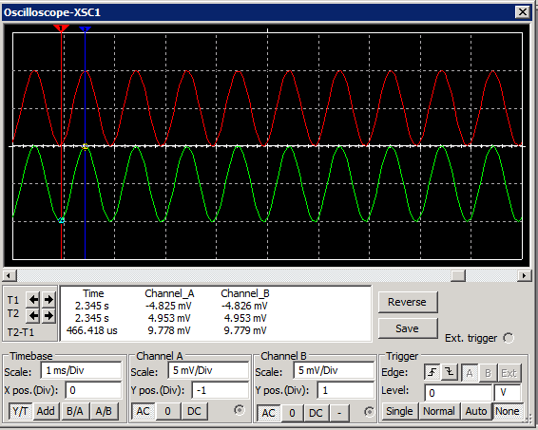
Support 2 : Simulation, Buffer Circuit

Slide 33
Conclusion: Support 3, Operational Amplifiers
The simulations functioned as expected and demonstrated the some of the uses of Operational Amplifiers (Op Amps).

Slide 34
Conclusion:
The Material reviewed assisted with the comprehension of the other labs in this course.

