Slide 1
Final Project
By Dakota Johnson
Class: EECT 111
Instructor: Lou Toth
Spring 2015

Slide 2
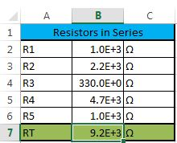
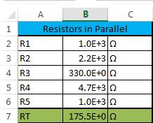
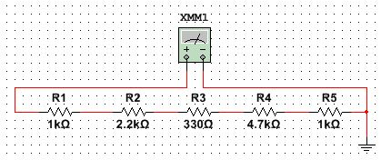
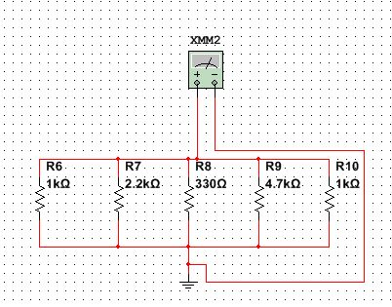
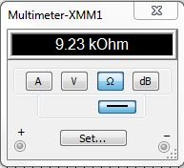
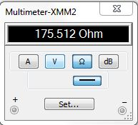


1.) Multiple resistors combine in series and parallel.
$$R_{T}=\frac{1}{\frac{1}{R_{1}}+\frac{1}{R_{2}}+\frac{1}{R_{3}}}$$
$$R_{T}=R_{1}+R_{2}+R_{3}$$

Slide 3








2.) By example calculate RT, IT, PT, and all the nodal voltages, branch currents and power dissipation of a resistor network.
Total Resistance
R1 | 10.0E+3 | Ω
R2 | 2.2E+3 | Ω
R3 | 2.2E+3 | Ω
R4 | 2.2E+3 | Ω
R5 | 1.0E+3 | Ω
R6 | 1.0E+3 | Ω
R234 | 733.3E+0 | Ω
RT | 12.7E+3 | Ω
$$R_{T}=R_{1}+R_{2}+R_{3}$$
$$R_{T}=\frac{1}{\frac{1}{R_{1}}+\frac{1}{R_{2}}+\frac{1}{R_{3}}}$$
$$V=I_{R}R$$
$$I_{T}=\frac{V_{T}}{R_{T}}$$
Nodal Voltage
VT | 5.0E+0 | V
IT | 392.7E-6 | A
V1 | 1.07E+0 | V
V2 | 1.07E+0 | V
V3 | 1.07E+0 | V
V4 | 1.07E+0 | V
V5 | 392.67E-3 | V
Total Current
VT | 5.0E+0 | V
RT | 13.0E+3 | Ω
IT | 383.7E-6 | A
$$I=V_{node}/R$$
$$P=IV$$
$$I=I_{T}/3$$
$$P=I_{Branch}V_{Node}$$
Total Power
VT | 5.0E+0 | V
IT | 383.7E-6 | A
PT | 1.9E-3 | W
Branch Current
V1 | 1.07E+0 | V
I2 | 130.89E-6 | A
I3 | 130.89E-6 | A
I4 | 130.89E-6 | A
I5 | 3.9E-3 | A
Power Dissapation
P1 | 421.5E-6 | W
P2 | 140.48E-6 | W
P3 | 140.48E-6 | W
P4 | 140.48E-6 | W
P5 | 1.5E-3 | W

Slide 4
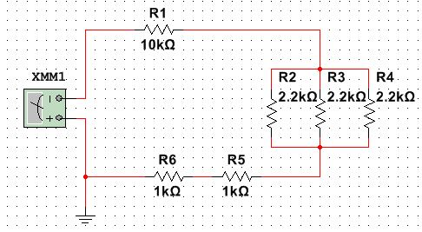
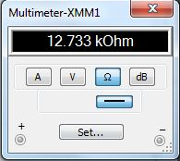
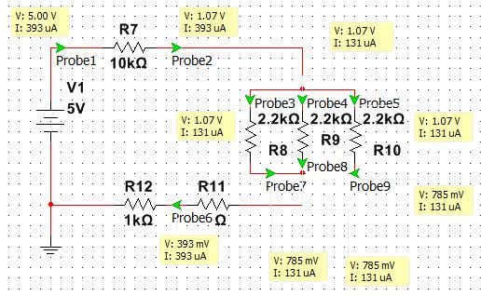
2.) By example calculate RT, IT, PT, and all the nodal voltages, branch currents and power dissipation of a resistor network.

Slide 5
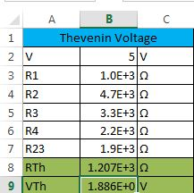
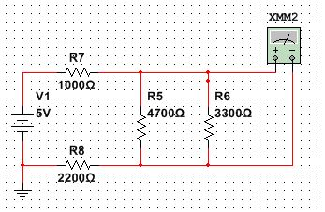
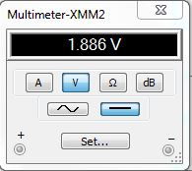
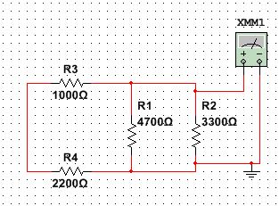
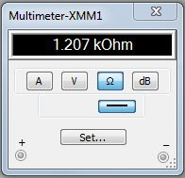
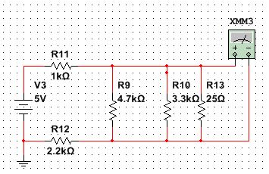
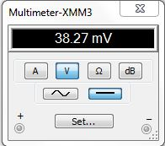
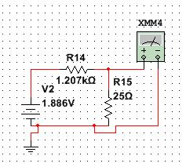
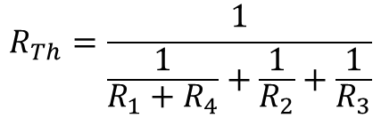


3.) By example calculate the Thevenin Resistance and
Voltage of a resistor network.
$$R_{Th}=\frac{1}{\frac{1}{R_{1}+R_{4}}+\frac{1}{R_{2}}+\frac{1}{R_{3}}}$$
RTh
VTh
$$V_{Th}=\frac{(V_{T}∗R_{23})}{R_{T}}$$

Slide 6
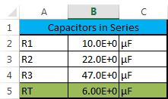
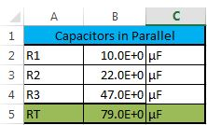
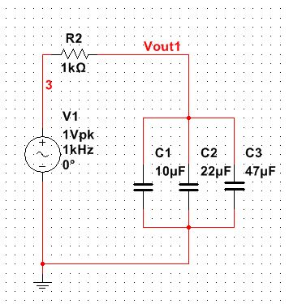
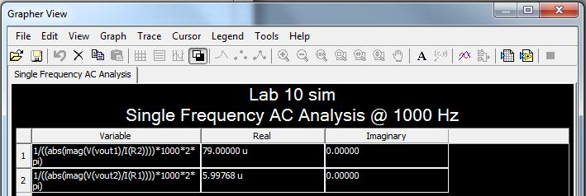
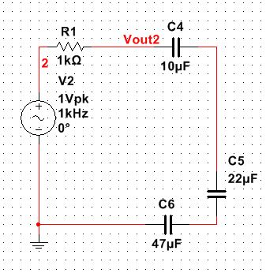


4.) Multiple capacitors combine in series and parallel.
CT
CT
$$C_{T}=\frac{1}{\frac{1}{C_{1}}+\frac{1}{C_{2}}+\frac{1}{C_{3}}}$$
$$C_{T}=C_{1}+C_{2}+C_{3}$$

Slide 7
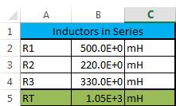
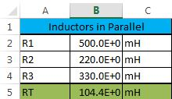
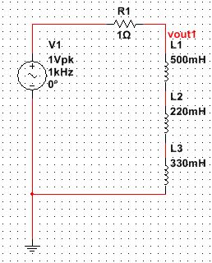
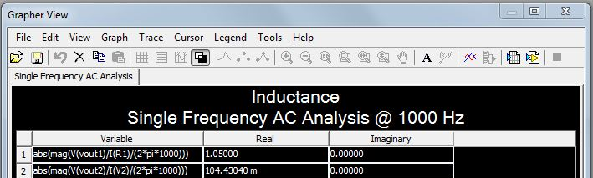
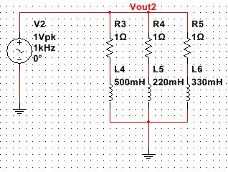


5.) Multiple inductors combine in series and parallel.
LT
LT
$$L_{T}=L_{1}+L_{2}+L_{3}$$
$$L_{T}=\frac{1}{\frac{1}{L_{1}}+\frac{1}{L_{2}}+\frac{1}{L_{3}}}$$

Slide 8
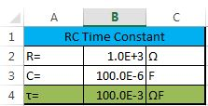
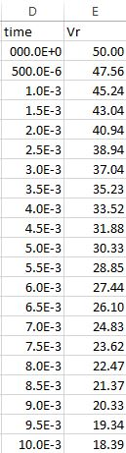
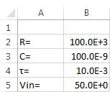


Using a simple RC circuit determine the a.) Time Constant b.) Create a graph that shows the RC time constant as a function of time
τ
$τ$=RC
$V_{R}=V_{T}(e^{−\frac{t}{τ}}$)
VR

Slide 9



Using a simple RC circuit determine the c.) Determine XC at a fixed frequency d.) Create a graph that shows how XC changes as a function of frequency
Xc
$$X_{C}=\frac{1}{2πfC}$$
Capacitor | 4.70E-07 | F
Frequency Hz | Xc
10 | 3.39E+04 | Ω
50 | 6.77E+03 | Ω
100 | 3.39E+03 | Ω
200 | 1.69E+03 | Ω
300 | 1.13E+03 | Ω
400 | 8.47E+02 | Ω
500 | 6.77E+02 | Ω
600 | 5.64E+02 | Ω
700 | 4.84E+02 | Ω
800 | 4.23E+02 | Ω
900 | 3.76E+02 | Ω
1000 | 3.39E+02 | Ω
2000 | 1.69E+02 | Ω
3000 | 1.13E+02 | Ω
4000 | 8.47E+01 | Ω
5000 | 6.77E+01 | Ω
6000 | 5.64E+01 | Ω
7000 | 4.84E+01 | Ω
8000 | 4.23E+01 | Ω
9000 | 3.76E+01 | Ω
10000 | 3.39E+01 | Ω

Slide 10
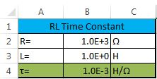



7.) Using a simple RL circuit determine the a.) Time Constant b.) Create a graph that shows the RL time constant as a function of time
$i=\frac{V_{s}}{R}(e^{−R_{t}/L}$)
τ
Vin | 5
000.0E+0 | 5.00
500.0E-6 | 3.03
1.0E-3 | 1.84
1.5E-3 | 1.12
2.0E-3 | 0.68
2.5E-3 | 0.41
3.0E-3 | 0.25
3.5E-3 | 0.15
4.0E-3 | 0.09
4.5E-3 | 0.06
5.0E-3 | 0.03
5.5E-3 | 0.02
6.0E-3 | 0.01
6.5E-3 | 0.01
7.0E-3 | 0.00
7.5E-3 | 0.00
8.0E-3 | 0.00
8.5E-3 | 0.00
9.0E-3 | 0.00
$$τ=L/R$$

Slide 11


7.) Using a simple RL circuit determine the c.) Determine XL at a fixed frequency d.) Create a graph that shows how XL changes as a function of frequency
$$X_{L}=2πfL$$
XL
Inductor | 1.00E+00 | H
Frequency Hz | XL
10 | 6.28E+01 | Ω
50 | 3.14E+02 | Ω
100 | 6.28E+02 | Ω
200 | 1.26E+03 | Ω
300 | 1.88E+03 | Ω
400 | 2.51E+03 | Ω
500 | 3.14E+03 | Ω
600 | 3.77E+03 | Ω
700 | 4.40E+03 | Ω
800 | 5.03E+03 | Ω
900 | 5.65E+03 | Ω
1000 | 6.28E+03 | Ω
2000 | 1.26E+04 | Ω
3000 | 1.88E+04 | Ω
4000 | 2.51E+04 | Ω
5000 | 3.14E+04 | Ω
6000 | 3.77E+04 | Ω
7000 | 4.40E+04 | Ω
8000 | 5.03E+04 | Ω
9000 | 5.65E+04 | Ω
10000 | 6.28E+04 | Ω

