Slide 1
Lab Notebook
Charles Slagal
50C-Intro to Circuits Analysis

Slide 2
Guide to Labs
Lab 1- Resistor Variablity
Lab 2- Reading and sorting resistors
Lab 3- Series Resistors
Lab 4- Black box design (2 resistors)
Lab 6- Black box design (3 resistors)
Lab 7- 4 Resistor parallel circuit
Lab 8- Black box design (3 equal resistors)
Lab 9- Series/Parallel
resistors
Lab 10- Series/Parallel capacitors
Lab 11- RC Lab
Lab 12- Series/Parallel Indu
Lab 13- RL Labs

Slide 3
Resistor Variability
The purpose of this lab is to show how resistors can vary. Resistors typically don’t have the exact expected resistance (Ohms).
For this reason, we measure resistors prior to using them in the lab.

Slide 4
How Resistors vary

Slide 5
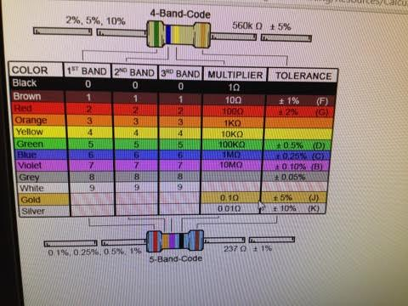
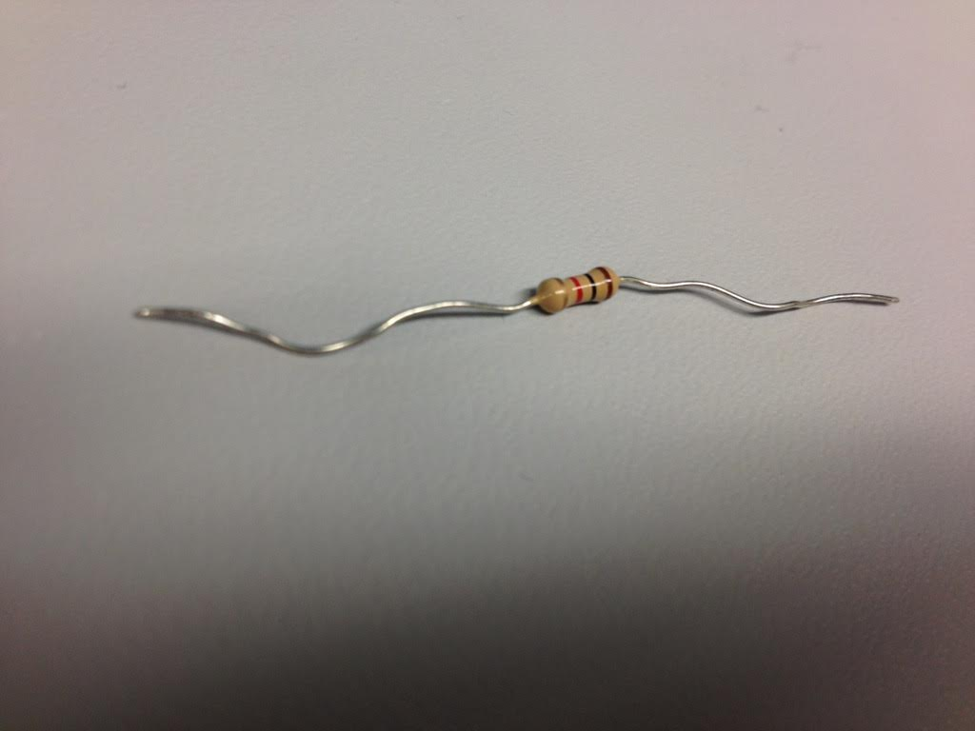
Resistors and their color codes

Slide 6
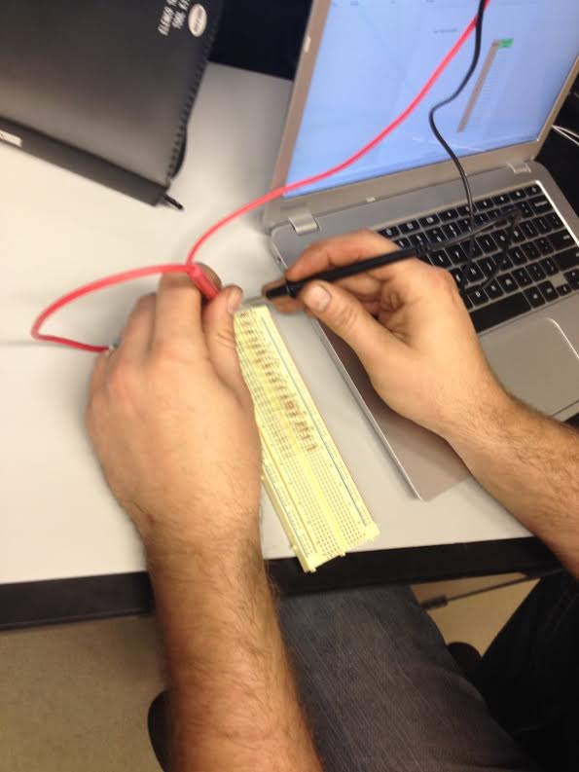
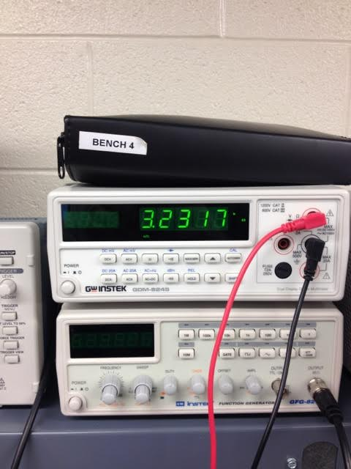
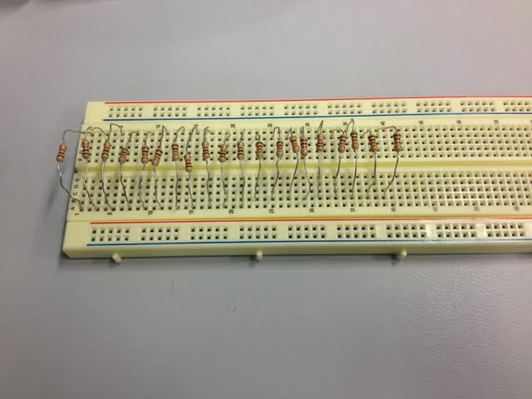
Measuring Resistors

Slide 7
Excel Data
Sample | Expected
1 | 470
2 | 470
3 | 470
4 | 470
5 | 470
6 | 470
7 | 470
8 | 470
9 | 470
10 | 470
11 | 470
12 | 470
13 | 470
14 | 470
15 | 470
16 | 470
17 | 470
18 | 470
19 | 470
20 | 470
Measured Value
459
456.6
463.8
463.5
465.6
462
465.8
459.7
463.7
462.4
472.5
460
466
460.7
456.8
457.7
463.7
458.5
460.8
457.4
% Difference
-0.02
-0.03
-0.01
-0.01
-0.01
-0.02
-0.01
-0.02
-0.01
-0.02
0.01
-0.02
-0.01
-0.02
-0.03
-0.03
-0.01
-0.02
-0.02
-0.03

Slide 8
Reading and sorting resistors
The purpose of this lab was to be able to identify the expected resistance of any given resistor by the color bands on them.

Slide 9
Measuring the resistors
We measured the resistors to make sure they were:
  The correct resistance
  Within tolerance of expected resistance

Slide 10
Resistor Color Code Chart
There are 12 colors
  The first three colors indicate a digit that is part of a three digit number
    The first and second band could be 0
  The 4th band indicates which multiplier to use.
    The first 8 are 1 to 10x10^6
  The last band indicates the tolerance of resistance for that resistor

Slide 11
Resistor Color Code Chart

Slide 12
Excel Data
Resistance Value | Measured Value | Percent Difference | -5% | 5%
100 | 98.31 | -1.69% | 95 | 105
220 | 216.7 | -1.50% | 209 | 231
330 | 324.7 | -1.61% | 313.5 | 346.5
470 | 465.2 | -1.02% | 446.5 | 493.5
1 | 0.9782 | -2.18% | 0.95 | 1.05
2.2 | 2.153 | -2.14% | 2.09 | 2.31
3.3 | 3.248 | -1.58% | 3.135 | 3.465
4.7 | 4.577 | -2.62% | 4.465 | 4.935
10 | 9.772 | -2.28% | 9.5 | 10.5
22 | 21.507 | -2.24% | 20.9 | 23.1
33 | 33.054 | 0.16% | 31.35 | 34.65
47 | 46.923 | -0.16% | 44.65 | 49.35
100 | 99.65 | -0.35% | 95 | 105
1 | 0.9976 | -0.24% | 0.95 | 1.05
10 | 10.28 | 2.80% | 9.5 | 10.5

Slide 13
Series Resistors
Our goal in this lab was to analyze resistors in a series circuit
We used a volt meter and a function generator

Slide 14
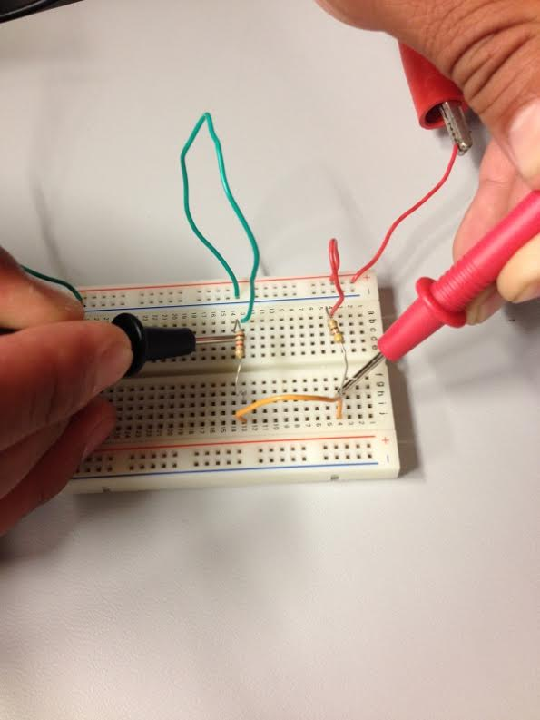
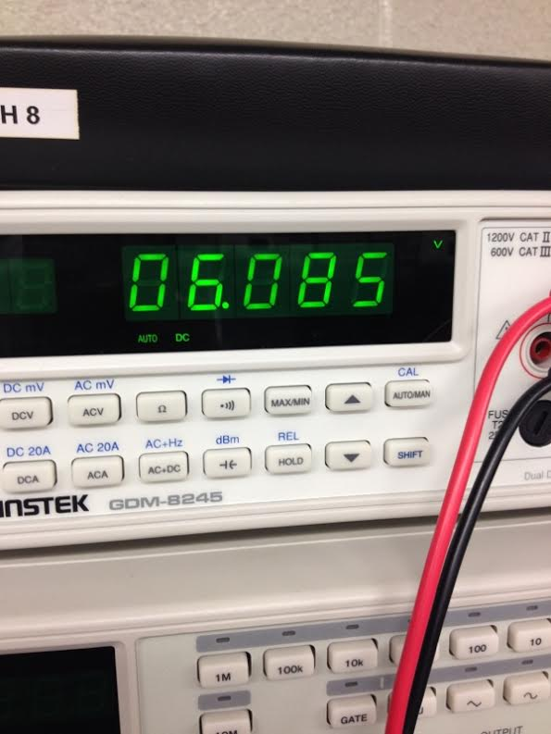
Measuring resistors

Slide 15
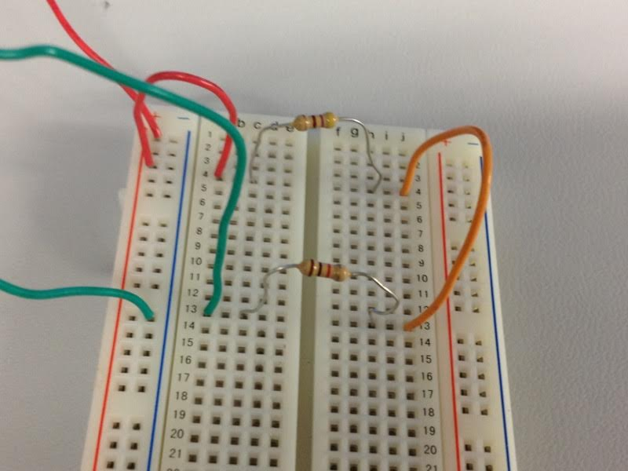
Circuit for series resistors

Slide 16
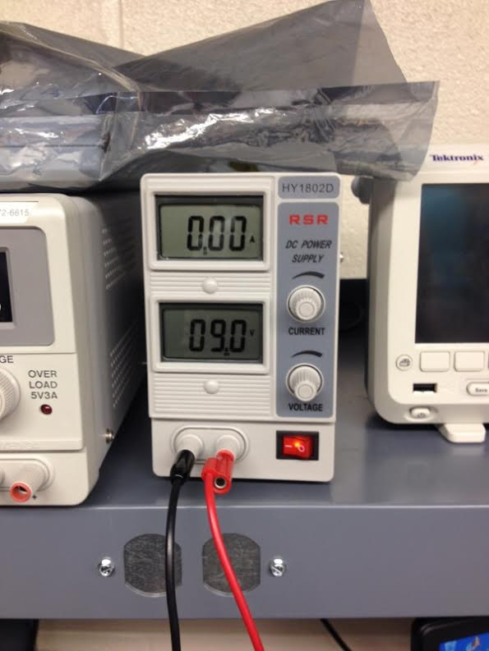
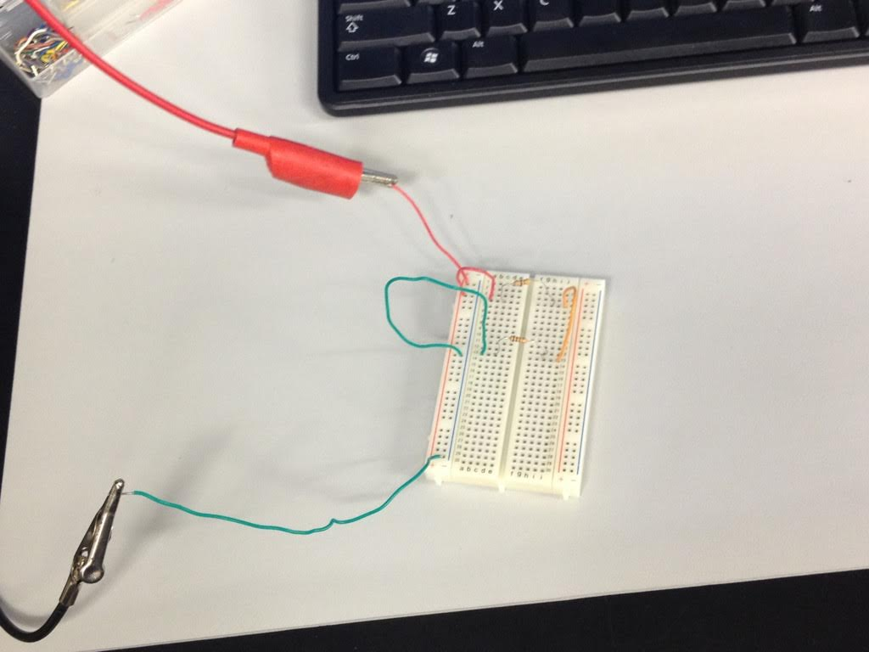
Power to Circuit

Slide 17
Excel Data
 | Measured | Calculated | Simulated
R1 = | 9.8E+3 | 10.0E+3 | 10.0E+3 | omhs
R2 = | 2.2E+3 | 2.2E+3 | 2.2E+3 | omhs
R3 = | 4.6E+3 | 4.7E+3 | 4.7E+3 | omhs
RT = | 16.6E+3 | 16.9E+3 | 16.9E+3 | omhs
 | Measured | Calculated | Simulated
IT = | 540.7E-6 | 532.5E-6 | 532.5E-6 | A
VT= | 8.949 | 9 | 9 | V
V1 = | 8.949 | 9 | 9 | V
VA = | 3.663 | 3.7E+0 | 3.67 | V
VB = | 2.495 | 2.5E+0 | 2.5 | V

Slide 18
Black Box Design (3 Resistors)
The purpose of this lab is further analysis of how resistors act in a series circuit.
The current going through the circuit must be 10mA. We were tasked with finding three standard resistor values that met the resistance requirements to have 10mA current.

Slide 19
Finding what resistor values we need
We need to use Ohm’s law; I = V/R, to find what the total resistance needed to be. We then found three standard resistor sizes that added up to that value.

Slide 20
Excel Data
 | Design | Measured | Calculated | Simulated | Units
V1 = | 9 | 9.009 | 9 | 9 | V
IT = | 10.0E-3 | 10.1E-3 | 10.0E-3 | 10.0E-3 | A
RT = | 900 | 882.7 | 900.0E+0 | 899.7E+0 | Ω
R1 = | 100 | 98.75 | 100 | 100 | Ω
R2 = | 330 | 324.1 | 330 | 330 | Ω
R3 = | 470 | 459.5 | 470.0E+0 | 470 | Ω
V | 9 | V
I | 10.0E-3 | A
R = V/I
R | 900.0E+0 | Ω

Slide 21
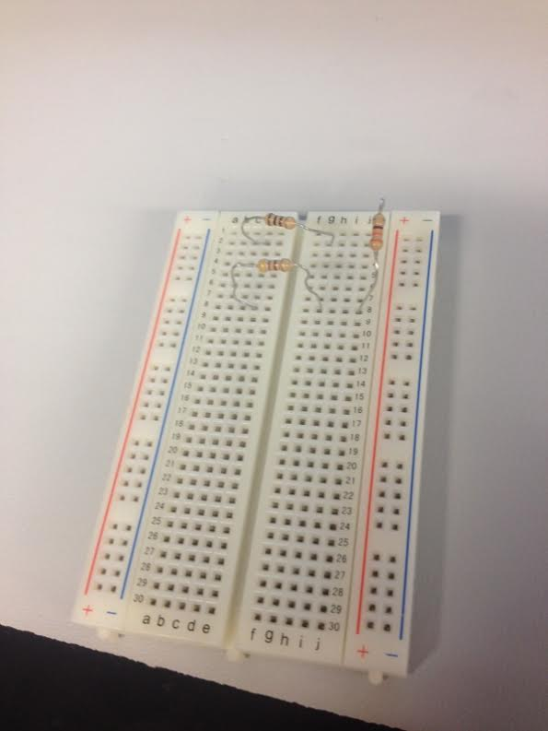
Circuit Board for black box

Slide 22
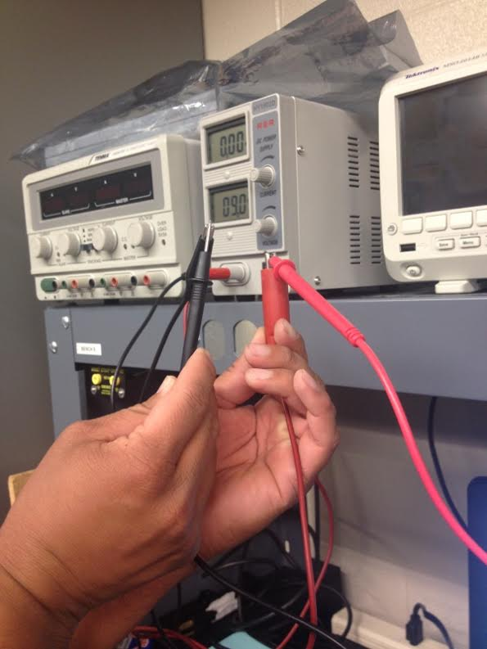
Measuring the power supply going to the black box

Slide 23
Excel Data 2
 | Resistance | Current
0.1 | 90.0E+0 | 100.0E-3
0.136 | 122.4E+0 | 73.5E-3
0.172 | 154.8E+0 | 58.1E-3
0.208 | 187.2E+0 | 48.1E-3
0.244 | 219.6E+0 | 41.0E-3
0.28 | 252.0E+0 | 35.7E-3
0.316 | 284.4E+0 | 31.6E-3
0.352 | 316.8E+0 | 28.4E-3
0.388 | 349.2E+0 | 25.8E-3
0.424 | 381.6E+0 | 23.6E-3
0.46 | 414.0E+0 | 21.7E-3
0.496 | 446.4E+0 | 20.2E-3
0.532 | 478.8E+0 | 18.8E-3
0.568 | 511.2E+0 | 17.6E-3
0.604 | 543.6E+0 | 16.6E-3
0.64 | 576.0E+0 | 15.6E-3
0.676 | 608.4E+0 | 14.8E-3
0.712 | 640.8E+0 | 14.0E-3
0.748 | 673.2E+0 | 13.4E-3
0.784 | 705.6E+0 | 12.8E-3
0.82 | 738.0E+0 | 12.2E-3
0.856 | 770.4E+0 | 11.7E-3
0.892 | 802.8E+0 | 11.2E-3
0.928 | 835.2E+0 | 10.8E-3
0.964 | 867.6E+0 | 10.4E-3
1 | 900.0E+0 | 10.0E-3
1.36 | 1.2E+3 | 7.4E-3
1.72 | 1.5E+3 | 5.8E-3
2.08 | 1.9E+3 | 4.8E-3
2.44 | 2.2E+3 | 4.1E-3
2.8 | 2.5E+3 | 3.6E-3
3.16 | 2.8E+3 | 3.2E-3
3.52 | 3.2E+3 | 2.8E-3
3.88 | 3.5E+3 | 2.6E-3
4.24 | 3.8E+3 | 2.4E-3
4.6 | 4.1E+3 | 2.2E-3
4.96 | 4.5E+3 | 2.0E-3
5.32 | 4.8E+3 | 1.9E-3
5.68 | 5.1E+3 | 1.8E-3
6.04 | 5.4E+3 | 1.7E-3
6.4 | 5.8E+3 | 1.6E-3
6.76 | 6.1E+3 | 1.5E-3
7.12 | 6.4E+3 | 1.4E-3
7.48 | 6.7E+3 | 1.3E-3
7.84 | 7.1E+3 | 1.3E-3
8.2 | 7.4E+3 | 1.2E-3
8.56 | 7.7E+3 | 1.2E-3
8.92 | 8.0E+3 | 1.1E-3
9.28 | 8.4E+3 | 1.1E-3
9.64 | 8.7E+3 | 1.0E-3
10 | 9.0E+3 | 1.0E-3

Slide 24
Black Box Design (2 Resistors)
The purpose of this lab was also to further analyze how resistors work in a series circuit.
The current going through the circuit is 18mA, so we must create a circuit with 2 resistors that meet those requirements.

Slide 25
Finding what resistors we need
We need to use Ohm’s law; I = V/R, to find what the total resistance needed to be. We then found two standard resistor sizes that added up to that value.

Slide 26
Excel Data
 | Calculated | Measured | Simulated
V1 | 9 | 9.11 | 9 | V
R1 | 220 | 216.1 | 220 | Ω
R2 | 330 | 325.4 | 330 | Ω
I1 | 40.9E-3 | 42.2E-3 | 40.9E-3 | Amps
I2 | 27.3E-3 | 28.0E-3 | 27.3E-3 | Amps
IT | 68.2E-3 | 70.2E-3 | 68.2E-3 | Amps
RT | 132.0E+0 | 129.8E+0 | 132.0E+0 | Ω

Slide 27
Resistor Parallel Circuit
The purpose of this lab was to analyze how resistors work in a parallel circuit.
The way you calculate resistance, current and voltage in parallel circuits differs than that of series circuits. You can’t just add the resistors together. You must use one of three ways to calculate the total resistance.
  Product over the sum method: (R1xR2)/(R1+R2)
  Reciprocal method: 1/((1/R1)+(1/R2)+(1/R3)) {Usually used with more than 2 resisitors.
  Equal value method: R/Rn

Slide 28
Excel Data
VA= | 9.0E+0 | v
R1= | 2.2E+3 | Ω
R2= | 3.3E+3 | Ω
R3= | 4.7E+3 | Ω
R4= | 4.7E+3 | Ω
I1= | 4.1E-3 | Amp
I2= | 2.7E-3 | Amp
I3= | 1.9E-3 | Amp
I4= | 1.9E-3 | Amp
IT= | 10.6E-3 | Amp
RT= | 845.2E+0 | Ω
RT= | 845.2E+0 | Ω
Used I = V/R
Used reciprocal method

Slide 29
Black Box Design (Equal value resistors)
The object of this lab was to create a circuit that produces 1.3 Volts
We needed to create the circuit by using three equal value resistors and produce close to 1.3 volts. Then, we needed to use an adjustable resistor to reach an exact value of 1.3 Volts.

Slide 30
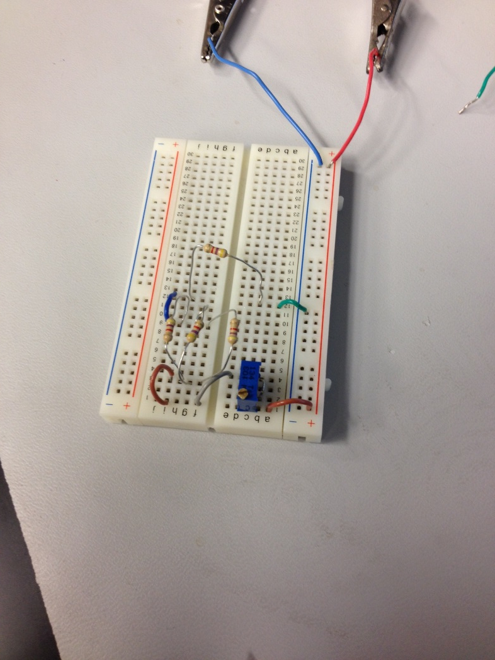
Measuring resistance

Slide 31
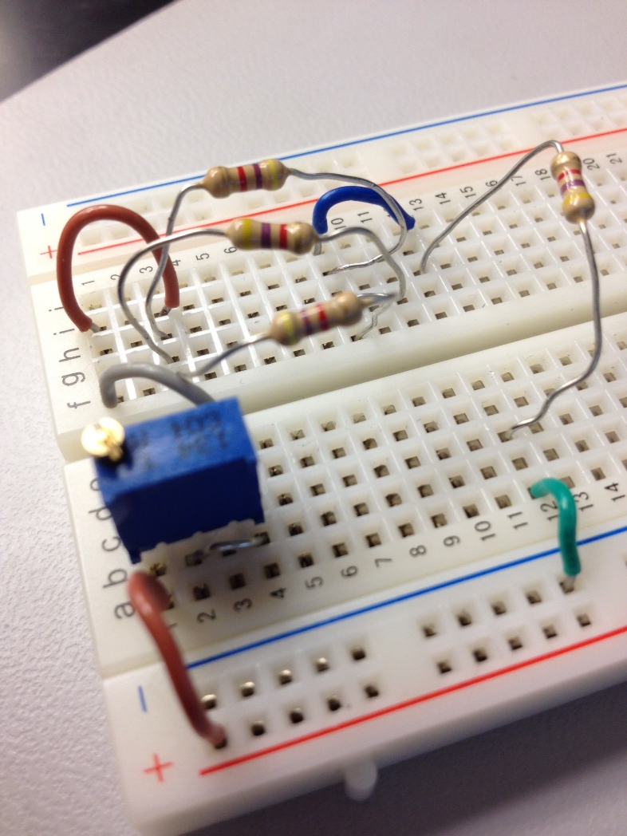
Adjusting the resistance to reach exactly 1.3v

Slide 32
Excel Data
 | Design | Measured
R1 = | 4.7E+3 | 4.6E+3
R2 = | 4.7E+3 | 4.6E+3
R3 = | 4.7E+3 | 4.7E+3
R4 = | 4.7E+3 | 4.6E+3
R5 = | 4.7E+3 | 4.7E+3
R(Black Box) = | 1.6E+3 | 1.5E+3
R1adj = | 4.6E+3 | 4.5E+3
RT | 11.0E+3
VT | 9.0E+0
IT | 820.7E-6
 |  | Measured | Calculated | Simulated
 | V1 = | 9 | 9 | 9
 | VA = | 5.2E+0 | 5.1E+0 | 5.1E+0
 | VB = | 3.9E+0 | 3.9E+0 | 3.9E+0
 | VA - VB = | 1.3E+0 | 1.3E+0 | 1.3E+0
 | (VA - VB) adj = | 1.3E+0 | 1.3E+0 | 1.3E+0

Slide 33
Series/Parallel Resistors
The goal of this lab was to analyze circuits that combine resistors in series and parallel circuits. We show how to simplify circuits.
You can combine resistors to reduce the amount of resistors needed in a circuit.

Slide 34
Circuit for Series/Parallel resistors

Slide 35
Excel Data
 | Expected | Measured
R1 = | 470.0E+0 | 455.2E+0 | Ω
R2 = | 470.0E+0 | 460.6E+0 | Ω
R3 = | 1.0E+3 | 983.7E+0 | Ω
R4 = | 1.0E+3 | 978.1E+0 | Ω
R5 = | 2.2E+3 | 2.1E+3 | Ω
R6 = | 3.3E+3 | 3.2E+3 | Ω
R7 = | 4.7E+3 | 4.6E+3 | Ω
R8 = | 10.0E+3 | 9.8E+3 | Ω
 | Calculated | Simulated | Measured
R34 = | 500.0E+0 | 500.0E+0 | 491.1E+0 | Ω
R567 = | 1.03E+3 | 1.03E+3 | 1.01E+3 | Ω
R345678 = | 11.53E+3 | 11.53E+3 | 11.24E+3 | Ω
R2345678 = | 451.6E+0 | 451.6E+0 | 460.8E+0 | Ω
RT = | 921.6E+0 | 921.6E+0 | 917.0E+0 | Ω
 | Calculated | Simulated | Measured
V1 = | 9.0E+0 | 9.0E+0 | 9.1E+0 | V
IT = | 9.8E-3 | 9.8E-3 | 10.1E-3 | A
VA = | 4.41E+0 | 4.41E+0 | 4.37E+0 | V
VB = | 4.22E+0 | 4.22E+0 | 4.18E+0 | V
VC = | 3.82E+0 | 3.82E+0 | 3.79E+0 | V
 | R2 Adjusted
 | Measured | Simulated | Calculated
VA = | 4.997 | 4.5 | 4.5 | V
R2 = | 443.23 | 490 | 489.97E+0 | Ω

Slide 36
Series and Parallel circuits with capacitors
The purpose of this lab was to show how capacitors combine in series circuits and in parallel circuits.
Capacitors are the opposite of resistors in regards to how they combine in series and parallel circuits.
  With capacitors in a series circuit, you can do any of the three methods
    Product over the sum, equal value (If they are the same) or the reciprocal method
  With capacitors in a parallel circuit, you simply add them together

Slide 37
Excel Data
 | Series
 | Expected | Measured
C1 = | 10.0E-6 | 9.6E-6 | F
C2 = | 22.0E-6 | 20.5E-6 | F
C3 = | 47.0E-6 | 37.463e-6 | F
CT = | 6.0E-6 | 5.2E-6 | F
 | Parallel
 | Expected | Measured
C1 = | 10.0E-6 | 9.6E-6 | F
C2 = | 22.0E-6 | 20.5E-6 | F
C3 = | 47.0E-6 | 37.463e-6 | F
CT = | 79.0E-6 | 79.5E-6 | F

Slide 38
Circuits for capacitors in series and in parallel

Slide 39
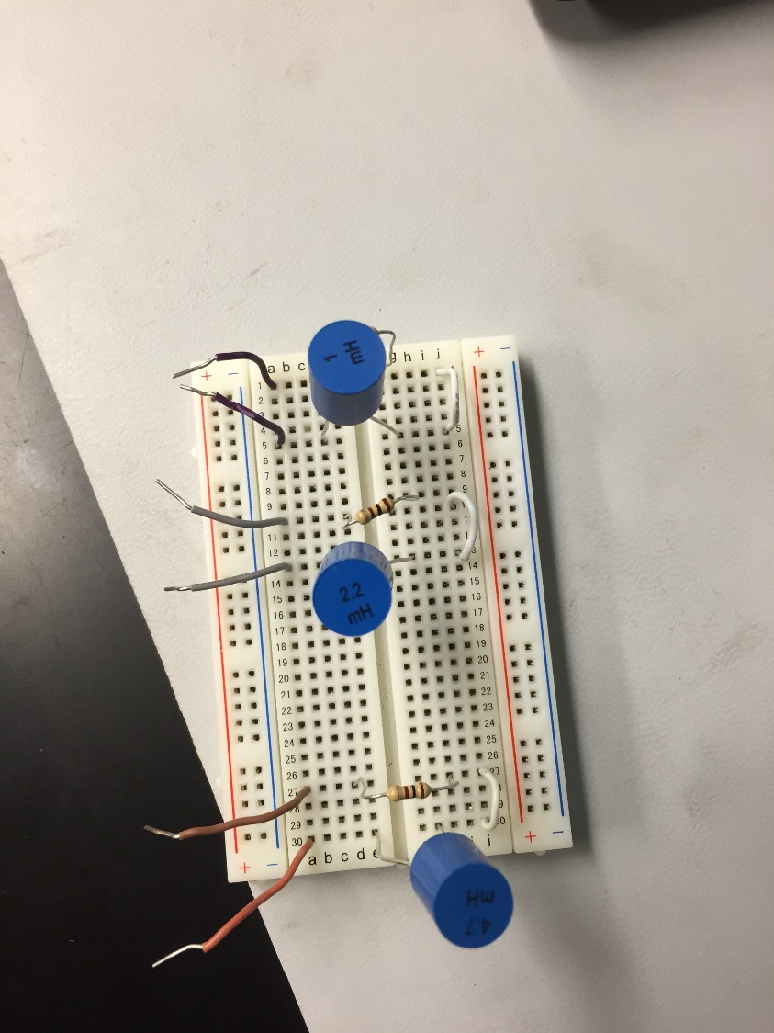
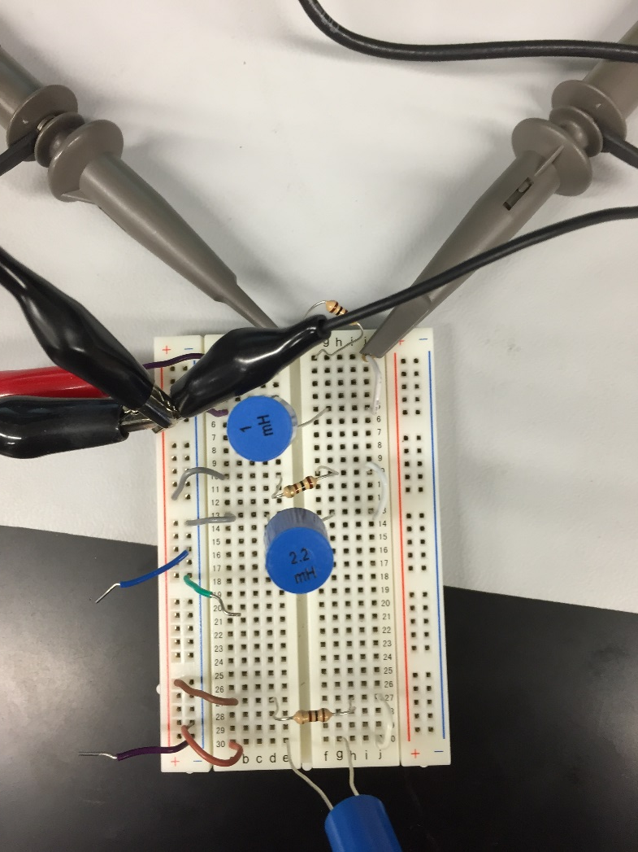
Capacitors in parallel

Slide 40
RC (Resistor & Capacitor) Lab
The point of this lab was to analyze RC (Resistor and capacitor) circuits
We wanted to find how the output voltage reacts in an RC circuit when the frequency was raised.

Slide 41
RC circuit

Slide 42
RL (Resistor & inductor) circuit
The point of this lab was to analyze RL (Resistor and inductor) circuits
We wanted to find how the output voltage reacts in an RL circuit when the frequency was raised.

Slide 43
RL Circuit

