Slide 1
LAB NOTEBOOK
EECT 112
Chad Creager and Matt Fowler

Slide 2
Table of Contents
Lab 1 – AND, OR 3
Lab 2 – NAND Alternative 10
Lab 3 – Car Alarm 19
Lab 4 – NAND SR Latch 28
Lab 5 – Binary To 7 Segment Counter 35
Lab 6a – BASIC Stamp LED Flasher 43
Lab 6b – BASIC Stamp Temp Sensor/Heater 50
Lab 7 – BASIC Stamp 4 Bit LED Binary Counter 57

Slide 3
LAB 1:
AND, OR

Slide 4
Objective
  Learn how AND and OR gates function.
Equipment and Material
  Bench 1 & 2, Elvis S#1677D3F, 74LSO8D,74LS32D, 2 X 10K Ohm Resistors, 2 X LEDS, 5 Volt DC Power Supply,
  Jumper Wires, Digital Multimeter GWInstek S#CL860264.
Research and Information

Slide 5
Procedures and Results
When we open switch one the AND gate goes high.
When we open switch two the OR gate goes high.
When both switches are open they both are high.
Measured results using digital multimeter.

Slide 6
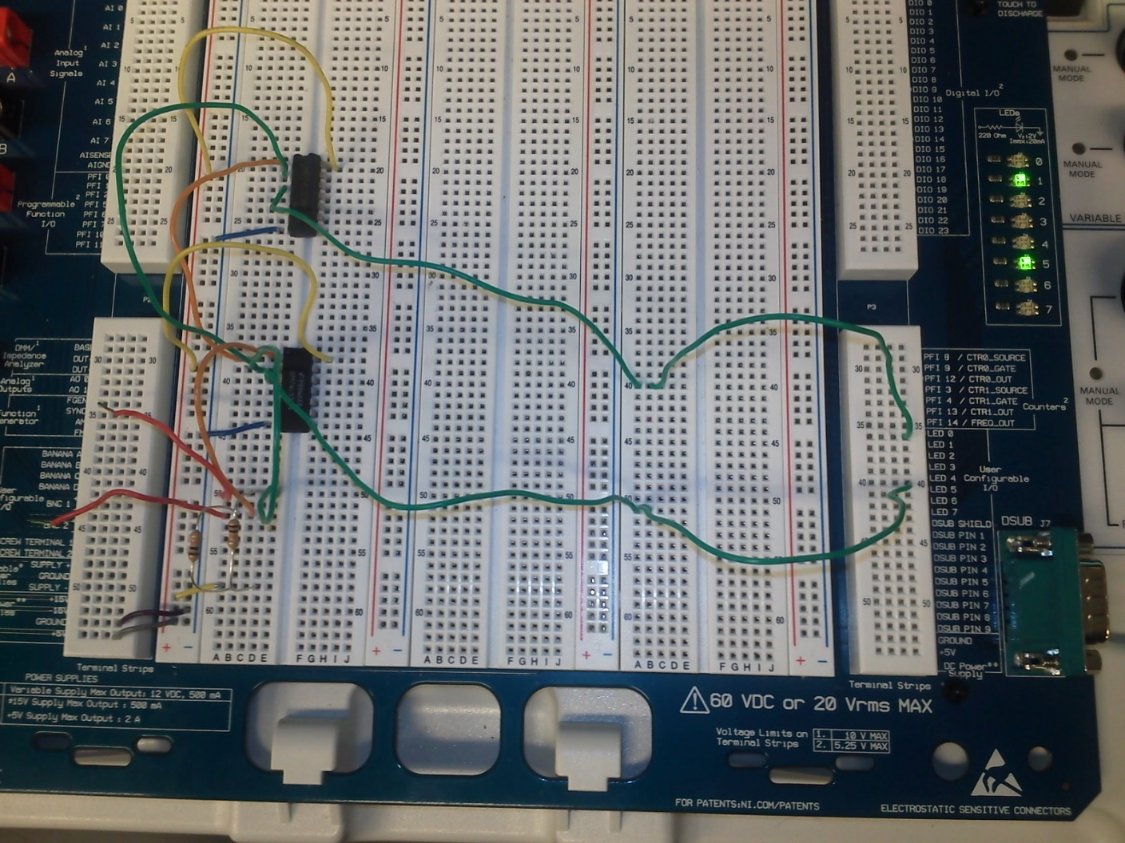
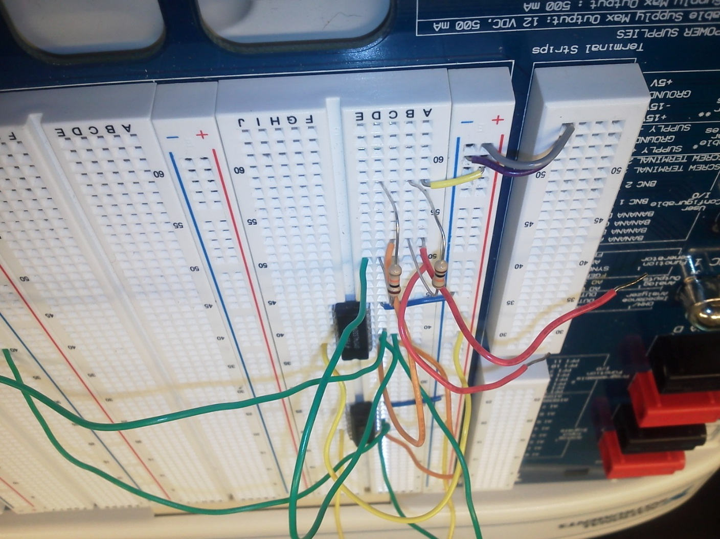

Slide 7
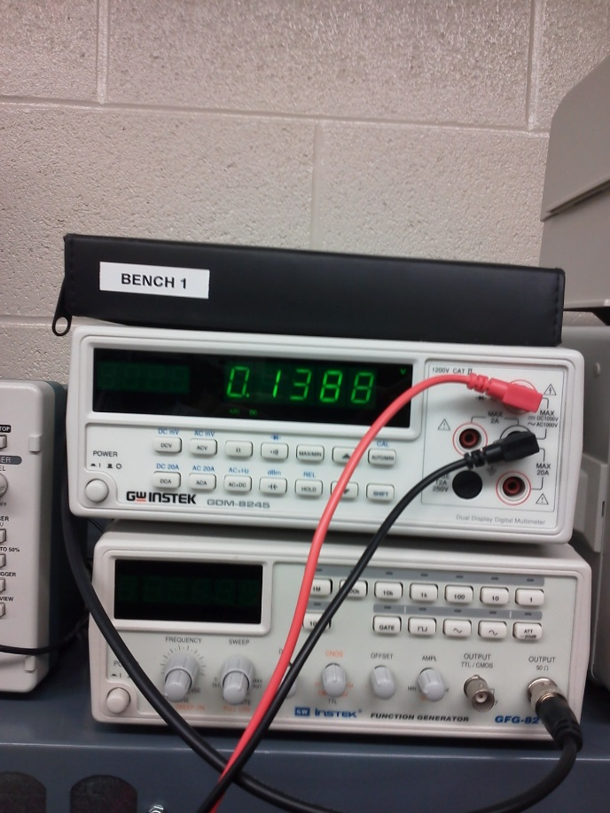
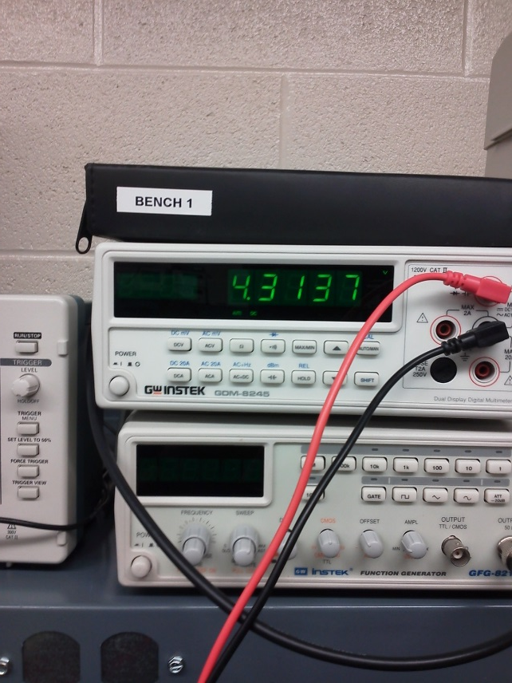
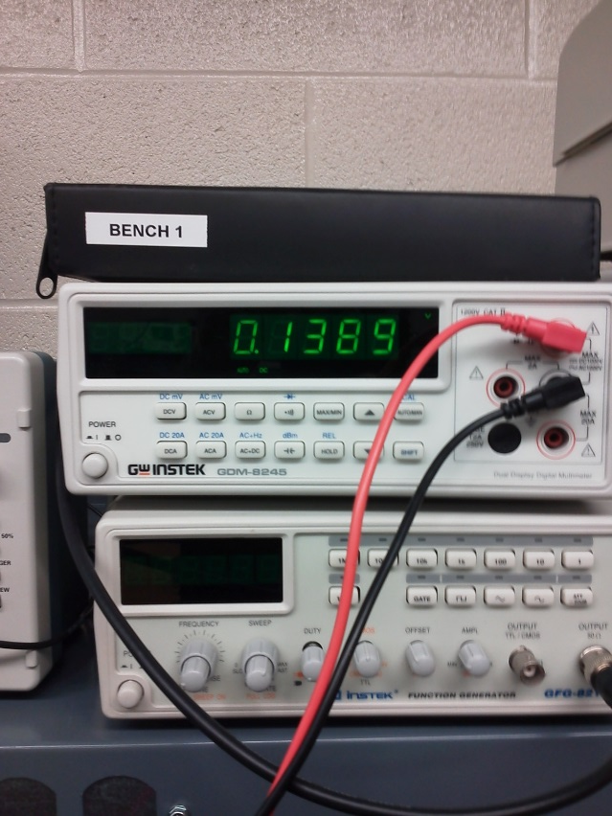
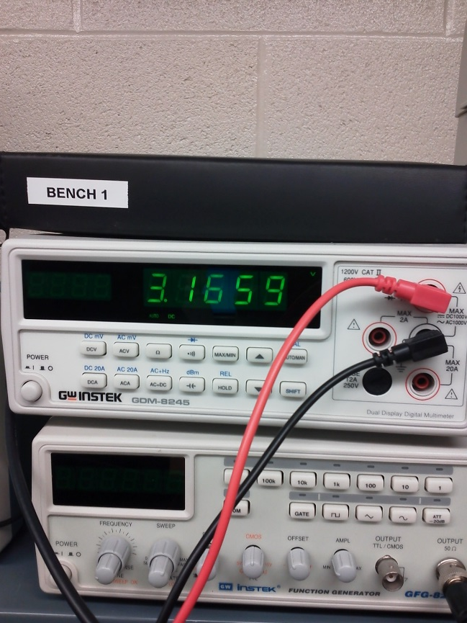

Slide 8
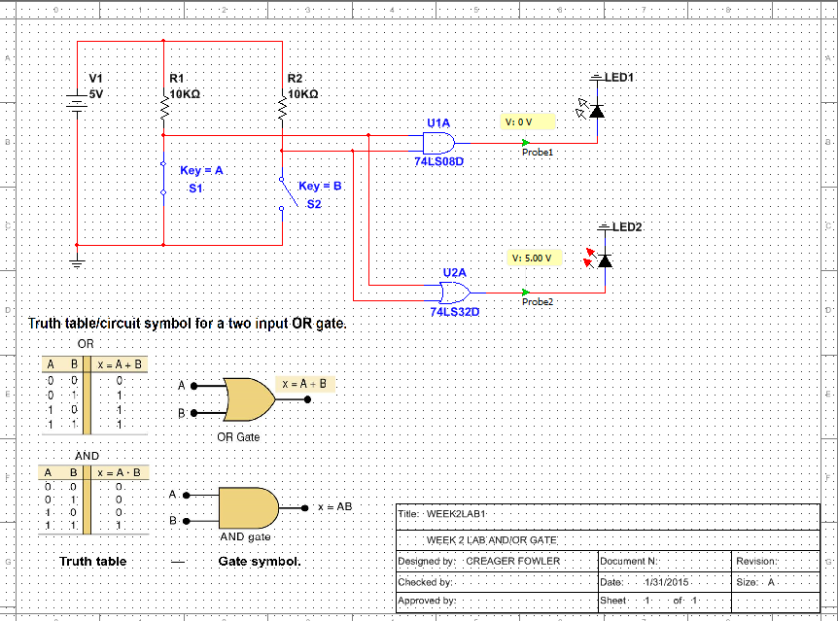

Slide 9
Summary and Conclusions
The lab results confirmed the MultiSim
We observed AND and OR gates in action.
Measured results confirmed MultiSim.

Slide 10
LAB 2:
NAND ALTERNATIVE

Slide 11
Objective
  Was to show that one NAND chip can do the same as 3 chips
Equipment and Material
  Bench 2, Elvis S#1677D3F, 74LSO8D,74LS00D,74LS04D,74LS32D
  4 X 10K Ohm Resistors, 2X LEDS, 5 Volt DC Power Supply, Jumper Wires, and Dip Switch.
Research and Information

Slide 13
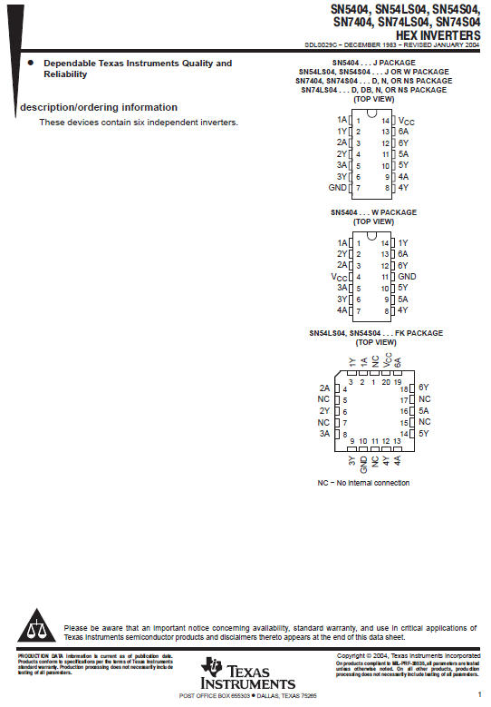
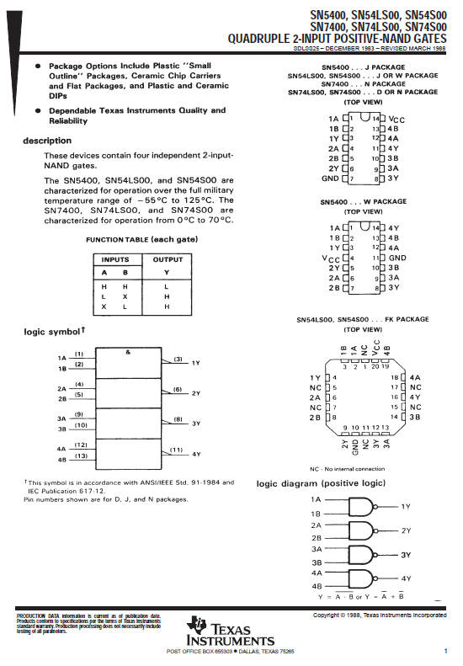

Slide 14
Procedures and Results
Hooked up 3 IC’s and tested circuit to see function then replicated using 1 NAND chip.

Slide 15
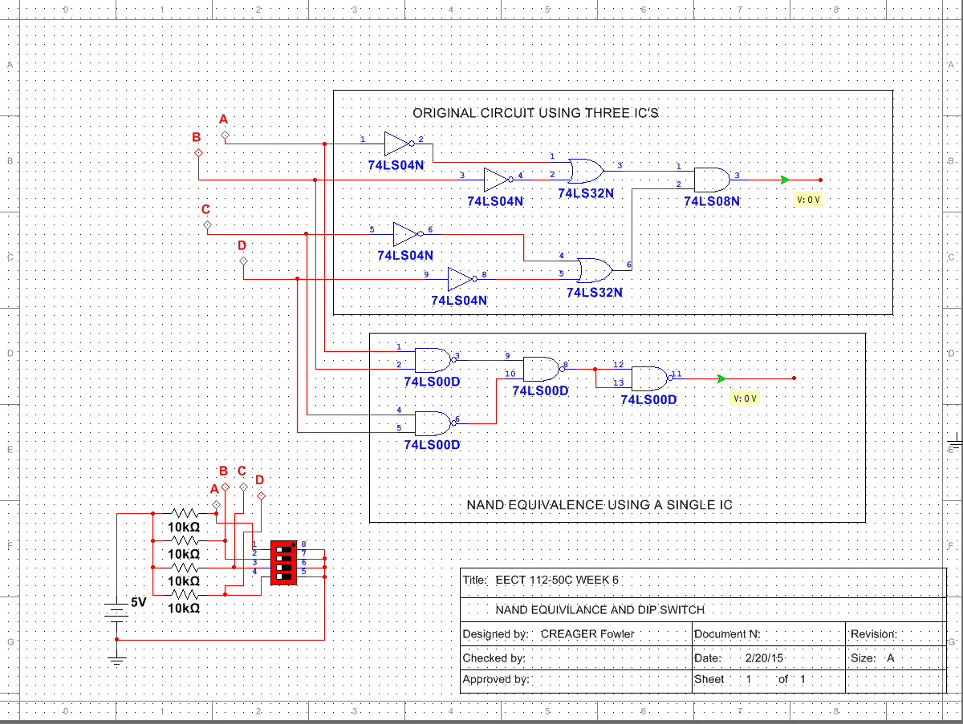

Slide 16
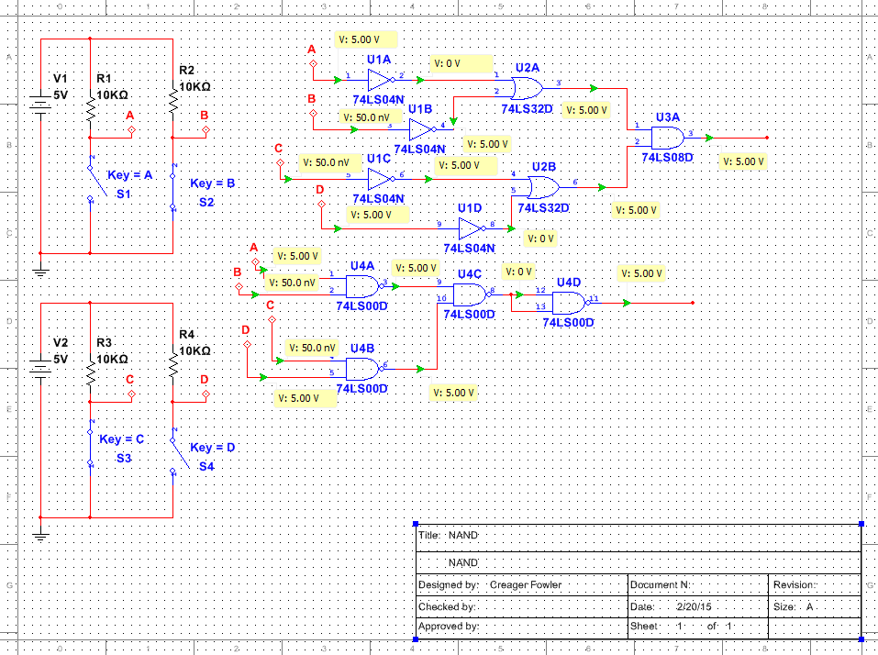

Slide 17
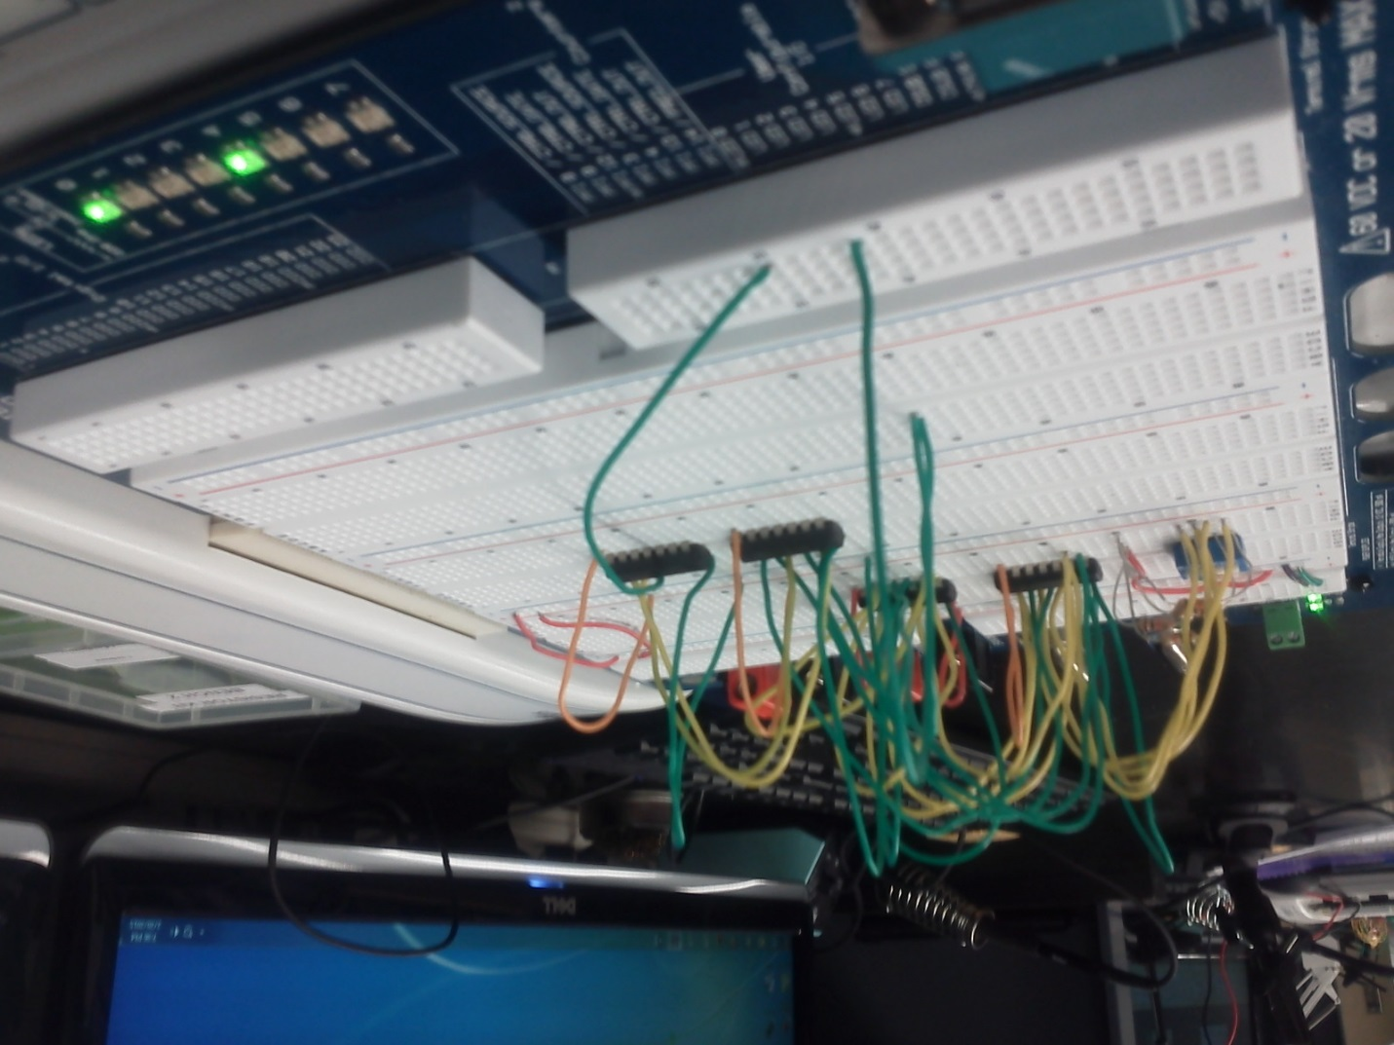
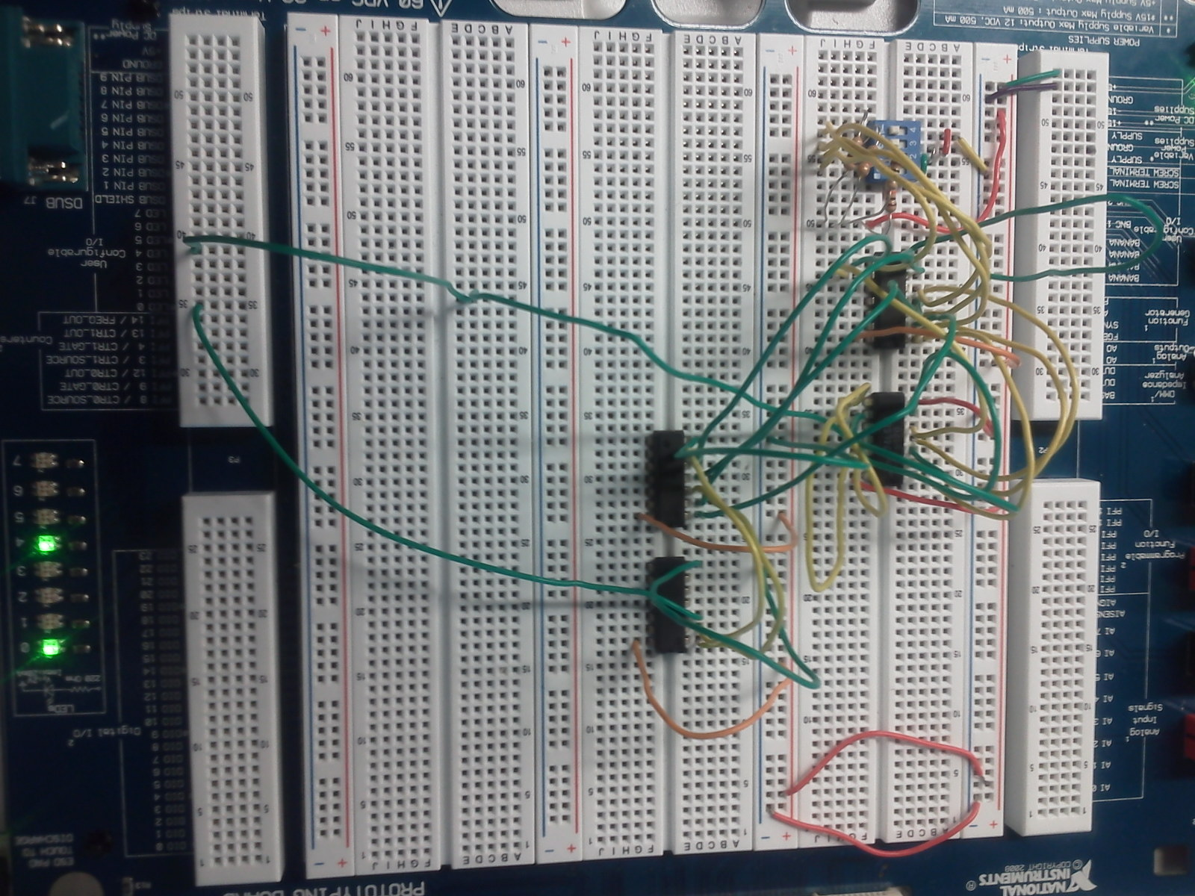

Slide 18
Summary and Conclusions
Was able to simplify the circuit using NAND chip to replace 3 IC’s.
Wiring the circuit was confusing with 3 chips.

Slide 19
LAB 3:
CAR ALARM

Slide 20
Objective
  Design a working car alarm using IC chips.
Equipment and Material
  Bench 4, Elvis S#1677D5B, 74LSO8D, 74LS32D, 74LS04D, 3 X 10K Ohm Resistors, 1 LED, 5 Volt DC Power Supply,
  Jumper Wires.
Research and Information

Slide 23
Procedures and results
Created truth table to get desired results.
Designed circuit using MultiSim to simulate.
Used Elvis to Complete.

Slide 24
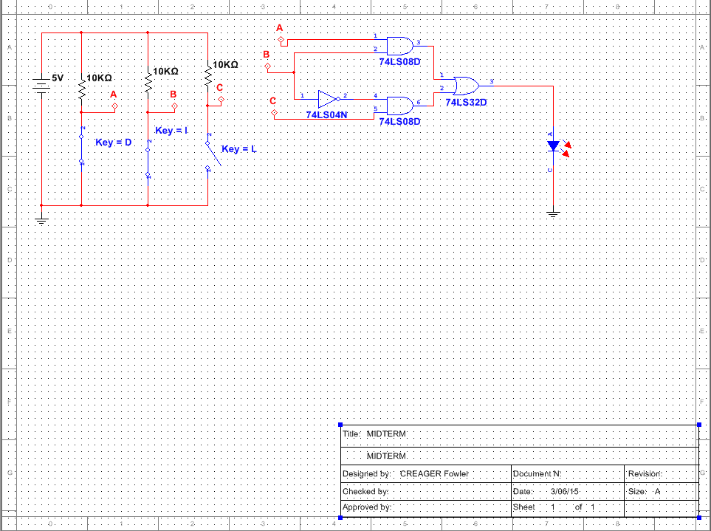

Slide 25
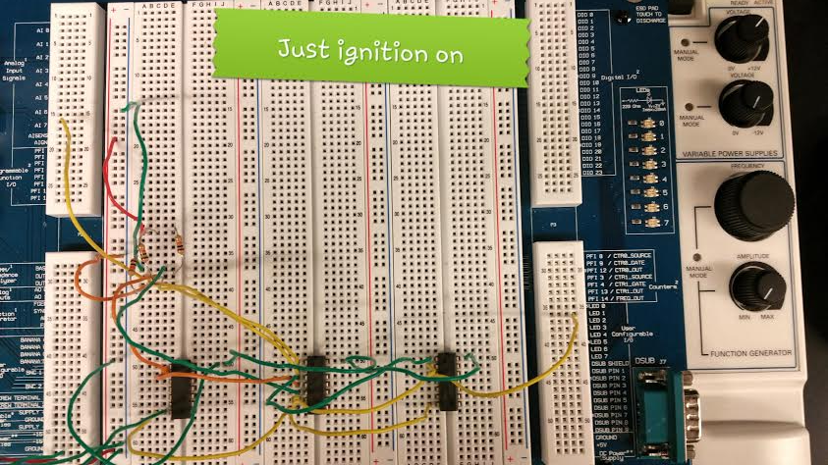
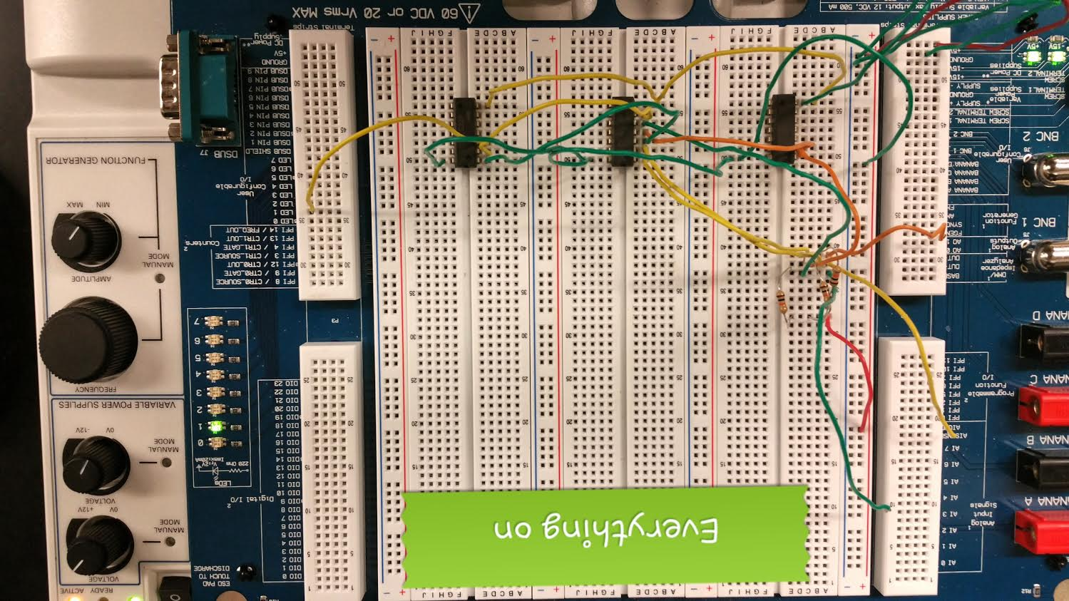
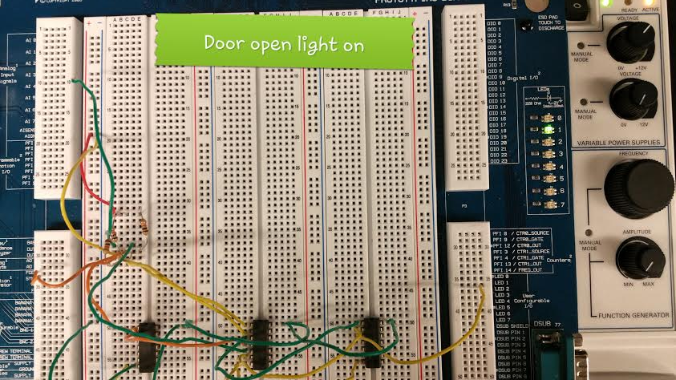
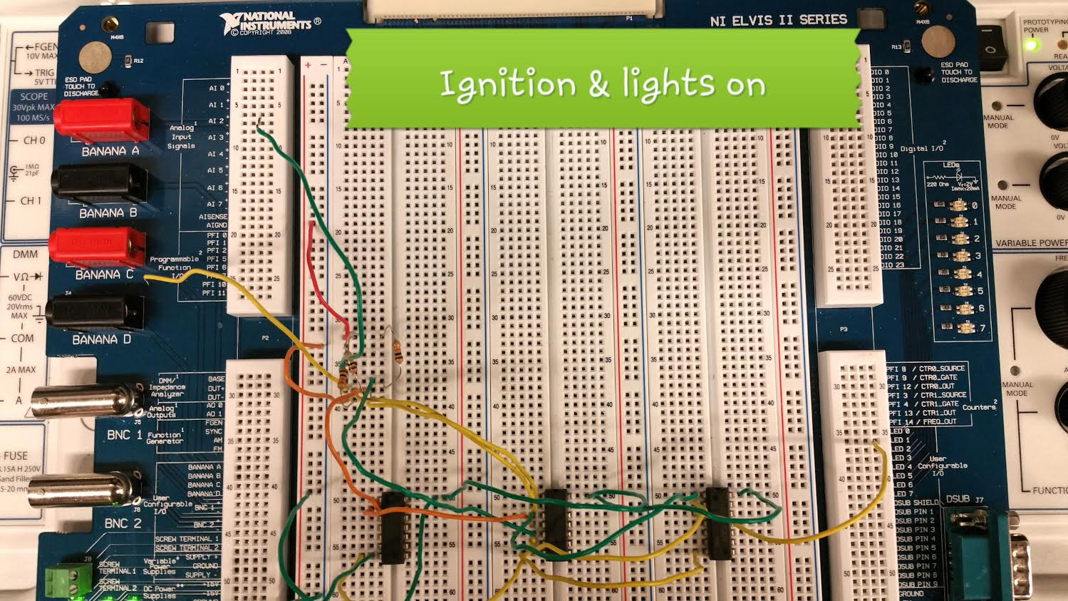

Slide 26
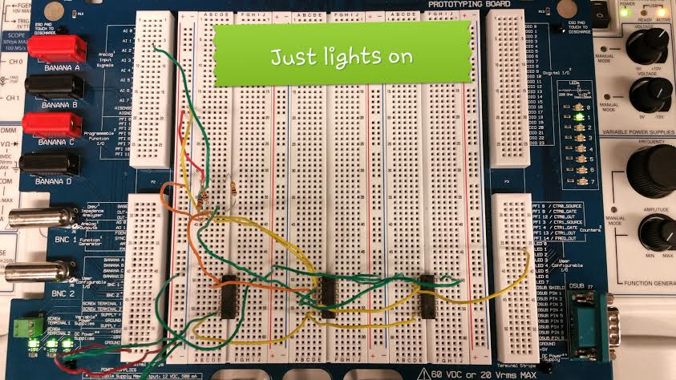
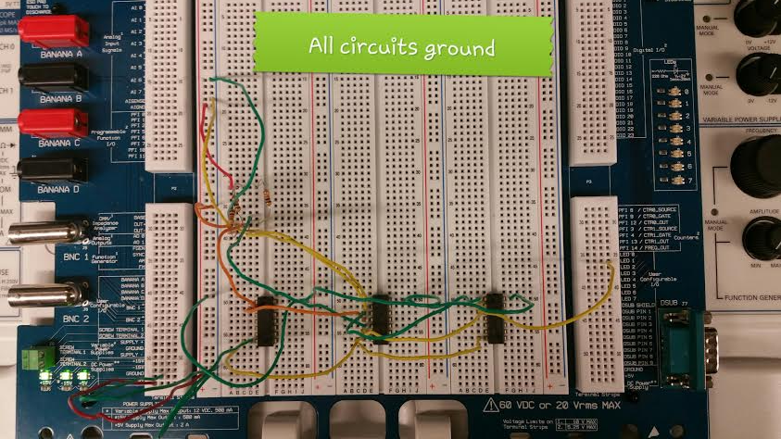
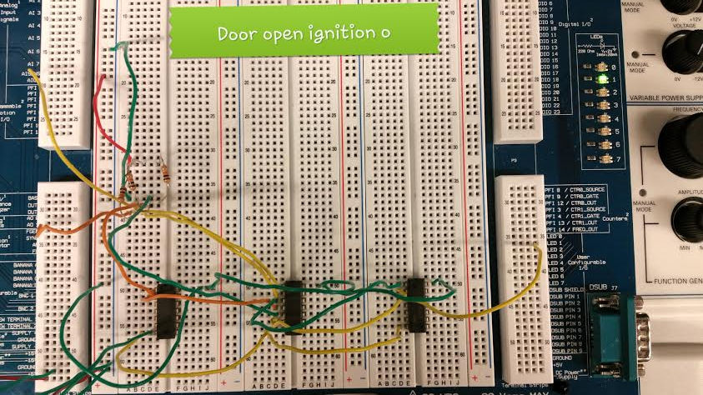
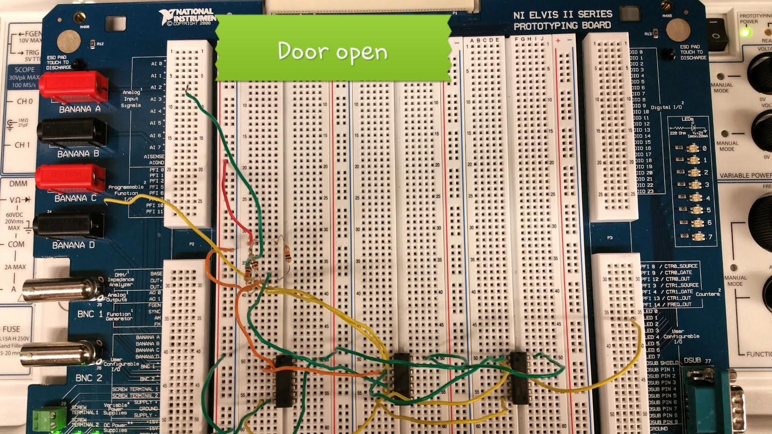

Slide 27
Summary and conclusions
We gained a working knowledge of different chips and was able to
design a working car alarm circuit.
Was easy to miss one of the conditions in the truth table that made
the car alarm work properly.

Slide 28
LAB 4:
NAND SR
LATCH

Slide 29
Objective
  Learn how NAND LATCH works.
Equipment and Material
  Bench 2, Elvis S#1677D3F, 74LS00D, 2 X 10K Ohm Resistors, GW Instek Function Generator S# C705253,
  GW Instek Digital Multimeter S# CL860264, Tektronix Oscilloscope S# B083242,5 Volt DC Power Supply, Jumper Wires.
Research and Information

Slide 30
Procedures and results
Created MultiSim using 74LS00D.
Built circuit in lab using Elvis.
Tested circuits with function generator, digital multimeter and oscilloscope.

Slide 31
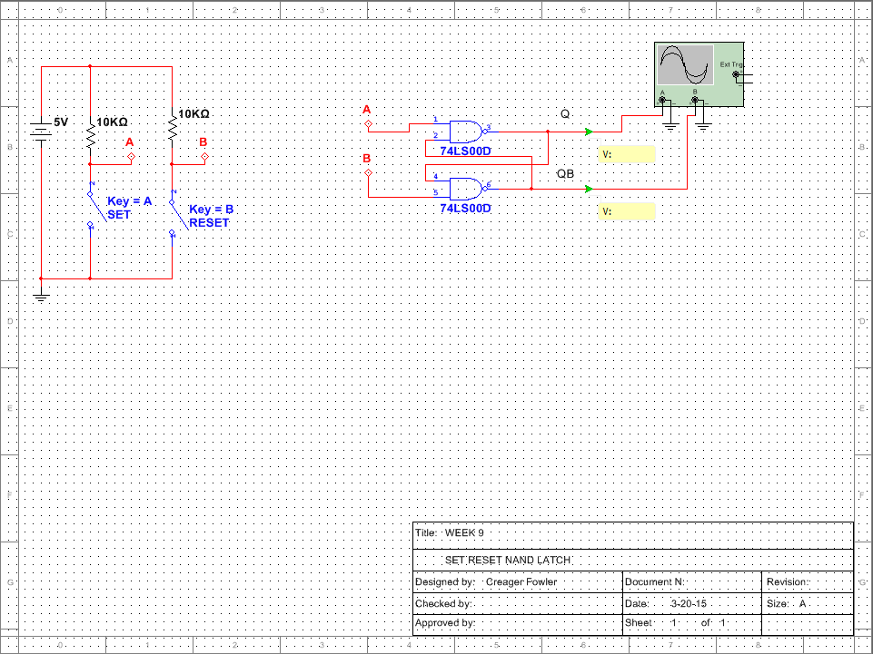

Slide 32
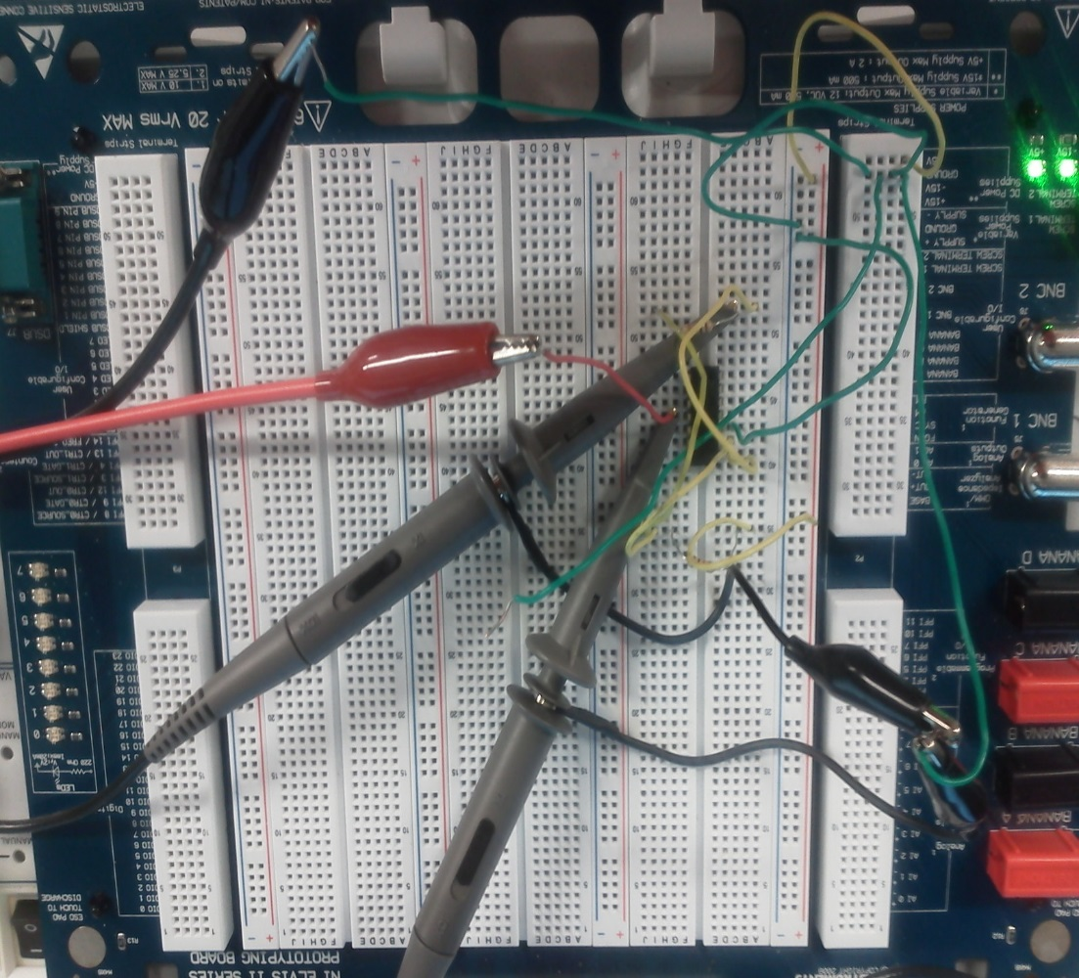
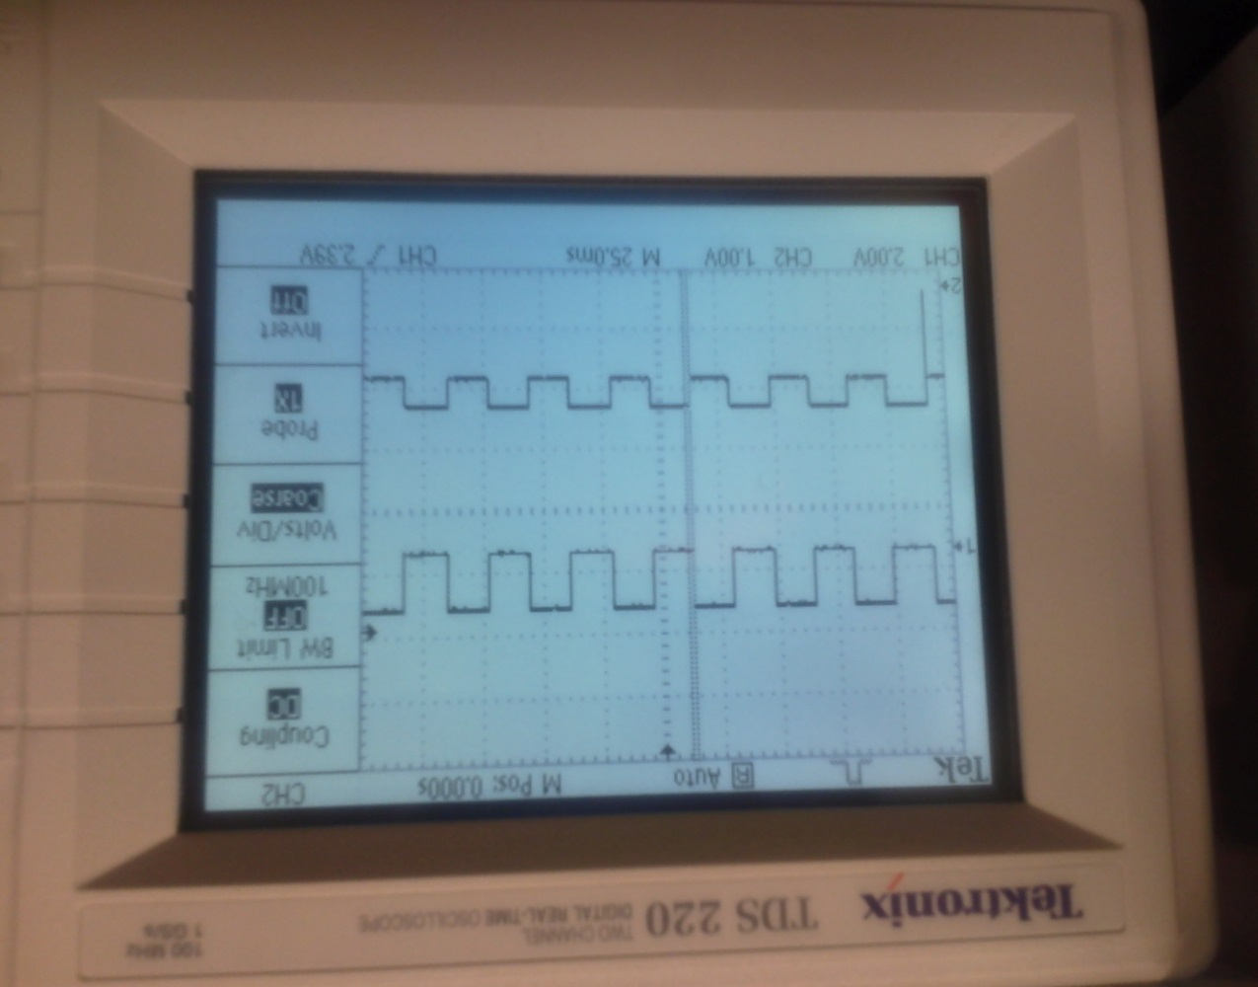

Slide 33
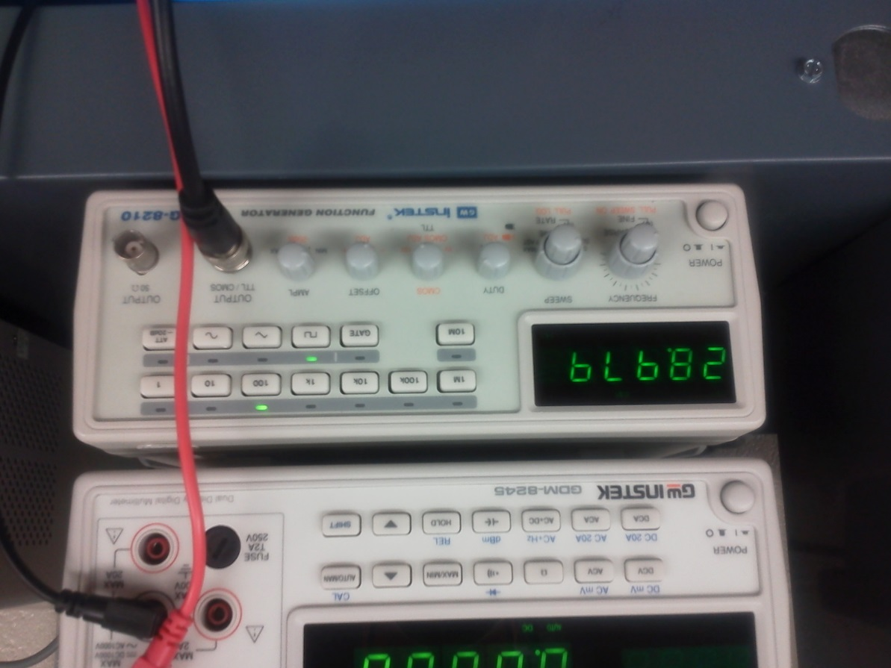
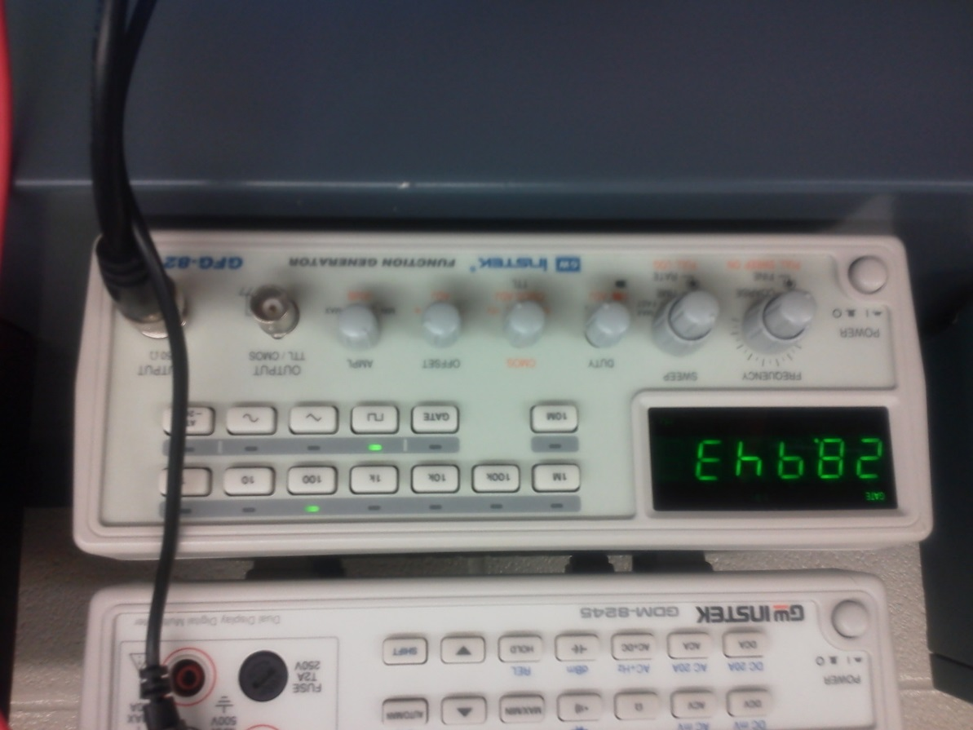

Slide 34
Summary and conclusion
MultiSim and Elvis simulations did not produce same results.
You can use Oscilloscope to tell when circuit latches and unlatches.
Elvis was more accurate then MultiSim in that MultiSim would read high only if
you timed it right when hooking it up.

Slide 35
LAB 5:
BINARY TO 7 SEGMENT COUNTER

Slide 36
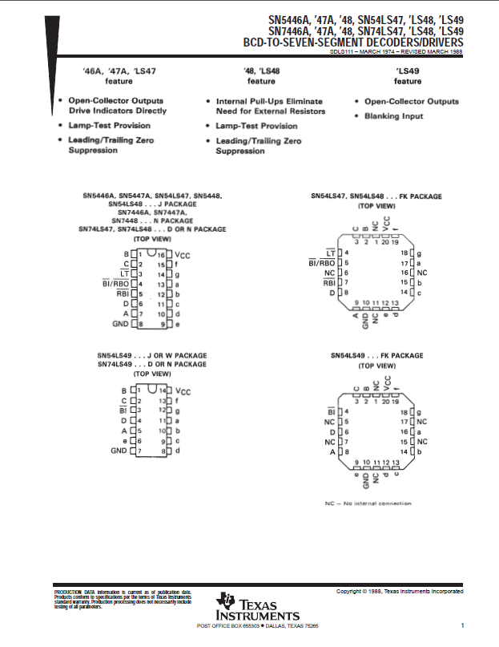
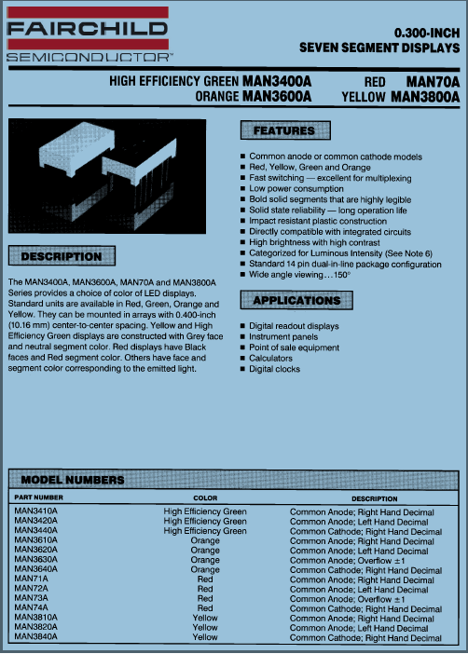
Objective
  Learn the how to use an inverter and
Equipment and Material
  Bench 4, Breadboard, 74LS04D, 74LS48D,74LS193D, 2 X 10K Ohm Resistors, MAN74A, 5 Volt DC Power Supply, Jumper Wires,
  GW Instek Function Generator S# C705254, Tektronix Oscilloscope S# B083259.
Research and Information

Slide 37
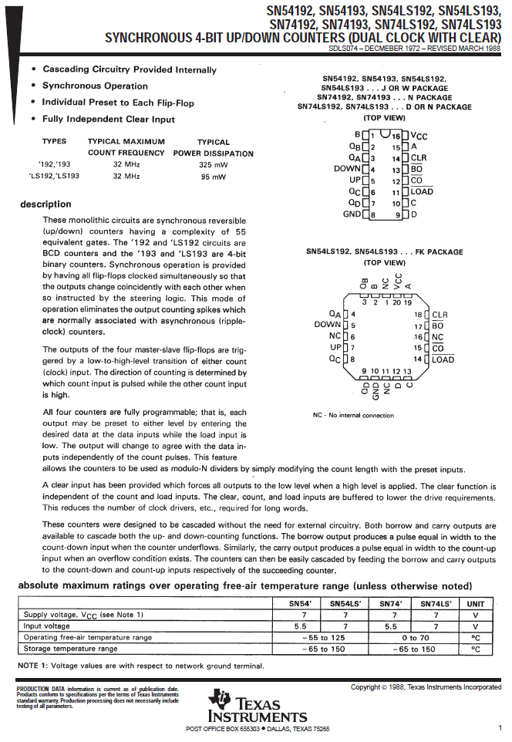

Slide 38
Procedures and results
Design circuit using MultiSim
Made Binary to 7 Segment Counter
Display would count up 0 to 9
MultiSim worked, but had generic display.

Slide 39
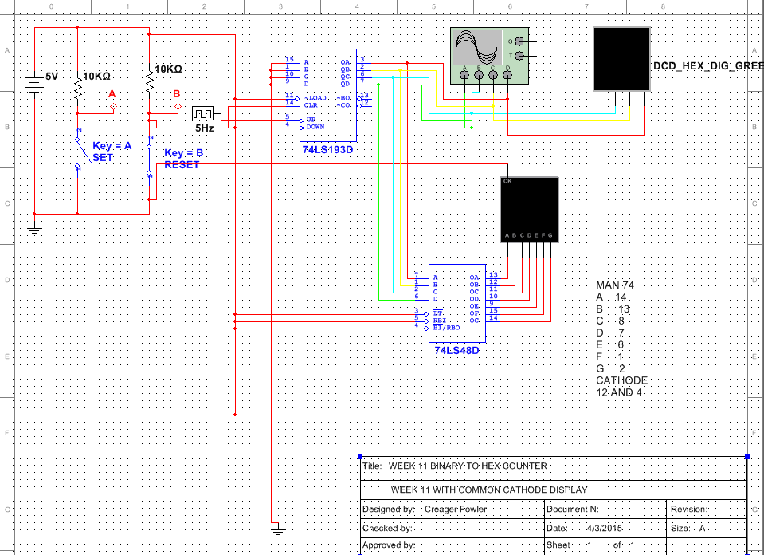

Slide 40
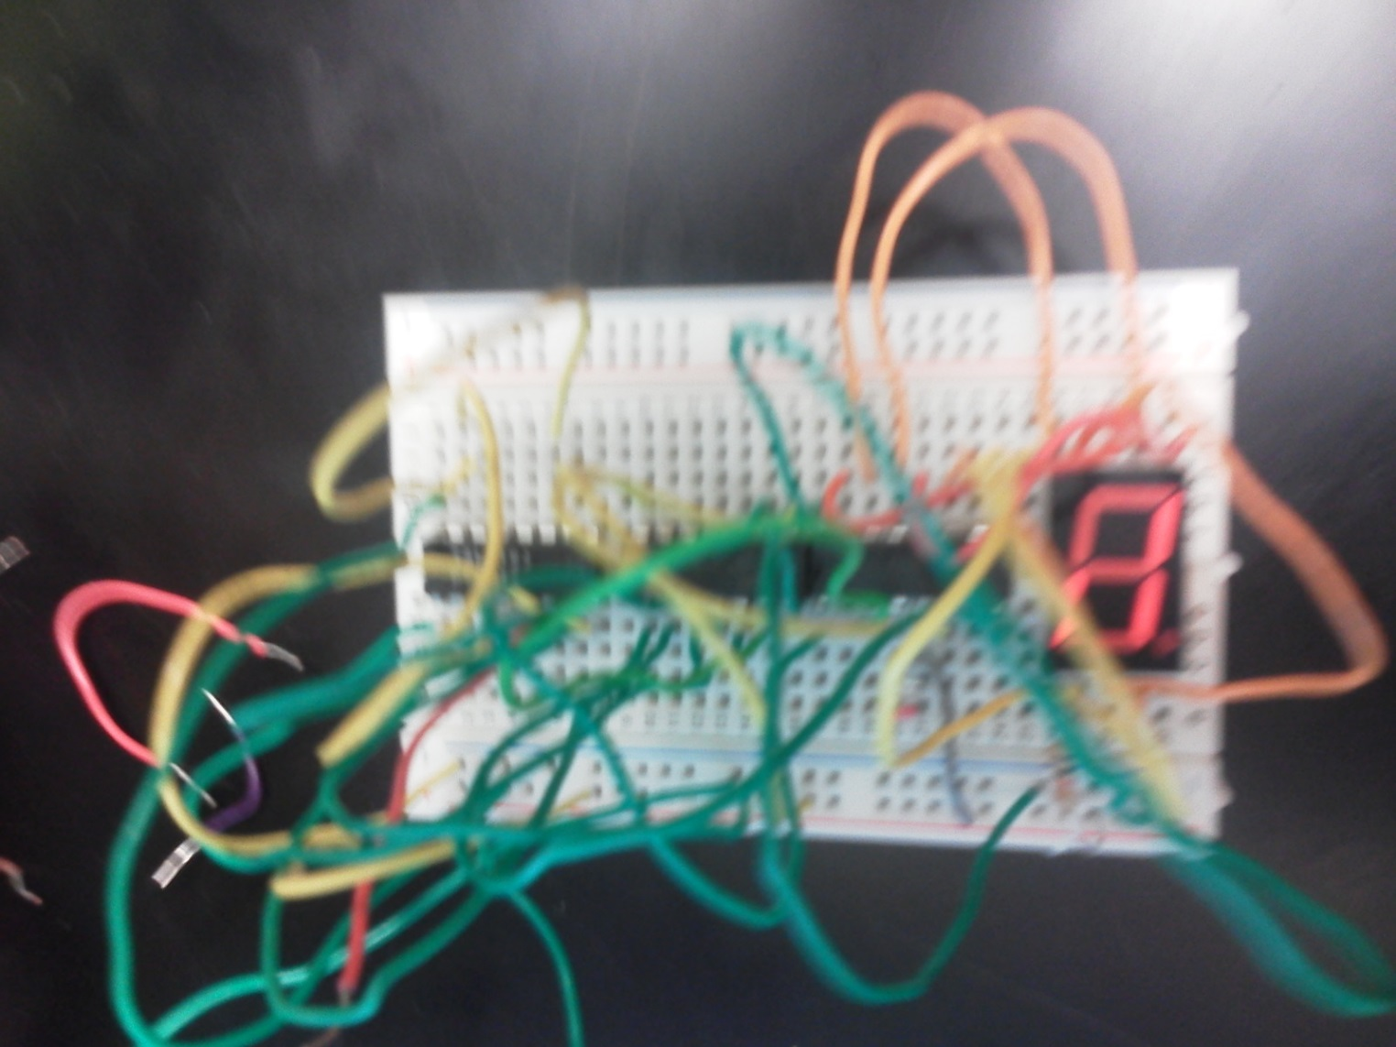
Failed attempt at using inverter.

Slide 41
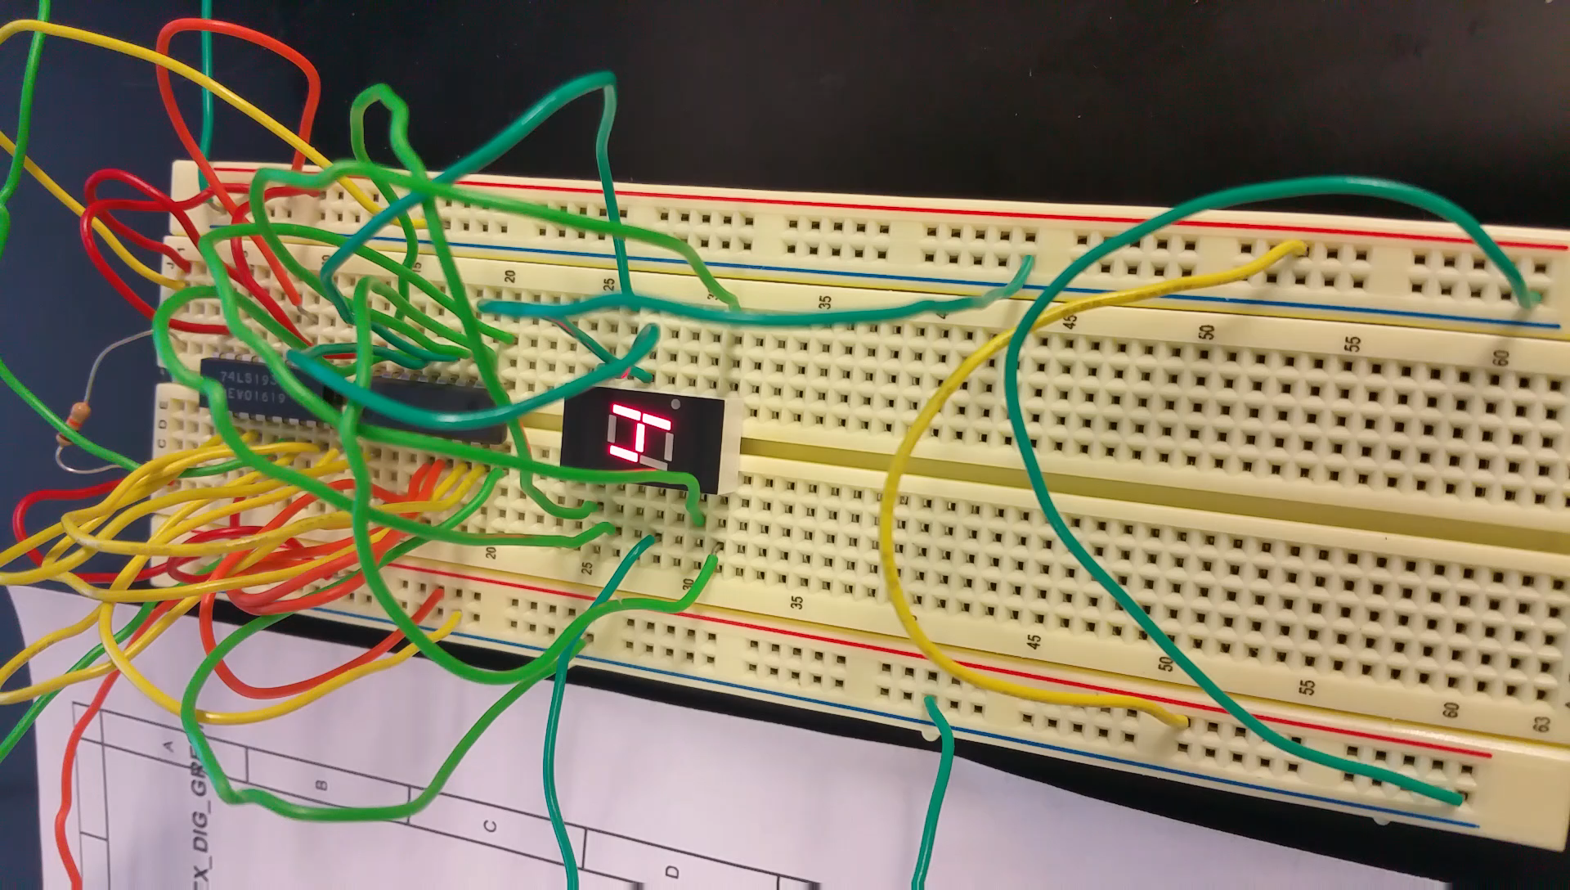

Slide 42
Summary and conclusion
MultiSim used generic displays.
First attempt was a failed attempt at trying to use an inverter.
Had problems because function generator was not set right.
Very important to check all lab equipment settings.

Slide 43
LAB 6a:
BASIC STAMP
LED FLASHER

Slide 44
Objective
  To create a program that will blink an LED 5 times over a ten second period when a button is pushed. The to create the
  circuit on the Basic Stamp breadboard to run this program.
Equipment and Material
  Bench 4, Serial Cable, Power Cable, 10K Ohm Resistor, 220 Ohm Resistor, LED, Pushbutton , Jumper Wires.
Research and Information
  Used Basic Stamp help guide and Industrial Control Student Workbook Version 1.1, p.14 for information on how to
  wire circuit.

Slide 45
Procedures and results
Used Basic Stamp software to create a program.
Built circuit on Basic Stamp breadboard.
Downloaded program to Basic Stamp.
Ran program to troubleshoot and correct problems.

Slide 46
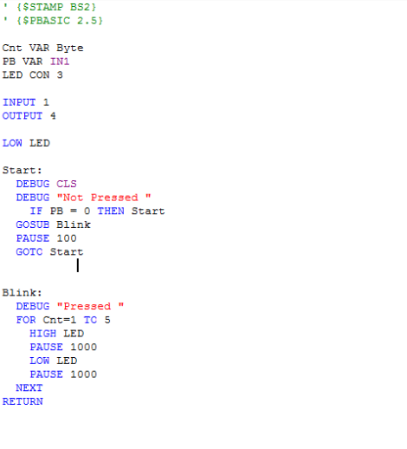
BASIC STAMP LED FLASHER PROGRAM

Slide 47
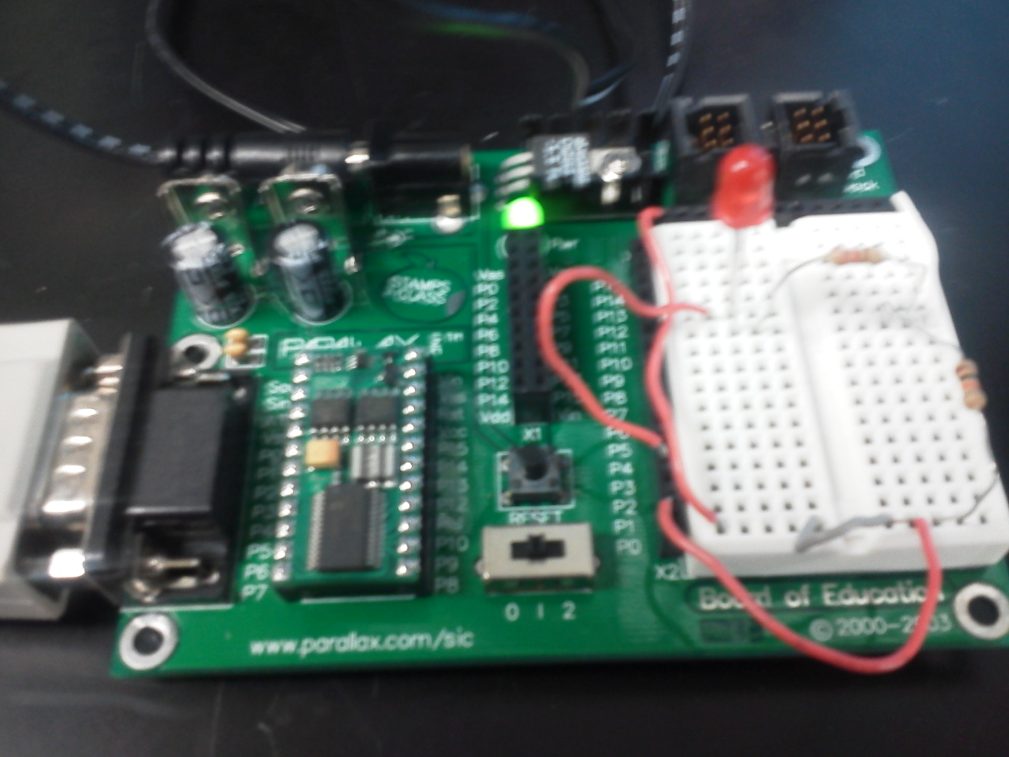

Slide 48
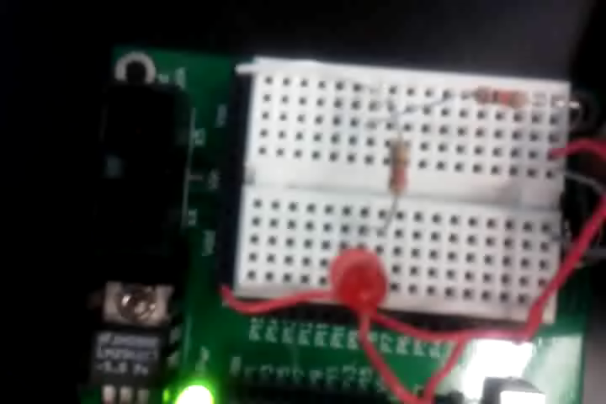

Slide 49
Summary and conclusion
This program was fairly basic and didn’t require much logic to complete.
Added debug into program to figure out why it was not working at first.
Found that pushbutton was loose in breadboard and losing contact.

Slide 50
LAB 6b:
BASIC STAMP
TEMP SENSOR/HEATER

Slide 51
Objective
  To create a program that will turn on LED when the temperature reaches a certain point and to turn the LED off when
  temperature reaches a certain point. The LED represents a heater going on and off and the potentiometer represents
  the temperature.
Equipment and Material
  Bench 4, Potentiometer, Basic Stamp, Serial Cable, Power Cord, 220 Ohm Resistor, LED, Capacitor, Jumper Wires.
Research and Information
  Used Basic Stamp help guide with program commands and functions. Also used Industrial Control Student Workbook
  Version 1.1, p.17 to design actual circuit.

Slide 52
Procedures and results
Used Basic Stamp software to create a program.
Built circuit on Basic Stamp breadboard.
Downloaded program to Basic Stamp.
Ran program to troubleshoot and correct problems.

Slide 53
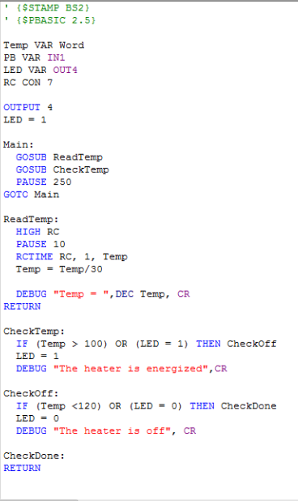
BASIC STAMP TEMP SENSOR/HEATER PROGRAM

Slide 54
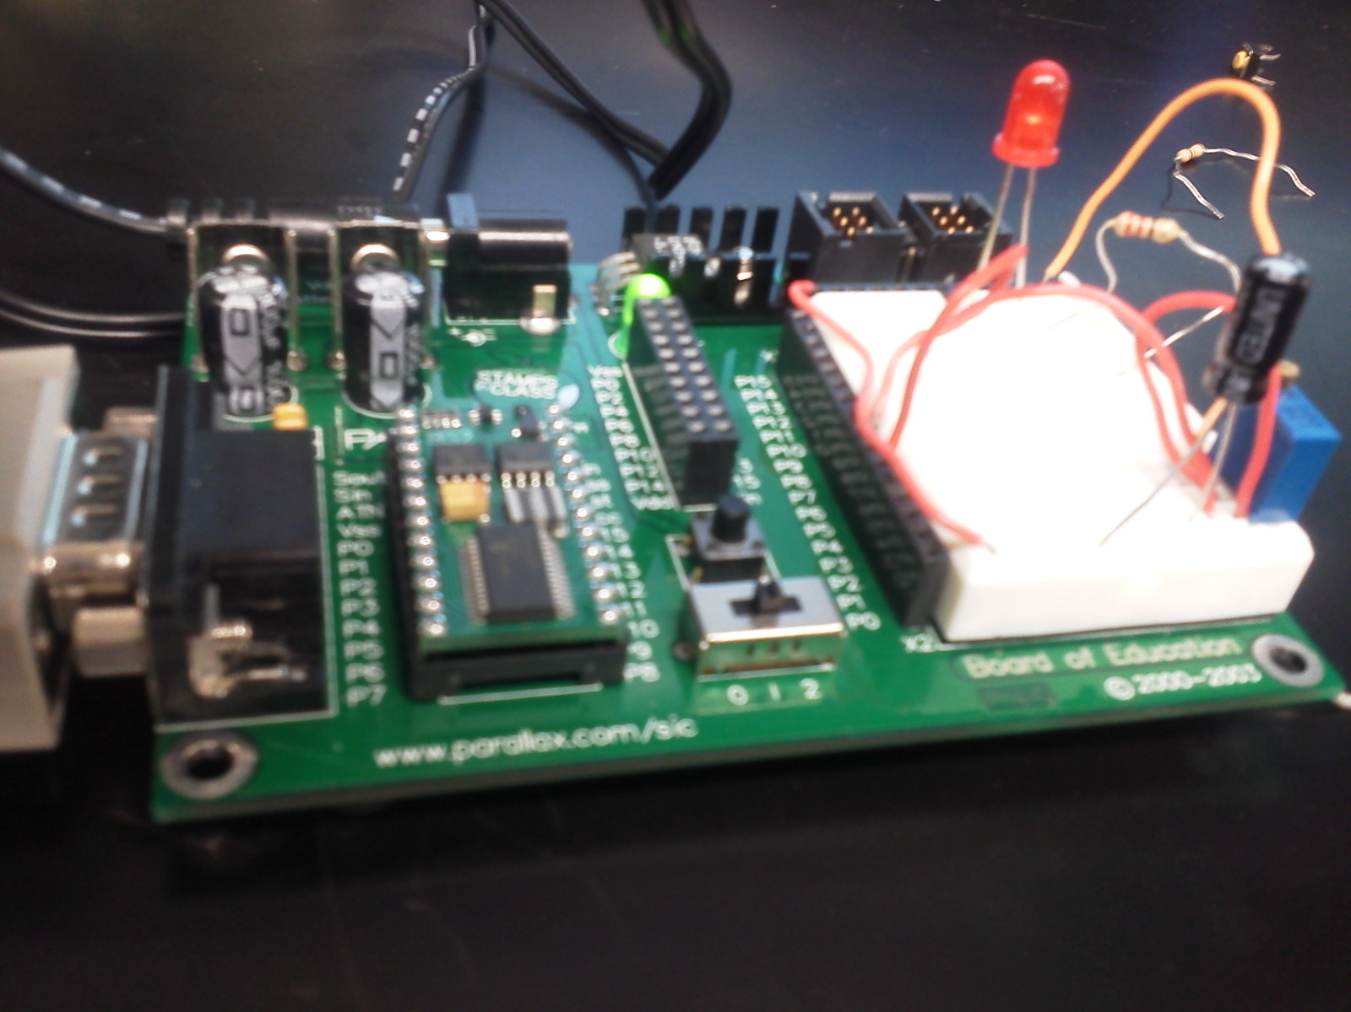

Slide 55
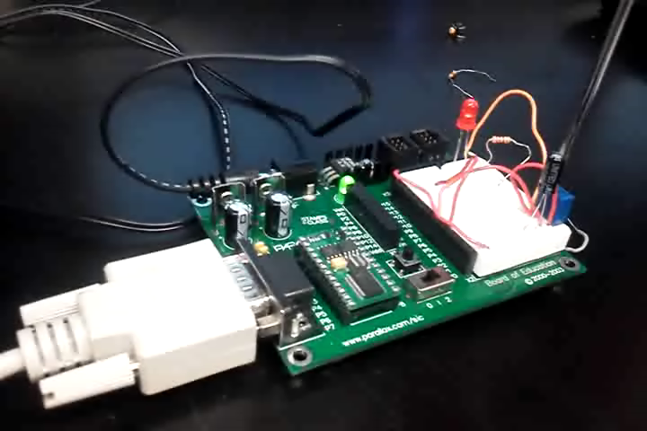

Slide 56
Summary and conclusion
The program for the Basic Stamp has several subroutines to complete the
  the proper functions.
The circuit requires an RC network to create an analog signal that represents
temperature.

Slide 57
LAB 7:
BASIC STAMP
4-BIT LED BINARY COUNTER

Slide 58
Objective
  Learn how to use program and hookup Basic Stamp to make a binary counter with four LEDs.
Equipment and Material
  Bench 4, 4 X LEDS, Serial Cable, Power Cord, 220 Ohm Resistor, Jumper Wires.
Research and Information
  We used the Basic Stamp help guide to find commands and to also help with the function of the commands.

Slide 59
Procedures and results
Used Basic Stamp software to create a program.
Built circuit on Basic Stamp breadboard.
Downloaded program to Basic Stamp.
Ran program to troubleshoot and correct problems.

Slide 60
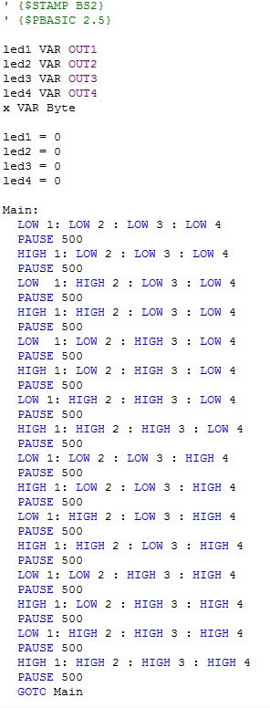
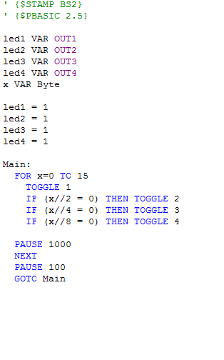
4-BIT BINARY COUNTER FIRST ATTEMPT
4-BIT BINARY COUNTER SECOND ATTEMPT

Slide 61
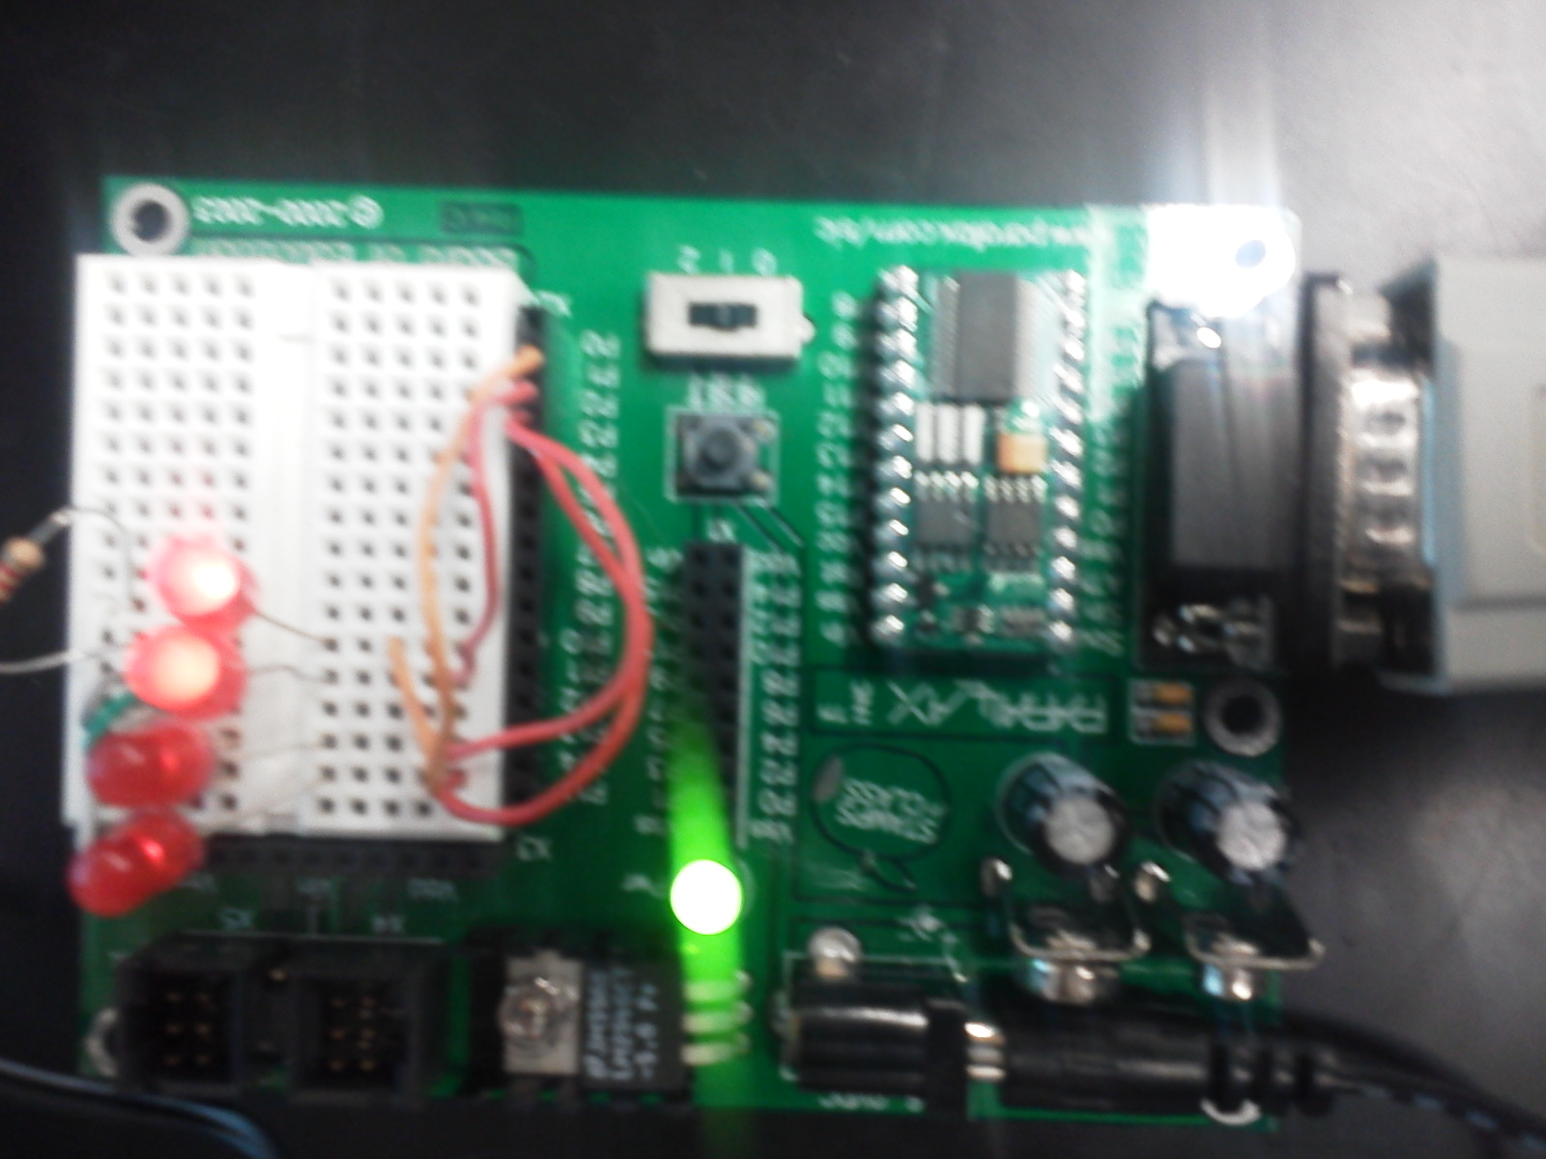

Slide 62
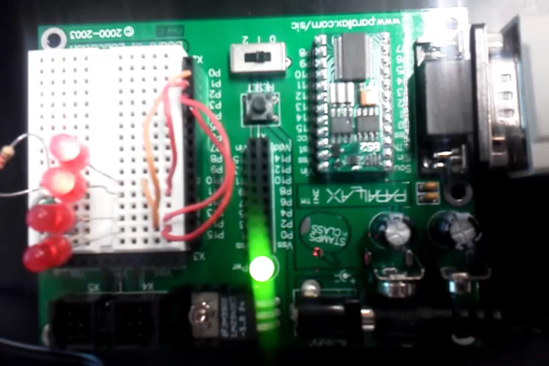

Slide 63
Summary and conclusion
We can see from the examples above that there is more than one way to write
the program for the Basic Stamp Binary Counter.
The programs usually need to be adjusted after the trial run to correct errors.

