Slide 1
Week 9- OFCA
Zach Anderson – EECT 111

Slide 2
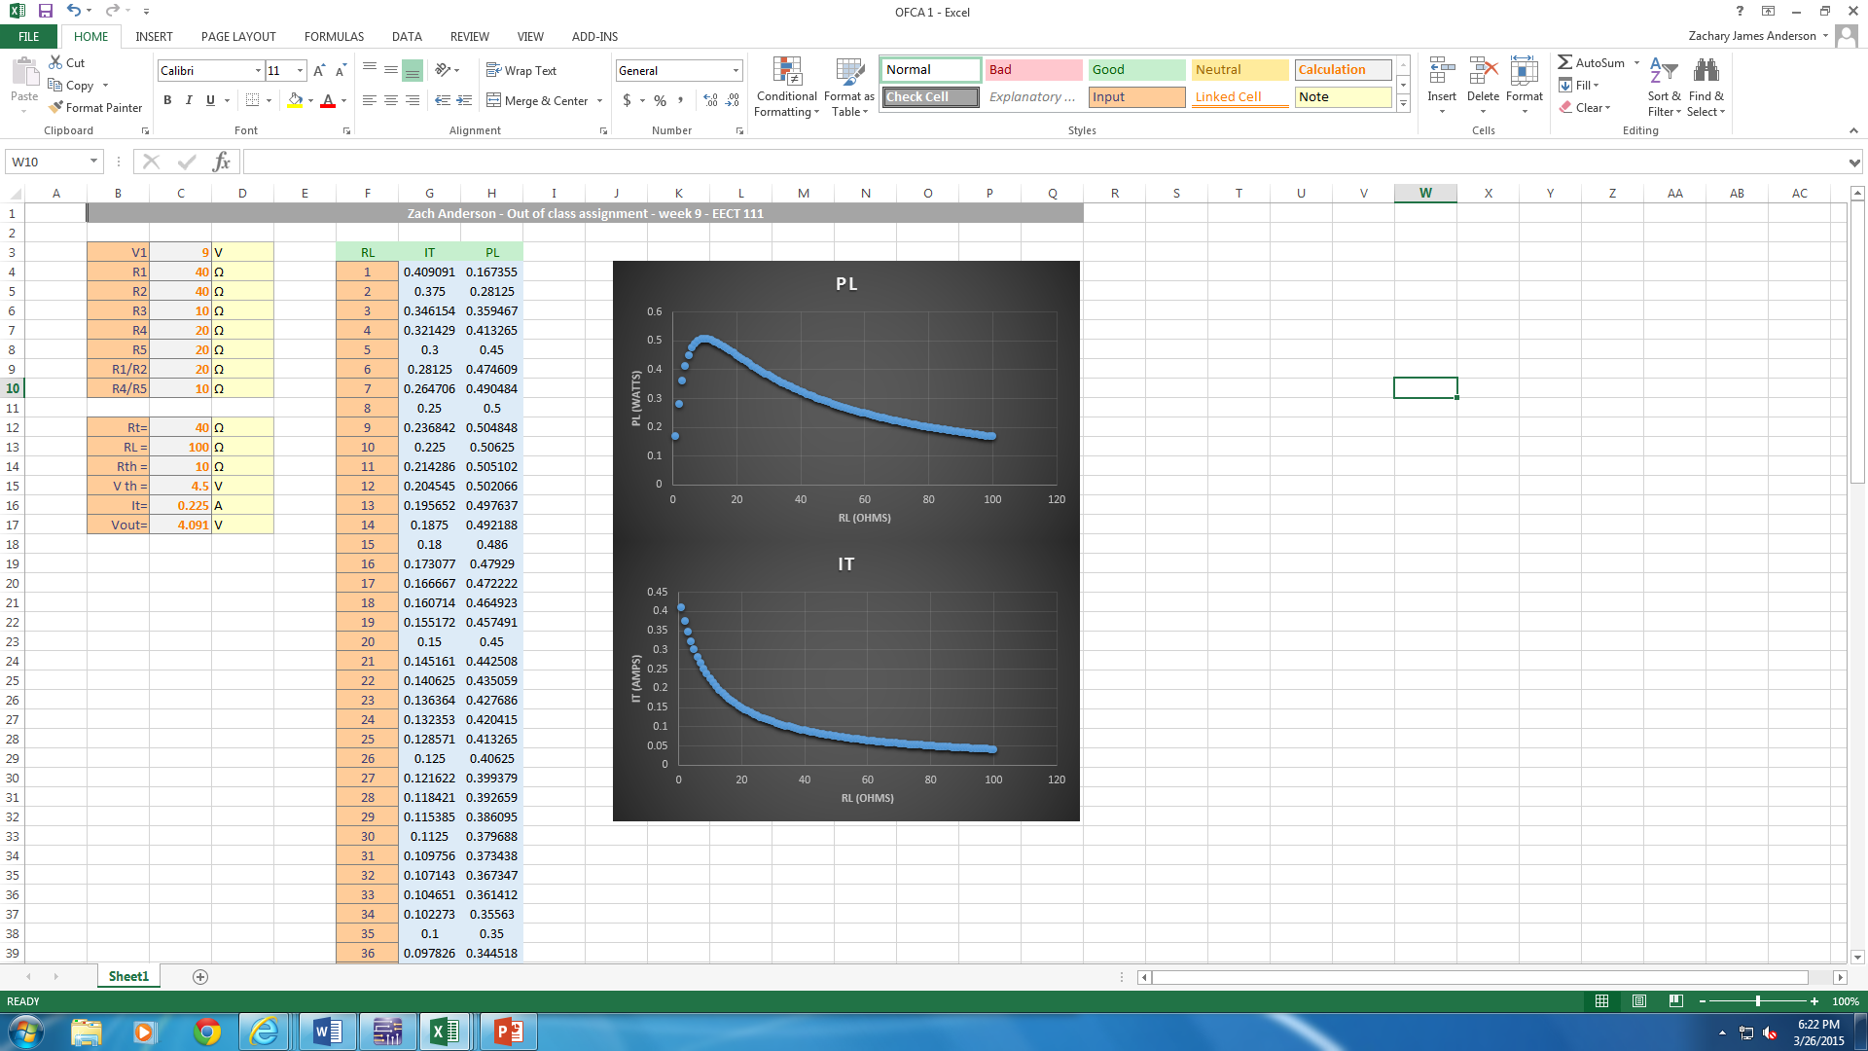

Slide 3
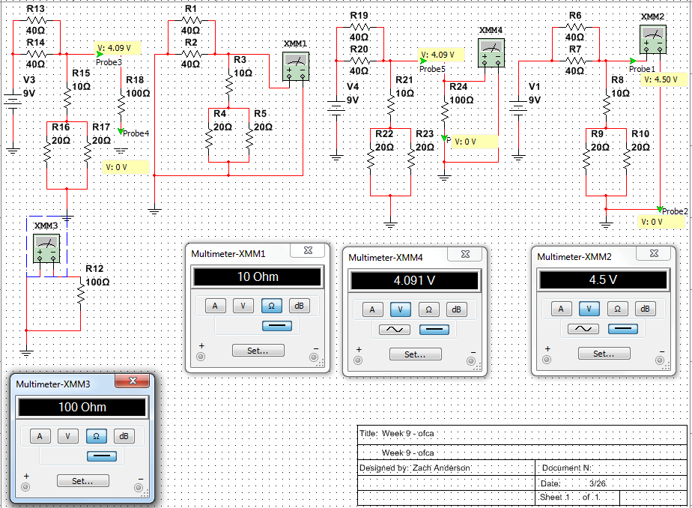

Slide 4
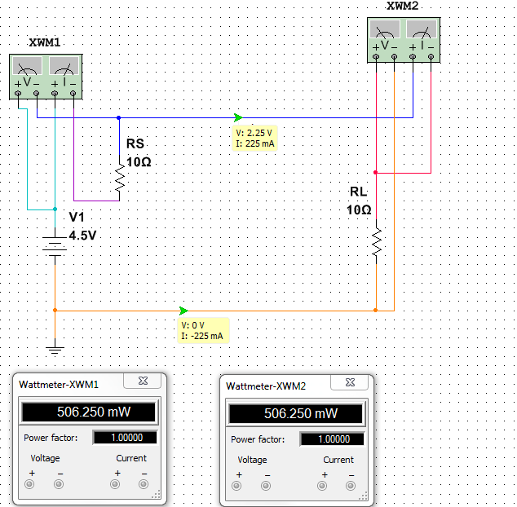
Max Power
Transfer

Slide 5
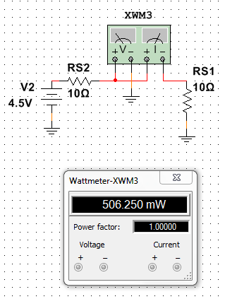
Double checking the maximum power

