Slide 1
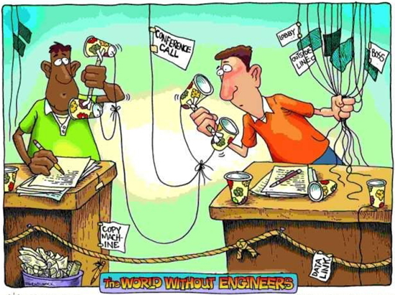
http://www.youtube.com/watch?v=BeR9KrIPF18
Electrical engineers conduct research, and design, develop, test, and oversee the development of electronic systems and manufacture of electrical and electronic equipment and devices. From GPS to electric motors, machinery controls, lighting, and wiring in buildings automobiles, aircraft, and radar navigation systems.
~http://www.careercornerstone.org/pdf/ee/eleceng.pdf

Slide 2
John Bardeen was an American physicist, electrical engineer, Nobel prize winner, co-inventor of the transistor (1947), an influential invention that changed the course of history for computers and electronics. John barden co-developed a fundamental theory of conventional superconductivity known as the BCS theory. ~http://inventors.about.com/od/bstartinventors/p/John_Bardeen.htm

Slide 3
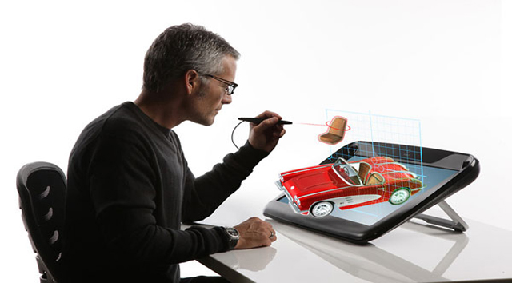
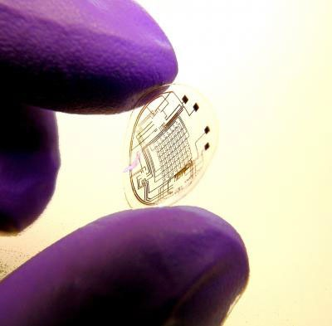
Future designs
“The name of this development zSpace, which means the space in the third dimension. According to the developers, this display aims to enhance the capacity of human creativity, by combining a simple two-dimensional world with holographic, sensory rich space.”
~itechfuture.com
“Scientists and engineers are racing to develop ways to use light instead of electricity to avoid traffic jams inside computers.
Today’s fastest computers employ miles of tiny copper wires to connect multiple data processors packed on silicon chips. Each little "brain" - in effect, a miniature adding machine - must exchange information with hundreds or thousands of partners on the same or connecting chips.
"The weakest link in the overall capability of the computer is the ability to move information from chip to chip," said John Stroman, a computer design strategist at Intel Corp., the big computer-chip maker based in Santa Clara, Calif. "Moving information around is the biggest limitation on the performance of computers, and it becomes a greater limitation as CPUs become faster."
Computer scientists think that the solution may be photons, the tiny packets of energy that make up a beam of light. Photons aren’t the same as electrons, the fundamental particles of electricity.” ~http://www.engineeringservicesoutsourcing.com
“This contact has a microscopic imprinted circuit with light emitting capabilities. This kind of breakthrough opens the door to a host of possible applications, including HUD overlays and immersive displays. ~Chris Hunter, BHFO.com
"Looking through a completed lens, you would see what the display is generating superimposed on the world outside," ~Babak Parviz

Slide 4
Thomas Edison
When people think of Thomas Edison, They think of the light bulb or the phonograph. What many people do not know is that he also was the first to produce a commercially successful projector in the U.S. or that he started a cement company that built Yankee stadium.
“Thomas Edison's interest in motion pictures began before 1888, however, the visit of Eadweard Muybridge to his laboratory in West Orange in February of that year certainly stimulated his resolve to invent a camera for motion pictures. Muybridge proposed that they collaborate and combine the Zoopraxiscope with the Edison phonograph. Although apparently intrigued, Edison decided not to participate in such a partnership, perhaps realizing that the Zoopraxiscope was not a very practical or efficient way of recording motion. In an attempt to protect his future, he filed a caveat with the Patents Office on October 17, 1888, describing his ideas for a device which would "do for the eye what the phonograph does for the ear" -- record and reproduce objects in motion. He called it a “kinetoscope,” using the Greek words "kineto" meaning "movement" and "scopos" meaning "to watch."
One of Edison's first motion picture and the first motion picture ever copyrighted showed his employee Fred Ott pretending to sneeze. One problem was that a good film for motion pictures was not available. In 1893, Eastman Kodak began supplying motion picture film stock, making it possible for Edison to step up the production of new motion pictures. He built a motion picture production studio in New Jersey. The studio had a roof that could be opened to let in daylight, and the entire building was constructed so that it could be moved to stay in line with the sun.
C. Francis Jenkins and Thomas Armat invented a film projector called the Vitascope and asked Edison to supply the films and manufacture the projector under his name. Eventually, the Edison Company developed its own projector, known as the Projectoscope, and stopped marketing the Vitascope. The first motion pictures shown in a "movie theater" in America were presented to audiences on April 23, 1896, in New York City.”~inventors.about.com
“However, not everything he created was a success; he also had a few failures.
One concept that never took off was Edison's interest in using cement to build things. He formed the Edison Portland Cement Co. in 1899, and made everything from cabinets (for phonographs) to pianos and houses. Unfortunately, at the time, concrete was too expensive and the idea was never accepted. Cement wasn't a total failure, though. His company was hired to build Yankee Stadium in the Bronx. ”~inventors.about.com
“From the beginning of the creation of motion pictures, many people tried to combine film and sound to make "talking" motion pictures. Here you can see to the left an example of an early film attempting to combine sound with pictures made by Edison's assistant, W.K.L. Dickson. By 1895, Edison had created the Kinetophone--a Kinetoscope (peep-hole motion picture viewer) with a phonograph that played inside the cabinet. Sound could be heard through two ear tubes while the viewer watched the images. This creation never really took off, and by 1915 Edison abandoned the idea of sound motion pictures. ”~inventors.about.com

Slide 5
Electrical and Electronics Engineering
Job Outlook 2010 – 2020 (proj.)
 | Employment 2010 | Employment Proj. 2020 | Employment Proj. (+/-) | Employment Expected Growth
Total Occupational Growth | ------ | ------ | ------ | 14%
Electrical & Electronics Engineering | 294,000 | 311,600 | + 17,600 | 6%
Electrical Engineering | 154,000 | 164,700 | + 10,700 | 7%
Electronics Engineering | 140,000 | 146,900 | + 6,900 | 5%
Source: Bureau of Labor Statistics

Slide 6
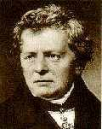
Georg Simon Ohm was born in 1787 in Erlangen, Germany. In 1805, Ohm entered the University of Erlangen and received a doctorate. He wrote an elementary geometry book while teaching mathematics at several schools. Ohm began experimental work in a school physics laboratory after he had learned of the discovery of electromagnetism in 1820.
He was able to define the fundamental relationship between voltage, current, and resistance. What is now known as Ohm's law appeared in his most famous work, a book published in 1827 that gave his complete theory of electricity.
The equation I = V/R is known as "Ohm’s Law". It states that the amount of steady current through a material is directly proportional to the voltage across the material divided by the electrical resistance of the material. The ohm (R), a unit of electrical resistance, is equal to that of a conductor in which a current (I) of one ampere is produced by a potential of one volt (V) across its terminals. These fundamental relationships represent the true beginning of electrical circuit analysis.
Source: www.absolute.com/library/inventors

Slide 7
Educational Requirements
Degrees
-Education requirements for electrical engineers differ depending on the level of position being sought as well as the employer. However, electrical engineers usually need a four-year bachelor's degree in this field through a college or university. Students in these programs usually can choose a concentration such as microwave engineering or power systems and get experience with both theory and design/lab work. In addition, a two-year master's degree can be helpful for those who want to advance to management roles in the electrical engineering field. Master's degree programs usually focus on a particular specialty such as electronics or digital systems and allow students to complete research. Doctoral degrees are designed for those interested in university teaching or high-level industrial research. Many colleges offer electrical engineering degrees online as well. The Accreditation Board for Engineering and Technology accredits electrical engineering programs, according to CollegeBoard.com.

Slide 8
Requirements Cont’D
Classes
-Courses in an electrical engineering training program might include computer programming, engineering economy, electrical circuits, thermodynamics, numerical analysis, and engineering materials. Other required courses might cover calculus, technical writing and engine/machinery technologies, according to DiplomaGuide.com. In addition, students might study integrated circuits, which are a major part of the entertainment and consumer appliance industries. Students additionally can learn about robotics, power systems and communication systems. Math and physics are at the heart of these programs.

Slide 9
Optional
Internship
-Many electrical engineering degree programs give students the opportunity to complete an internship in this field. An internship allows students to apply the scientific and engineering principles they learned in school to current engineering problems in a business setting, according to the Massachusetts Institute of Technology.
Licenses
-Licensure for electrical and electronics engineers is not as common as it is for other engineering occupations, but it is encouraged for those working in companies that have contracts with the government at all levels. Engineers who become licensed are designated professional engineers (PEs). Licensure generally requires the following:
A degree from an engineering program accredited by the ABET
A passing score on the Fundamentals of Engineering (FE) exam
Relevant work experience
A passing score on the Professional Engineering (PE) exam

Slide 10
Important Qualities
Active learning.
Communication skills
Detail oriented.
Math skills.
Teamwork.

Slide 11
Costs
Depending on how long a engineer is enrolled in school The cost of school may range from 2,000-50,000 depending on which institute one attends.

Slide 12
http://www.bls.gov/ooh/architecture-and-engineering/electrical-and-electronics-engineers.htm#tab-4
http://wiki.answers.com/Q/How_much_will_college_cost_to_become_an_electrical_engineer
http://inventors.about.com/cs/inventorsalphabet/a/electricity.htm
http://www.bls.gov/ooh/architecture-and-engineering/electrical-and-electronics-engineers.htm#tab-4

Slide 13
Early Inventor
History of Electricity - Leyden Jar
The leyden jar was the original capacitor, a device that stores and releases an electrical charge. (At that time electricity was considered the mysterious fluid or force.) The leyden jar was invented Holland in 1745 and in Germany almost simultaneously.

Slide 14
Inventor Cont’D
Both Dutch physicist Pieter van Musschenbroek and German clergyman and scientist, Ewald Christian Von Kleist invented a leyden jar. When Von Kleist first touched his leyden jar he received a powerful shock that knocked him to the floor.
The leyden jar was named after Musschenbroek's hometown and university Leyden, by Abbe Nolett, a French scientist, who first coined the term "Leyden jar". The jar was once called the Kleistian jar after Von Kleist, but this name did not stick.

Slide 15
Electrical Engineering pay rates
How much does a electrical engineering make? An electrical engineer makes thirty to thirty two dollars an hour and they make 64,910 a year. In 2010 annual wages were 56,040 it has increased since then. You can make more just depends on how much experience and expertise you have. With a four year degree entry level engineer can make 40k to 60k. A senior engineer with a masters degree in electrical engineering and many years of experience can make 80k to 100k. A engineer who is considered to be technical specialist or a, manager in the field who leads a team can make between 100k to 170k per year.

Slide 16
Ralph H. Baer
Ralph Baer (Left) receives the National Medal of Technology from former president George W. Bush (Right)
Born (1922-03-08) March 8, 1922 (age 90)
Rodalben, Palatinate, Germany
Occupation Inventor
Spouse Dena Whinston (1952-2006)
Children James, Mark, Nancy
Parents James L. Baer Lucy K. Linard
Website
Official Website
Ralph H. Baer (born March 8, 1922) is a German-born American video game pioneer, inventor, engineer, known as "The Father of Video Games",[1] who is noted for his many contributions to games and the video game industry. In 2006, he was awarded the National Medal of Technology for inventing the home console for video games and spawning the video game industry.
Contents [hide]
1 Life
2 Inventions
3 Awards
4 See also
5 Notes
6 References
7 External links

Slide 17
[edit] LifeWhen Baer was eleven, he was expelled from school in Germany because of his Jewish ancestry and had to go to an all-Jewish school. His father worked in a shoe factory in Pirmasens at the time. Two months before Kristallnacht, he and his family escaped from Germany. In America, he was self-taught and worked in a factory for a weekly wage of twelve dollars. He graduated from the National Radio Institute as a radio service technician in 1940. In 1943 he was drafted to fight in World War II, assigned to Military intelligence at the US Army headquarters in London.
Baer graduated with a Bachelor of Science degree in Television Engineering (unique at the time) from the American Television Institute of Technology [2][3] in Chicago in 1949.
In 1949, Baer went to work as chief engineer for a small electro medical equipment firm, Wappler, Inc where he designed and built surgical cutting machines, epilators, and low frequency pulse generating muscle-toning equipment. In 1951, Baer went to work as a senior engineer for Loral Electronics in the Bronx, New York, where he designed power line carrier signaling equipment for IBM. From 1952 to 1956, he worked at Transitron, Inc., in New York City as a chief engineer and later as vice president. He started his own company before joining Sanders Associates in 1956, where he stayed until retiring in 1987.[4]
Baer is best known for leading the development of the Brown Box and Magnavox Odyssey, the first home video game console and his pioneering patented work in establishing video games.[5] He is now partnered with Bob Pelovitz of Acsiom, LLC,[6] and they have been inventing and marketing toy and game ideas since 1983.[7] In 2006, Baer donated all his hardware prototypes and documents to the Smithsonian.[8]
Baer is a Life Senior Member of Institute of Electrical and Electronics Engineers.[9]
[edit] InventionsBaer started development of the "Brown Box" console video game system and several other prototypes in 1966 for the defense-electronics company Sanders Associates in Nashua, New Hampshire (now part of BAE Systems). In 1971, it was licensed to Magnavox, and after being renamed Magnavox Odyssey, the console was released to the public in 1972. For a time it was Sanders' most profitable line, though many in the company looked down on game development.

Slide 18
Baer created the first light gun and game for home television use, sold grouped with a game expansion pack for the Odyssey, and collectively known as the Shooting Gallery.[7] The light gun itself was the first peripheral for a video game console.
Another invention is Simon, an electronic pattern-matching game that was immensely popular in the late 1970s and 1980s.[10]
[edit] AwardsIn 2005, at G4's video game award show G-Phoria, Baer received a Legend Award for his work in the development of video games.[11]
On February 13, 2006, Baer was given a National Medal of Technology by Former President George W. Bush, in honor of his "groundbreaking and pioneering creation, development and commercialization of interactive video games".[12]
In 2008, Baer received the IEEE Masaru Ibuka Consumer Electronics Award.[13] He received the Pioneer award at GDC on Wednesday, February 20, 2006.
On February 27, 2008, Baer received the 2008 Developers Choice Awards "Pioneer" award. The award recognizes individuals who have contributed the advancement of the videogame industry through technology, concept, or gameplay design.[1]
On April 1, 2010, Baer was inducted into the National Inventors Hall of Fame at a ceremony at the United States Department of Commerce in Washington, D.C.[14]

