Slide 1
Lab #2 Computer Lab
Jason Brown
Kevin Keating
04/23/2013

Slide 2
Lab #2- Computer Lab
Jason Brown
Kevin Keating
Date: 04/23/2013
Tools:
Philips Screwdriver
Parts:
Used Computer Tower
Procedure:
Test computer to see if it is working. Disassemble the computer to a bare case. Examine and record the list of parts. Reassemble the parts and test to make sure it is working.

Slide 3
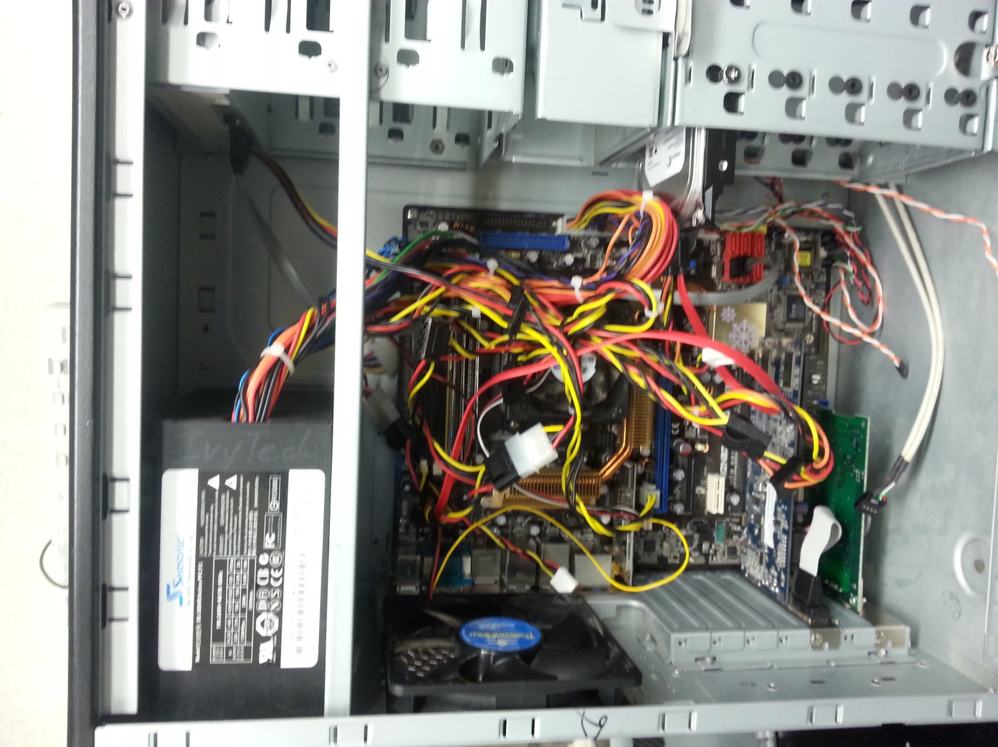
Open Computer Prior to Disassembly

Slide 4
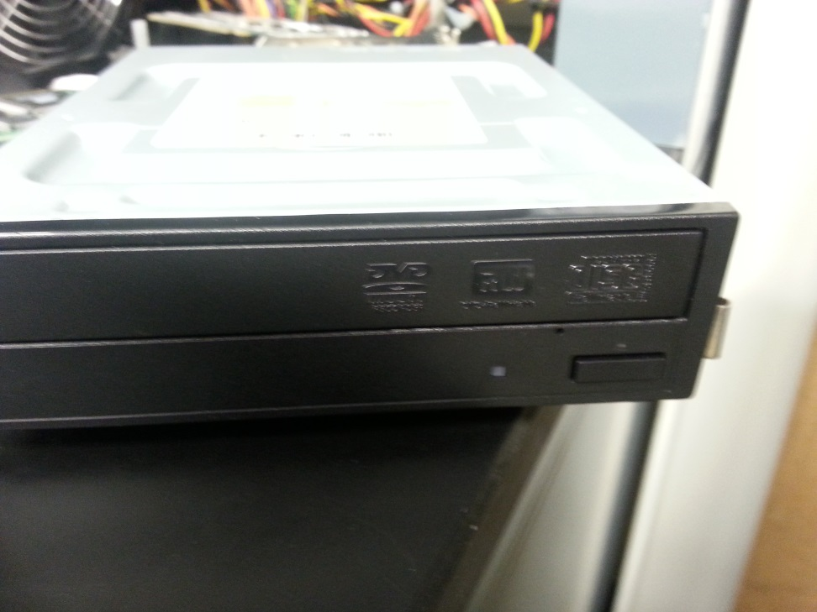
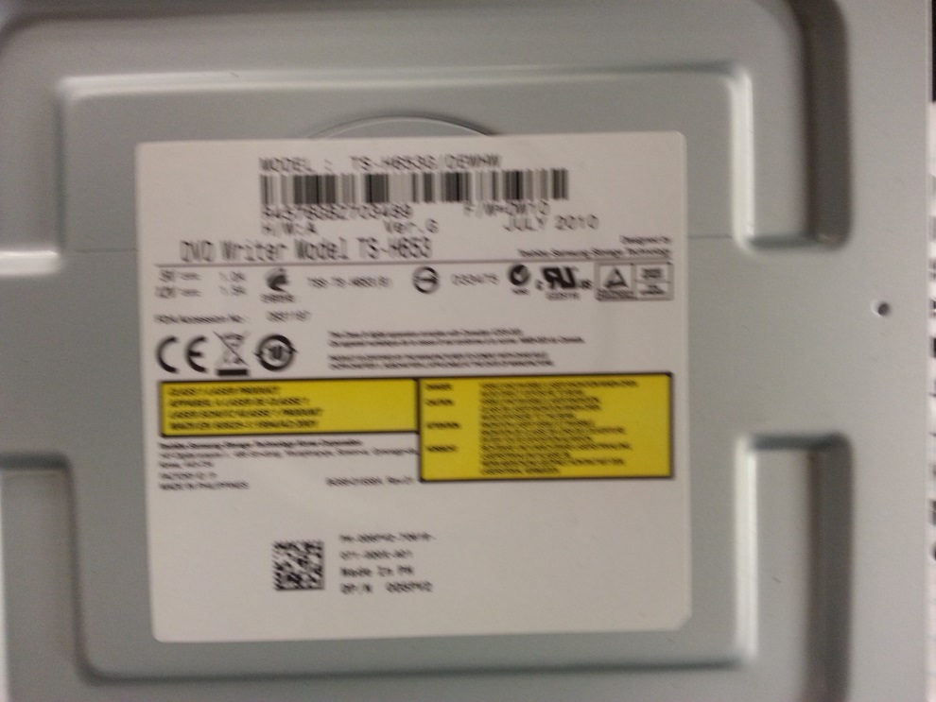
Desktop Optical Drive
Toshiba/Samsung TS-H653 20x DVD±RW DL SATA Drive

Slide 5
RAM
800MHz DDR2
CL 4-3-3-8(CAS-TRCD-TRP-TRAS)
1GB (2x512MB) Dual Channel Optimized Kits
Unbuffered
Platinum Mirrored Copper Heatspreader
Lifetime Warranty
2.1 Volts
240 Pin DIMM

Slide 6
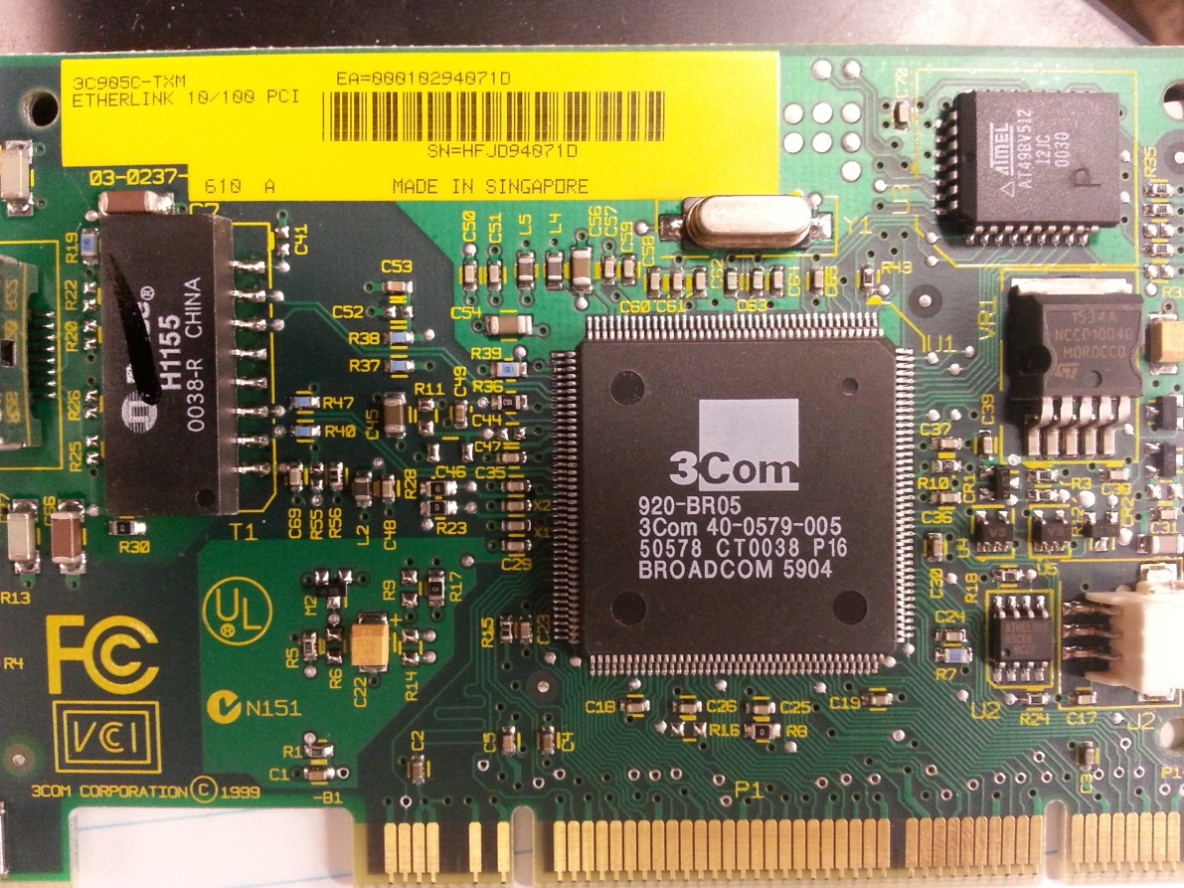
Ethernet Card
PCI
3Com
3C905C-TXM
10BaseT/100BaseT Network Card
PNP

Slide 7
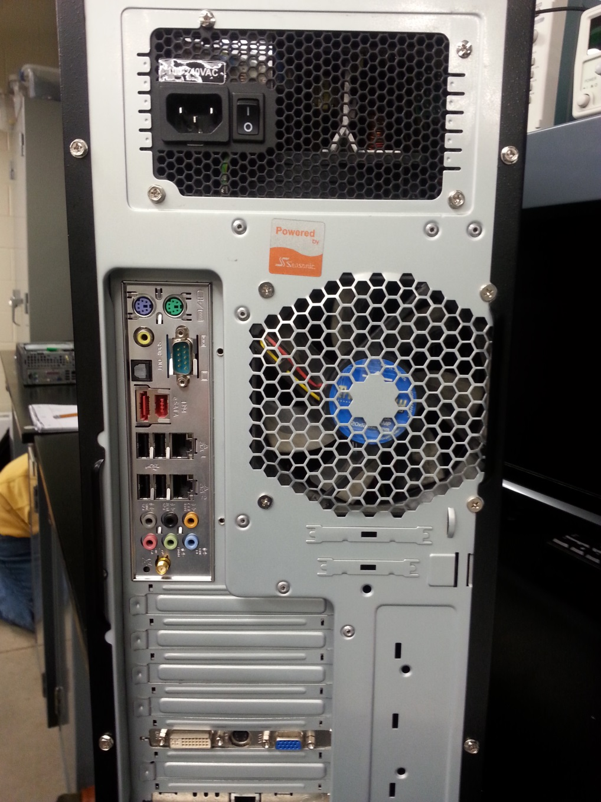
Back of Computer

Slide 8
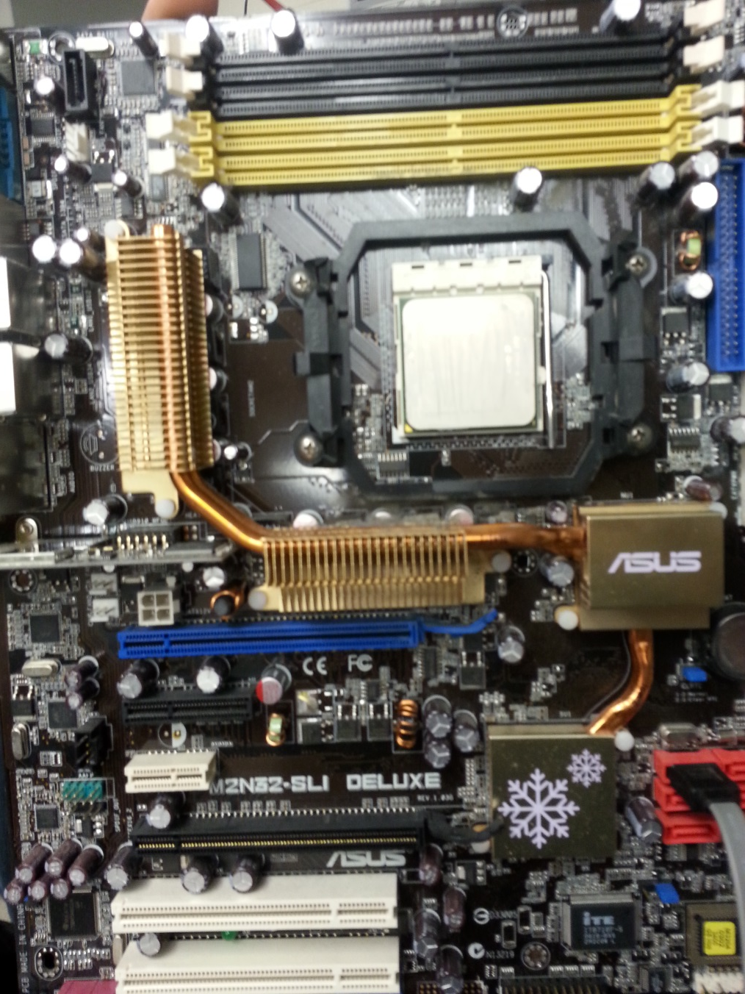
Motherboard
ASUS M2N32-SLI Deluxe Wireless Edition
AM2 NVIDIA nForce 590 SLI MCP ATX
AMD Motherboard

Slide 9
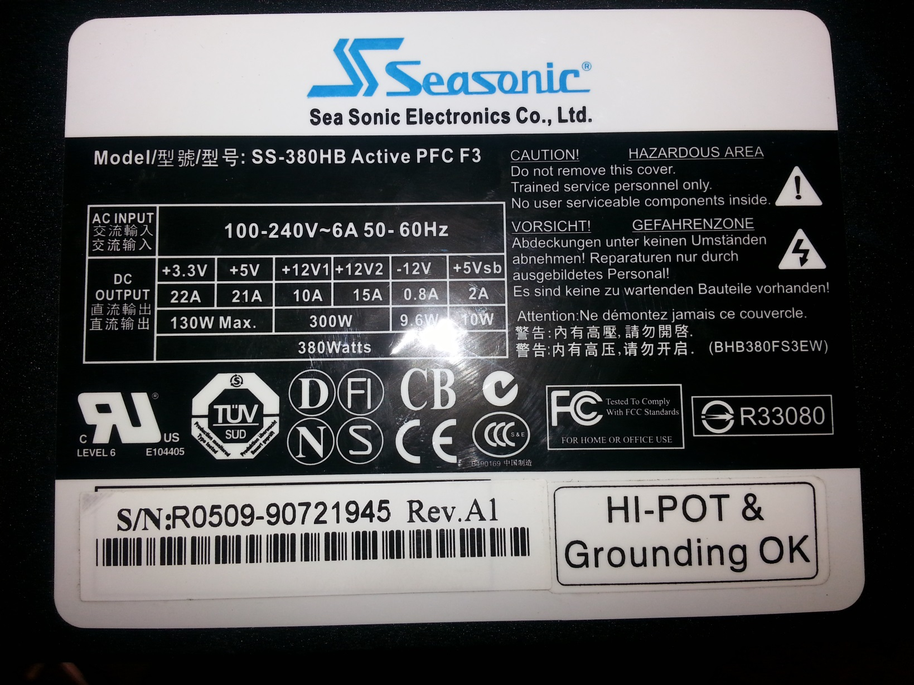
Power Supply

Slide 10
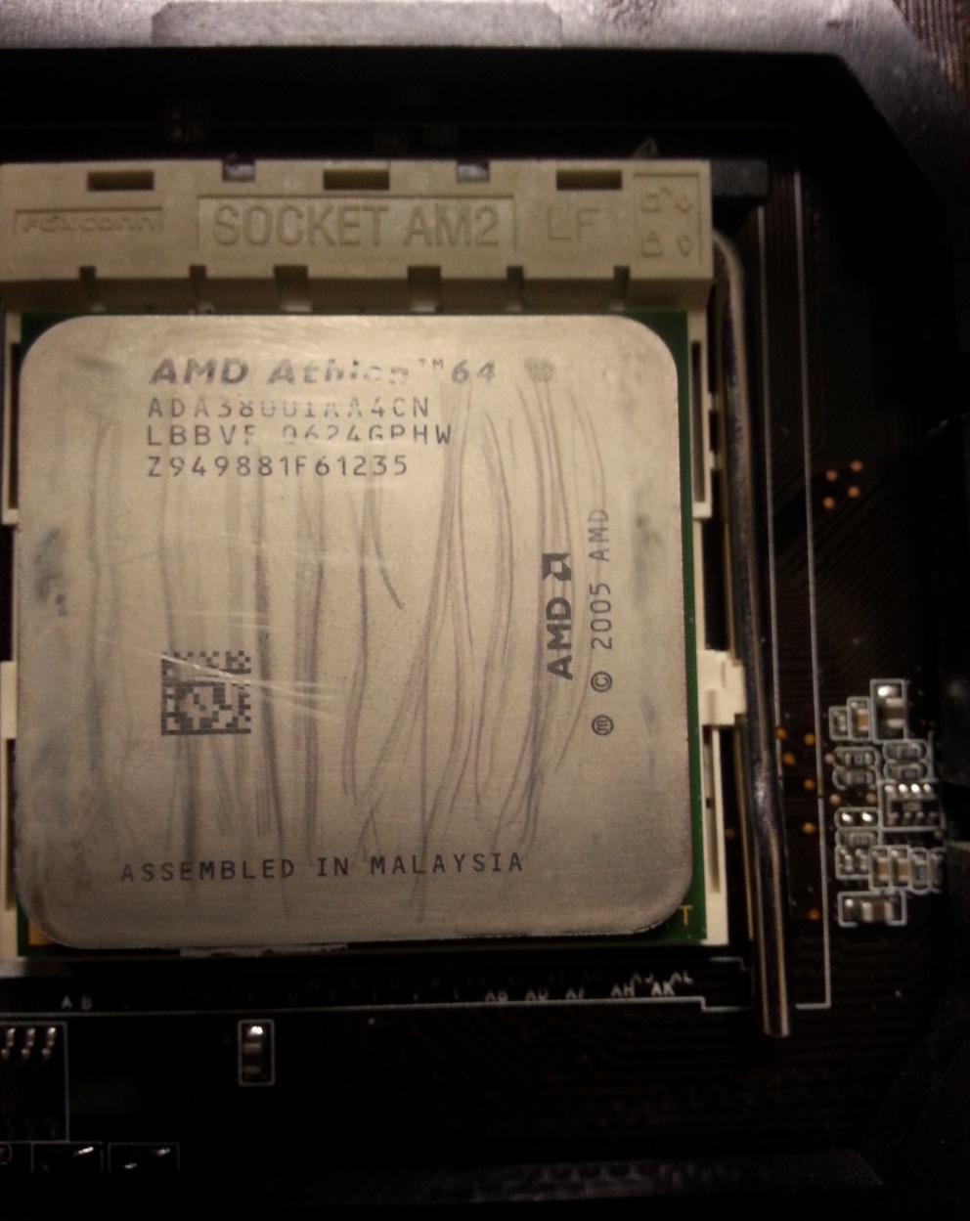
CPU
Clock multiplier 12
Package 940-pin organic micro-PGA
AMD Package number 29248
Socket Socket AM2
Introduction date May 23, 2006

Slide 11
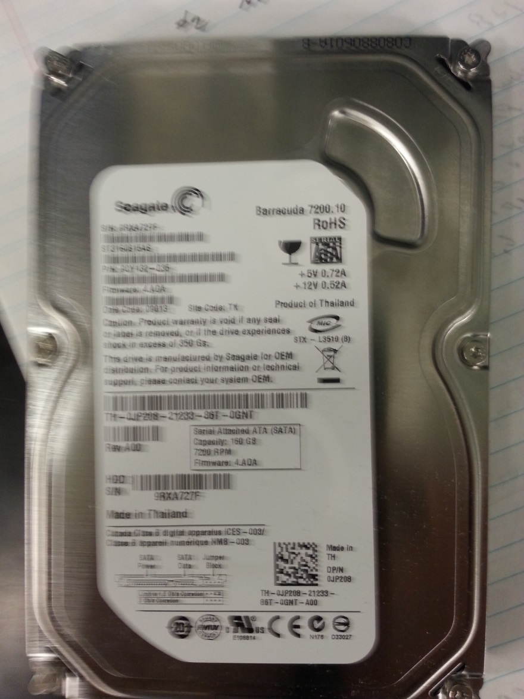
Hard Drive
Seagate Barracuda 7200.10
Sata
160 GB
7200 RPM

Slide 12
Graphics Card
XFX GeForce 6500 256MB DDR2 PCI Express (PCIe) DVI/VGA Video Card w/TV-Out

Slide 13
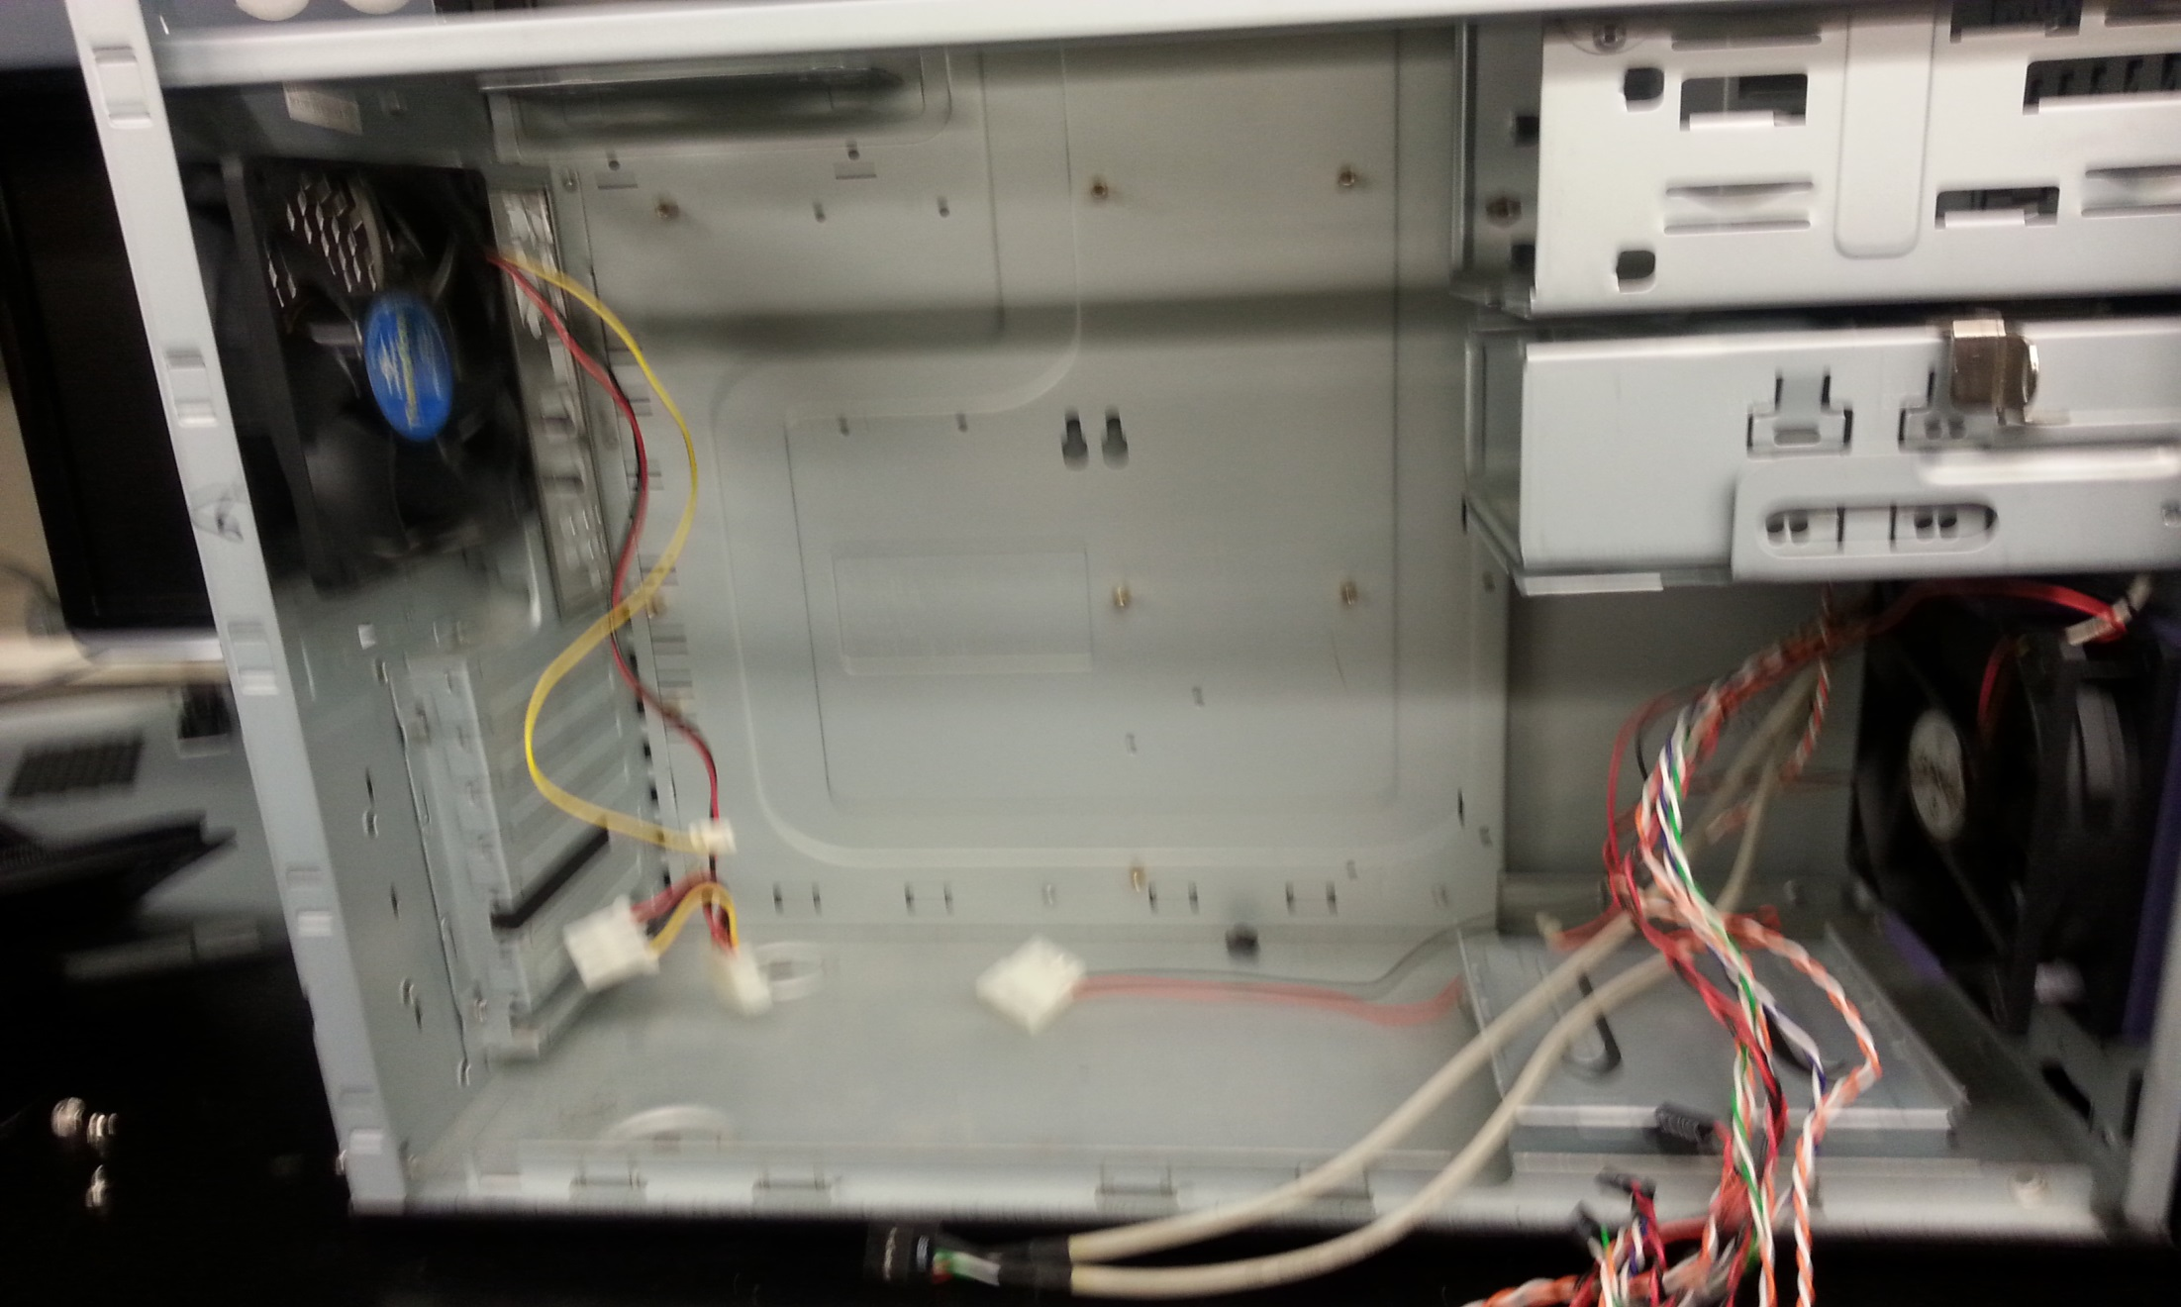
Empty Case

Slide 14
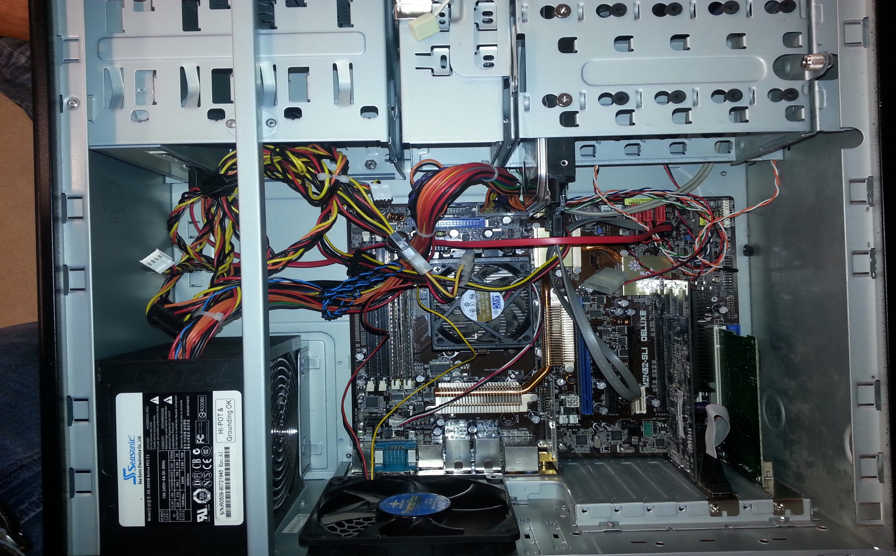
Reassemble Computer

Slide 15
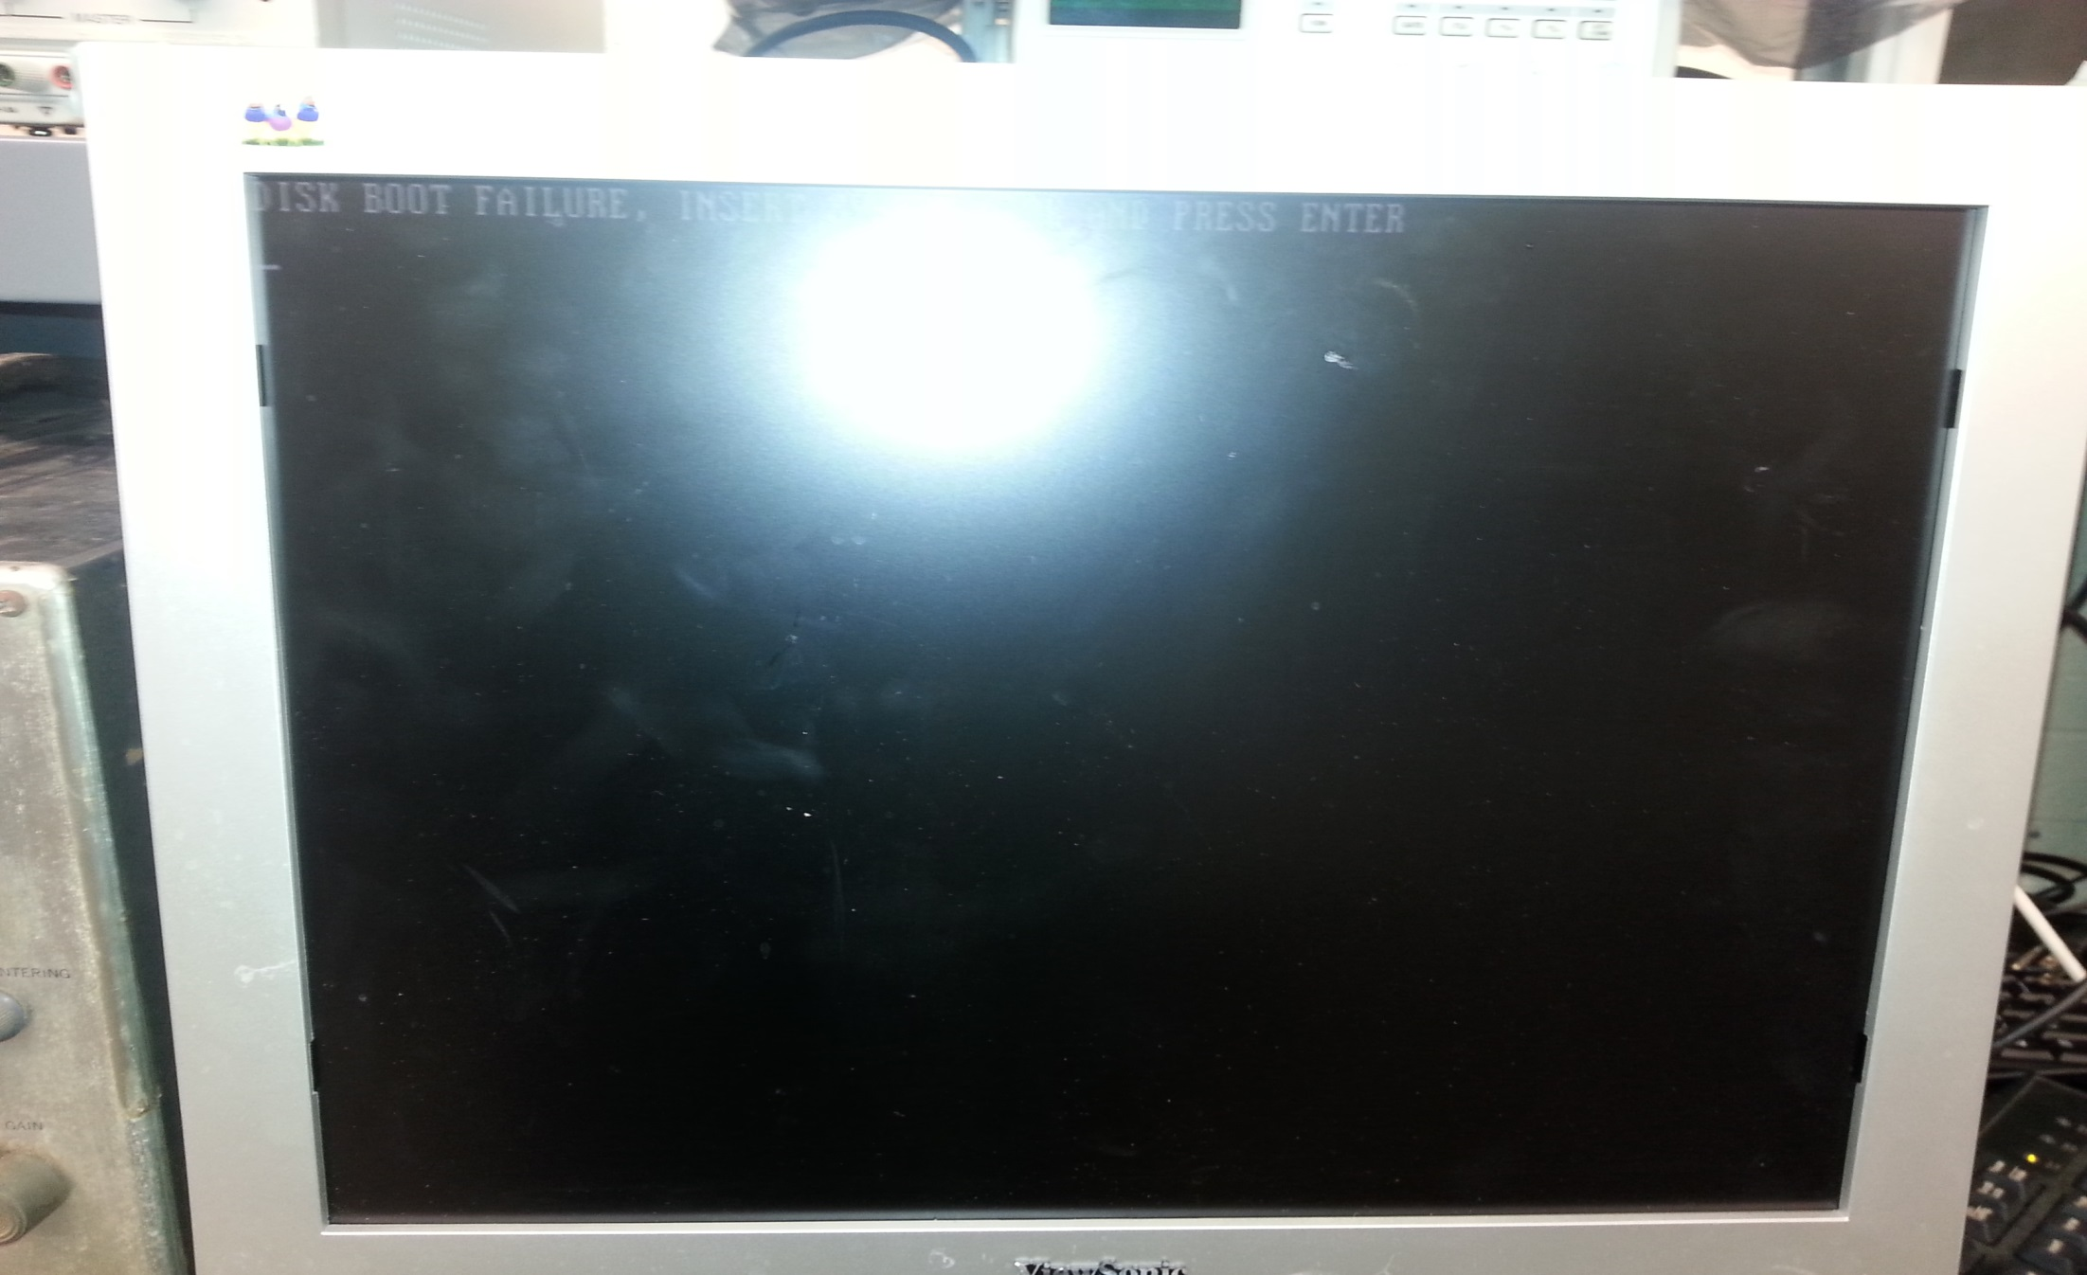
Computer Works after Reassembly

