Slide 1
Lab #1 Resistor
Cody Kieler
Kevin Keating
02/15/2013

Slide 2
Lab #1 - Resistor Lab
Cody Kieler
Kevin Keating
Date: 02/15/2013
Tools:
Multimeter
Parts:
25- 100 ohm resistors
Procedure:
Use the multimeter to measure the resistance in each resistor. Record the data and compare the results with the anticipated results. Calculate the tolerance for each resistor.
Include the findings from the other groups for a broader analysis.

Slide 3
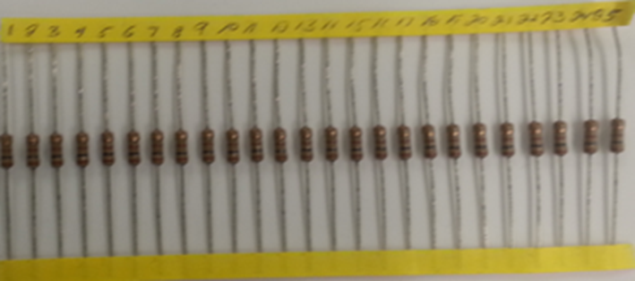
Resistors
resistor | reading
1 | 100.39
2 | 99.82
3 | 100.32
4 | 99.81
5 | 100.1
6 | 100.33
7 | 100.05
8 | 99.78
9 | 100.73
10 | 100.31
11 | 100.7
12 | 100.14
13 | 100.42
14 | 100.68
15 | 99.93
16 | 99.72
17 | 100.01
18 | 100.36
19 | 100.2
20 | 100.4
21 | 100.05
22 | 100.12
23 | 99.74
24 | 100.22
25 | 100.59

Slide 4
Measurements from Other Groups
26 | 100.26
27 | 100.85
28 | 100.62
29 | 99.91
30 | 100.3
31 | 100.44
32 | 99.83
33 | 99.89
34 | 100.02
35 | 100.22
36 | 99.74
37 | 100.27
38 | 100.28
39 | 100.15
40 | 100.07
41 | 100.2
42 | 100.79
43 | 100.41
44 | 100.22
45 | 100.29
46 | 100.29
47 | 100.15
48 | 100.15
49 | 99.79
50 | 100.32
51 | 100.41
52 | 99.63
53 | 100.84
54 | 100.43
55 | 100.32
56 | 99.58
57 | 100.44
58 | 100.13
59 | 100.42
60 | 100.06
61 | 100.6
62 | 99.52
63 | 99.71
64 | 99.97
65 | 99.83
66 | 100.29
67 | 99.395
68 | 99.98
69 | 100.54
70 | 100.63
71 | 100.27
72 | 100.31
73 | 100.55
74 | 99.99
75 | 100.41
76 | 100.43
77 | 100.65
78 | 100.42
79 | 99.72
80 | 100.81
81 | 100.01
82 | 100.43
83 | 100.91
84 | 99.95
85 | 100.45
86 | 100.57
87 | 99.87
88 | 100.38
89 | 100.17
90 | 100.59
91 | 100.12
92 | 99.83
93 | 100.74
94 | 100.39
95 | 99.89
96 | 99.78
97 | 100.15
98 | 100.2
99 | 100.8
100 | 99.87
101 | 100.39
102 | 99.82
103 | 100.32
104 | 99.81
105 | 100.1
106 | 100.33
107 | 100.05
108 | 99.78
109 | 100.73
110 | 100.31
111 | 100.7
112 | 100.14
113 | 100.42
114 | 100.68
115 | 99.93
116 | 99.72
117 | 100.01
118 | 100.36
119 | 100.2
120 | 100.4
121 | 100.05
122 | 100.12
123 | 99.74
124 | 100.22
125 | 100.59
126 | 100.3
127 | 100.23
128 | 100.42
129 | 100.36
130 | 100.48
131 | 100.59
132 | 99.89
133 | 99.86
134 | 100.59
135 | 100.38
136 | 100.12
137 | 100.24
138 | 100.65
139 | 100.28
140 | 100.05
141 | 99.6
142 | 99.87
143 | 100.7
144 | 100.34
145 | 100.3
146 | 100.08
147 | 100.97
148 | 100.4
149 | 99.94
150 | 100.49

