Slide 1


Digital Applications
by Andrew G. Bell
abell118@ivytech.edu
(260) 481-2288
Lecture on 3 Bit Adder and Binary to BCD

Slide 2
Objectives
Selected areas covered in this lecture:
  Building a digital model in Multisim based on truth table
  Using 74LS283 4-Bit Binary Full Adders With Fast Carry
  Common Anode and Common Cathode 7 Segment Displays

Slide 3
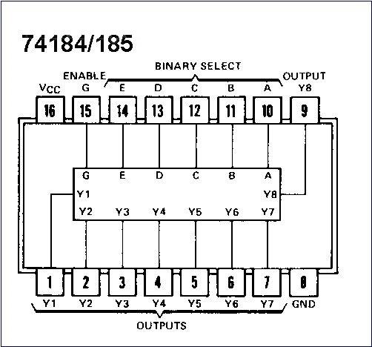

Introduction
Some parts that existed and provide a unique function may become obsolete so you can no longer buy them. Old designs that use these parts must be redesigned or the parts may need to be replaced with new technology. This is true for the
74185 BCD-to-Binary and Binary-to-BCD Converters

Slide 4
2-4 BCD Code
Binary Coded Decimal (BCD) is a widely used
way to present decimal numbers in binary form.
  Combines features of both decimal and binary systems.
    Each digit is converted to a binary equivalent.
BCD is not a number system.
  It is a decimal number with each digit encoded
  to its binary equivalent.
A BCD number is not the same as a straight binary number.
  The primary advantage of BCD is the relative
  ease of converting to and from decimal.
Copyright ©2007 by Pearson Education, Inc.
Columbus, OH 43235
All rights reserved.

Slide 5
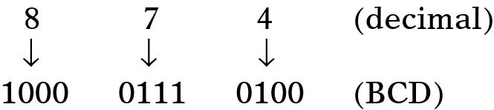
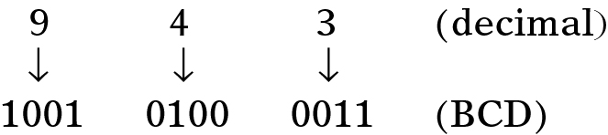
2-4 BCD Code
Convert the number 874₁₀ to BCD:
  Each decimal digit is represented using 4 bits.
    Each 4-bit group can never be greater than 9.
Reverse the process to convert BCD to decimal.
Copyright ©2007 by Pearson Education, Inc.
Columbus, OH 43235
All rights reserved.

Slide 6
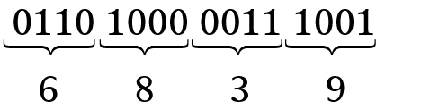
2-4 BCD Code
Convert 0110100000111001 (BCD) to its
decimal equivalent.
Divide the BCD number into four-bit
groups and convert each to decimal.
Copyright ©2007 by Pearson Education, Inc.
Columbus, OH 43235
All rights reserved.

Slide 7
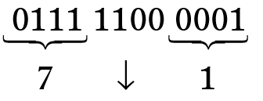
2-4 BCD Code
Convert BCD 011111000001 to its decimal equivalent.
The forbidden group represents
an error in the BCD number.
Copyright ©2007 by Pearson Education, Inc.
Columbus, OH 43235
All rights reserved.

Slide 8
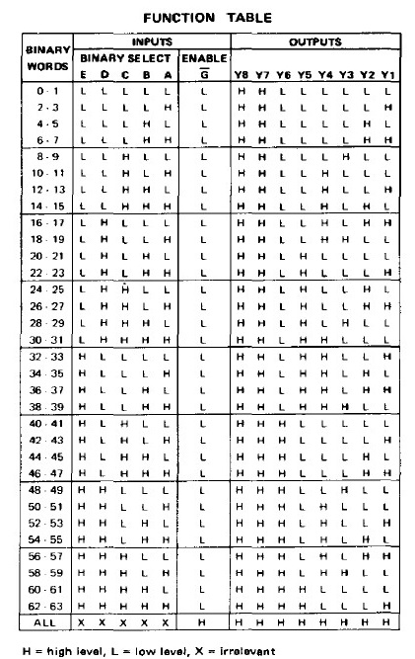
74185
The 74185 converts Binary to BCD code but it is an obsolete part, i.e. you can no longer buy it.
Also, Multisim does not have a model for it so we could build a model for it and use it to design a replacement part using combinational logic. All we need is the “truth table”

Slide 9

3 bit adder with display
We want to build a two 3 bit circuit that can display the results as a two digit BCD using seven segment LEDs
Copyright ©2007 by Pearson Education, Inc.
Columbus, OH 43235
All rights reserved.

Slide 10
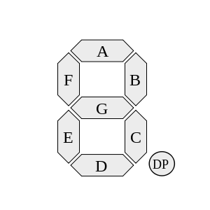
The 7 Segment Display
So lets start at the end and try to understand 7 segment displays. There are two common types: common cathode and common anode. Each LED has a letter from “A” to “G” associated with it. Some also have a “DP” decimal point. To illuminate a segment you must apply
Copyright ©2007 by Pearson Education, Inc.
Columbus, OH 43235
All rights reserved.

Slide 11
Multisim – Seven Segment Display
Here is how you would bias a Common Anode 7 Segment Display
Copyright ©2007 by Pearson Education, Inc.
Columbus, OH 43235
All rights reserved.

Slide 12
Multisim – Seven Segment Display
Here is how you would bias a Common Cathode 7 Segment Display
Copyright ©2007 by Pearson Education, Inc.
Columbus, OH 43235
All rights reserved.

Slide 13
Multisim – BCD with Common Anode 7 Segment Display
Here is how you would drive a Common Anode 7 Segment Display with a 74LS47
Copyright ©2007 by Pearson Education, Inc.
Columbus, OH 43235
All rights reserved.

Slide 14
Multisim – BCD with Common Cathode 7 Segment Display
Here is how you would drive a Common Cathode 7 Segment Display with a 74LS48
Copyright ©2007 by Pearson Education, Inc.
Columbus, OH 43235
All rights reserved.

Slide 15


Use Excel to build the model
Here are the steps to build the code for the model using Excel
Copyright ©2007 by Pearson Education, Inc.
Columbus, OH 43235
All rights reserved.

Slide 16
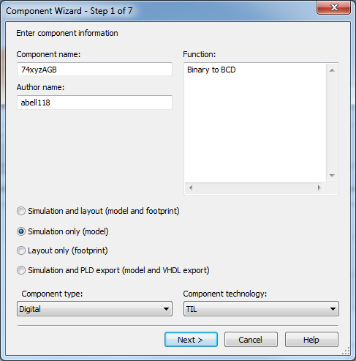
Now build the model
Launch the Component Wizard in Multisim
Name your component and describe its function
It should be a “Simulation only”, Digital model
Copyright ©2007 by Pearson Education, Inc.
Columbus, OH 43235
All rights reserved.

Slide 17
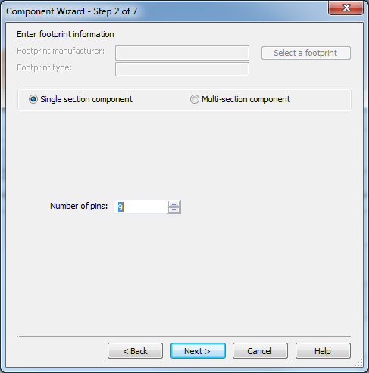
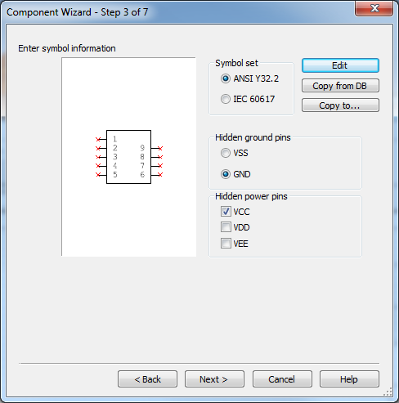
Now build the model
It only has 9 pins: 4 inputs and 5 outputs
Will need to adjust the symbol to put the inputs on the left and outputs on the right
Copyright ©2007 by Pearson Education, Inc.
Columbus, OH 43235
All rights reserved.

Slide 18
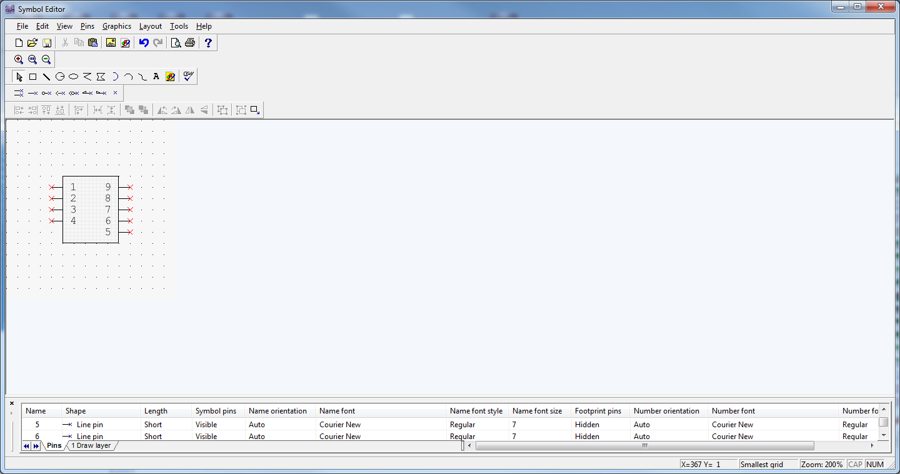
Now build the model
Modify the symbol with the Symbol Editor
Copyright ©2007 by Pearson Education, Inc.
Columbus, OH 43235
All rights reserved.

Slide 19
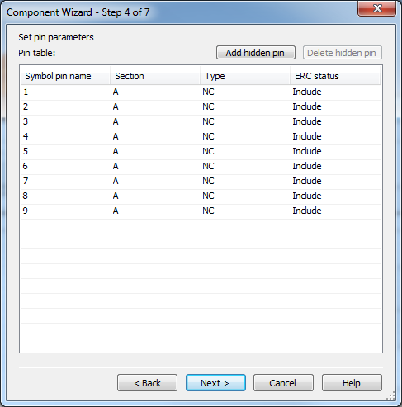
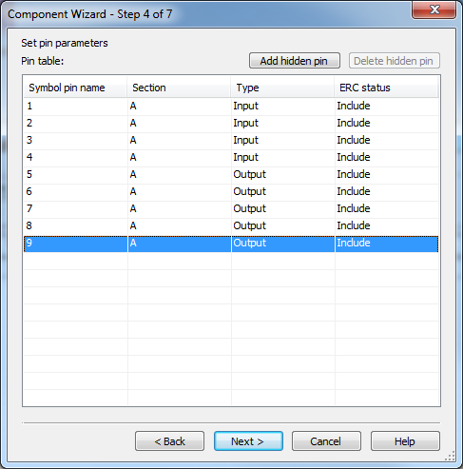
Now build the model
Define the inputs as inputs and outputs as outputs
Copyright ©2007 by Pearson Education, Inc.
Columbus, OH 43235
All rights reserved.

Slide 20
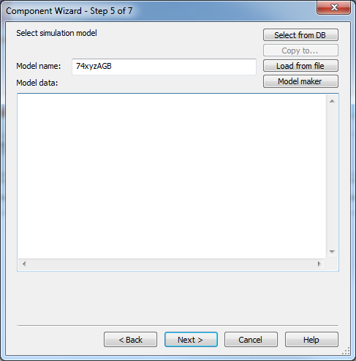
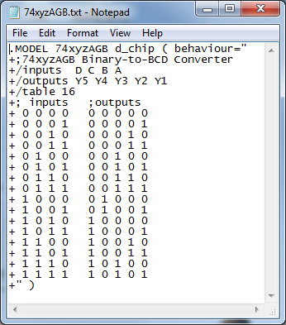
Now build the model
Insert the model for the part.
To do this it is good to create a text file and pull everything together
For more info: http://forums.ni.com/ni/attachments/ni/370/6606/1/d_chip.pdf
This is a digital part so it should have this sort of header because you are using a truth table.
Everything else based on the spreadsheet
Copyright ©2007 by Pearson Education, Inc.
Columbus, OH 43235
All rights reserved.

Slide 21
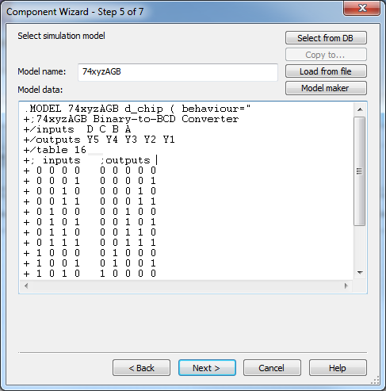
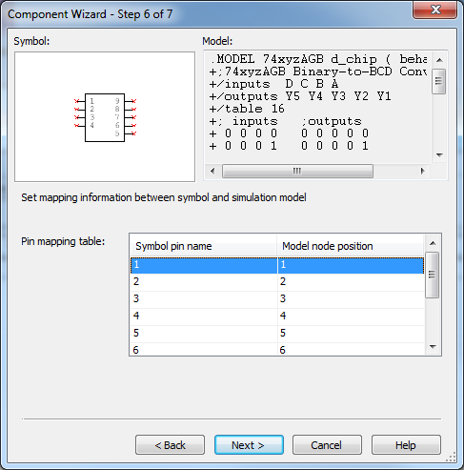
Now build the model
Step 5 is the real simulation model
Also need to connect the simulation model to the symbol pins. In our case we don’t need to do anything because model and symbol pins align.
Copyright ©2007 by Pearson Education, Inc.
Columbus, OH 43235
All rights reserved.

Slide 22
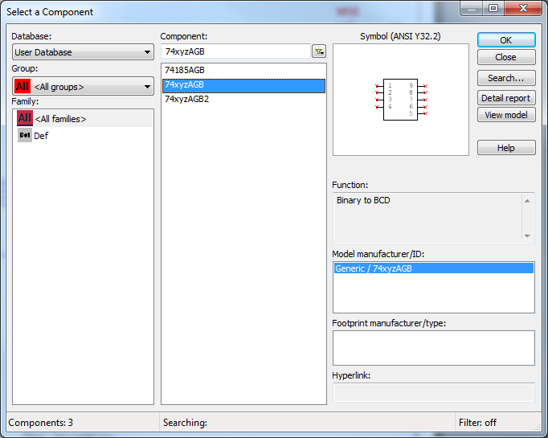
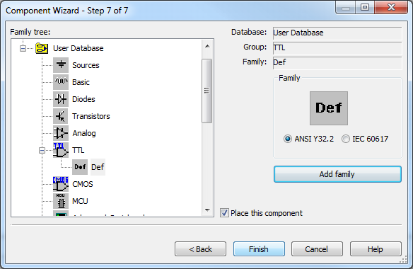
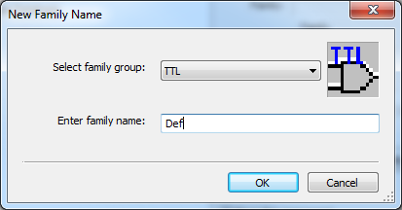
Now build the model
Final step is to save it in the library
Afterwards we can find the part in the User Database.
Copyright ©2007 by Pearson Education, Inc.
Columbus, OH 43235
All rights reserved.

Slide 23
Now we can test the model
It works!
Copyright ©2007 by Pearson Education, Inc.
Columbus, OH 43235
All rights reserved.

Slide 24
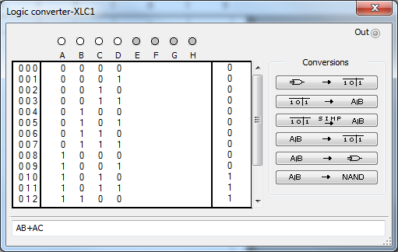
Build a circuit for the model
Use the logic converter and extract the Booleans
Then build and test the Boolean equivalent circuit
Copyright ©2007 by Pearson Education, Inc.
Columbus, OH 43235
All rights reserved.

Slide 25
Build a circuit for the model
It works! We can now build it …
Copyright ©2007 by Pearson Education, Inc.
Columbus, OH 43235
All rights reserved.

Slide 26
Design, Build and Test
Based on the simulation results build the 3 Bit Adder with a two digit 7 segment display.
Option 1 use combinational logic for Binary to BCD conversion
Option 2 use Arduino or Basic Stamp for conversion
Option 3 use EEPROM for conversion
Option 4 use CPLD Xilinx board for conversion
Copyright ©2007 by Pearson Education, Inc.
Columbus, OH 43235
All rights reserved.

