Slide 1
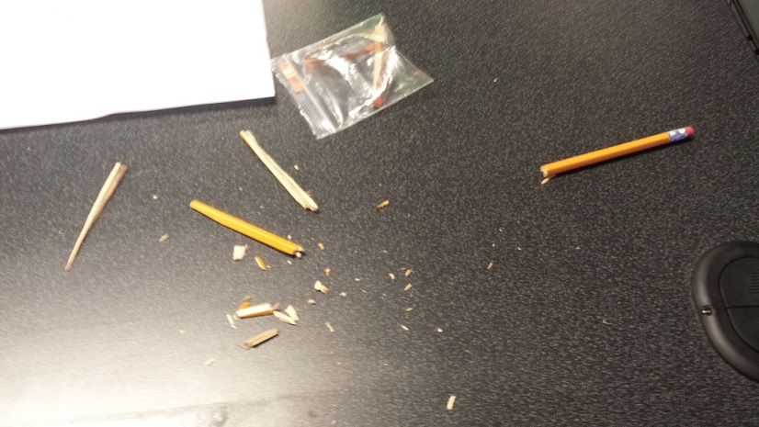
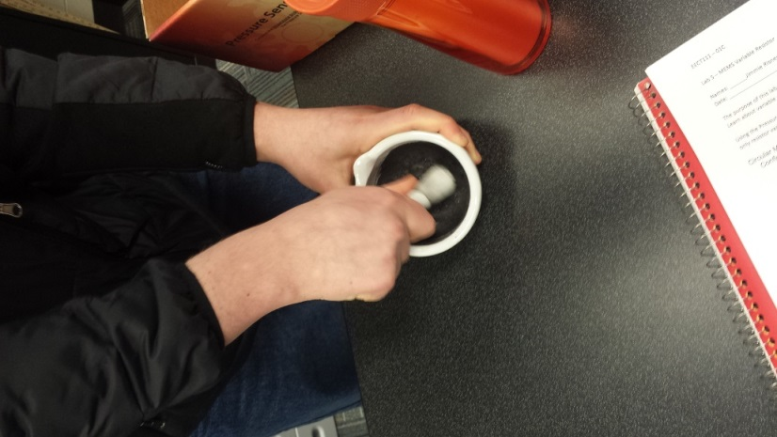
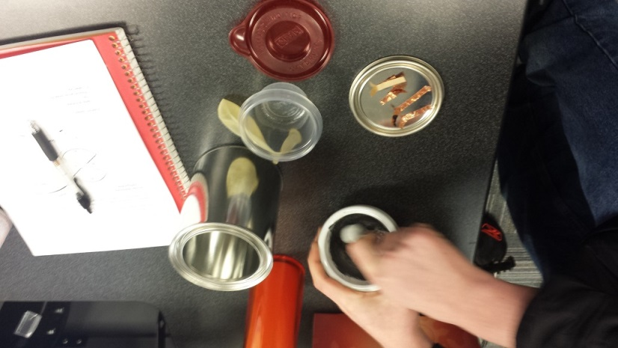
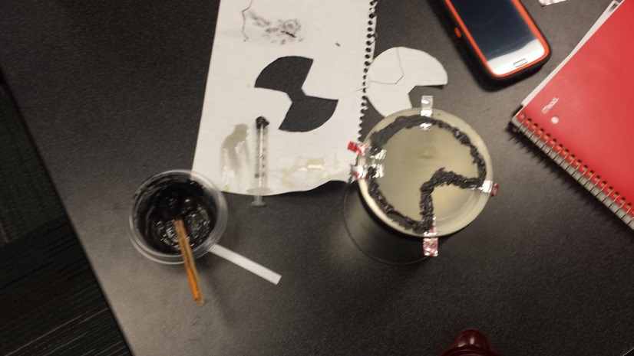
Used #2 Pencils for carbon
Crushed lead in crucible
Pre-assembly
Final design
Observations: Built Pressure Sensor but It was never Tested

