Slide 1

Miller Indices
By : Cody, David, and Shane

Slide 2
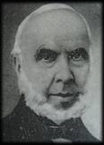
Inventor of Miller indices
This scheme, devised by
British mineralogist and crystallographer William Hallowes Miller, in 1839, has the advantage of eliminating all fractions from the notation for a plane.

Slide 3
Definition of Miller Indices
Miller indices - group of three numbers that indicates the orientation of a plane or set of parallel planes of atoms in a crystal.
Miller Indices - (a method of describing planes and directions within a crystal)
http://www.youtube.com/watch?v=pMTA_wiY784

Slide 4
A better Sense of things
If each atom in the crystal is represented by a point and these points are connected by lines, the resulting lattice may be divided into a number of identical blocks, or unit cells.
the intersecting edges of one of the unit cells defines a set of crystallographic axes, and the Miller indices are determined by the intersection of the plane with these axes.
The reciprocals of these intercepts are computed, and fractions are cleared to give the three Miller indices (hkl).

Slide 5
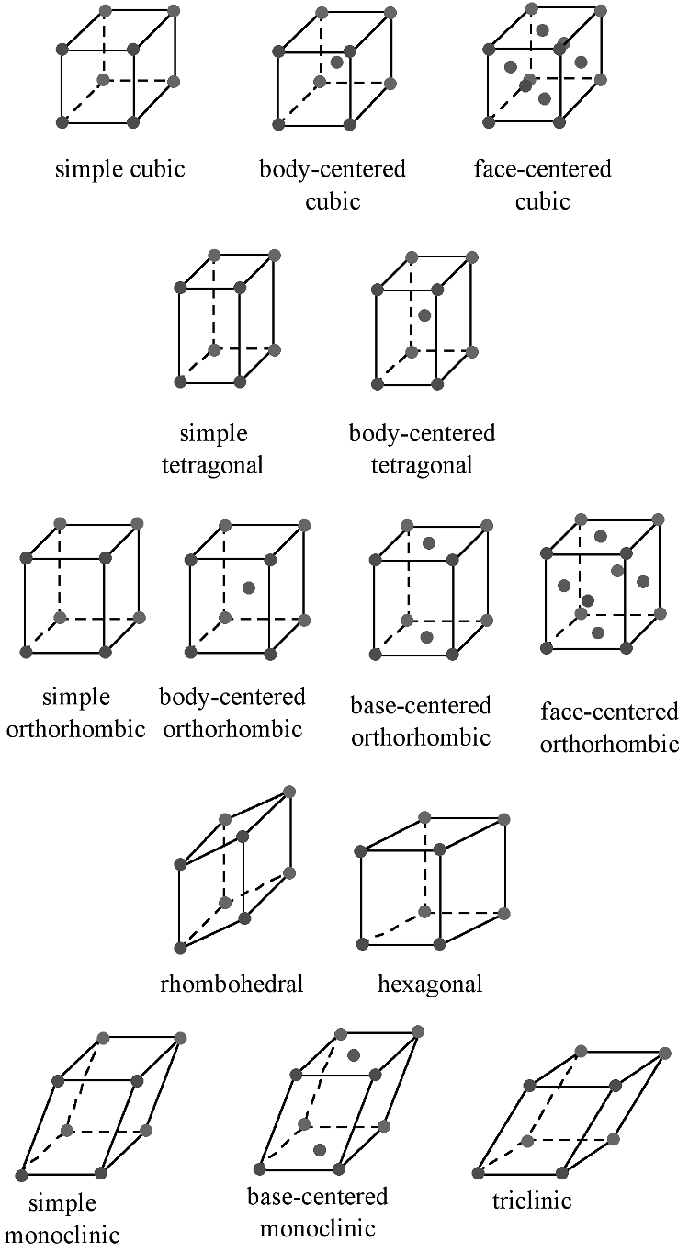
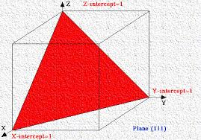
Pictures of planes, and different atom unit cells

Slide 6
Conclusion
If a Miller index is zero, the plane is parallel to that axis.
• The smaller a Miller index, the more nearly parallel the plane is to the axis.
The larger a Miller index, the more nearly perpendicular a plane is to that axis.
Multiplying or dividing a Miller index by a constant has no effect on the orientation of the plane
Miller indices are almost always small.

Slide 7
Cited
http://www.britannica.com/EBchecked/topic/382843/Miller-indices
chemistry.bd.psu.edu
http://cnx.org/content/m16927/latest/

