Slide 1
METC 143 Lab NOTEBOOK
SPRING 2014
Tanner

Slide 2
Instron 5960 Dual Column Table top Universal Testing System
By: “Wild” Billy and Tanner

Slide 3
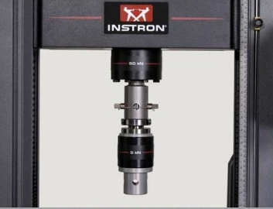
What it is.
We know it best as one of our tensile testers
Universal, static testing systems that perform tensile and compression testing
Can also perform shear, flexure, peel, tear, cyclic, and bend tests.

Slide 4
Features
Load measurement accuracy: +/- 0.5%
Up to 2.5 kHz data acquisition rate
Speed range of 0.001 - 3000 mm/min
50 kN (11,250 lbs) capacity
1212 mm (47.7 in) vertical test space

Slide 5
How it works
Pressure is applied from various directions, to test different properties of the metal.
  Compression
  Tension
  As well as a variety of other tests

Slide 6
Instron in Action!!!!!
http://www.youtube.com/watch?v=ivTHHyHTjNU

Slide 7
Source
http://www.instron.us/wa/product/5960-Dual-Column-Testing-Systems.aspx

Slide 8
Lab 2/ Crystallography Lab
Post-Activity Questions
1. In this activity, you broke two silicon wafers. One wafer had a (100) crystal surface
plane orientation and the other a (111) surface plane orientation. In the making of the
original silicon ingot, what determined the crystal orientation of the silicon wafer? The number of surface atoms are
2. At what approximate angle did the (111) wafer b
break? It broke into 6 separate 60 degree pieces
3. At what approximate angle did the (100) wafer break? It broke into 4 separate 90 degrees pieces
4. Did each wafer continue to break at the same angle when you broke the smaller pieces?
Why or why not? Silicon wafer (100) broke an individual piece for second time the results were not exactly 4 90 degree pieces like before but for the most part rectangles or perfect squares. Silicon wafer (111) when a piece was broken for a second time, broke into 6 almost exact representational pieces of the original broken pieces as the first break was.
5. Which orientation (100) or (111) has more silicon atoms exposed to the wafer's surface? 111
6. Why is crystal orientation important in the fabrication of microsystems? To be able to know and produce a piece of material with the necessary requirements that particular piece of material needs to at hear to.
7. Identify the crystal orientation of each of the following pieces of silicon.

Slide 9
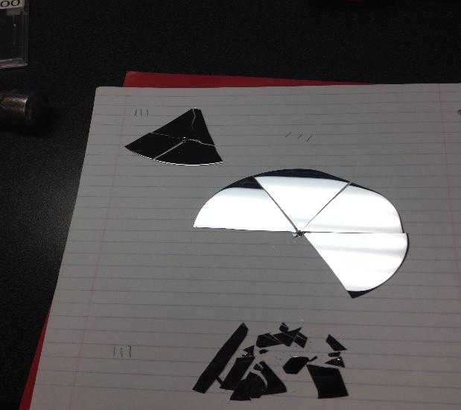
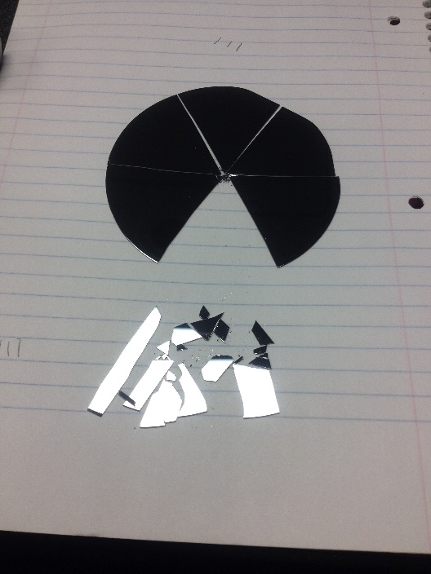
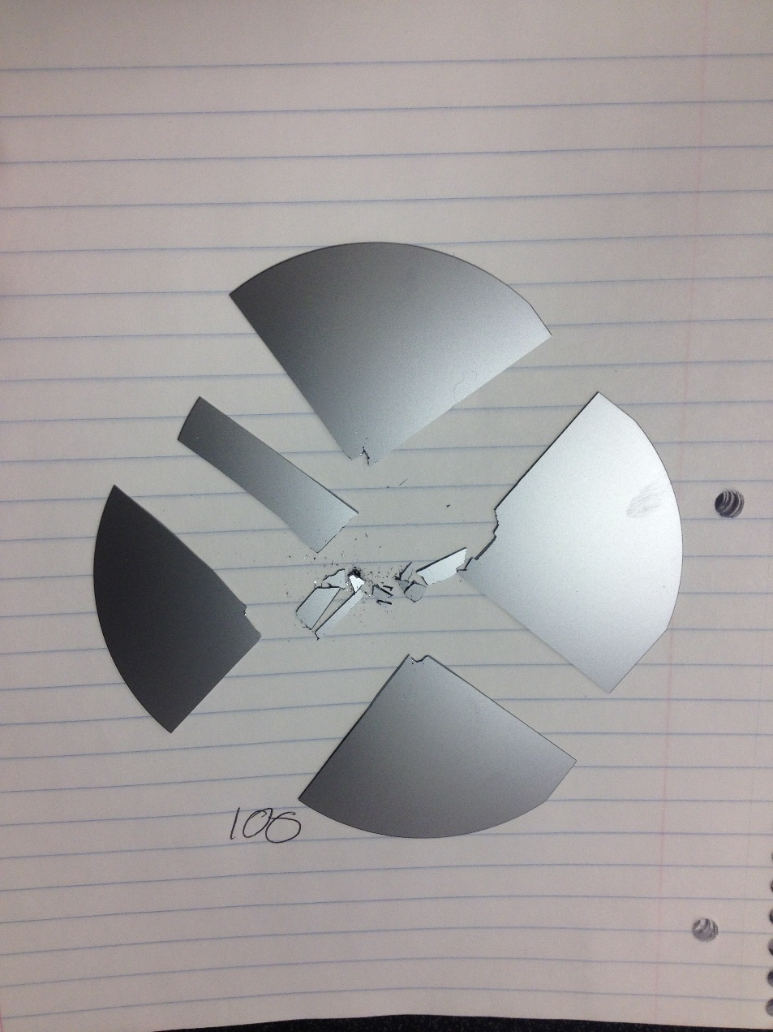
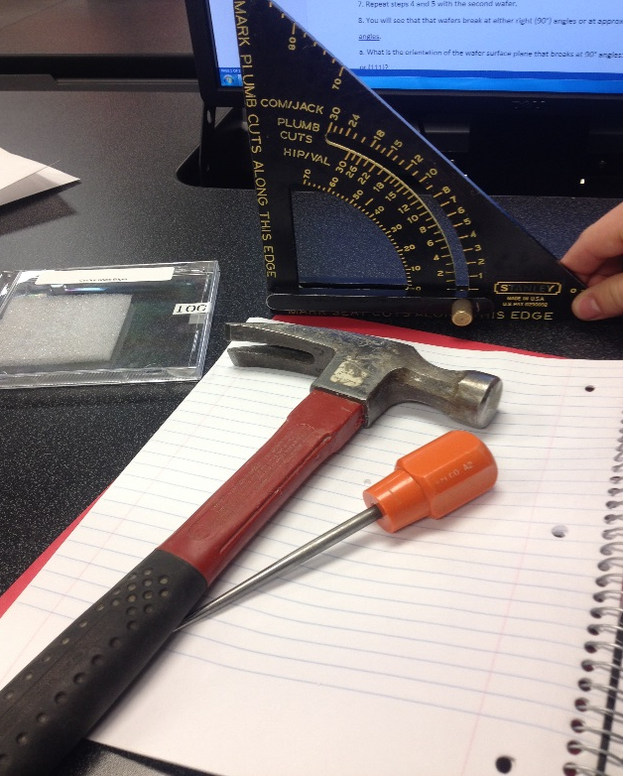

Lab 2 Cont…..

Slide 10
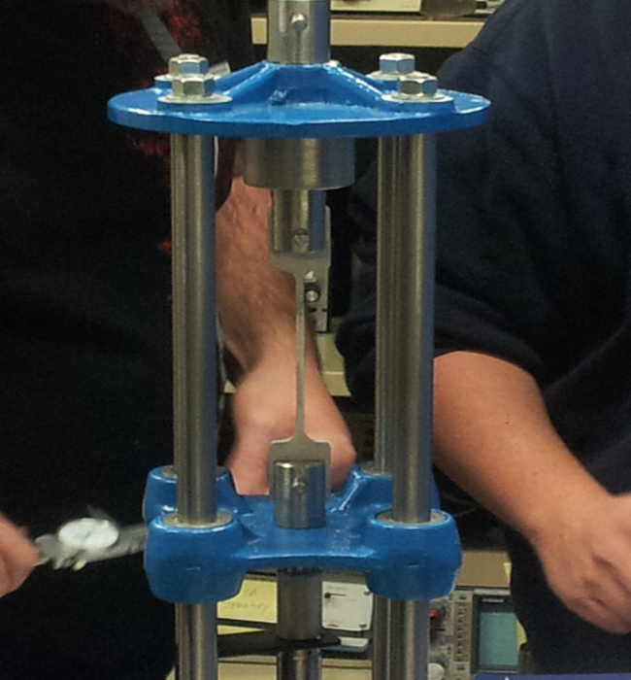
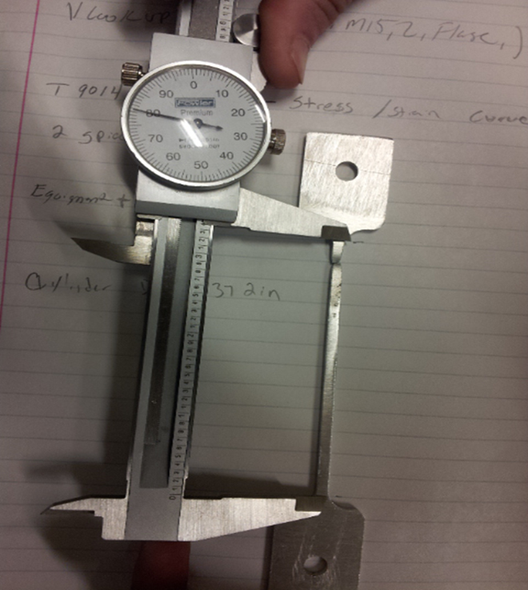
Lab 3 T9014 Aluminum

Slide 11
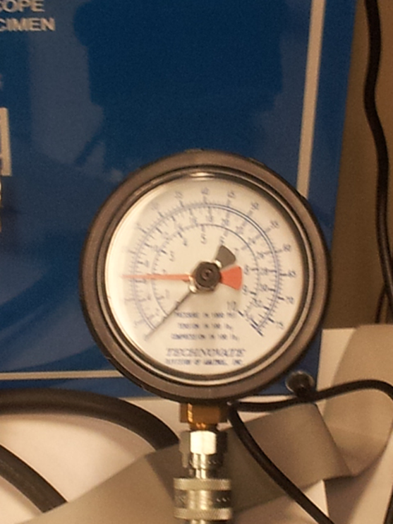
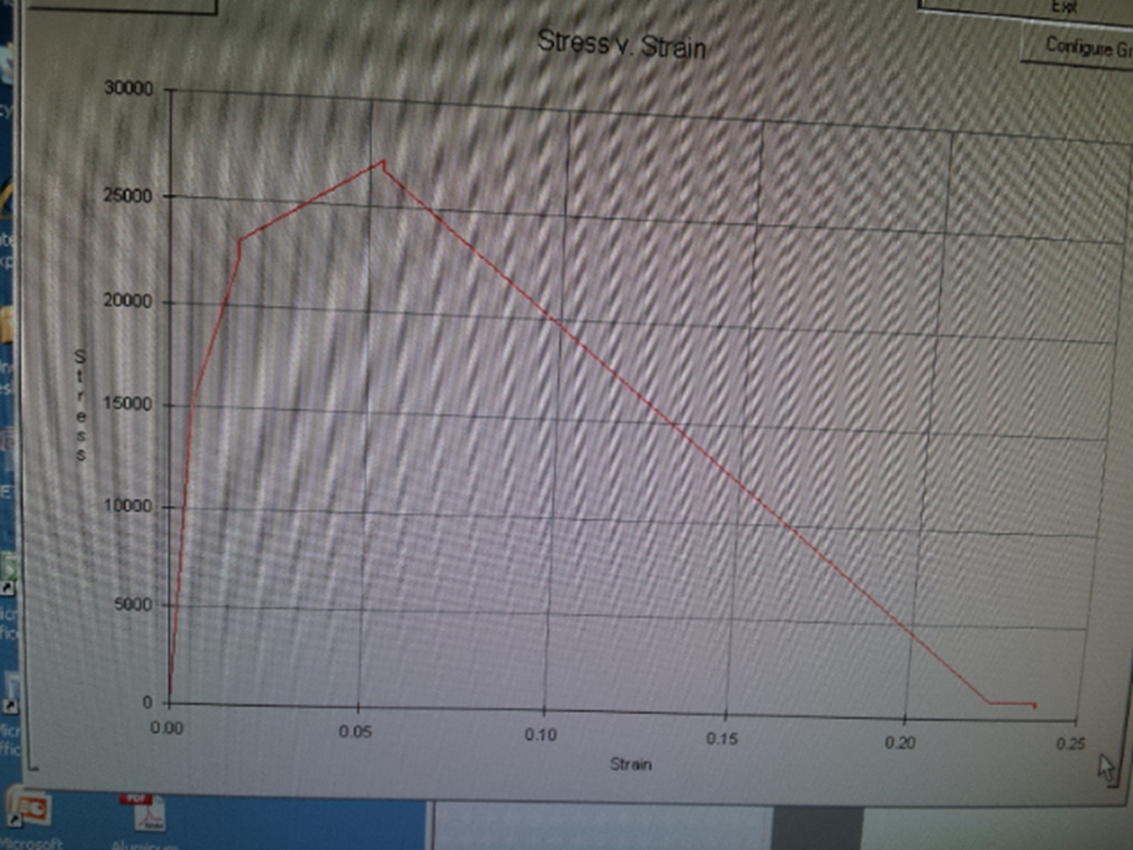
Lab 3 Cont……

Slide 12
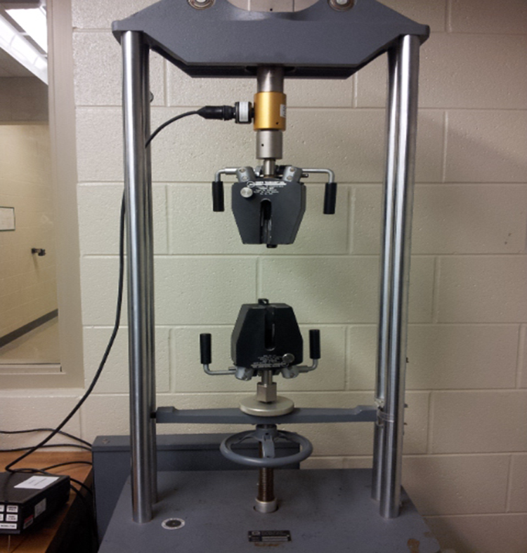
Lab 4: TC1548 Steel Tensile Tester

Slide 13
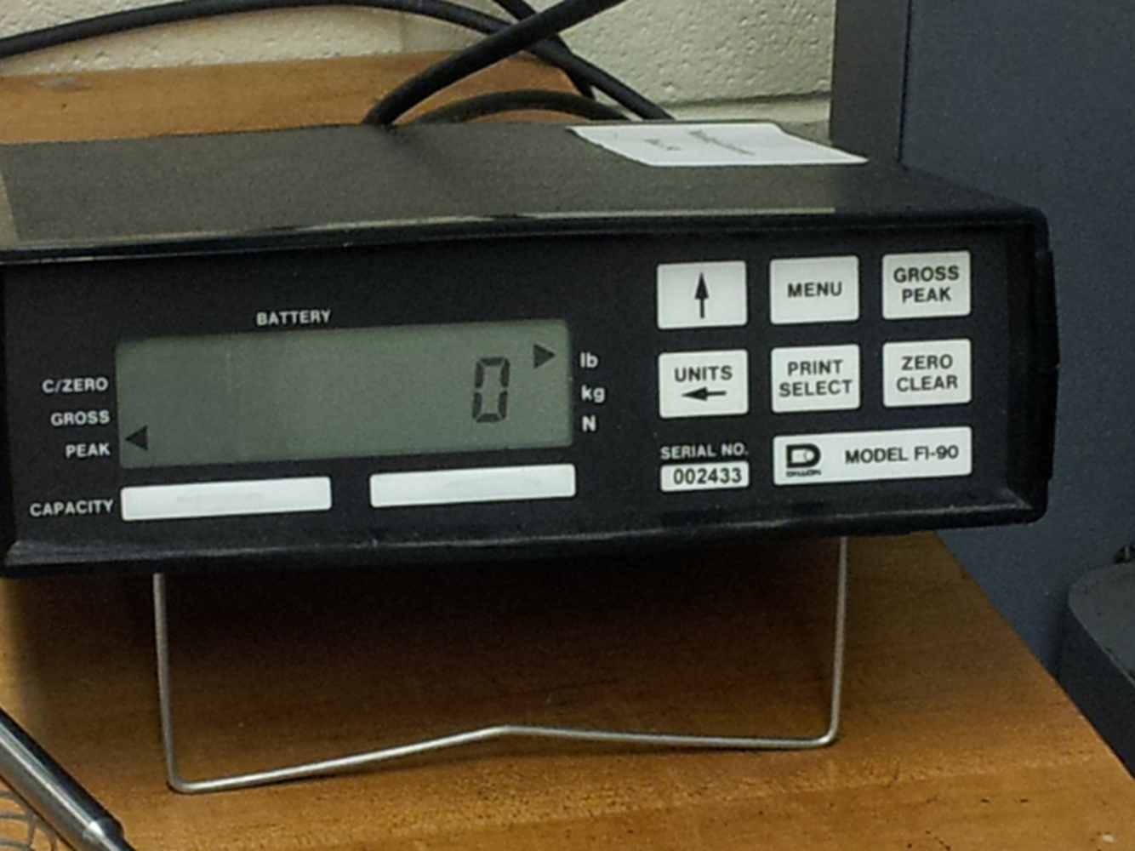
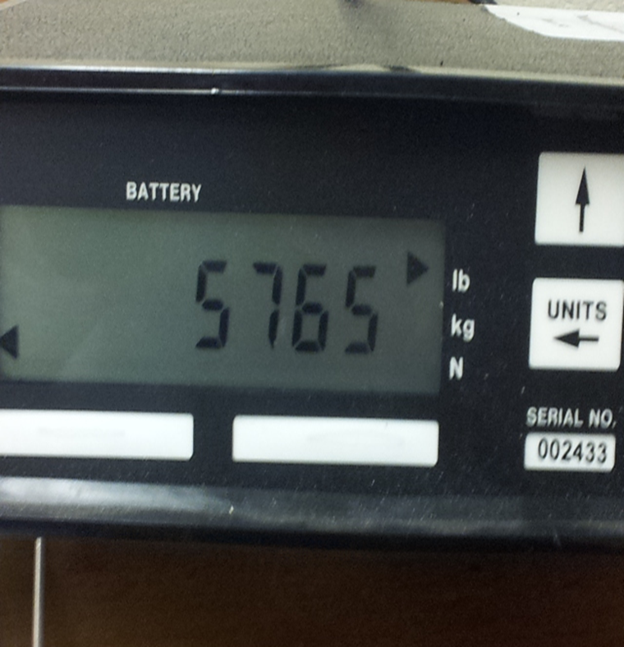
Lab 4: Cont….

Slide 14
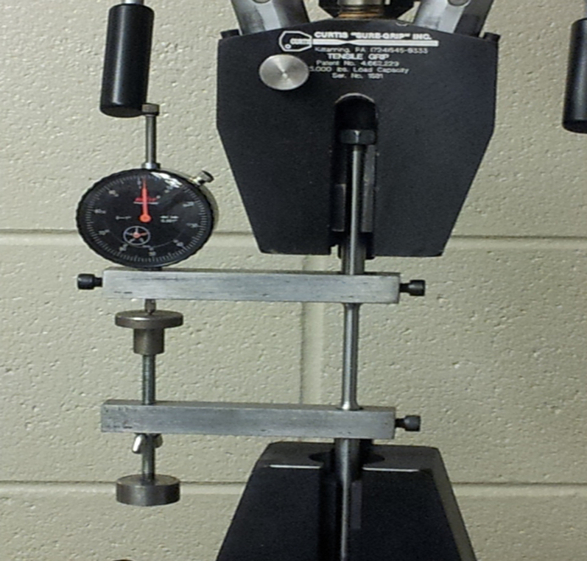
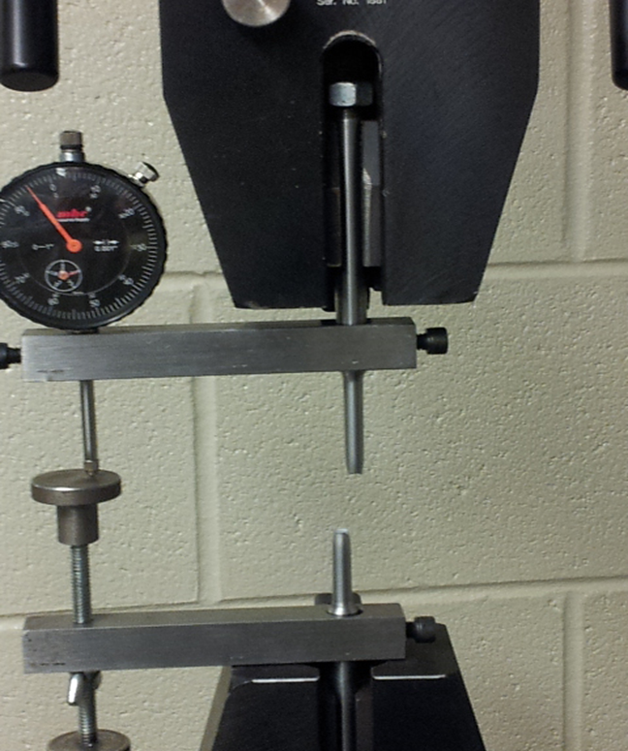
Lab 4: Cont…..

Slide 15
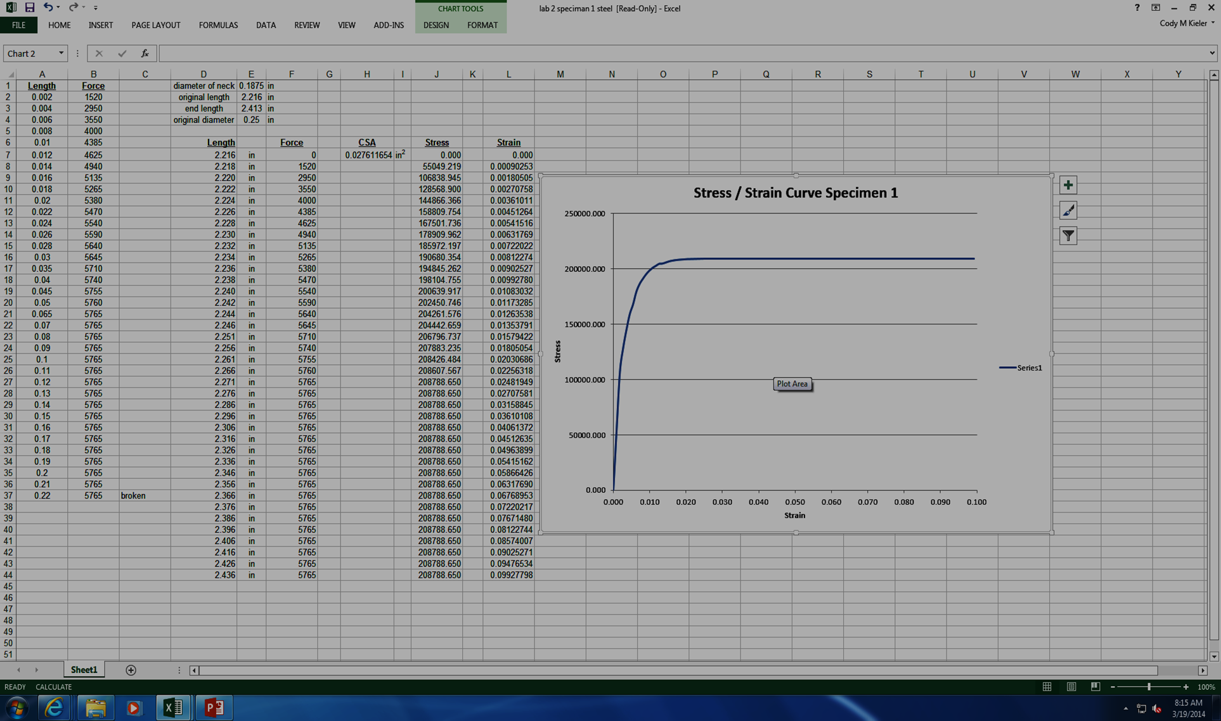
Lab 4: Cont…

Slide 16
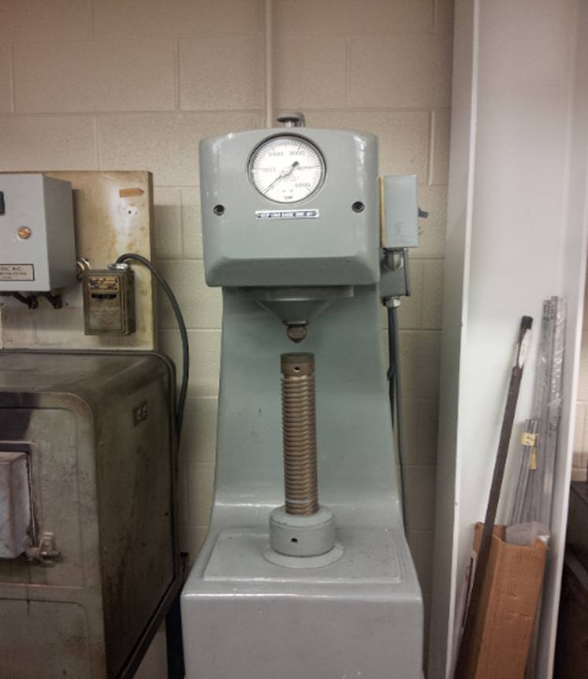
Lab 5: Brinell & Rockwell Hardness Testing on Cu/Al

Slide 17
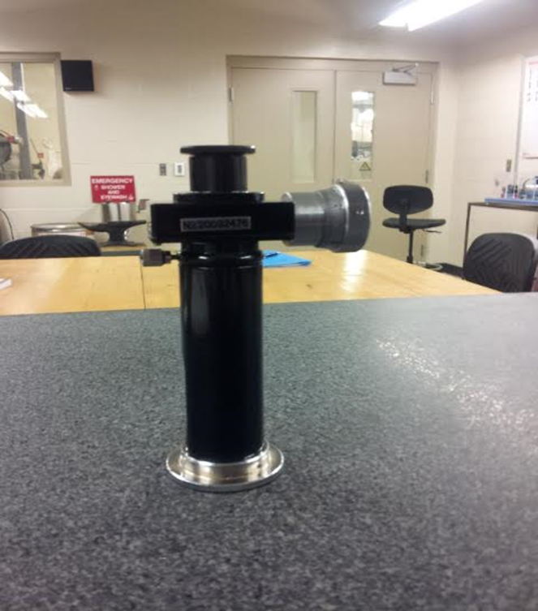
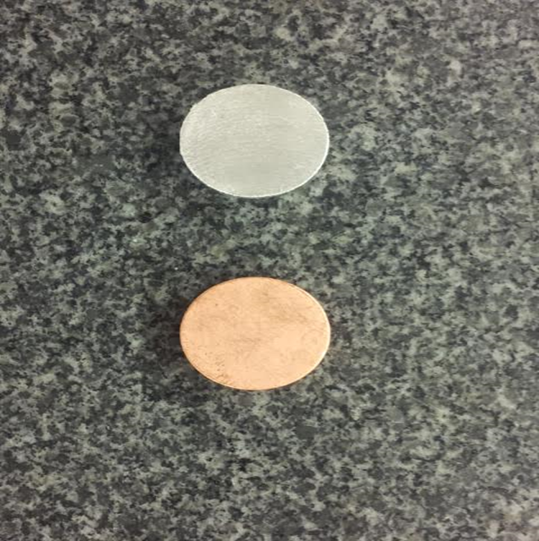
Lab 5: Cont….

Slide 18
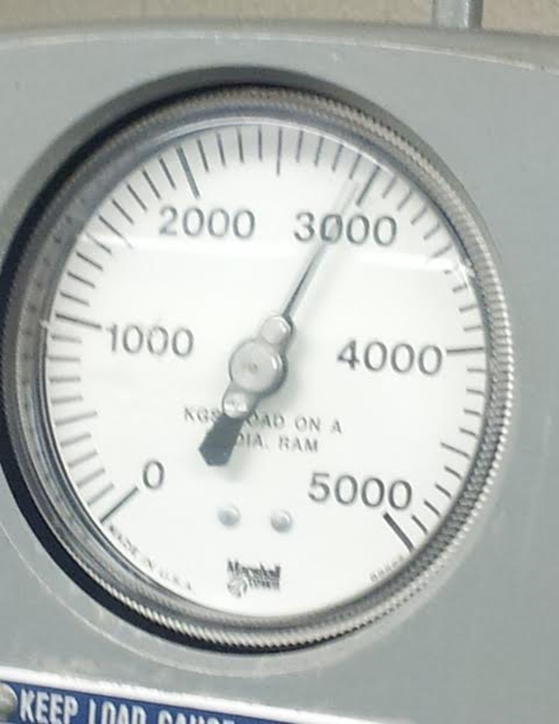
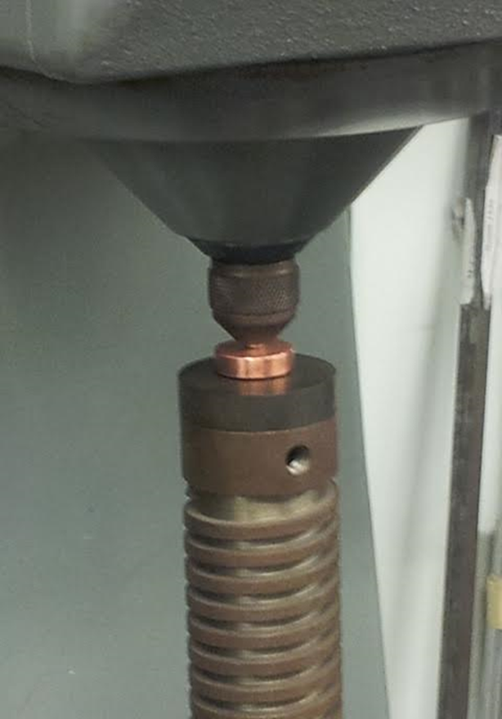
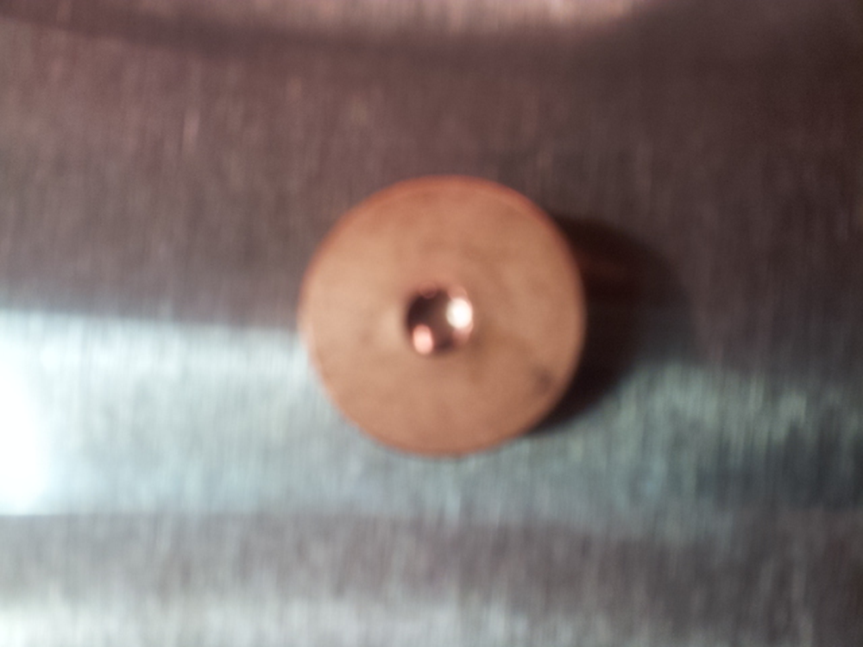
Lab 5: Cont… Cu sample

Slide 19
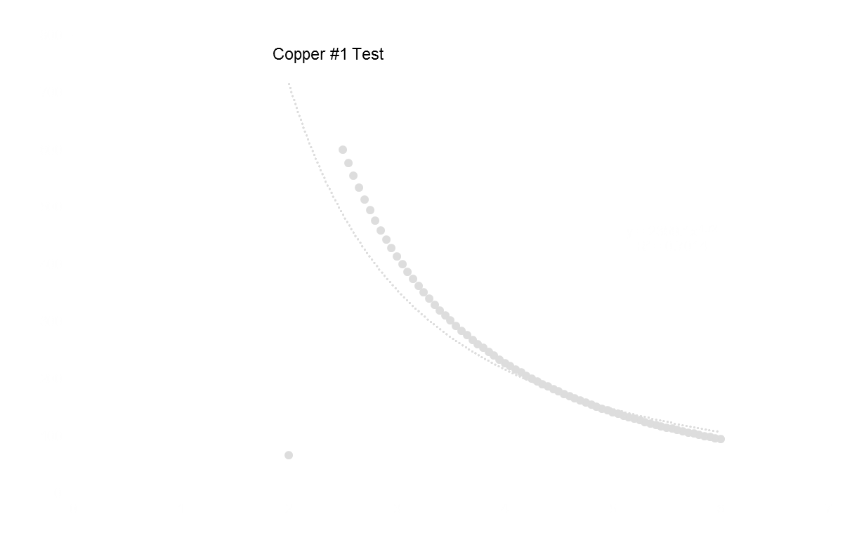
Lab 5: Cont…
Copper Trend Line
Froce
3000
kg
PI()
3.141593
Diameter
10
mm
d
6.98
mm
HB=
67.27172

Slide 20
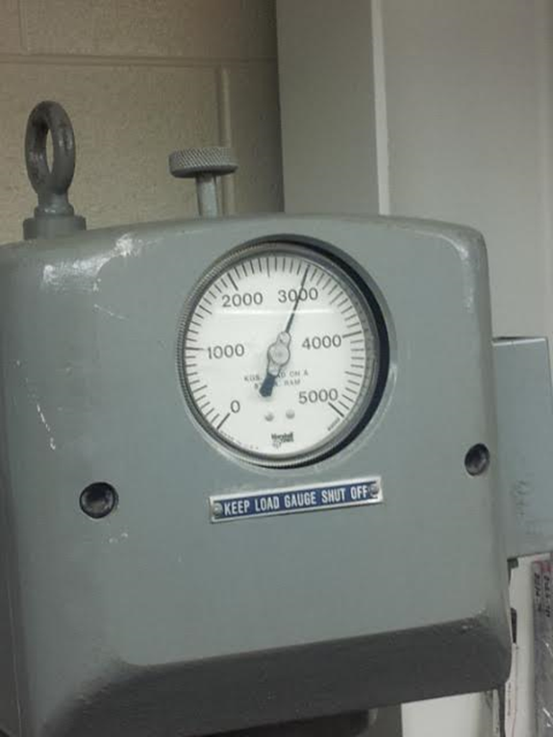
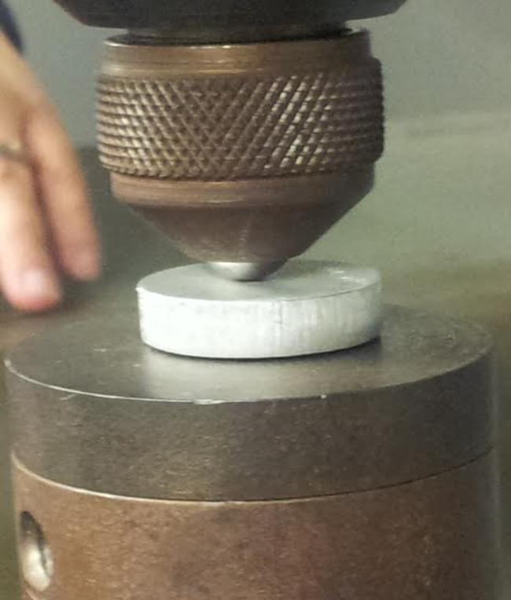
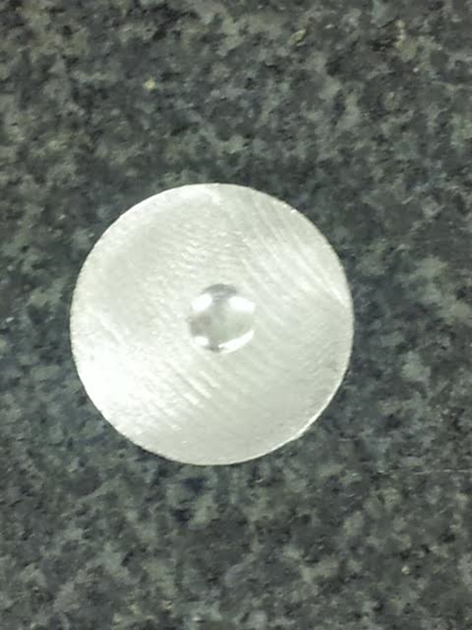
Lab 5: Cont…. Al sample

Slide 21
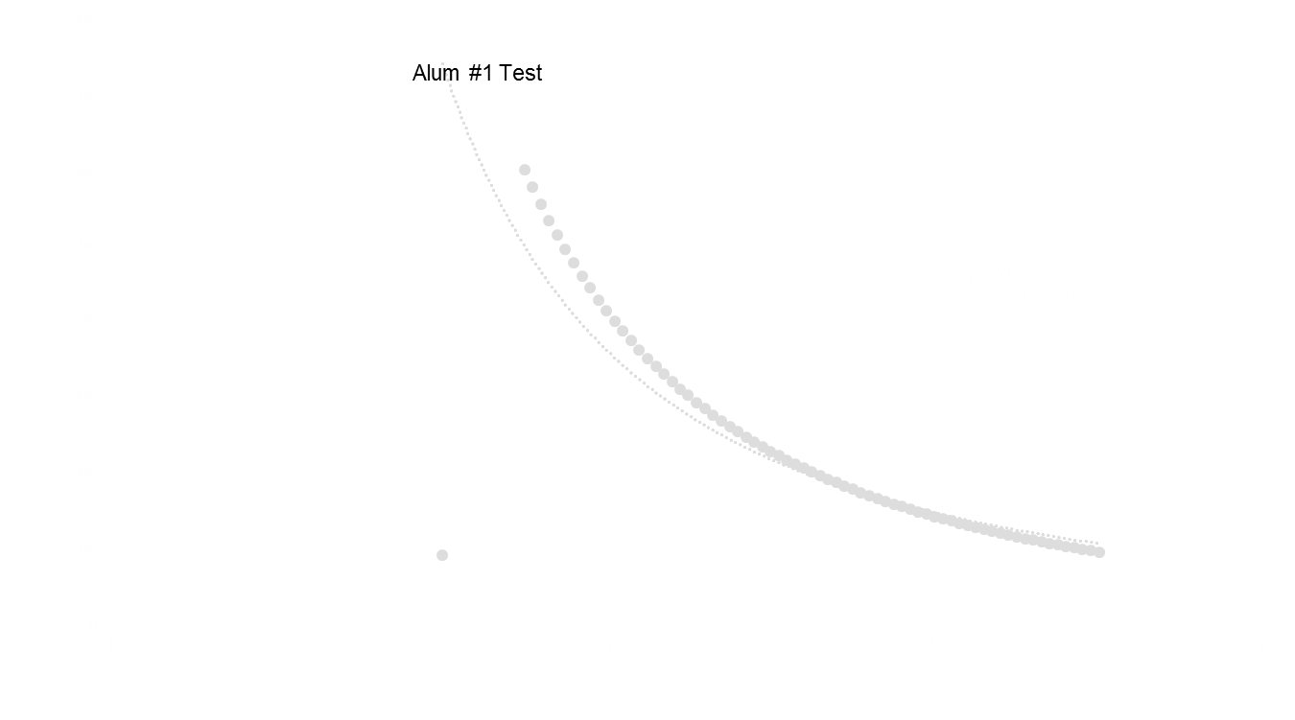
Lab 5: Cont…
Al Trend line Curve

Slide 22
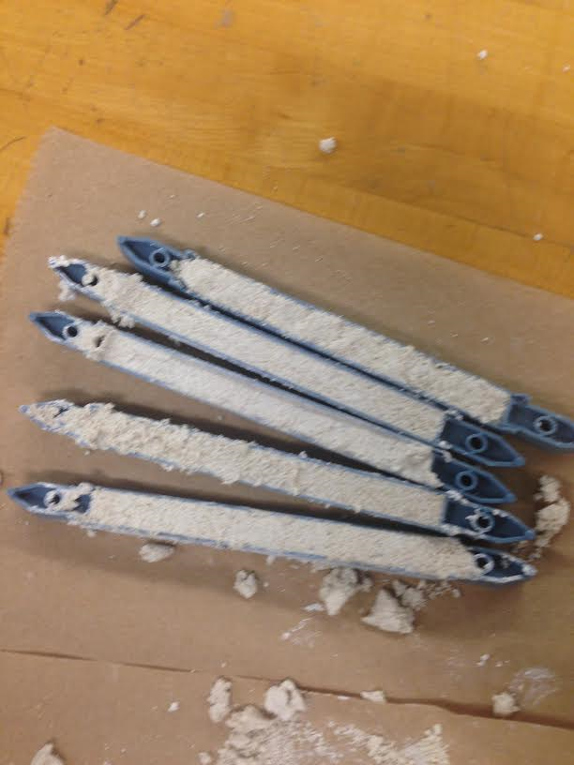
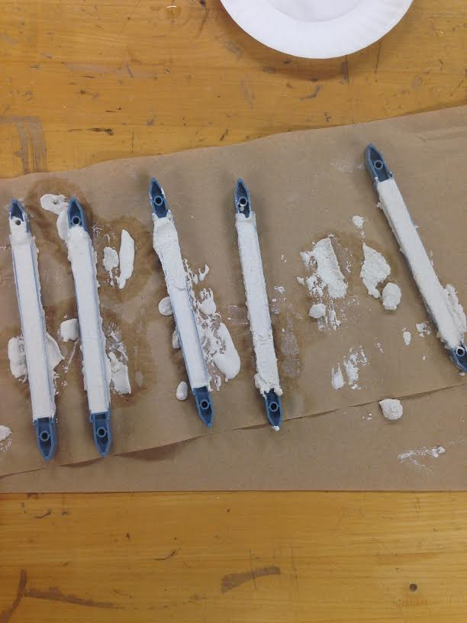
Lab 6: Beginning of Pasco Strength Tester
Making our samples

Slide 23
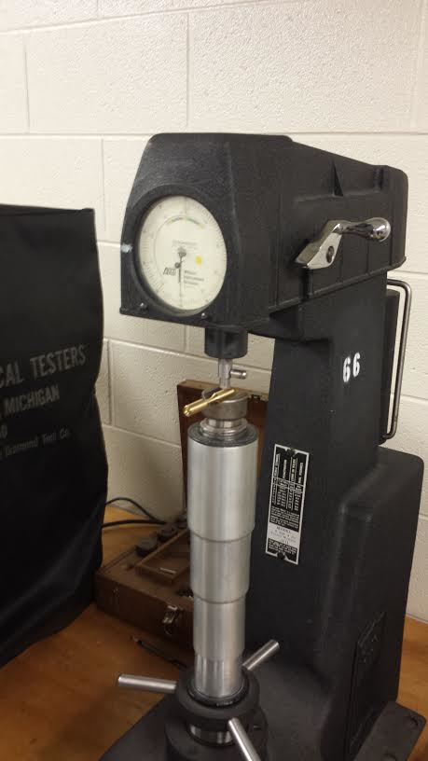
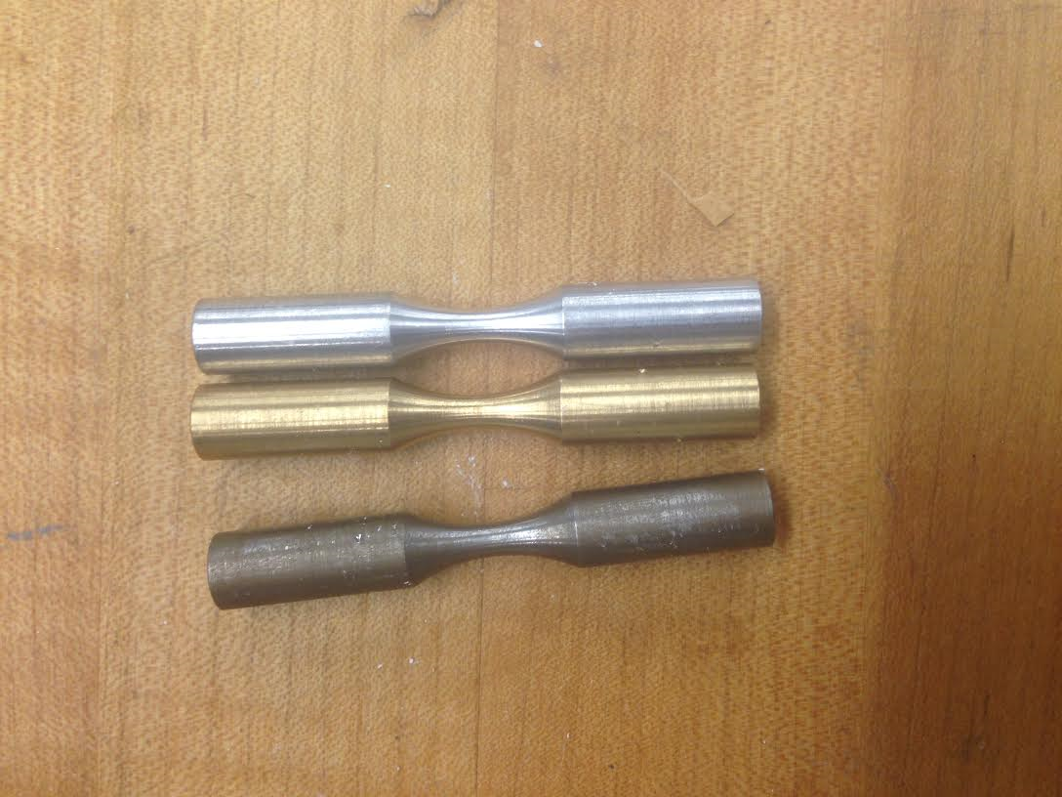
Lab 7: Rockwell Hardness Test of Al, Steel, & Brass

